Slide 1
Computational Systems Biology for Medical Applications Lecture 16: Practical Techniques for Discovering Biochemical Models
Joseph L. Hellerstein*
Herbert Sauro**
*eScience Institute, Computer Science & Engineering
**BioEngineering

Slide 2
Downloads
http://shorturl.at/crOS2
Open Lecture_16
Download all files into the same directory

Slide 3
Agenda
Granger causality statistic
Generating parameters from names
Residual-driven model discovery

Slide 4
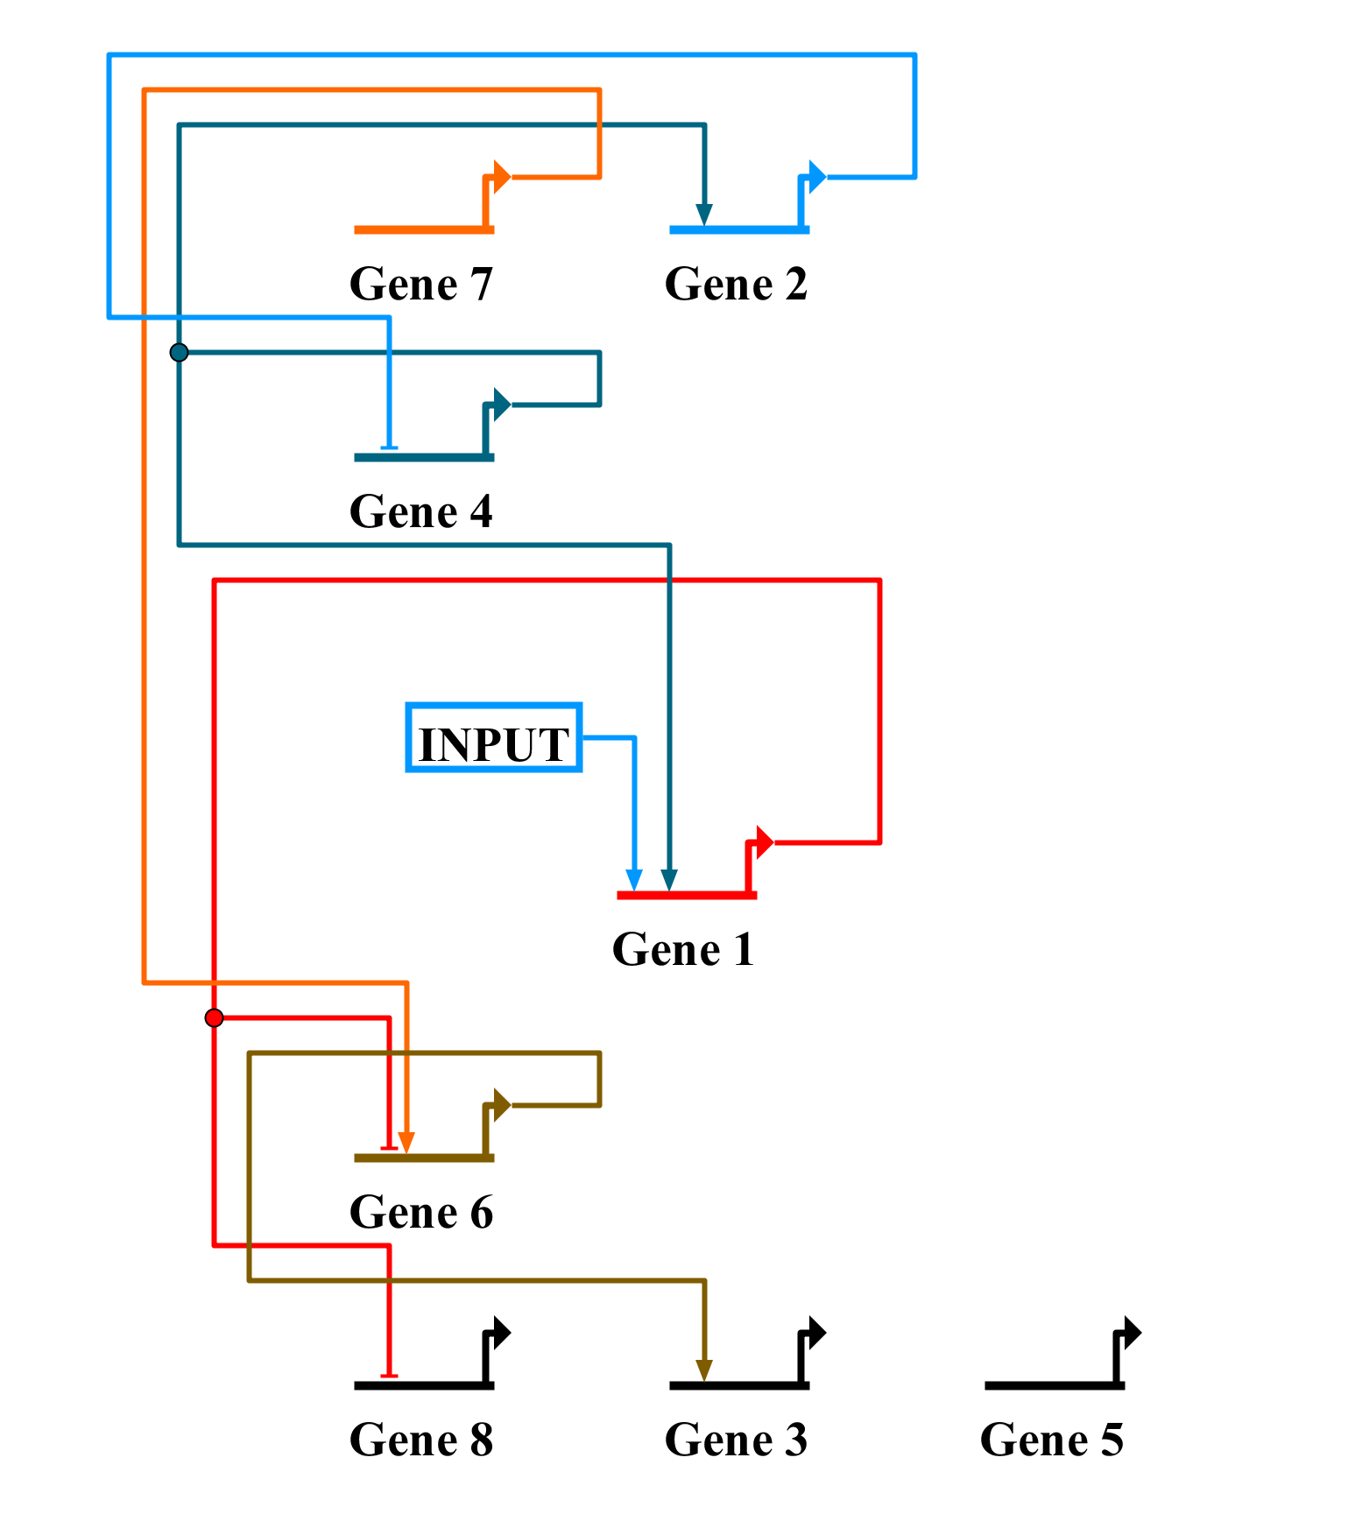
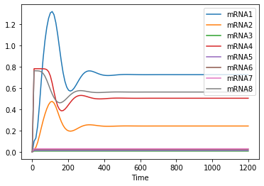
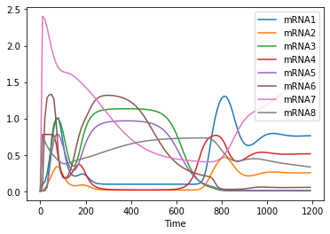
Motivating Example – Modeling Game
Simulation of Base Model
mRNA Measurements
Now what?

Slide 5
Granger Causality Statistics: Overview
Does the time series X have a causal effect on the time series Y?
Granger approach: Do we get a better model of Y if we include X?
Uses autoregressive models, linear function of past values.

Slide 6
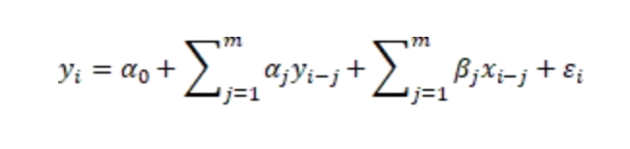
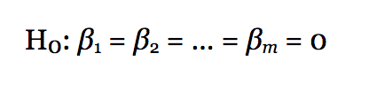
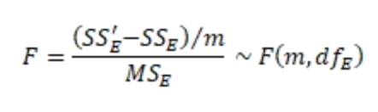
Granger Causality: Statistical Test*
Model y with x
Model y without x
Model without x
Model with x
*See link.

Slide 7
Using Granger
Python library: statsmodels.tsa.stattools
grangercausalitytests(x, maxlag, addconst=True)
x : array, 2d
maxlag : integer
Caveat
Granger assumes stationary data, not the time varying characteristics of dynamical systems

Slide 8
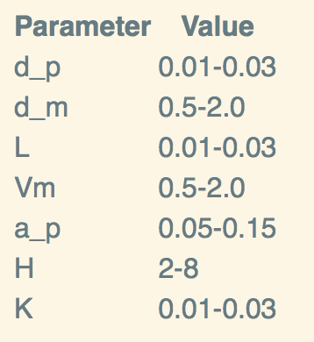
Managing Unknown Parameters
Example: Modeling game reaction J7
J7: => mRNA7; L7 - d_mRNA7*mRNA7
If interactions between Gene 7 and Gene 1
J7: => mRNA7;
L7 + Vm7*(K1_7*P1^H7/(1 + K1_7*P1^H7)) - d_mRNA7*mRNA7
To fit this model, we must specify lmfit parameters
parameters = lmfit.Parameters()
parameters.add(‘Vm7’, min=0.5, max=2)
parameters.add(‘K1_7’, min=0.01, max=0.03)
parameters.add(‘H7’, min=2, max=8)

Slide 9
Workflow for Incremental Model Updates
Update reaction kinetics.
L7 + Vm7*(K1_7*P1^H7/(1 + K1_7*P1^H7)) - d_mRNA7*mRNA7
Create lmfit.Parameters.
parameters = lmfit.Parameters()
parameters.add(‘Vm7’, min=0.5, max=2)
parameters.add(‘K1_7’, min=0.01, max=0.03)
parameters.add(‘H7’, min=2, max=8)
Run lmfit.minimizer , which simulates using parameters.
Analyze fit.
Done.

Slide 10
How Many Possible Parameters Are There?
Parameter Type | Count
d_p | 8
d_m | 8
L | 8
Vm | 8
a_p | 8
H | 8
K | 56
TOTAL | 120
Do you want to write parameters.add(…) 120 times?
Actually, you only need a subset. But finding that subset likely means writing many more parameters.add(…).
Even worse, what if you want to explore different initial values?

Slide 11
Residual-Driven Model Discovery (RDMD)
Find earliest time with large residuals
Identify which chemical species have large residuals
Adjust model and add parameters to reduce residuals.
Cross validate and/or bootstrap using just the time range under study.

Slide 12
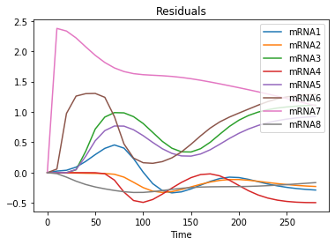
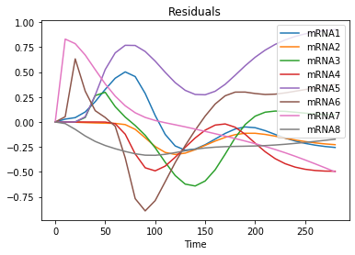
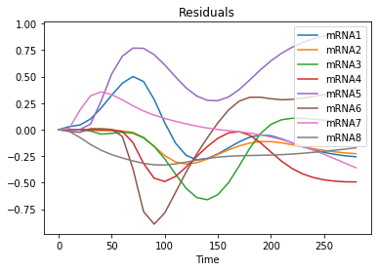
Example of RDMD
Initial
mRNA7 kinetics
L7
- d_mRNA7*mRNA7;
P7 inihibition
L7 + Vm7*(1/(1 + K2_7*P7^H7))
- d_mRNA7*mRNA7;
P7 inihibition + P1 activation
L7 + Vm7*( K1_7*P1^H7/(1 + K1_7*P1^H7) + 1/(1 + K2_7*P7^H7))
- d_mRNA7*mRNA7;

Slide 13
BACKUP

Slide 14
Example
Generating a random model for a given set of chemical species and the boundary species

Slide 15
Topics
Motivation – why generate models
Elements of generation
Base model
Reaction
Kinetics - constant
Initializations
Example
Code in notebook

