Slide 1
Computational Systems Biology for Medical Applications Lecture 17: Generating and Using Multiple Models
Joseph L. Hellerstein*
Herbert Sauro**
*eScience Institute, Computer Science & Engineering
**BioEngineering

Slide 2
Downloads
http://shorturl.at/crOS2
Open Lecture_17
Download all files into the same directory

Slide 3
Agenda
Generating models for the modeling game
Model ensembles

Slide 4
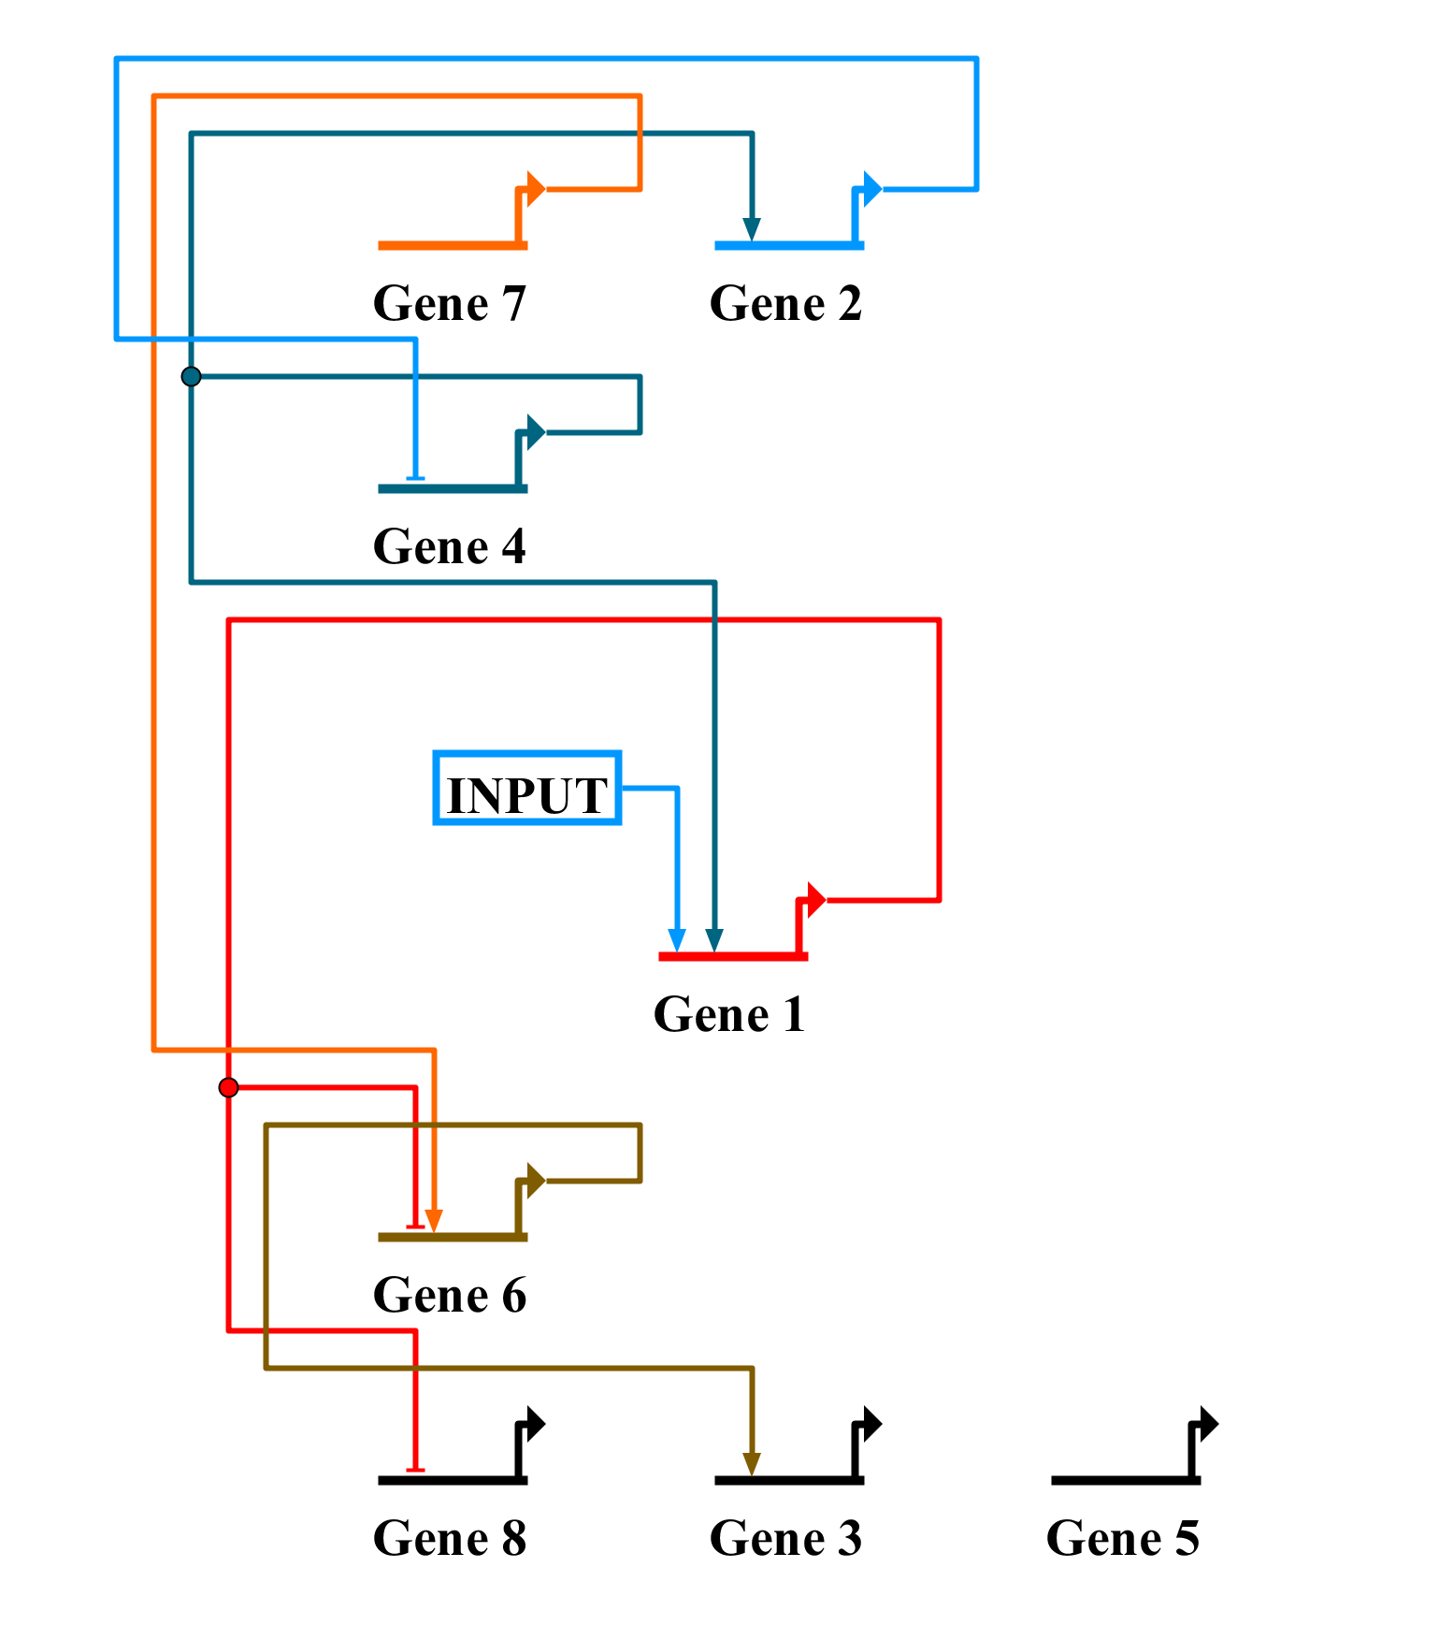
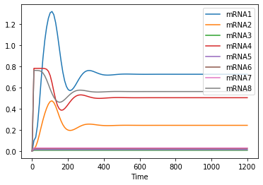
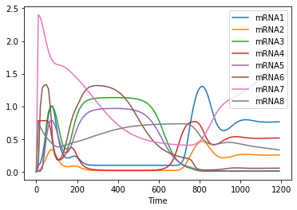
Motivating Example – Modeling Game
Simulation of Base Model
mRNA Measurements
Now what?

Slide 5

Can We Express A Model In Simple Text?
A model consists of a set of interactions of proteins on genes as expressed in the kinetics of mRNA production
mAn: Protein m activates Gene n
mHn: Protein m inhibits Gene n
1H6, 1H8,
2H4,
4A1, 4A2
6A3
7A6
$$≡$$
Notes:
If we can express a model as simple text, then we can generate simple text to generate models.

Slide 6
Generating An Antimony Model From Text Representation
Scope
Create kinetics expression
Add constant initializations
Check for constraints on operators for Genes

