Slide 1
Computational Systems Biology for Medical Applications Lecture 13: Modeling Case Study
Joseph L. Hellerstein*
Herbert Sauro**
*eScience Institute, Computer Science & Engineering
**BioEngineering

Slide 2
Downloads
http://shorturl.at/crOS2
Open Lecture_13
Download all files into the same directory

Slide 3
Why MAPK Cascade?
Critical for cellular decisions to proliferate, differentiate, or undergo apoptosis
Evolutionarily conserved
Multiple (usually three) levels: MAPK, MAPKK, MAPKKK
Activated kinase at each level phosphorylates the kinase at the next level down the cascade.
Each individual level is a two-site phosphorylation required for full activation and dephosphorylation

Slide 4
MAPK Cascade

Slide 5
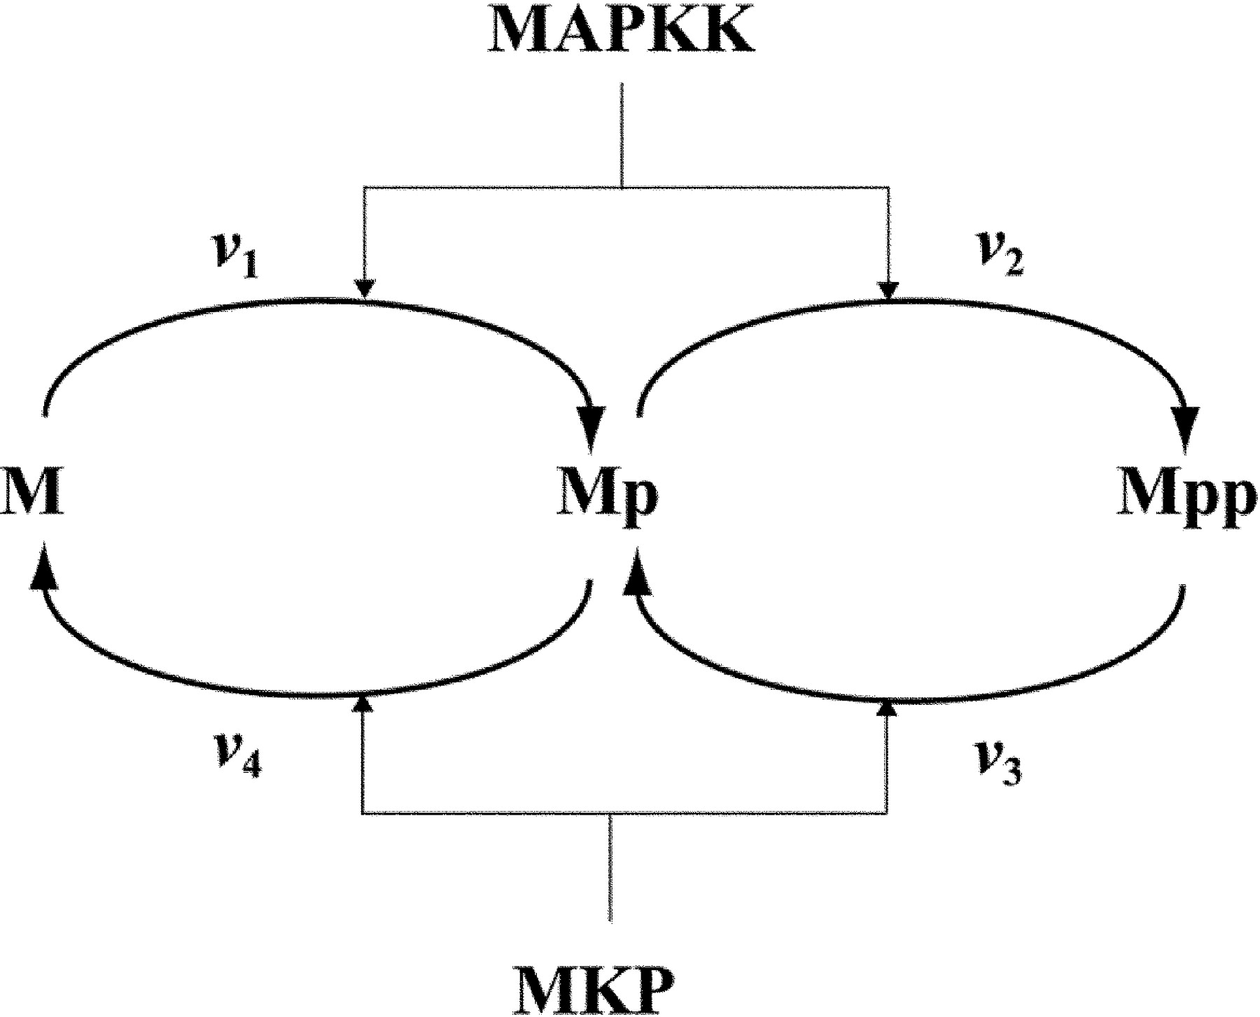
Our Focus in the Cascade
Kinase: Catalyzes phosphorylation
M = MAPK
Phosphatase: Catalyzes dephosphorylation

Slide 6
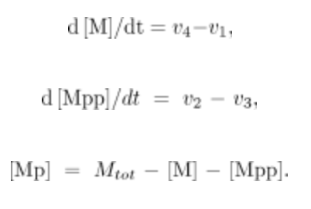
Write The Differential Equations for These Reactions

Slide 7
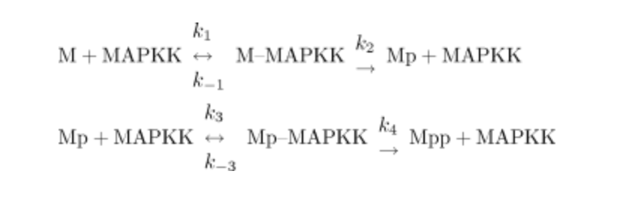
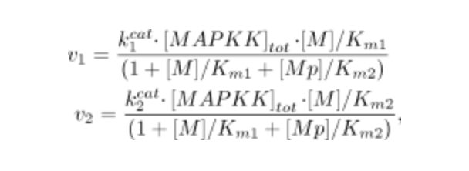
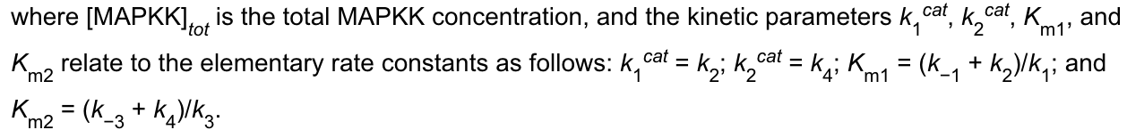
Calculating the Rates
Assume Michaelis-Menten kinetics
p

Slide 8
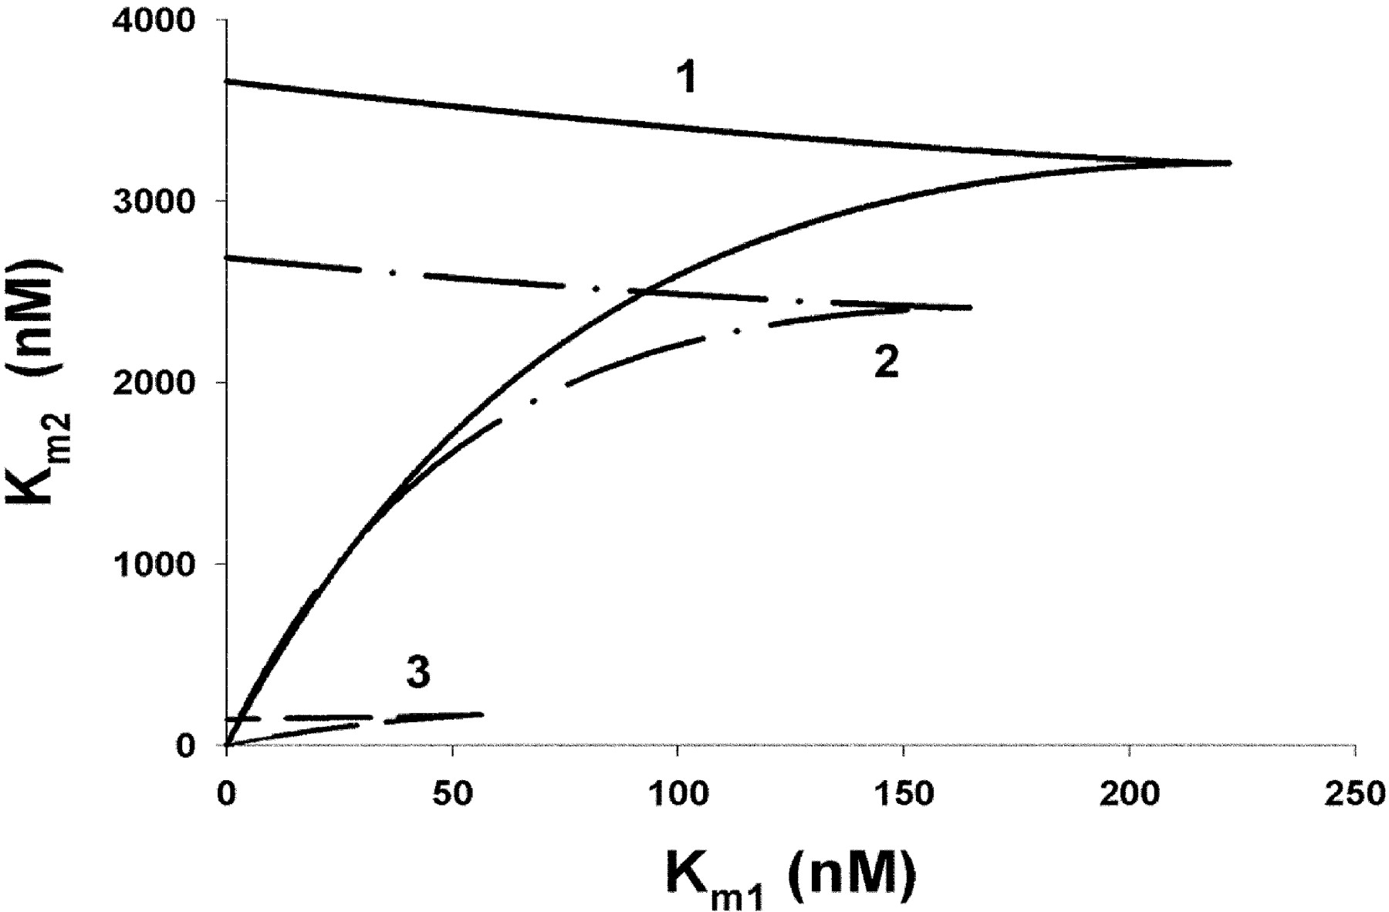
Construct a Model
Pick values of K’s as indicated.
MAPKK = 100nM, M=500nM

Slide 9
Questions
What simulation run length is needed to see dynamics?
What dynamics are observed?

Slide 10
Evaluation Parameter Estimation

