Slide 1
Computational Systems Biology for Medical Applications Modeling Fitting: Optimization Techniques
Joseph L. Hellerstein*
Herbert Sauro**
*eScience Institute, Computer Science & Engineering
**BioEngineering

Slide 2
Review

Slide 3
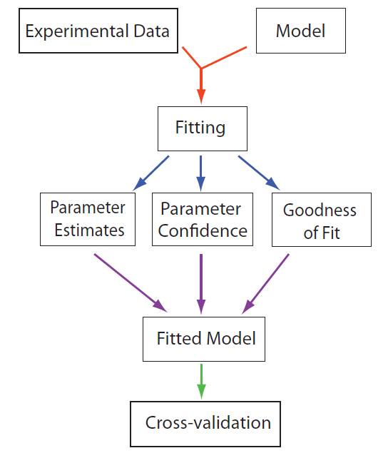
Model Fitting Work flow

Slide 4
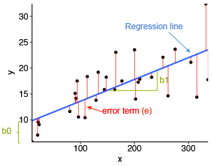




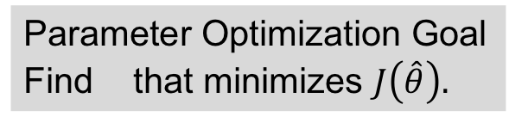
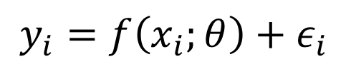

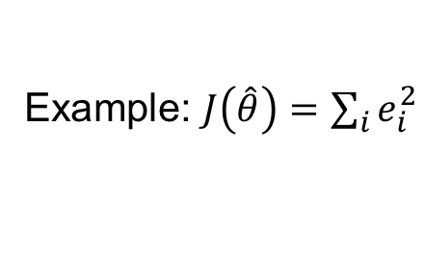


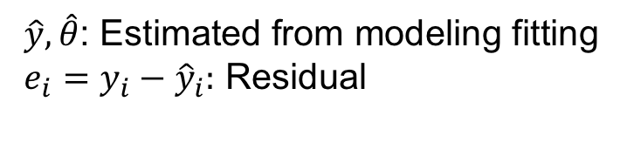
Parameter Optimization Summary
The Model
Ex: Linear Model
$$y_{i}=f\left(x_{i};θ\right)+ε_{i}$$
$$y_{i}=θ_{0}+θ_{1}x_{i}+ε_{i}$$
Observations
residuals
Model
$$e_{i}$$
Explanatory variables
Parameters
$$\hat{y}$$
predicted
Noise (random variable) – i.i.d.
$${\hat{θ}}_{1}$$
$${\hat{θ}}_{0}$$
Parameter Optimization Goal
Find that minimizes $J\left(\hat{θ}\right).$
$\hat{y}, \hat{θ}$: Estimated from modeling fitting
$e_{i}=y_{i}−{\hat{y}}_{i}:$ Residual
$$\hat{θ}$$
$J\left(\hat{θ}\right):$Non-zero measure of model quality
Example: $J\left(\hat{θ}\right)=\sum_{i}{e_{i}^{2}}$

Slide 5
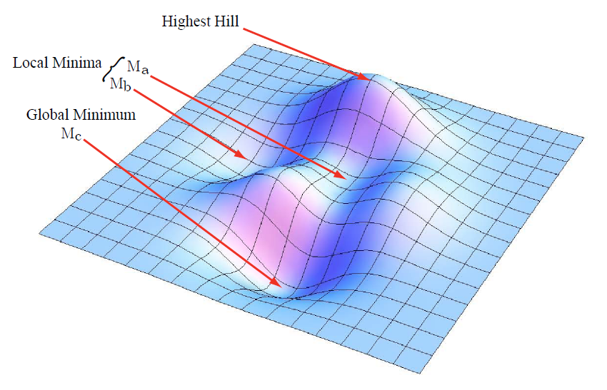
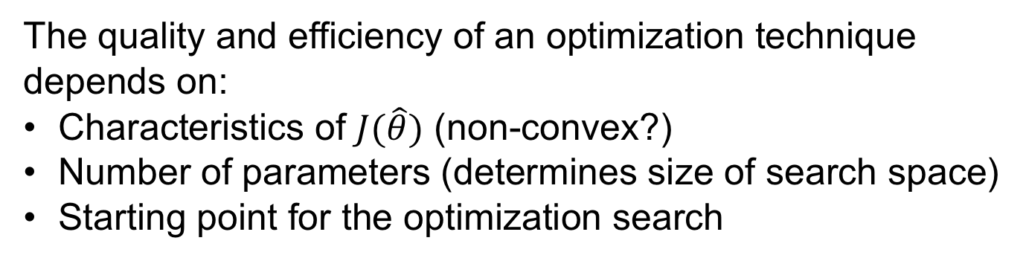
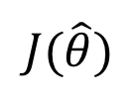



Parameter Optimization Minimize $J(\hat{θ})$
$$J(\hat{θ})$$
$${\hat{θ}}_{1}$$
$${\hat{θ}}_{0}$$
The quality and efficiency of an optimization technique
depends on:
Characteristics of $J(\hat{θ})$ (non-convex?)
Number of parameters (determines size of search space)
Starting point for the optimization search

Slide 6
Errata

Slide 7
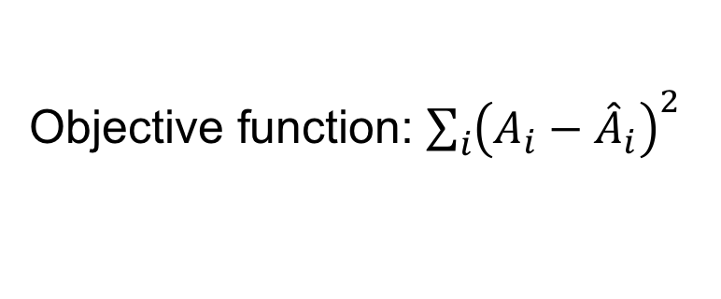
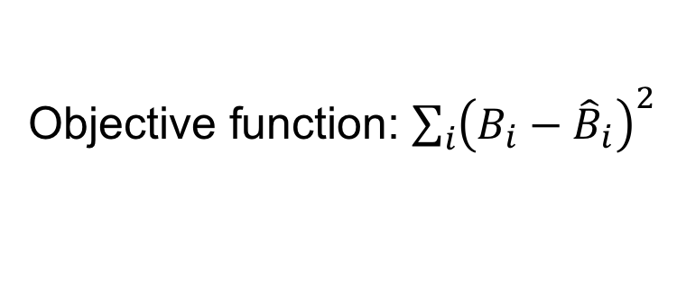

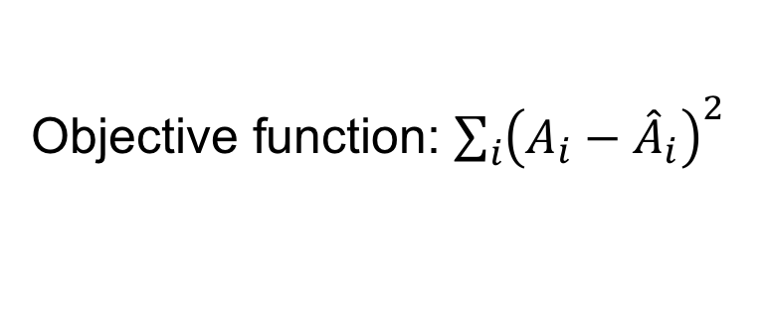


Correction to 2 Parameter Model
Choosing the right objective function
Model 1
$$A→B;k_{1}A$$
Objective function: ${\sum_{i}{\left(A_{i}−{\hat{A}}_{i}\right)}}^{2}$
Model 2
$$A→B;k_{1}A$$
Objective function: ${\sum_{i}{\left(A_{i}−{\hat{A}}_{i}\right)}}^{2}$
$$B→C;k_{2}B$$
Objective function: ${\sum_{i}{\left(B_{i}−{\hat{B}}_{i}\right)}}^{2}$
Why?

Slide 8
Optimization Techniques

Slide 9
Optimization Techniques
Gradient decent
Gauss-Newton
Lavenberg-Marquardt
Simulated annealing
Differential evolution

Slide 10
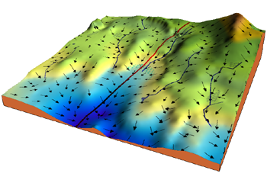
Gradient Descent
It’s the algorithm, that rivers and
streams use to get to the sea.
$$J(\hat{θ})$$
$${\hat{θ}}_{1}$$
$${\hat{θ}}_{0}$$

Slide 11
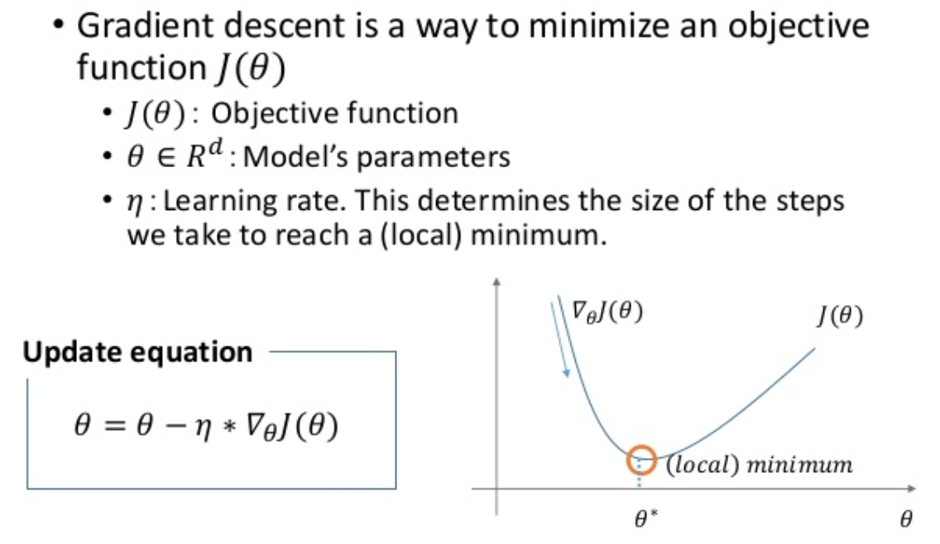

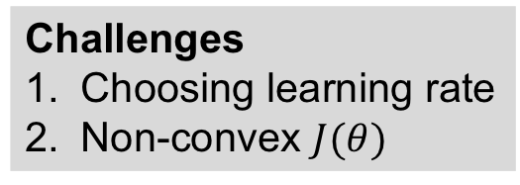
Gradient Descent In Brief
$$R^{M}$$
Challenges
Choosing learning rate
Non-convex $J(θ)$

Slide 12
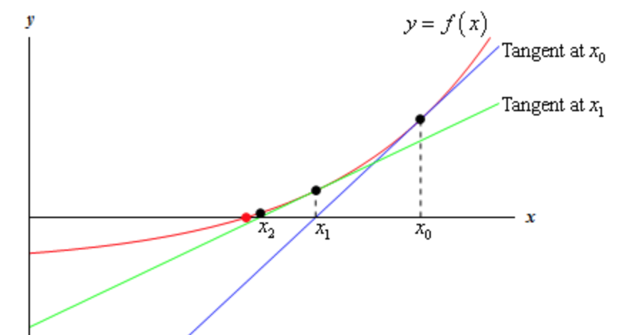
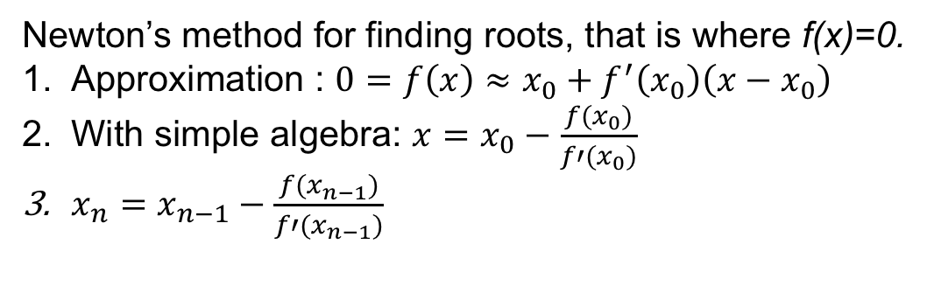
(Gauss) Newton
Extends Newton’s method for finding roots.
Newton’s method for finding roots, that is where f(x)=0.
Approximation : $0=f\left(x\right)≈x_{0}+f^{′}\left(x_{0}\right)\left(x−x_{0}\right)$
With simple algebra: $x=x_{0}−\frac{f(x_{0})}{f′(x_{0})}$
$x_{n}=x_{n−1}−\frac{f(x_{n−1})}{f′(x_{n−1})}$

Slide 13
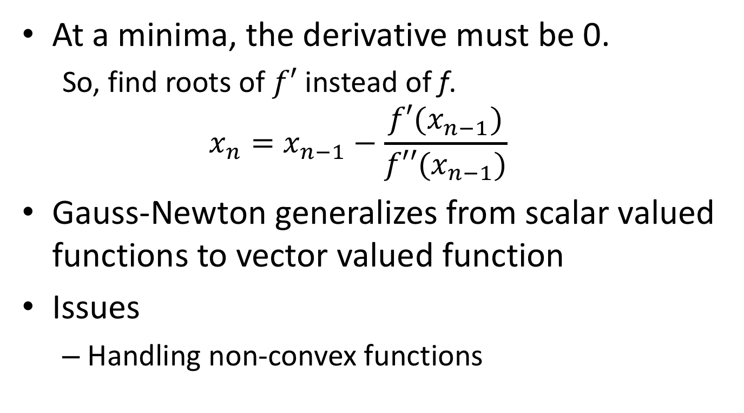
Gauss-Newton & Minima
At a minima, the derivative must be 0.
So, find roots of $f′$ instead of f.
$$x_{n}=x_{n−1}−\frac{f′(x_{n−1})}{f′′(x_{n−1})}$$
Gauss-Newton generalizes from scalar valued functions to vector valued function
Issues
Handling non-convex functions

Slide 14
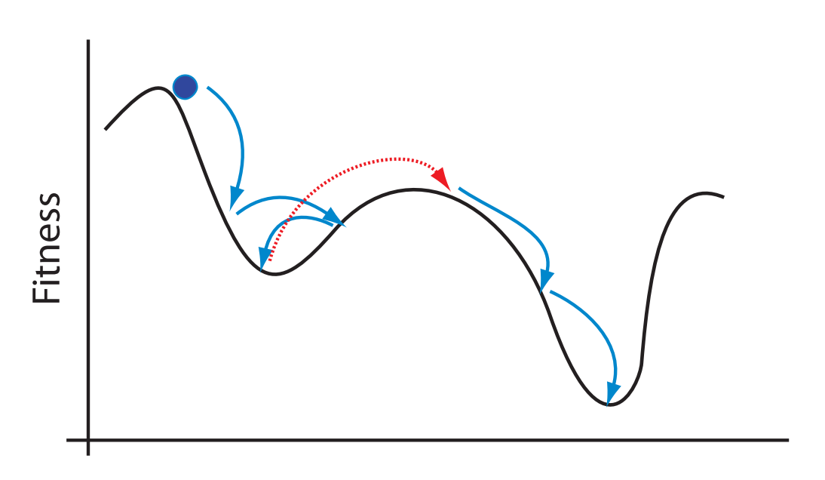
Simulated Annealing

