Slide 1
Computational Systems Biology for Medical Applications Modeling Fitting: Optimization Techniques
Joseph L. Hellerstein*
Herbert Sauro**
*eScience Institute, Computer Science & Engineering
**BioEngineering

Slide 2
Review

Slide 3
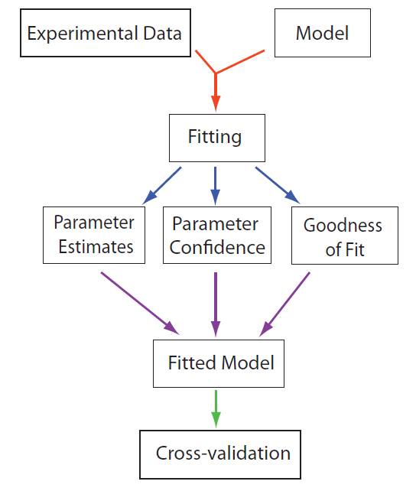
Model Fitting Work flow

Slide 4
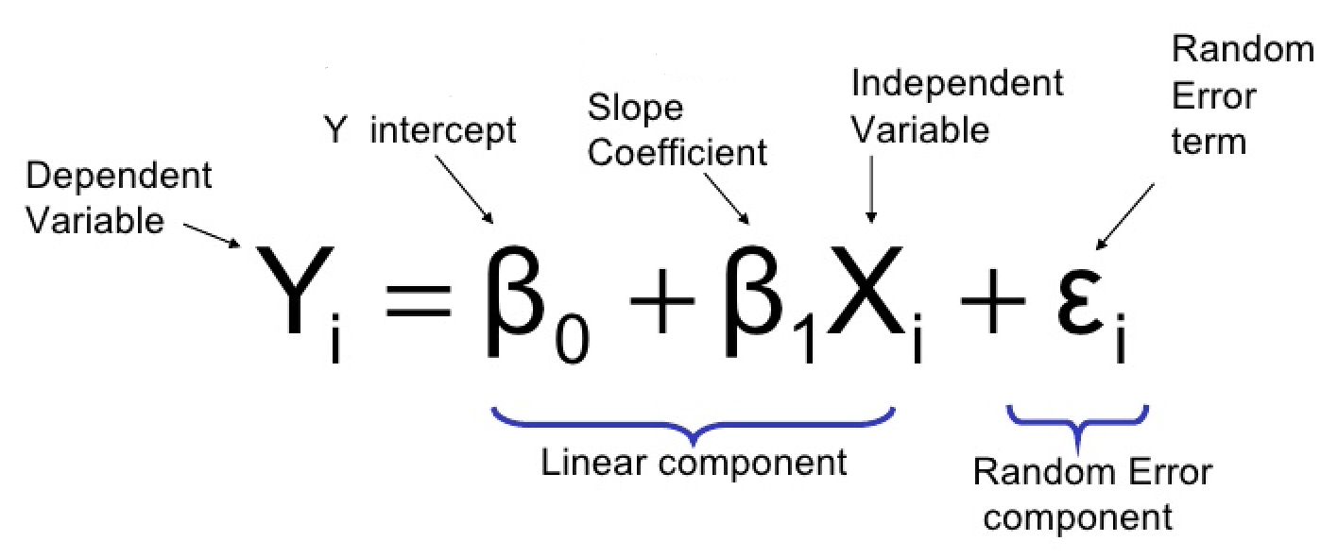
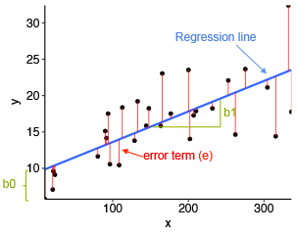
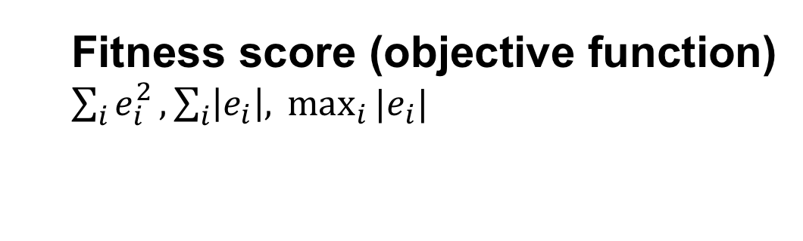


Modeling Example: Linear Regression
The Model
The Fit
residuals
$$e_{i}$$
$$\hat{y}$$
predicted
The Fitted Parameters
Parameter
estimate
Fitness score (objective function)
$\sum_{i}{e_{i}^{2}}, \sum_{i}{\left|e_{i}\right|, }\max_{i}{{|e}_{i}|}$

Slide 5
Estimating Parameter Values
Least squares linear regression
Can calculate optimal estimates from data
Estimating parameter values for complicated models, like simulations requires searching the “parameter space”
Parameter space: the combination of all possible values of parameters

Slide 6
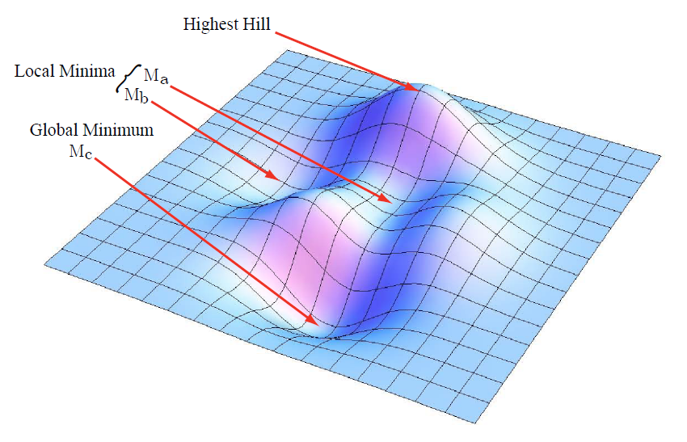
Parameter Optimization Find smallest value of objective function
Response
surface
Parameter 1
Parameter 2
The quality and efficiency of an optimization technique
depends on:
Characteristics of the response surface (non-convex?)
Number of parameters (determines size of search space)
Starting point for the optimization search

Slide 7
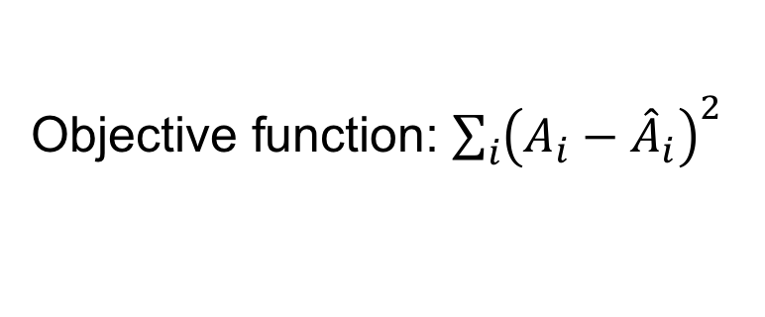
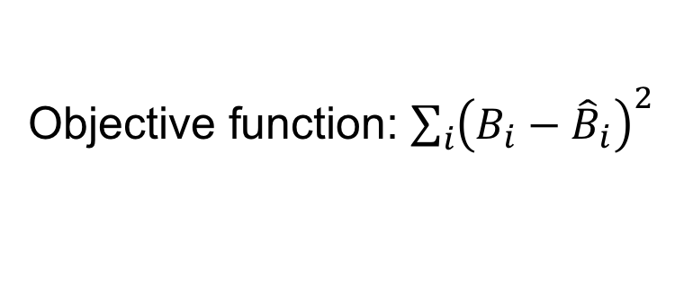

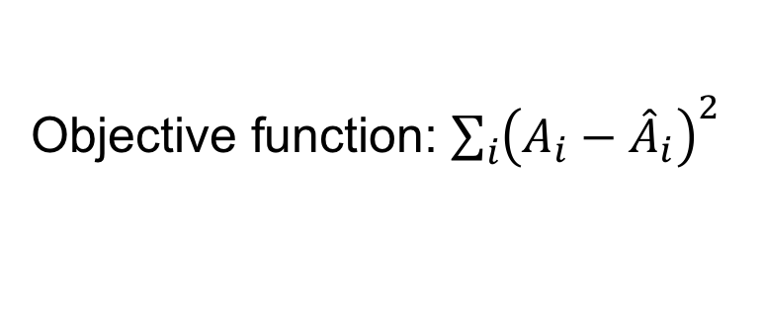


Errata
Choosing the right objective function
Model 1
$$A→B;k_{1}A$$
Objective function: ${\sum_{i}{\left(A_{i}−{\hat{A}}_{i}\right)}}^{2}$
Model 2
$$A→B;k_{1}A$$
Objective function: ${\sum_{i}{\left(A_{i}−{\hat{A}}_{i}\right)}}^{2}$
$$B→C;k_{2}B$$
Objective function: ${\sum_{i}{\left(B_{i}−{\hat{B}}_{i}\right)}}^{2}$
Why?

Slide 8
Optimization Techniques
Gradient decent
Gauss Newton
﻿Levenberg-Marquardt
Simulated annealing
Differential evolution

Slide 9
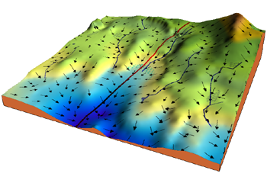
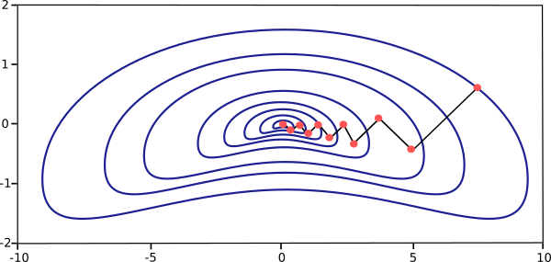
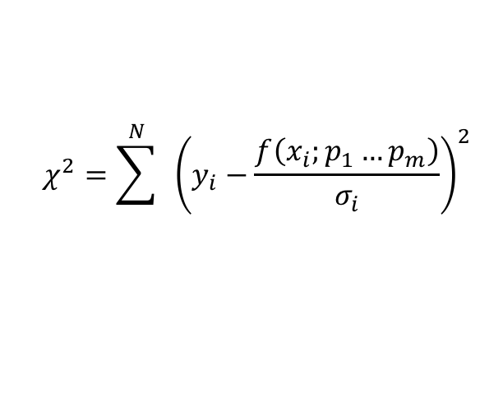
Gradient Descent
It’s the algorithm, that rivers and
streams use to get to the sea.
$$χ^{2}=\sum^{N}{ }{\left(y_{i}−\frac{f\left(x_{i};p_{1}…p_{m}\right)}{σ_{i}}\right)}^{2}$$

Slide 10
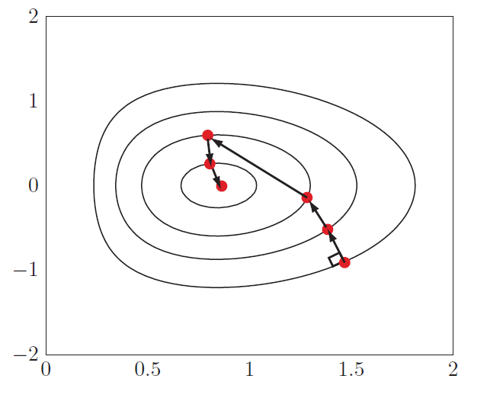
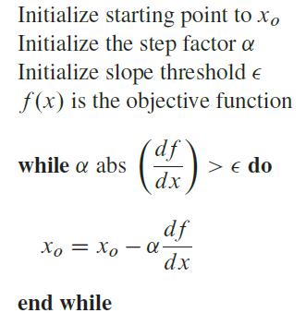
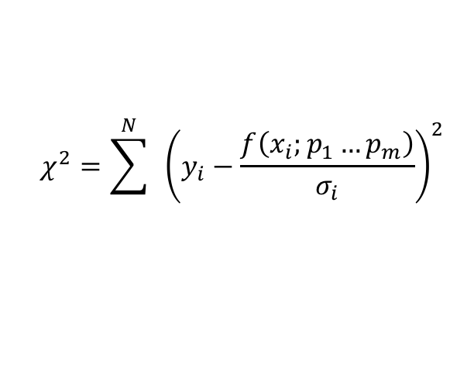
Gradient Descent
$$χ^{2}=\sum^{N}{ }{\left(y_{i}−\frac{f\left(x_{i};p_{1}…p_{m}\right)}{σ_{i}}\right)}^{2}$$
In gradient descent movement is perpendicular to the counter lines.
Major problem is judging how far to travel at each step. There is therefore
a tendency to either overshoot of take small steps and take tool long to get
the bottom of the fitness landscape.

Slide 11
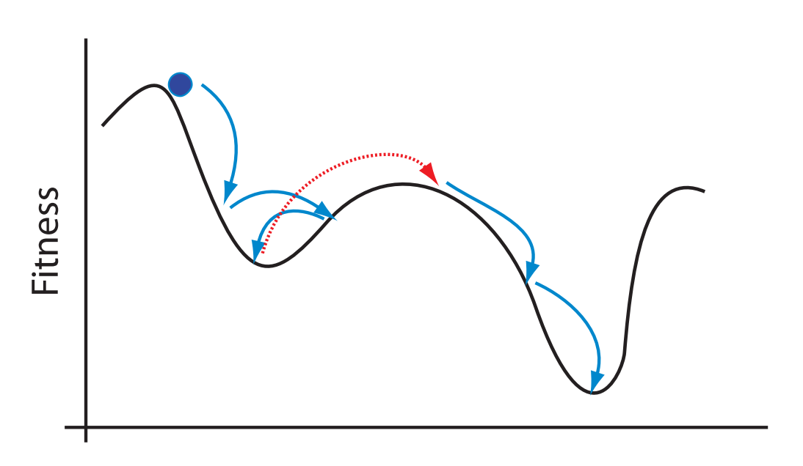
Simulated Annealing

