Slide 1
Computational Systems Biology for Medical Applications Lecture 17: Generating Kinetics Models
Joseph L. Hellerstein*
Herbert Sauro**
*eScience Institute, Computer Science & Engineering
**BioEngineering

Slide 2
Downloads
http://shorturl.at/crOS2
Open Lecture_17
Download all files into the same directory

Slide 3
Agenda
Improving model management by generating models from a more convenient representation
Application to the modeling game

Slide 4
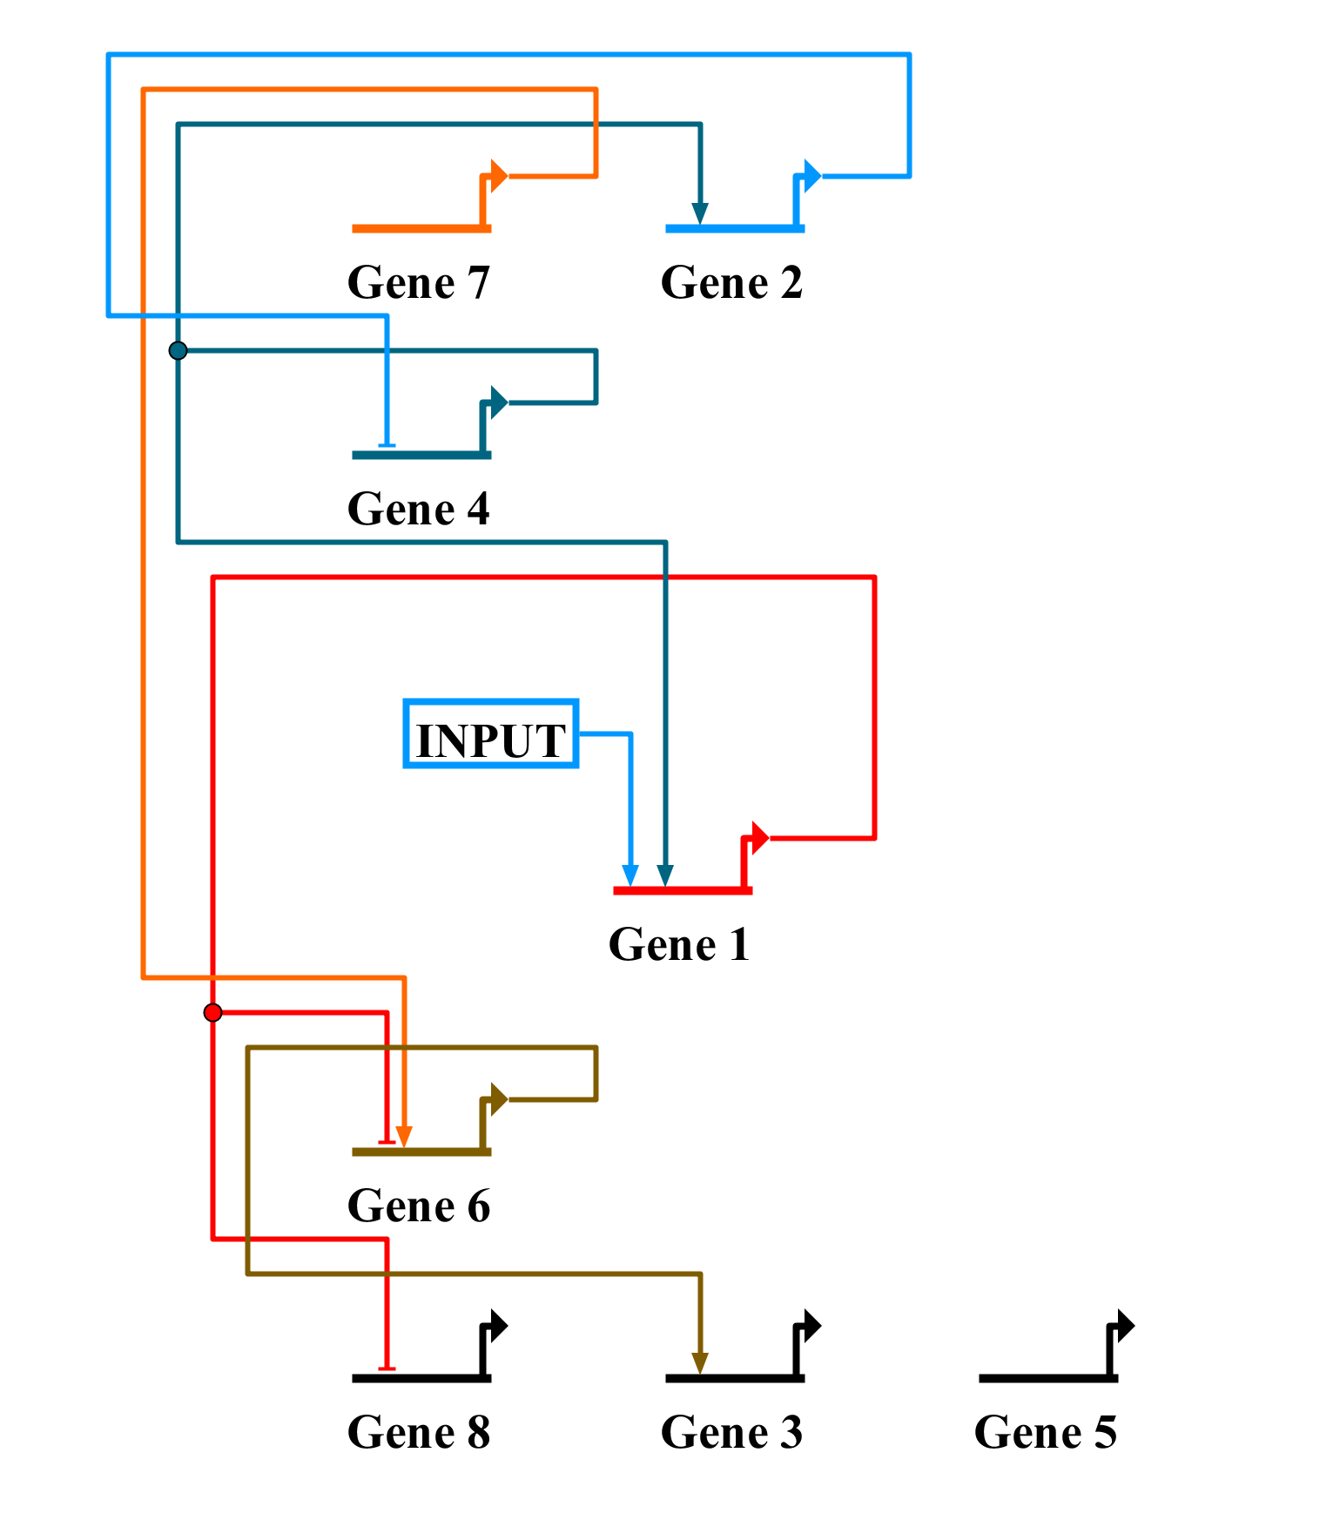
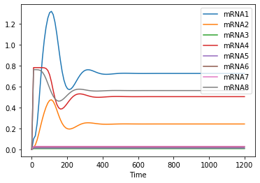
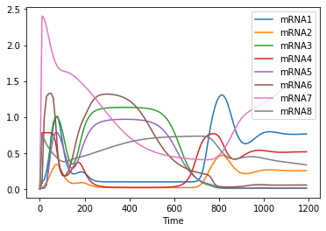
Motivating Example – Modeling Game
Simulation of Base Model
mRNA Measurements
Now what?

Slide 5
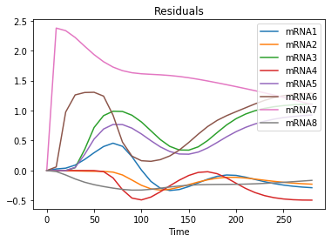
Modeling Workflow
Model 1
Model 100
Done
Run Model
Analyze results
You will investigate many, many models.
Update model

Slide 6
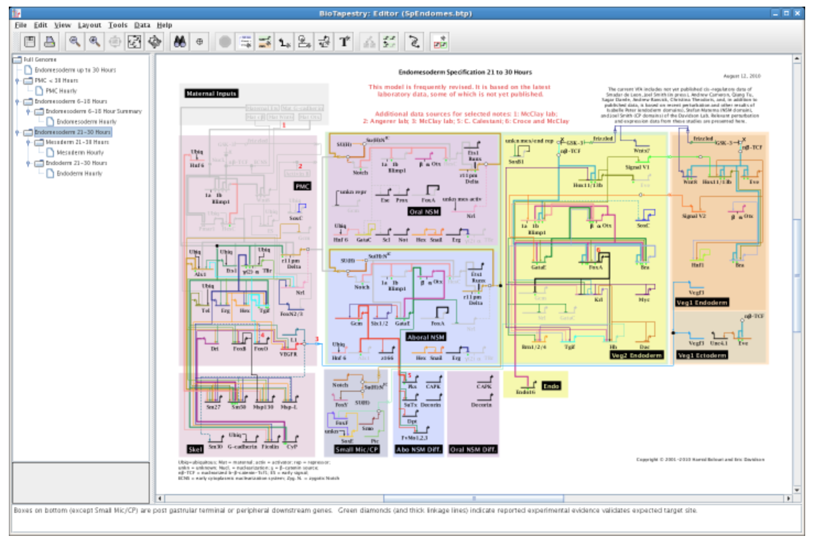
BioTapestry
Appeal
Draw gene network
Generate SBML
Issues
Control over kinetics generated
Cannot construct new models programmatically

Slide 7
Model Management
You will create many, many models.
How will you keep track of:
What you’ve explored?
Which ones work best?
Comparisons between models?
Default approach
Keep many versions of the antimony (biotapestry) source

Slide 8
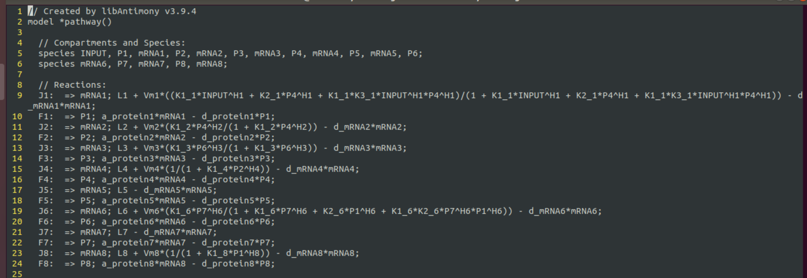
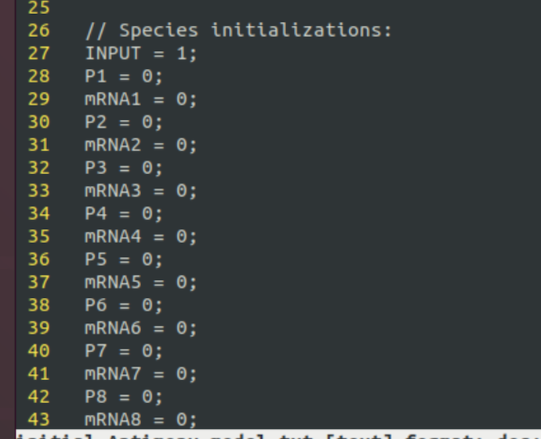
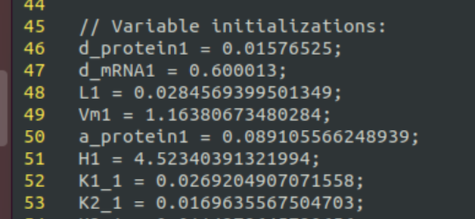
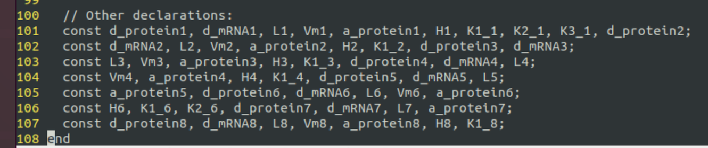
What changes when you make a model update?

Slide 9
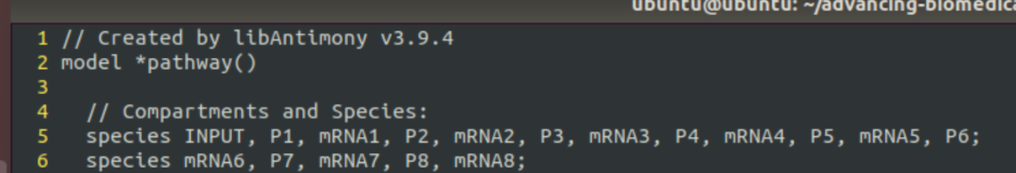
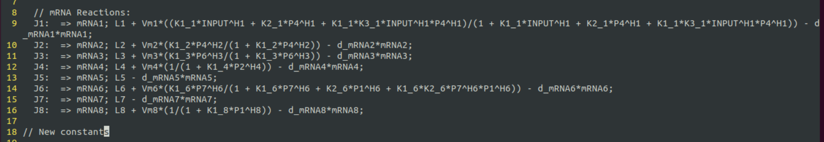
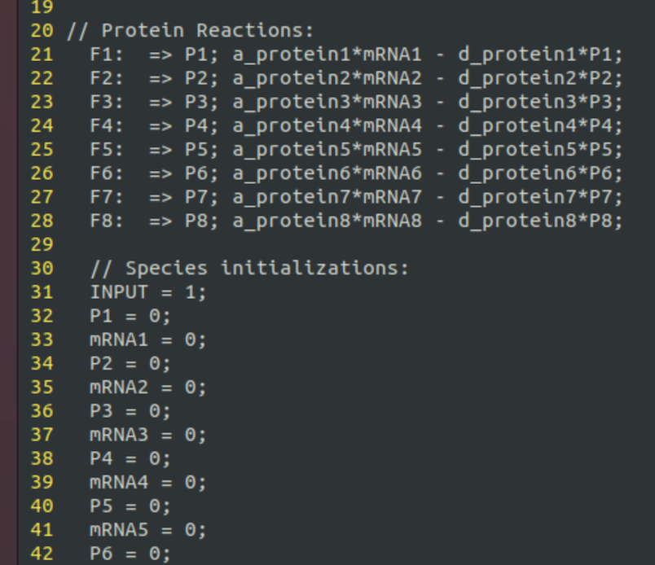
Head (constant)
Middle (varies)
“Middle” has
mRNA reactions
Kinetics constants for mRNA reactions
Simplify “model” by:
Having model specified by “middle”
Generate full model by concatenating head + middle + tail
Tail (constant)

Slide 10
Model Generation
Antimony Model
new-middle
Original
Generation
Simulation
Generate Model
Head + Middle + Tail
Simulation

Slide 11
But “middle” is still complicated
Ideal: Make model update as easy as drawing a line, but have a text representation so it can be done programmatically.

Slide 12
What’s in Middle?
Reaction expression
Trivial once you know the gene number
Algebraic expressions for kinetics
Complicated
Initializations of new constants
Depends on the kinetics expressions

Slide 13
Example: P1 Activates Gene 7
L7 + Vm7*(K1_7*P1^H7/(1 + K1_7*P1^H7)) - d_mRNA7*mRNA7
P1 activates Gene 7
Algebraic expression (red)
Constants: Vm7, K1_7, H7
Add P7 represses Gene 7
Updates algebraic expression (terms with P7)
Adds a constant: K2_7
L7 + Vm7*(K1_7*P1^H7/(1 + K1_7*P1^H7 + K2_7*P7^H7 + K3_7*P1^H7 *P7^H7)) - d_mRNA7*mRNA7
Notes:
If we can express a model as simple text, then we can generate simple text to generate models.

Slide 14
Essential Information to Write mRNA Kinetics
L7 + Vm7*(K1_7*P1^H7/(1 + K1_7*P1^H7)) - d_mRNA7*mRNA7
Kinetics Determining Information (KDI) for a gene
Which proteins are TFs?
Whether a protein activates or inhibits
How effects of TFs are “integrated”: AND, OR
Claim: If you know the KDI, you can write the gene kinetics

Slide 15
Exercise
Kinetics for Gene 8 in initial model: L8 - d_mRNA8*mRNA8
Write the kinetics expressions for the following and list the constants that must be added as a result.
Gene 7 activates Gene 8
Gene 7 or Gene 4 activate Gene 8
L8 + Vm8*(K1_8*P7^H8 /(1 + K1_8*P7^H8)) d_mRNA8*mRNA8
New constants: Vm8, K1_8, H8
L8 + Vm8*(K1_8*P7^H8 + K2_8*P4^H8 + K3_8*P7^H8*P4^H8)
/(1 + K1_8*P7^H8 + K2_8*P4^H8 + K3_8*P7^H8*P4^H8))- d_mRNA8*mRNA8
New constants: K2_8, K3_8

Slide 16
Representing KDI
KDI
Which proteins are TFs?
Whether a protein activates or inhibits
How effects of TFs are “integrated”: AND, OR
Gene 7 activates Gene 8: 8X+7
Gene 7 or Gene 4 activate Gene 8: 8O+7,+8
L8 + Vm8*(K1_8*P7^H8 /(1 + K1_8*P7^H8)) d_mRNA8*mRNA8
L8 + Vm8*(K1_8*P7^H8 + K2_8*P4^H8 + K3_8*P7^H8*P4^H8)
/(1 + K1_8*P7^H8 + K2_8*P4^H8 + K3_8*P7^H8*P4^H8))- d_mRNA8*mRNA8
Text representation: {Gn}{X,A,O}{+,-}{Pi}{+,-}{Pj}
Gn: gene for which kinetics are described
X,A,O: Integration of signals. A=and, O=or
Pi, Pj: Protein numbers
+, -: activation, inhibition

Slide 17

Expressing KDI as Text
KDI
Which proteins are TFs?
Whether a protein activates or inhibits
How effects of TFs are “integrated”: AND, OR
(Gene 0)
1A+0,+4
2X+4
3X+6
4X-2
6A+7,-1
8X-1
$$≡$$
Notes:
If we can express a model as simple text, then we can generate simple text to generate models.

Slide 18
Generating Model From KDI Text
Isolate static and dynamic parts of the antimony source (as before)
Write codes to generate the dynamic part

Slide 19

Testing: Detect Errors in Model Generation
Antimony Model
Compressed Representation
Simulation
Model Generation
Simulation
?
$$≡$$

Slide 20
Backup

Slide 21
What’s The Key Information In The Model: The Lines tell it all.
Given a line, we know:
Which reaction is impacted
The form of the kinetics expression
The constants that must be added
Notes:
If we can express a model as simple text, then we can generate simple text to generate models.

