Slide 1

Contact:
djacobs1@uncc.edu
Part 2
Exact Numerical Solutions for the DCM
Donald Jacobs, Professor
Department of Physics and Optical Science

Slide 2
The Distance Constraint Model
Entropy reduction due to mechanically coupled subsystems
Resolves the problem of non-additivity in entropy
By explicitly regarding network rigidity as a long-range mechanical interaction between subsystems, the independent contributions to conformational entropy between coupled subsystems are identified.
Microscopic interactions are modeled as distance constraints.
Distance constraints are assigned component enthalpies and entropies.
Constraints contributing greater conformational entropy are weaker.
Total enthalpy is additive over all constraints present in the network.
Entropy is additive only over the most constrictive independent constraints.
Jacobs, et. al., Phys. Rev. E 68, 061109 (2003).

Slide 3
Energy and Entropy Assignments to Constraints
Modeling a pairwise interaction
V
γ
ΔX
ΔX = L_{o}e
By how much will this pair of atoms wiggle?
0
X
X
Coarse grained properties of molecular interactions
d = distance constraint
ε = effective energy
γ = effective pure entropy
ε
ΔE
d
Note: γ = S/R
R = ideal gas constant

Slide 4
Energy and Entropy Assignments to Constraints
Quantifying the strength of an interaction
depth comparison
V
ΔE
width comparison
γ₁ < γ₂ < γ₃ < γ₄
(ε₁,γ₁)
very strong interaction
strong interaction
weak interaction
very weak interaction
(ε₂,γ₂)
(ε₃,γ₃)
(ε₄,γ₄)

Slide 5
Energy and Entropy Assignments to Constraints
Rank order the strength of an interaction
depth comparison
depth comparison
V
V
ΔE
rank order
width comparison
γ₁ < γ₂ < γ₃ < γ₄
(ε₁,γ₁)
very strong interaction
strong interaction
weak interaction
very weak interaction
(ε₂,γ₂)
(ε₃,γ₃)
(ε₄,γ₄)

Slide 6
Hidden Thermodynamics Revealed!
Network rigidity is regarded as an underlying mechanical interaction
Jacobs, et. al., Phys. Rev. E 68, 061109 (2003).
For each constraint type, t:
Assign molecular free energy contribution: G_{t} = E_{t} - TS_{t}
Common assumption of free energy additivity: G_{total} = ∑G_{t}
REPLACE
E_{total} = ∑ E_{t} N_{t} S_{total} = ∑S_{t} I_{t} → G_{total} = E_{total} - TS_{total}
Total # of independent constraints of type t
Determined by network rigidity calculation
Total number of constraints of type t
Provides upper bound estimate, but is not unique
A rigorous lowest upper bound is obtained by preferentially placing constraint types with the lowest S_{t} values first.

Slide 7
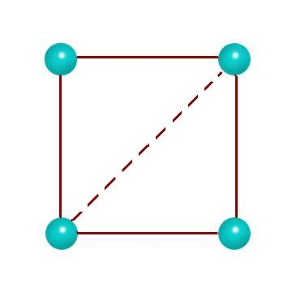
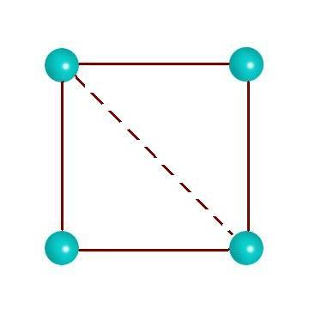
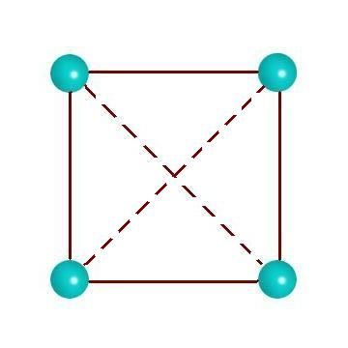

Tao of the DCM
Free energy reconstitution consistent with mechanical constraints
Jacobs, et al. Proteins (2001) 44:150
Jacobs, et al. Phys. Rev. E (2003) 68:061109
Jacobs & Dallakyan (2005) Biophysical J. 88:903
ΔH = 0
ΔS = 0
ΔH = -ε
ΔS = -δ
ΔH = -ε
ΔS = -δ
ΔH = -ε + -ε
ΔS = -δ + 0
Regarding NETWORK RIGIDITY as a mechanical interaction accounts for NON-ADDITIVITY IN ENTROPY

Slide 8


The Distance Constraint Model
Looking at the Two-Dimensional Square Example (Again)
Pure entropy
Jacobs, et. al., Phys. Rev. E 68, 061109 (2003).
interaction
constraint
energy
type
ε₁
γ₁
Quenched
curvature defines the constraint strength
strong bond
weak bond
ε₂
γ₂
Fluctuating
ΔE
Angular force
ε₃
γ₃
Quenched
Note: γ₁ < γ₂ < γ₃
mechanical framework F
total
energy E( F )
total pure
entropy τ( F )
×2
4γ₁+ γ₂
We model enthalpy-entropy compensation for each distinct constraint topology
4ε₁+ 4ε₃ + ε₂
4ε₁+ 4ε₃
4γ₁+ γ₃

Slide 9
Gibbs ensemble over all accessible constraint topologies
The partition function
×2
The ensemble is over
constraint topologies
-TS
H
H
-TS
Network of constraints defines microstate of the system
Let γ_{t} ≡ S_{t}/R Provides a dimensionless pure entropy
Suppose: γ₁ < γ₂ < γ₃ < … Ordering of entropies is important
E = N₁ε₁ + N₂ε₂ + N₃ε₃ + …. τ = I₁γ₁ + I₂γ₂ + I₃γ₃ + ….
Total energy at fixed constraint topology
Total pure entropy. Conformational degeneracy = e^{τ}
Sum over all topologically distinct mechanical frameworks
Jacobs, et. al., Phys. Rev. E 68, 061109 (2003).

Slide 10
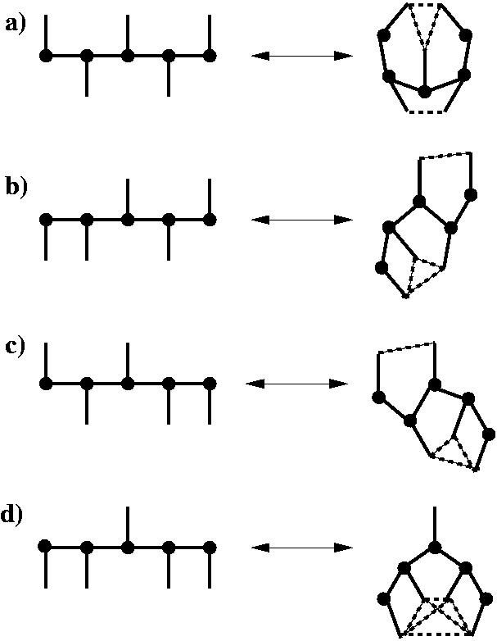
Distance Constraint Model for a Flexible Molecule
An illustrative two dimensional toy model
Constraint types
#BF=2⁴
(U_{c}, γ_{c})
Strong “covalent bond”
#BF=2⁴
(U, γ)
medium “hydrogen bond”
#BF=2⁴
(V, δ)
Weak “dihedral angle”
#BF=2⁶
Total #BF in partition function = 112
Jacobs, et. al., Phys. Rev. E 68, 061109 (2003).

Slide 11
Distance Constraint Model for a Flexible Molecule
An illustrative two dimensional toy model
Heat Capacity
A structural phase transition
4 atom
rigid pocket
The entire molecule is globally flexible
A rigid trapezoid forms when all six or only five constraints are present.
Order Parameter
Jacobs, et. al., Phys. Rev. E 68, 061109 (2003).

Slide 12
Distance Constraint Model for a Flexible Molecule
Phase diagram for the two dimensional toy model
Jacobs, et. al., Phys. Rev. E 68, 061109 (2003).

Slide 13
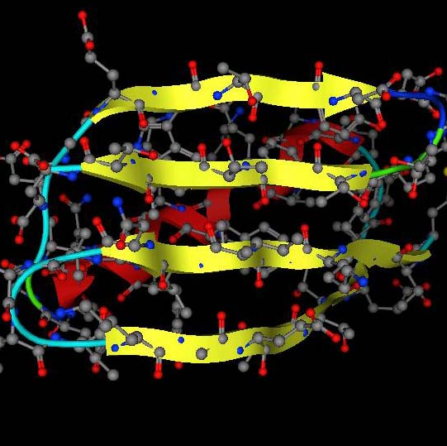
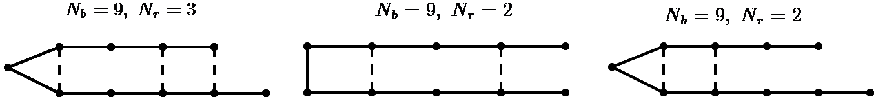
Exact Results on the Beta-Hairpin Turn
Under the Maxwell counting approximation
Model
Hairpin
N_{b} = N - 1
D. Jacobs and M. Fairchild, Progress in Biopolymer Research, pp 45-76 Editor: Pablo C. Sanchez, ISBN: 1-60021-984-5 45-76 (2007).

Slide 14
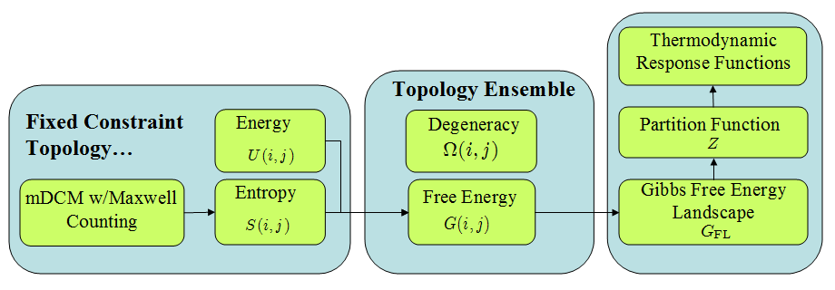
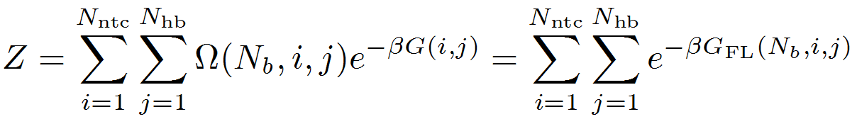
Exact Results on the Beta-Hairpin Turn
Under the Maxwell counting approximation
N = N_{b} + 1
Defines a 2D space
D. Jacobs and M. Fairchild, Progress in Biopolymer Research, pp 45-76 Editor: Pablo C. Sanchez, ISBN: 1-60021-984-5 45-76 (2007).

Slide 15
Free Energy Landscape
Macrostates are defined within a 2D constraint space
N_{nt}
F
more native torsion constraints
U
more H-bond crosslink constraints
N_{hb}

Slide 16
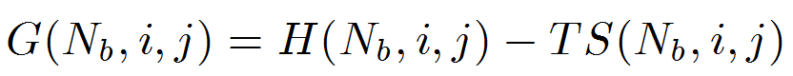
Exact Results on the Beta-Hairpin Turn
Under the Maxwell counting approximation
Free energy of constraint topology
Apply Maxwell counting
N = N_{b} + 1
Degeneracy in constraint topology
D. Jacobs and M. Fairchild, Progress in Biopolymer Research, pp 45-76 Editor: Pablo C. Sanchez, ISBN: 1-60021-984-5 45-76 (2007).

Slide 17
Exact Results on the Beta-Hairpin Turn
Under the Maxwell counting approximation
Bucket of 100 constraints
System of 50 DOF (degrees of freedom)
Apply
DOF
Rigidity Transition
0
25
50
75
100
E = N₁ε₁ + N₂ε₂ + N₃ε₃ + …. τ = I₁γ₁ + I₂γ₂ + I₃γ₃ + ….
Independent
constraints
Redundant
constraints
Hydrogen bond
Native torsion
Entropy
Energy
Disordered torsion
0
25
50
75
100
0
25
50
75
100
D. Jacobs and M. Fairchild, Progress in Biopolymer Research, pp 45-76 Editor: Pablo C. Sanchez, ISBN: 1-60021-984-5 45-76 (2007).

Slide 18
Exact Results on the Beta-Hairpin Turn
Under the Maxwell counting approximation
High T
-TS
Two extreme states
H
Low T
H
-TS
Energy
β-Hairpin
Random Coil
Energy
Disordered torsion
0
Hydrogen bond
ΔH
Native torsion
Entropy
Entropy
ΔS

Slide 19
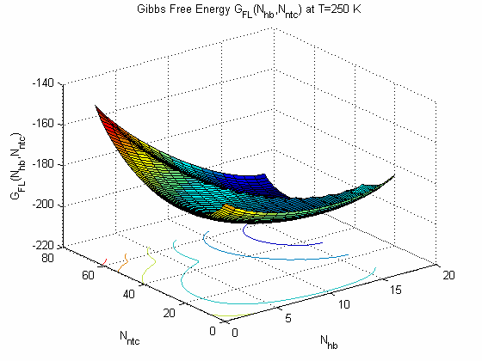
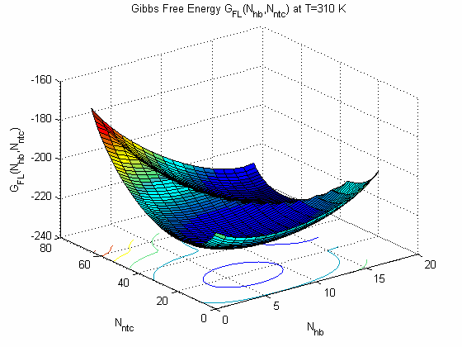
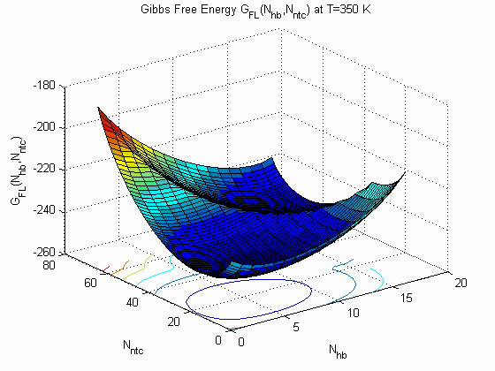
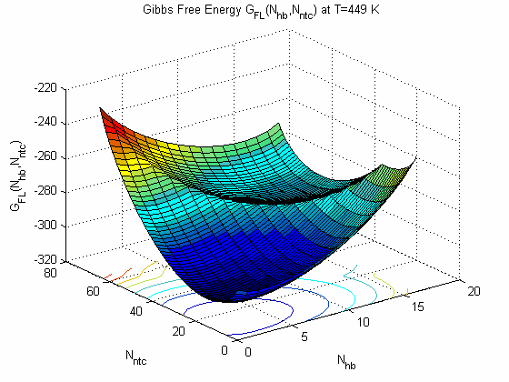
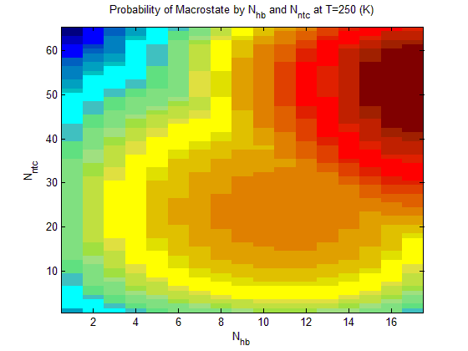
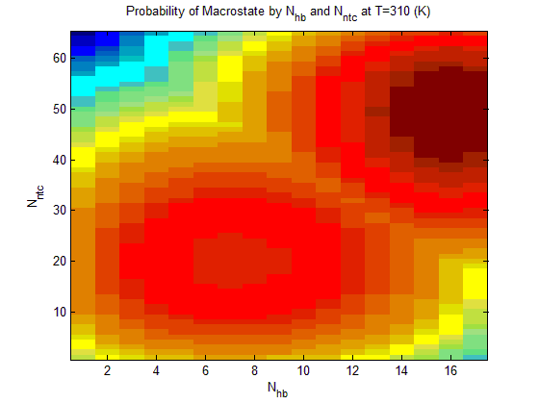
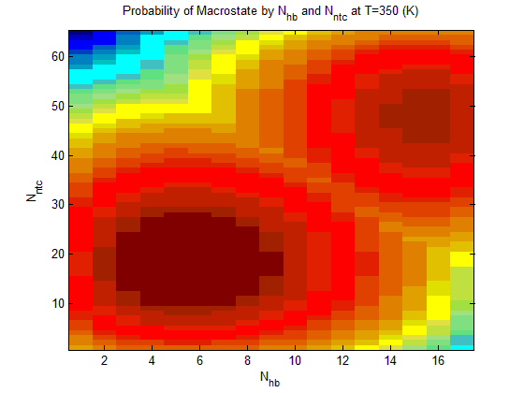
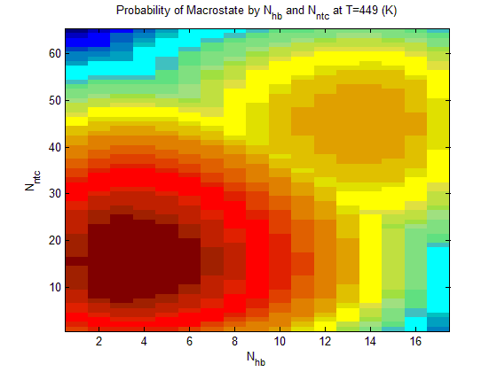
Exact Results on the Beta-Hairpin Turn
Under the Maxwell counting approximation
Example of Free Energy Landscapes

Slide 20
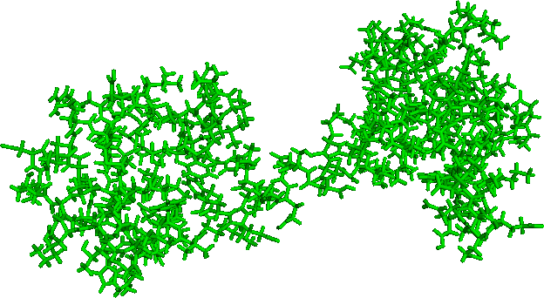
Transfer Matrix Solution to the DCM
Application to proteins with Maxwell constraint counting
native interactions are defined by the structure of a folded protein

Slide 21
Transfer Matrix Solution to the DCM
Test case: A simple two dimensional
native state
with all native contacts present
quenched constraint
fluctuating constraint

Slide 22
Solution to the DCM by Exact Enumeration
Test case: A simple two dimensional
constraint topology
N_{c}
F
Ω
ΔH
ΔS
Z(N_{c})
0
2
1
0
0
1
1
1
3
-ε
-γ
-γ + βε
3e
2
0
3
-2ε
-2γ
-2γ + β2ε
3e
3
0
1
-3ε
-2γ
-2γ + β3ε
e
-γ + βε
-2γ + β2ε
-2γ + β3ε
Z = 1 +
3e
+
3e
+
e

Slide 23
Solution to the DCM by Exact Enumeration
Test case: A simple two dimensional
constraint topology
N_{c}
F
Ω
ΔH
ΔS
Z(N_{c})
0
2
1
0
0
1
1
1
3
-ε
-γ
-γ + βε
3e
2
0
3
-2ε
-2γ
-2γ + β2ε
3e
3
0
1
-3ε
-2γ
-2γ + β3ε
nonadditive
e
-γ + βε
-2γ + β2ε
-2γ + β3ε
Z = 1 +
3e
+
3e
+
e
rigid structures

Slide 24
Introduce a Transfer Matrix to Solve the DCM
Recursion relation for adding another constraint
constraint topology
independent constraints
- γ + βε
e
a =
statistical weights
βε
redundant constraints
e
b =
a
add a constraint within a _______ region.
Z(N_{c} + 1) = a Z(N_{c}) flexible
a
Z(N_{c} + 1) = b Z(N_{c}) rigid
b
network rigidity
must be solved
Jacobs, et. al., Phys. Rev. E 68, 061109 (2003)
Jacobs & Dallakyan, Biophysical J. 88:903 (2005)
rigid structures

Slide 25
Maxwell Constraint Counting
Mean field approximation for network rigidity
N particles
dN (DOF)
Nc constraints
uniformly distributed
Estimate of flexibility
add
dN
− Nc constraints
− d(d+1)/2 rigid body DOF
F = dN − Nc − d(d+1)/2
J. C. Maxwell, Philos. Mag. 27 294 (1864)
Bucket of 100 constraints
System of 50 DOF (degrees of freedom)
F
Apply
DOF
Rigidity Transition
0
25
50
75
100
Vorov, et. al., Biophysical Journal, 100:1129-38 (2011)
Nc

Slide 26
The Transfer Matrix
Maxwell constraint counting for network rigidity
constraint topology
independent constraints
- γ + βε
e
a =
statistical weights
βε
redundant constraints
e
b =
a
Transfer matrix: T = 1 + C
1
0
0
0
0
0
0
0
a
1 =
0
1
0
0
C =
a
0
0
0
0
0
1
0
0
a
0
0
0
0
0
1
0
0
b
0
b
1
3
Z = (1,1,1,1) T
0
0
0
-γ + βε
-2γ + β2ε
-2γ + β3ε
Z = 1 +
3e
+
3e
+
e
rigid structures

Slide 27
DCM Using Maxwell Constraint Counting
Example system having 50 DOF and 100 constraints in native state
Transfer matrix: T = 1 + C
F
flexible
rigid
Z(0)
1
Z(1)
0
Z(2)
0
DOF
Rigidity Transition
100
Z(49)
= T
0
Z(50)
0
constraints placed
Z(51)
0
0
25
50
75
100
Z(98)
0
Nc
Z(99)
0
Z(100)
0
b
Z = ∑ z(N_{c})
0
0
independent constraints
N_{c}
a
a
0
0
a
0
0
a
a
- γ + βε
0
e
a
0
0
a =
statistical weights
C =
a
0
0
Rigidity Transition
a
0
βε
a
a
0
0
e
0
b
b
0
b =
b
b
0
b
0
0
redundant constraints
b
b
0
0
b

Slide 28
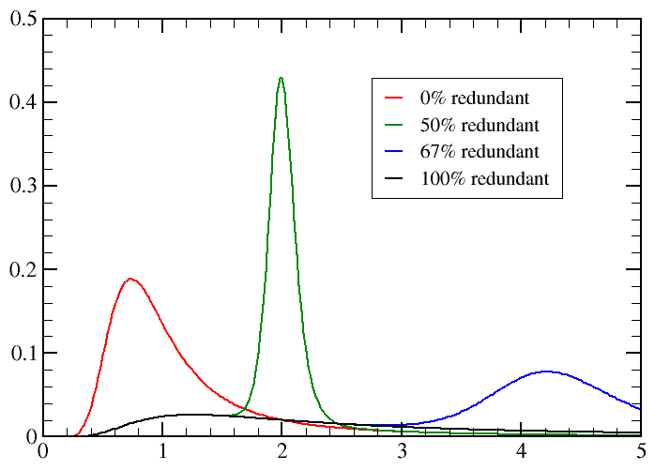
Relating Cooperativity to Rigidity Transition
Example system having X DOF and 100 constraints in native state
F
F
F
F
100
0% redundant
100
50% redundant
100
67% redundant
100
100% redundant
75
X=100
75
X=50
75
X=33
75
X=0
50
50
50
50
25
25
25
25
0
0
0
0
0
25
50
75
100
N_{c}
0
25
50
75
100
N_{c}
0
25
50
75
100
N_{c}
0
25
50
75
100
N_{c}
recall ...
transfer
matrix:
T = 1 + C
C_{p} kcal/(mol K)
0% redundant
50% redundant
C =
67% redundant
100% redundant
KT/ε

Slide 29
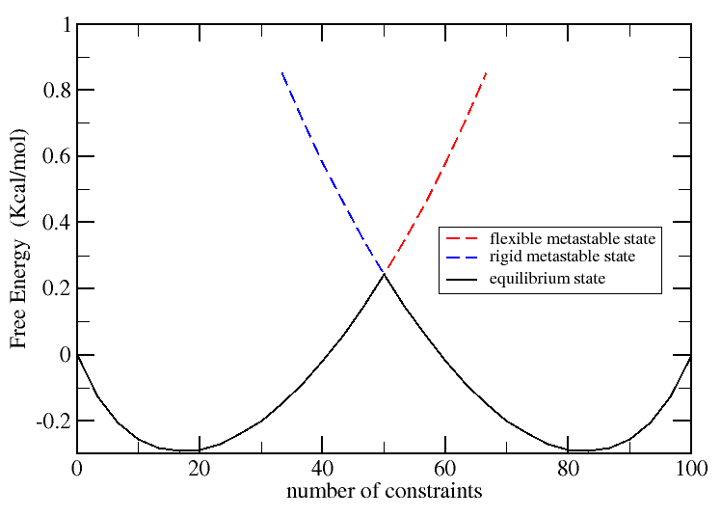
DCM Using Maxwell Constraint Counting
Example system having 50 DOF and 100 constraints in native state
F
50% redundant
Rigidity Transition
Z(0)
1
DOF
Z(1)
0
Z(2)
0
100
Z(49)
= T
0
Z(50)
0
Z(51)
0
0
25
50
75
100
Nc
Z(98)
0
Z(99)
0
Z(100)
0
cracking
@ T = T_{m}
at T = T_{m}
G(N_{c}) = -KT ln[ Z(N_{c}) ]
flexible state
rigid state

Slide 30
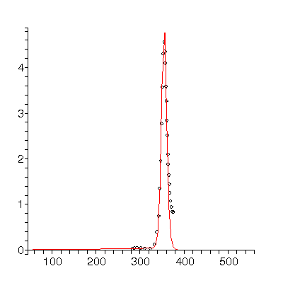
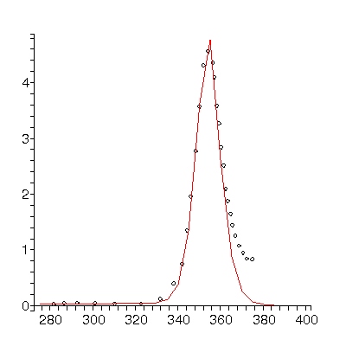
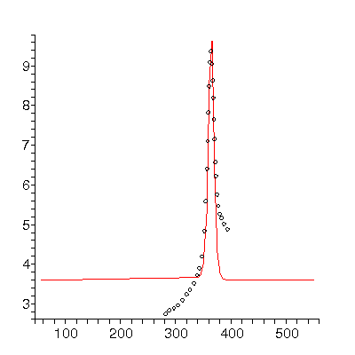
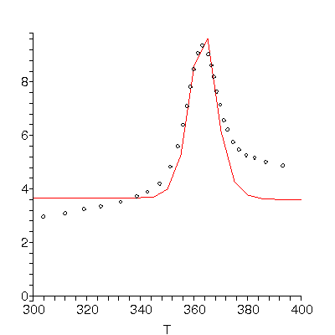
Simple Theory of Protein Folding
Application of Maxwell constraint counting
Cp curves: dots – experimental points
zoom
PROTEIN G
U_sol = -3.56
% ind. = 12
Vorov, et. al., Biophysical Journal, 100:1129-38 (2011)
zoom
UBIQUITIN
U_sol = -2.41
% ind. = 12
offset = 3.6

Slide 31
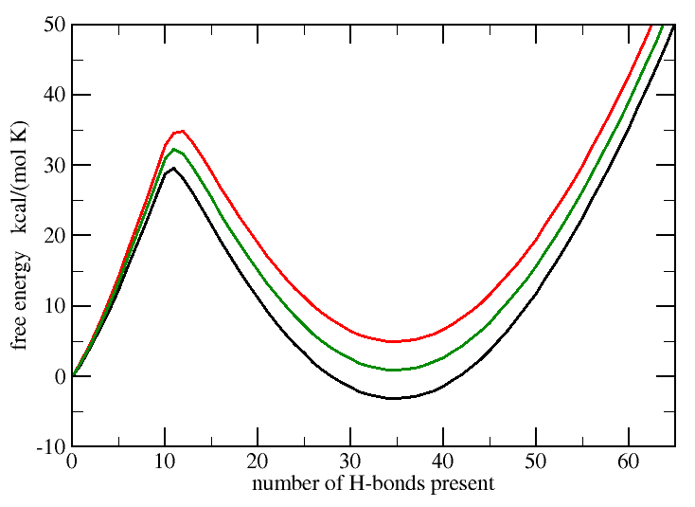
Rigidity is a Universal Mechanism for Protein Folding
Mean field approximation for network rigidity
transition state defined by the rigidity transition
flexible
rigid
T > T_{m}
T = T_{m}
T < T_{m}

Slide 32
DCM within Maxwell Constraint Counting
Some conclusions on the transfer matrix method
Maxwell constraint counting serves as a mean field approximation for the DCM that simplifies solving for network rigidity to a counting problem that can be solved using a transfer matrix method for any shaped 3D object!
The essential link between network rigidity, conformational entropy and mixing entropy in the accessible constraint arrangements is captured.
In the mean field limit, the transition state is largely controlled by the rigidity transition, leading to a simple two-state process.
The predicted barrier height is higher than it should be, indicating the nucleation process of a folding core depends on fluctuations in how rigidity is distributed throughout protein structure.
O.K. Vorov, D.R. Livesay and D.J. Jacobs, Nonadditivity in Conformational Entropy Upon Molecular Rigidification Reveals a Universal Mechanism for Affecting Folding Cooperativity, Biophysical Journal, 100:1129-38 (2011).

Slide 33
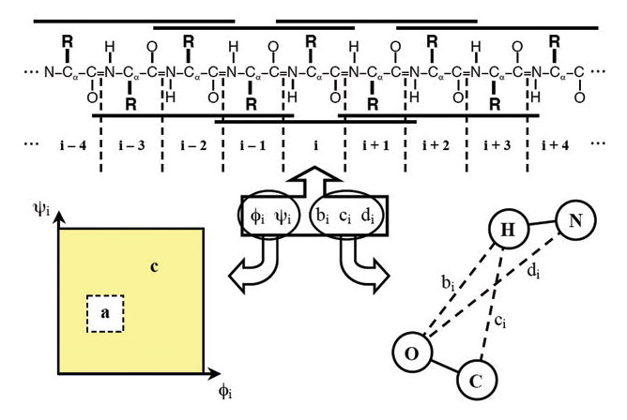
Exact Solution for alpha-helix to coil transition
Free energy decomposition and DCM parameterization

Slide 34
Exact Solution for alpha-helix to coil transition
Free energy decomposition and DCM parameterization
Each residue is allowed to be in two conformational states:
Let a ≡ alpha helical conformation
Let c ≡ coil conformation
i
i+4
Polypeptide chain → ccaacaaacaaaaaaccaaaaaccccc
Constraint types:
Native torsion: (V_{a}, 2δ_{a})
Coil torsion: (V_{c}, 2δ_{c})
H-bonding i to i+4: (U_{xyz}, γ_{xyz}) where x,y,z = a or c
H-bonding to solvent: U_{o}
No γ_{o} because solvent is mobile
D.J. Jacobs, S. Dallakayan, G.G. Wood and A. Heckathorne, Network rigidity at finite temperature: Relationships between thermodynamic stability, the nonadditivity of entropy, and cooperativity in molecular systems. Physical Review E. 68:061109 1-21 (2003).

Slide 35
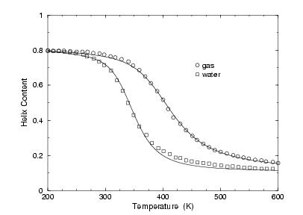
Exact Solution for alpha-helix to coil transition
Helix to Coil transition in polyalanine (gas and aqueous solution)
DATA: A. Mitsutake and Y. Okamoto, Chem. Phys. Lett. 309, 95-100 (1999)
The DCM quantitatively describes the alpha-helix to coil transition in different types of environments markedly well.
Jacobs, et. al., Phys. Rev. E 68, 061109 (2003).

Slide 36
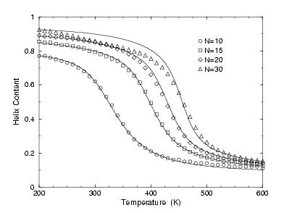
Exact Solution for alpha-helix to coil transition
Helix to Coil transition in polyalanine (size dependence)
DATA: Y. Peng, U.H.E. Hansmann, N.A. Alves, J. Chem. Phys. 118, 2374 (2003)
The DCM quantitatively describes the alpha-helix to coil transition size dependence well.
Jacobs, et. al., Phys. Rev. E 68, 061109 (2003).

Slide 37
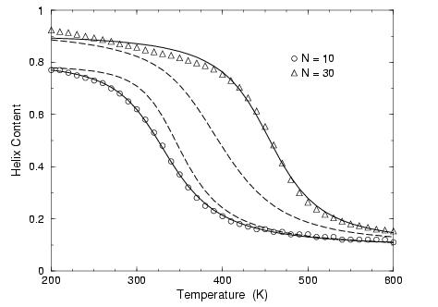
Comparing DCM to the Classic Lifson-Roig Model
Lifson-Roig model does not describe the helix-coil transition correctly
The LRM fails to predict the N=10 case when its free parameters are fitted to the N=30 case.
The LRM fails to predict the N=30 case when its free parameters are fitted to the N=10 case.
Jacobs, et. al., Phys. Rev. E 68, 061109 (2003).

Slide 38
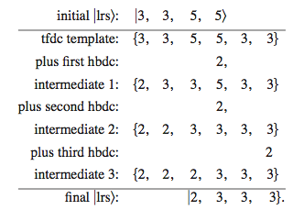
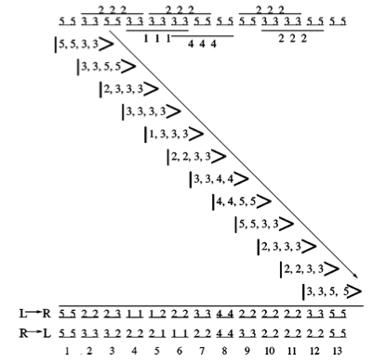
Exact Solution for alpha-helix to coil transition
A brief encounter with complicated mathematics and algorithms
Transfer matrix was created to account for network rigidity exactly.
The transfer matrix method works due to the 1D character of the alpha-helix.
Matrix elements in the transfer matrix track local triplet conformational states.
Algorithm to propagate a local rigidity state (lrs)
Rigidity propagation (left to right)
Jacobs, et. al., Phys. Rev. E 68, 061109 (2003).

Slide 39

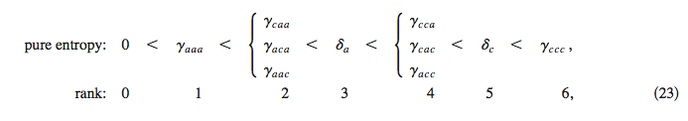
Exact Solution for alpha-helix to coil transition
A brief encounter with complicated mathematics and algorithms
As a direct product, rigidity information is encoded into the matrix elements.
The partition function is calculated from N-terminus to C-terminus and reverse.
A general transfer matrix element that needs to be determined.
A partition function exactly calculated with boundary conditions for finite chain length.
The rank order of entropy values for various molecular interactions are important.
Jacobs, et. al., Phys. Rev. E 68, 061109 (2003).

Slide 40
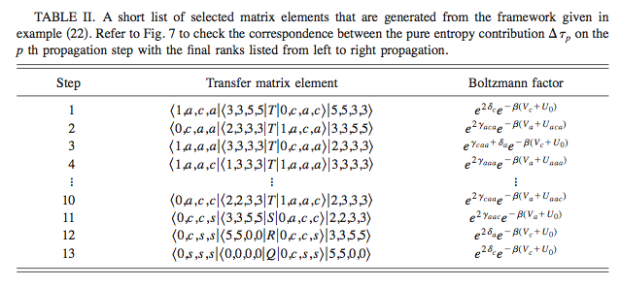
Exact Solution for alpha-helix to coil transition
A brief encounter with complicated mathematics and algorithms
Matrix elements are successively calculated for a complete set of microstates.
The number of microstates depends on the precise values of entropy parameters.
The microstates are determined based on an exhaustive counting algorithm.
Jacobs, et. al., Phys. Rev. E 68, 061109 (2003).

Slide 41
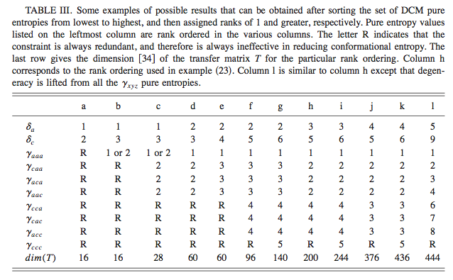
Exact Solution for alpha-helix to coil transition
A brief encounter with complicated mathematics and algorithms
The entropy spectrum plays a critical role in determining the rigidity correlation length.
As entropy parameters change, the size of the transfer matrix changes.
Numerical checks indicate predictions are a continuous function of the parameters.
Jacobs, et. al., Phys. Rev. E 68, 061109 (2003).

Slide 42
Alpha-helix to Coil Transition in Mixed Solvent
Free energy decomposition and DCM parameterization
“I have yet to see any problem, however complicated, which, when you looked at it in the right way, did not become still more complicated”. --- Poul Anderson in New Scientist (1969)
Each residue is allowed to be in three conformational states:
Let a ≡ alpha helical conformation
Let c ≡ coil conformation
Let h ≡ hydrated conformation
Polypeptide chain → hcaacachhcaaaaaccaaaachhhcc
Constraint types:
Native torsion: (V_{a}, 2δ_{a})
Coil torsion: (V_{c}, 2δ_{c})
Hydrated torsion: (V_{h}, 2δ_{h})
Accounts for structured water around residue
H-bonding i to i+4: (U_{xyz}, γ_{xyz}) where x,y,z = a or c
(No h)
H-bonding to solvent: U_{o}
No γ_{o} because solvent is mobile

Slide 43
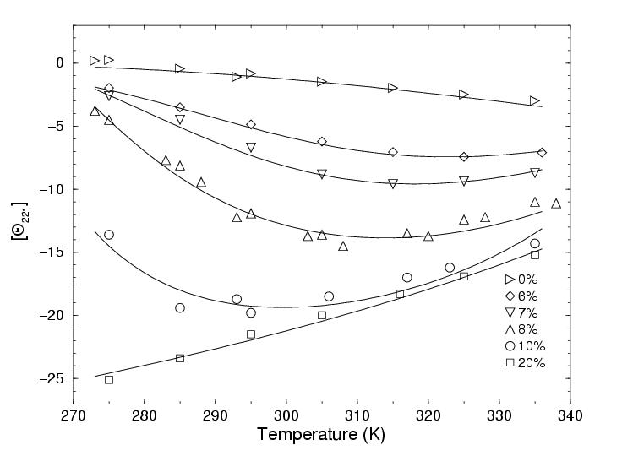
Alpha-helix to Coil Transition in Mixed Solvent
DCM correctly models both heat and cold denaturation
Parameters are temperature independent
Parameters are linearly dependent on solute concentration
D.J. Jacobs and G.G. Wood, Understanding the α-Helix to Coil Transition in Polypeptides Using Network Rigidity: Predicting Heat and Cold Denaturation in Mixed Solvent Conditions. Biopolymers. 75:1-31 (2004).
x 10⁻³
DATA: N. H. Andersen, et. al. J. Am. Chem. Soc. 118, 10309 (1996)
Monomeric peptide in different concentrations (by volume) of HFIP

Slide 44
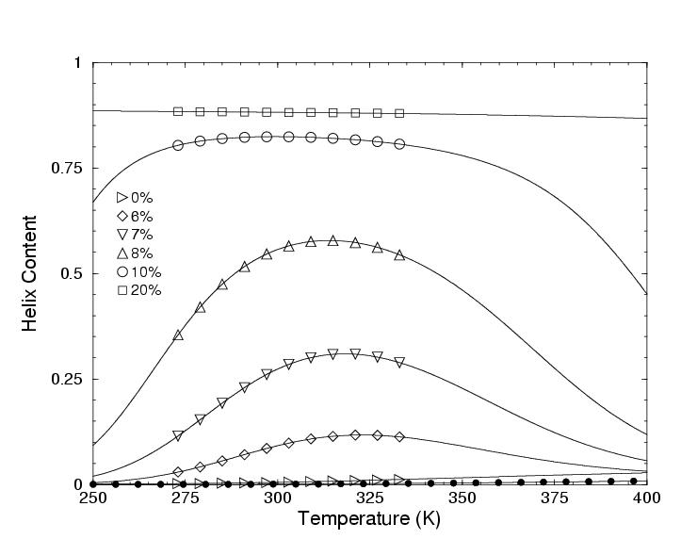
Alpha-helix to Coil Transition in Mixed Solvent
Helix content for heat and cold denaturation over extended range
D.J. Jacobs and G.G. Wood, Understanding the α-Helix to Coil Transition in Polypeptides Using Network Rigidity: Predicting Heat and Cold Denaturation in Mixed Solvent Conditions. Biopolymers. 75:1-31 (2004).
DATA: N. H. Andersen, et. al. J. Am. Chem. Soc. 118, 10309 (1996)
Monomeric peptide in different concentrations (by volume) of HFIP

Slide 45
Hidden Thermodynamics Revealed!
The DCM paradigm is a versatile, pragmatic and tractable approach
Initial state:
A soup of structural
building blocks and
their thermodynamic
characteristics {ΔH, ΔS}
?
Final state:
A protein with specified
structure and its total
Gibbs free energy
Hidden
Thermodynamics
Hidden Thermodynamics of Mutant Proteins: A Molecular Dynamic Analysis
J. Gao, K. Kuczera, B. Tidor and M. Karplus, Science 244, 1069 (1989)
Decomposition of the Free Energy of a System in Terms of Specific Interactions
A. E. Mark and W. F van Gunsteren, J. Mol. Biol. 240, 167 (1994)
“In regard to the detailed separation of free energy components, we must acknowledge that the hidden thermodynamics of a protein will, unfortunately, remain hidden”
the hidden thermodynamics is, fortunately, revealed through constraint theory.
“Protein Heat Capacity: Inconsistencies in current view of cold denaturation”
B. Hallerbach and H.J. Hinz Biophysical Chemistry 76, 219(1999)
The heat capacity problem is solved!
“if your theory is found to be against the Second Law of Thermodynamics I can give you no hope; there is nothing for it to collapse in deepest humiliation”.
--- Sir Arthur Stanley Eddington, The Nature of the Physical World (1928)

Slide 46
Distance Constraint Model
Recap of the main results thus far
The DCM is based upon a free energy decomposition scheme. In general entropies are non-additive, which requires constraint theory to account for the coupling between DOF in order to afford a free energy reconstitution.
Many flavors of models can be built and solved in many different ways, which includes applying mean field theory to describe network rigidity.
The DCM parameters reflect a certain amount of coarse-graining of microstates. This provides a computational advantage, especially when working within a limited temperature range (i.e. within 250K to 400K).
An advantage of the DCM is that it retains phenomenological parameters that can be adjusted to fit to experimental thermodynamic data.
For a detailed review, see:
Donald J. Jacobs, An Interfacial Thermodynamics Model for Protein Stability,
Biophysics, Ed: A.N. Misra, Intech publishers, p91-132, ISBN 978-953-51-0376-9 (2012).

