Slide 1
BPL
“std::vector like”
on DPU

Slide 2
Sketches for DPU “std-like” containers
Constraints with WRAM and MRAM
  Some of them only, with restricted set of methods
Example: std::vector on DPU
  Just focus on this case for a few minutes
Dynamic nature
  inserting items without knowing the initial size
Not easy on DPU
  Dynamic allocation only on WRAM
  Need some “dynamic allocation” on MRAM

Slide 3
std::vector on DPU
Vector holding items of type T
  Type known during the object declaration: vector<int> x;
  Possible to provide a size at initialization: vector<int> x(100);
  Possible to reserve some memory: vector<int> x; x.reserve(100);
Data structure of variable size
  Adding items dynamically: x.push_back (35);
  Dynamic allocation required
How to do this on DPU ?
  Not possible to keep the whole vector in WRAM → necessarely in MRAM
  We can keep a part of the vector in WRAM (and the whole vector in MRAM)
      as an array<T,N> of fixed known size N (WRAM)
      as a linked list of array<T,N> (MRAM)

Slide 4
std::vector on DPU
During initialization
  The current block is initialized in WRAM
user code
MRAM
vector<int> x;
WRAM
0
1
2
3
4
.
.
.
.
.
Array<int,5> currentBlock;
firstBlockPtr = nullptr;

Slide 5
std::vector on DPU
During insertion
  If the current block in WRAM is not full, we add the item
user code
MRAM
vector<int> x;
x.push_back (35)
WRAM
0
1
2
3
4
35
.
.
.
.
Array<int,5> currentBlock;
firstBlockPtr = nullptr;

Slide 6
std::vector on DPU
During insertion
  If the current block in WRAM is not full, we add the item
  Otherwise, we copy the current block into MRAM and we initialize a new one in WRAM; we can then insert the item.
user code
1
MRAM
x.push_back (17)
WRAM
0
1
2
3
4
35
56
29
22
44
Array<int,5> currentBlock;
firstBlockPtr = nullptr;

Slide 7
std::vector on DPU
During insertion
  If the current block in WRAM is not full, we add the item
  Otherwise, we copy the current block into MRAM and we initialize a new one in WRAM; we can then insert the item.
user code
2
MRAM
x.push_back (17)
0
1
2
3
4
35
56
29
22
44
WRAM
next = null
0
1
2
3
4
17
.
.
.
.
Array<int,5> currentBlock;
firstBlockPtr = 0x123456;

Slide 8
std::vector on DPU
After several insertions
  Several blocks are in MRAM
  In WRAM, we have a pointer on the first block in MRAM
    → allows to iterate the vector, block after block by using the linked list in MRAM
MRAM
0
1
2
3
4
35
56
29
22
44
WRAM
next =
0
1
2
3
4
17
19
21
23
25
0
1
2
3
4
14
74
98
.
.
Array<int,5> currentBlock;
firstBlockPtr = 0x123456;
next = null

Slide 9
std::vector on DPU
Remarks
  We need an allocator in MRAM, shared by the tasklets
  Size N of the block array<T,N> is important:
      Statically defined if we use array<T,N>
      Can not be too big because array<T,N> has to be in the stack
      Minimization of transfers number WRAM / MRAM
      Items number of the linked list more or less big
MRAM
0
1
2
3
4
35
56
29
22
44
WRAM
next =
0
1
2
3
4
17
19
21
23
25
0
1
2
3
4
14
74
98
.
.
Array<int,5> currentBlock;
firstBlockPtr = 0x123456;
next = null

Slide 10
std::vector on DPU
Remarks : using insertion method ‘push_back’
  If the vector is a global object, possible to have concurrent access between tasklets.
  ‘push_back’: synchonization has to be done only when a full block of N items has to be copied in MRAM
      → synchro only every N>1 items (not every item)
  On the other hand, syncho can be avoided if the vector is local to the “main” function of the tasklet
global
local
vector<int> x;
int main ()
{ x.push_back(35); }
int main ()
{
vector<int> x;
x.push_back(35);
}
MRAM
WRAM
0
1
2
3
4
35
56
29
22
44
0
1
2
3
4
35
56
29
22
44
Array<int,5> currentBlock;
firstBlockPtr = nullptr;
next =

Slide 11
std::vector on DPU
Remark: random access
  i.e. operator [] (size_t i)
  Knowing ‘i’ and the block size allows to compute the block number where the item is.
  On the other hand, a linked list implementation forbids to directly access to the given block.
user code
MRAM
X[8] // should be 23
0
1
2
3
4
35
56
29
22
44
WRAM
next =
0
1
2
3
4
17
19
21
23
25
0
1
2
3
4
14
74
98
.
.
Array<int,5> currentBlock;
firstBlockPtr = 0x123456;
next = null

Slide 12
std::vector on DPU
Remark: random access
  In MRAM, possibility to put the “next block” pointer in another location
  We can use a linked list of arrays made of pointers to the blocks
user code
MRAM
X[8] // should be 23
0
1
2
3
4
35
56
29
22
44
0
1
2
3
4
17
19
21
23
25
...
WRAM
0
1
2
3
4
14
74
98
.
.
Array<int,5> currentBlock;
firstBlockPtr =
ptr = 0x1234
ptr = 0x3423
ptr = 0x9843
ptr = 0xA123
next =
ptr = 0xA345
ptr = 0xA789
ptr = 0xB451
Ptr = null
next = null

Slide 13
std::vector on DPU
However, not perfect for huge vector
  Random access more and more costly when lookup index goes large
DPU
MRAM
user code
0
1
2
3
4
35
56
29
22
44
0
1
2
3
4
17
19
21
23
25
...
dpu::vector<int> v;
ptr = 0x1234
ptr = 0x3423
ptr = 0x9843
ptr = 0xA123
next =
ptr = 0xA345
ptr = 0xA789
ptr = 0xB451
ptr = 0xC654
next =
ptr = 0xC762
ptr = 0xC813
ptr = 0xC966
ptr = 0xD013
next =
ptr = 0xD123
ptr = 0xD456
ptr = 0xDA32
ptr = 0xDF01
next = ...
one data block → 5 items
one links block → 4 pointers
Accessing v[4] needs to:
  access 1 links block
  access 1 data block
Accessing v[20480] needs to:
  access 1024 links block
  access 1 data block

Slide 14
std::vector on DPU
Using a binary tree for links blocks
DPU
MRAM
user code
ptr = 0x6513
ptr = 0x9811
dpu::vector<int> v;
ptr = 0x1234
ptr = 0x3423
ptr = 0xA345
ptr = null
Accessing v[20480] needs to:
  access 12 links block
  access 1 data block
ptr = 0x...
ptr = 0x...
ptr = 0x...
ptr = 0x...
ptr = 0x...
ptr = null
ptr = null
ptr = null
0
1
2
3
4
35
56
29
22
44
0
1
2
3
4
17
19
21
23
25
0
1
2
3
4
6
9
12
15
18
0
1
2
3
4
31
41
59
26
53
0
1
2
3
4
98
87
76

Slide 15
std::vector on DPU
Using a tree for links blocks
DPU
MRAM
ptr = 0x6513
ptr = 0x9811
ptr = null
ptr = null
user code
dpu::vector<int> v;
0x6513
0x9811
ptr = 0x1234
ptr = 0x3423
ptr = 0x9843
ptr = 0xA123
ptr = 0xA345
ptr = 0xA789
ptr = 0xB451
ptr = null
ptr = null
ptr = null
ptr = null
ptr = null
ptr = null
ptr = null
ptr = null
ptr = null
Accessing v[20480] needs to:
  access 6 links block
  access 1 data block
0x1234
ptr = 0x...
ptr = 0x...
ptr = 0x...
ptr = 0x...
ptr = 0x...
ptr = 0x...
ptr = 0x...
ptr = 0x...
ptr = 0x...
ptr = 0x...
ptr = 0x...
ptr = 0x...
ptr = 0x...
ptr = 0x...
ptr = 0x...
ptr = 0x...
ptr = 0x...
ptr = 0x...
ptr = 0x...
ptr = 0x...
ptr = 0x...
ptr = 0x...
ptr = 0x...
ptr = 0x...
ptr = 0x...
ptr = 0x...
ptr = 0x...
ptr = 0x...
0
1
2
3
4
35
56
29
22
44
0
1
2
3
4
17
19
21
23
25
0
1
2
3
4
6
9
12
15
18
0
1
2
3
4
31
41
59
26
53

Slide 16
std::vector on DPU
MRAM
ptr = 0x6513
ptr = 0x9811
ptr = null
ptr = 0x1234
ptr = 0x3423
ptr = 0x9843
ptr = 0xA345
ptr = 0xA789
ptr = null
ptr = null
ptr = null
ptr = null
ptr = 0x...
ptr = 0x...
ptr = 0x...
ptr = 0x...
ptr = 0x...
ptr = 0x...
ptr = 0x...
ptr = 0x...
ptr = 0x...
ptr = 0x...
ptr = 0x...
ptr = 0x...
ptr = 0x...
ptr = 0x...
ptr = 0x...
ptr = 0x...
ptr = 0x...
0
1
2
3
4
35
56
29
22
44
0
1
2
3
4
17
19
21
23
25
0
1
2
3
4
6
9
12
15
18
Memory mapping tree

Slide 17
std::vector : random access
MRAM
0
1
0
1
2
0
1
2
0
1
2
0
1
2
0
1
2
0
1
2
0
1
2
0
1

Slide 18
std::vector : random access
MRAM
query
V [37]
0
1
0
1
2
0
1
2
0
1
2
0
1
2
0
1
2
0
1
2
0
1
2
0
1
17 leaves, each pointing to
a data chunk of N=5 items
37 / 5 = 710 = 0213
37 % 5 = 2
0
1
2
3
4
17
19
21
23
25

Slide 19
std::vector : random access
MRAM
query
V [39]
0
1
0
1
2
0
1
2
0
1
2
0
1
2
0
1
2
0
1
2
0
1
2
0
1
Same data block as before,
so no MRAM access required
39 / 5 = 710 = 0213
39 % 5 = 4
0
1
2
3
4
17
19
21
23
25

Slide 20
std::vector : random access
MRAM
query
V [43]
0
1
0
1
2
0
1
2
0
1
2
0
1
2
0
1
2
0
1
2
0
1
2
0
1
Here, only the last digit has changed, so only one pointer block needs to be retrieved
43 / 5 = 810 = 0223
43 % 5 = 3
0
1
2
3
4
64
12
78
37
77

Slide 21
std::vector : random access
MRAM
query
V [72]
0
1
0
1
2
0
1
2
0
1
2
0
1
2
0
1
2
0
1
2
0
1
2
0
1
Here, a full tree traversal is need
72 / 5 = 1410 = 1123
72 % 5 = 2
0
1
2
3
4
11
87
64
43
12

Slide 22
std::vector : iteration
MRAM
0
1
0
1
2
0
1
2
0
1
2
0
1
2
0
1
2
0
1
2
0
1
2
0
1
Add sibling information for speeding up iteration
(in other words, integrate a linked list)
Double linked list if reverse
iteration is wanted

Slide 23
std::vector on DPU
MRAM access number for getting an item of the vector
  MRAM access → mram_read
  Access pointer nodes : [logP(N/D)] times with
      N := number of items in the vector
      D := data block size
      P := pointer block size
  Access data block : 1 time
  Total: A = [logP(N/D)] + 1
Examples
  N = 1,000,000 D = 10 P = 4 => A = 10
  N = 1,000,000 D = 100 P = 16 => A = 5
  N = 1,000,000 D = 1000 P = 32 => A = 3

Slide 24
std::vector on DPU
WRAM usage for storing items of type T
  MemData := data block size * sizeof (T)
  MemPtr := pointer block size * sizeof (address_t)
      address_t = uint64_t (easier alignment management but could be improved)
  At any moment, only M = MemData + MemPtr bytes are stored in the stack
Examples
  T=uint8_t D = 10 P = 4 => M = 42 bytes
  T=uint8_t D = 1000 P = 32 => M = 1256 bytes
  T=uint32_t D = 100 P = 16 => M = 528 bytes

Slide 25
std::vector on DPU
If the required index matches the currently stored data block
  Data directly reachable in the WRAM
Otherwise...
  Data must be retrieved from the MRAM
So, “not too random” access leads to fewer MRAM access
  Locality of data access in the vector
MRAM allocator needed
  To be shared by all tasklets
  Protected against concurrent access
  Frequency usage depends on D (data block size) and P(pointer block size)

Slide 26
In brief...
Generic implementation of “std like” vector
  Allows some dynamic behavior with “push_back”
  Use (almost) no resources when not filled
To be compared to the UPMEM mechanism
  “An MRAM variable can be accessed like any WRAM variable. When doing so, a pre-defined cache in WRAM is used to handle the MRAM transactions.”
  A global MRAM array will always take the same memory size, whatever its usage.
Benchmarking will be necessary
  MRAM access strategy powerful enough ? (for iteration and direct access)
  Comparison with
      UPMEM mechanism (implicit MRAM access, seqread, ...)
      Hand written code (mram_write, mram_read)

Slide 27
std::vector on DPU
In a nutshell
  Implementation of a class vector<T> for DPU “looking like” std::vector<T> from the C++ standard library
Methods to be implemented (part 1)
      Default constructor vector<int> x;
      Number of items x.size();
      Insert an item x.push_back (35);
      Iterating items for (int n : x) { }
Methods to be implemented (part 2)
      Random access x[8];
      Memory reservation x.reserve (100);
      Resizing (shrink) x.resize (30);

Slide 28
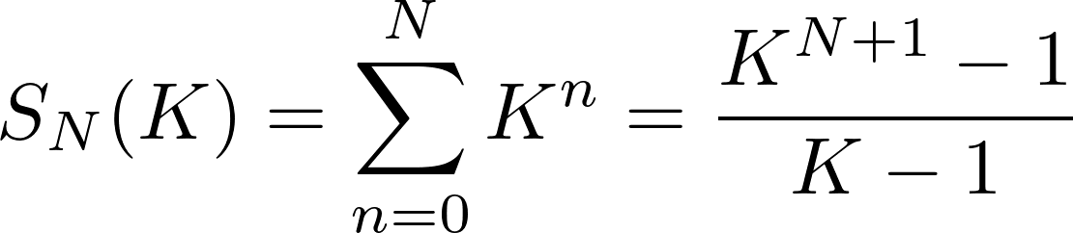
std::vector : iteration
0
0
1
2
3
0
1
2
3
0
1
2
3
0
1
2
3
0
1
2
3

Slide 29
Benchmark: write
void vector_write ()
{
bpl::core::vector <type, Allocator> vec;
for (uint32_t n=0; n<NMAX; n++) { vec.push_back (type(n)); }
}
type __mram_noinit big [NMAX];
void handcrafted_write ()
{
__dma_aligned type input[BUFFER];
for (uint32_t n=0; n<NMAX; n+=BUFFER)
{
for (uint32_t i=0; i<BUFFER; i++) { input[i] = type(n+i); }
mram_write (input, (__mram_ptr void *) ( (type*)big + n), sizeof(input));
}
}
void upmem_write ()
{
for (uint32_t n=0; n<NMAX; n++) { big[n] = type(n); }
}

Slide 30
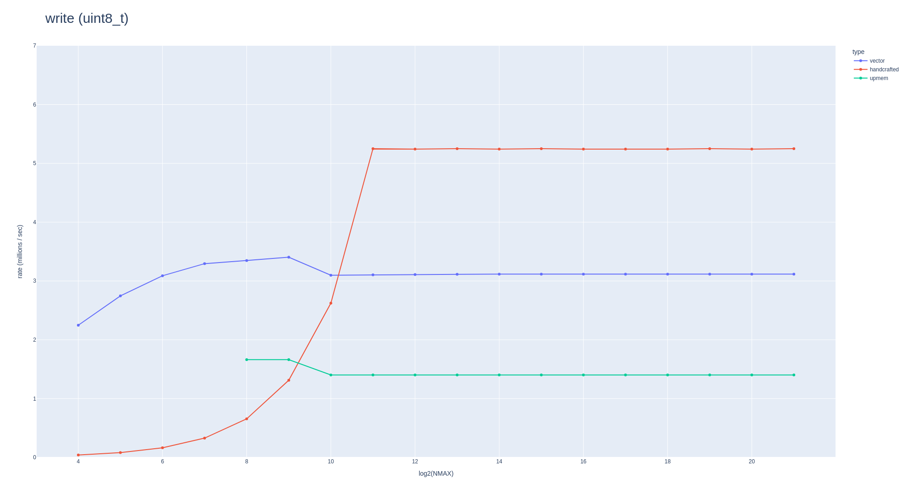
Benchmark: write

Slide 31
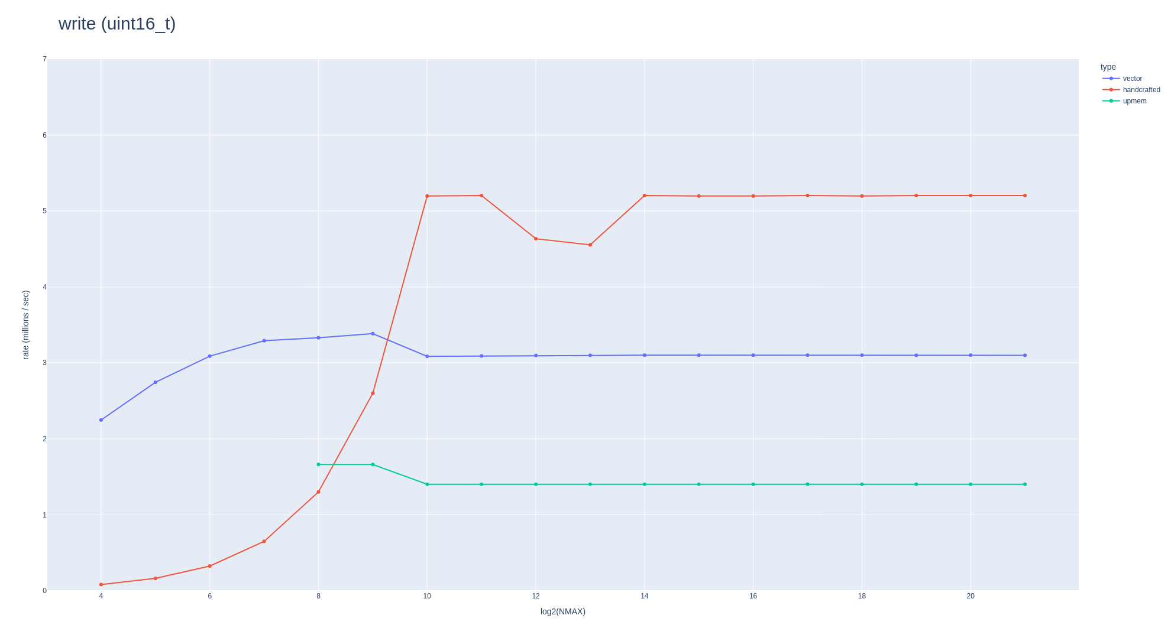
Benchmark: write

Slide 32
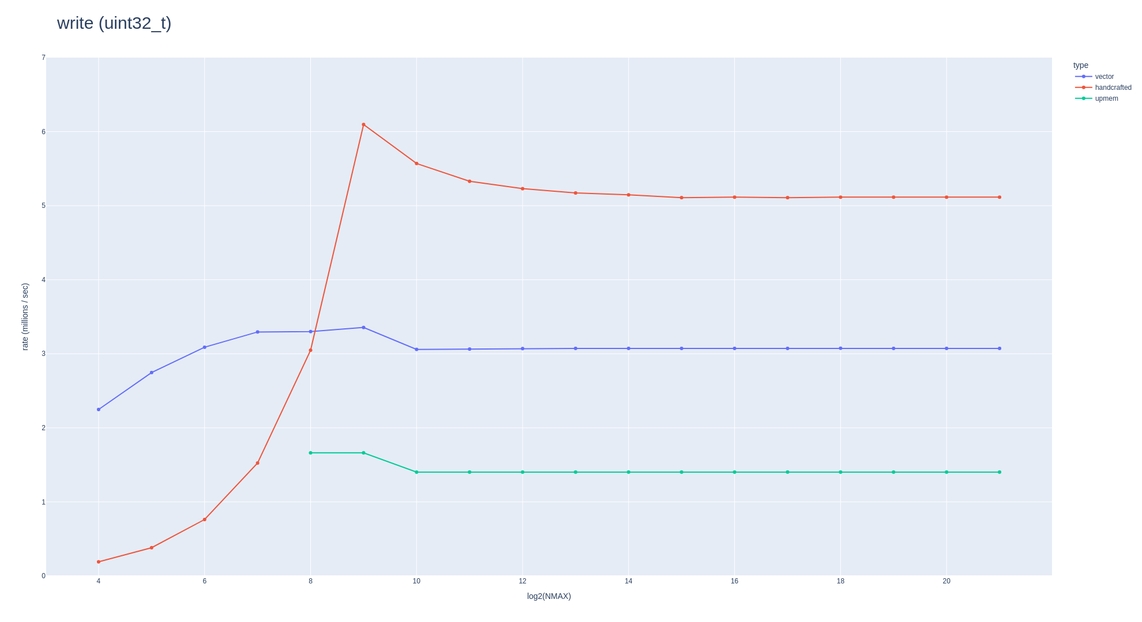
Benchmark: write

Slide 33
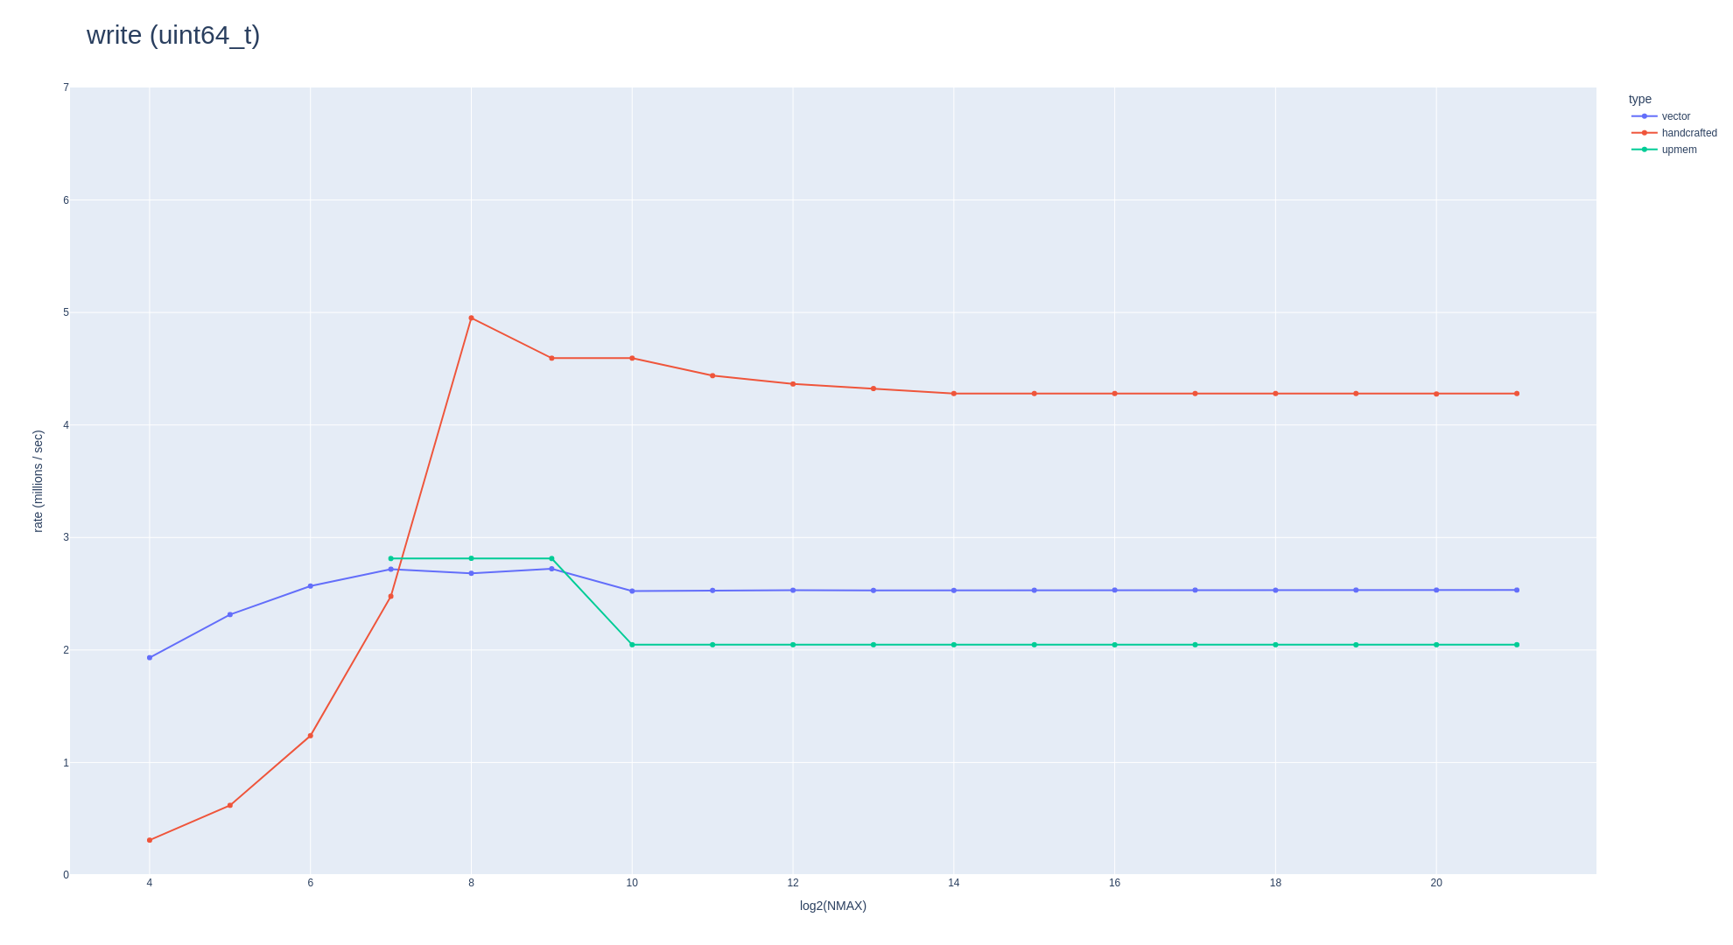
Benchmark: write

Slide 34
Benchmark: iterate (increasing)
void vector_iterate ()
{
bpl::core::vector <type, Allocator> vec;
for (uint32_t n=0; n<NMAX; n++) { vec.push_back (type(n)); }
uint64_t result=0;
vec.iterate ([&] (type n) { result += n; });
}
type __mram_noinit big [NMAX];
void handcrafted_iterate ()
{
__dma_aligned type input[BUFFER];
for (uint32_t n=0; n<NMAX; n+=BUFFER)
{
for (uint32_t i=0; i<BUFFER; i++) { input[i] = type(n+i); }
mram_write (input, (__mram_ptr void *) ( (type*)big + n), sizeof(input));
}
uint64_t result=0;
for (uint32_t n=0; n<NMAX; n+=BUFFER)
{
mram_read ((__mram_ptr void *) ( (type*)big + n), input, sizeof(input));
for (uint32_t i=0; i<BUFFER; i++) { result += input[i]; }
}
}
void upmem_iterate ()
{
for (uint32_t n=0; n<NMAX; n++) { big[n] = type(n); }
uint64_t result=0;
for (uint32_t n=0; n<NMAX; n++) { result += big[n]; }
}

Slide 35
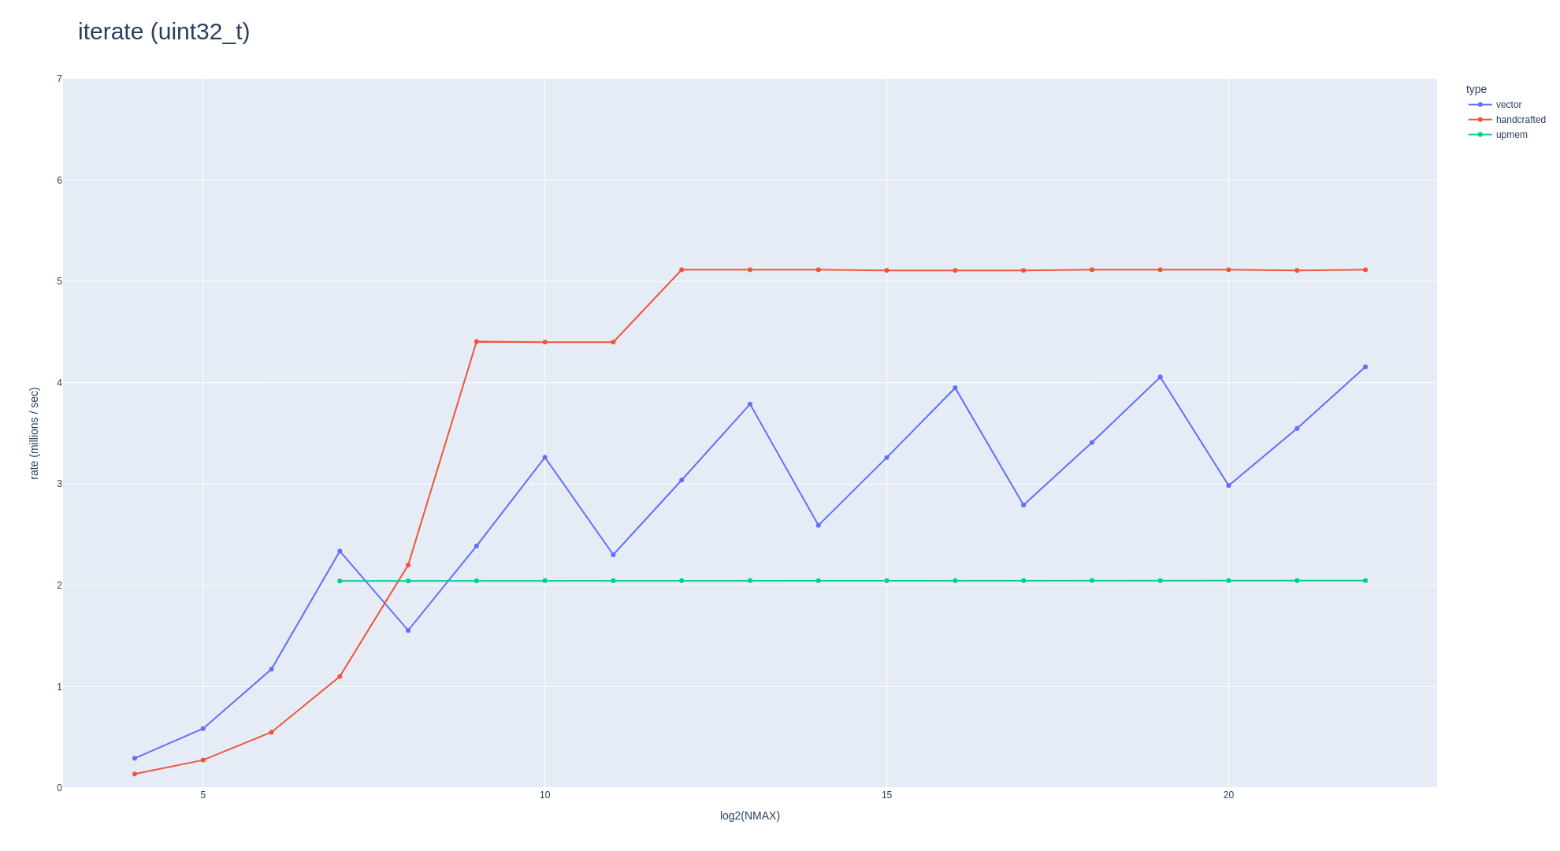
Benchmark: iterate (increasing)

Slide 36
Benchmark: iterate with [ ] (increasing)
void vector_iterate ()
{
bpl::core::vector <type, Allocator> vec;
for (uint32_t n=0; n<NMAX; n++) { vec.push_back (type(n)); }
uint64_t result=0;
for (uint32_t n=0; n<NMAX; n++) { result += vec[n]; }
}
type __mram_noinit big [NMAX];
void handcrafted_iterate ()
{
__dma_aligned type input[BUFFER];
for (uint32_t n=0; n<NMAX; n+=BUFFER)
{
for (uint32_t i=0; i<BUFFER; i++) { input[i] = type(n+i); }
mram_write (input, (__mram_ptr void *) ( (type*)big + n), sizeof(input));
}
uint64_t result=0;
for (uint32_t n=0; n<NMAX; n+=BUFFER)
{
mram_read ((__mram_ptr void *) ( (type*)big + n), input, sizeof(input));
for (uint32_t i=0; i<BUFFER; i++) { result += input[i]; }
}
}
void upmem_iterate ()
{
for (uint32_t n=0; n<NMAX; n++) { big[n] = type(n); }
uint64_t result=0;
for (uint32_t n=0; n<NMAX; n++) { result += big[n]; }
}

Slide 37
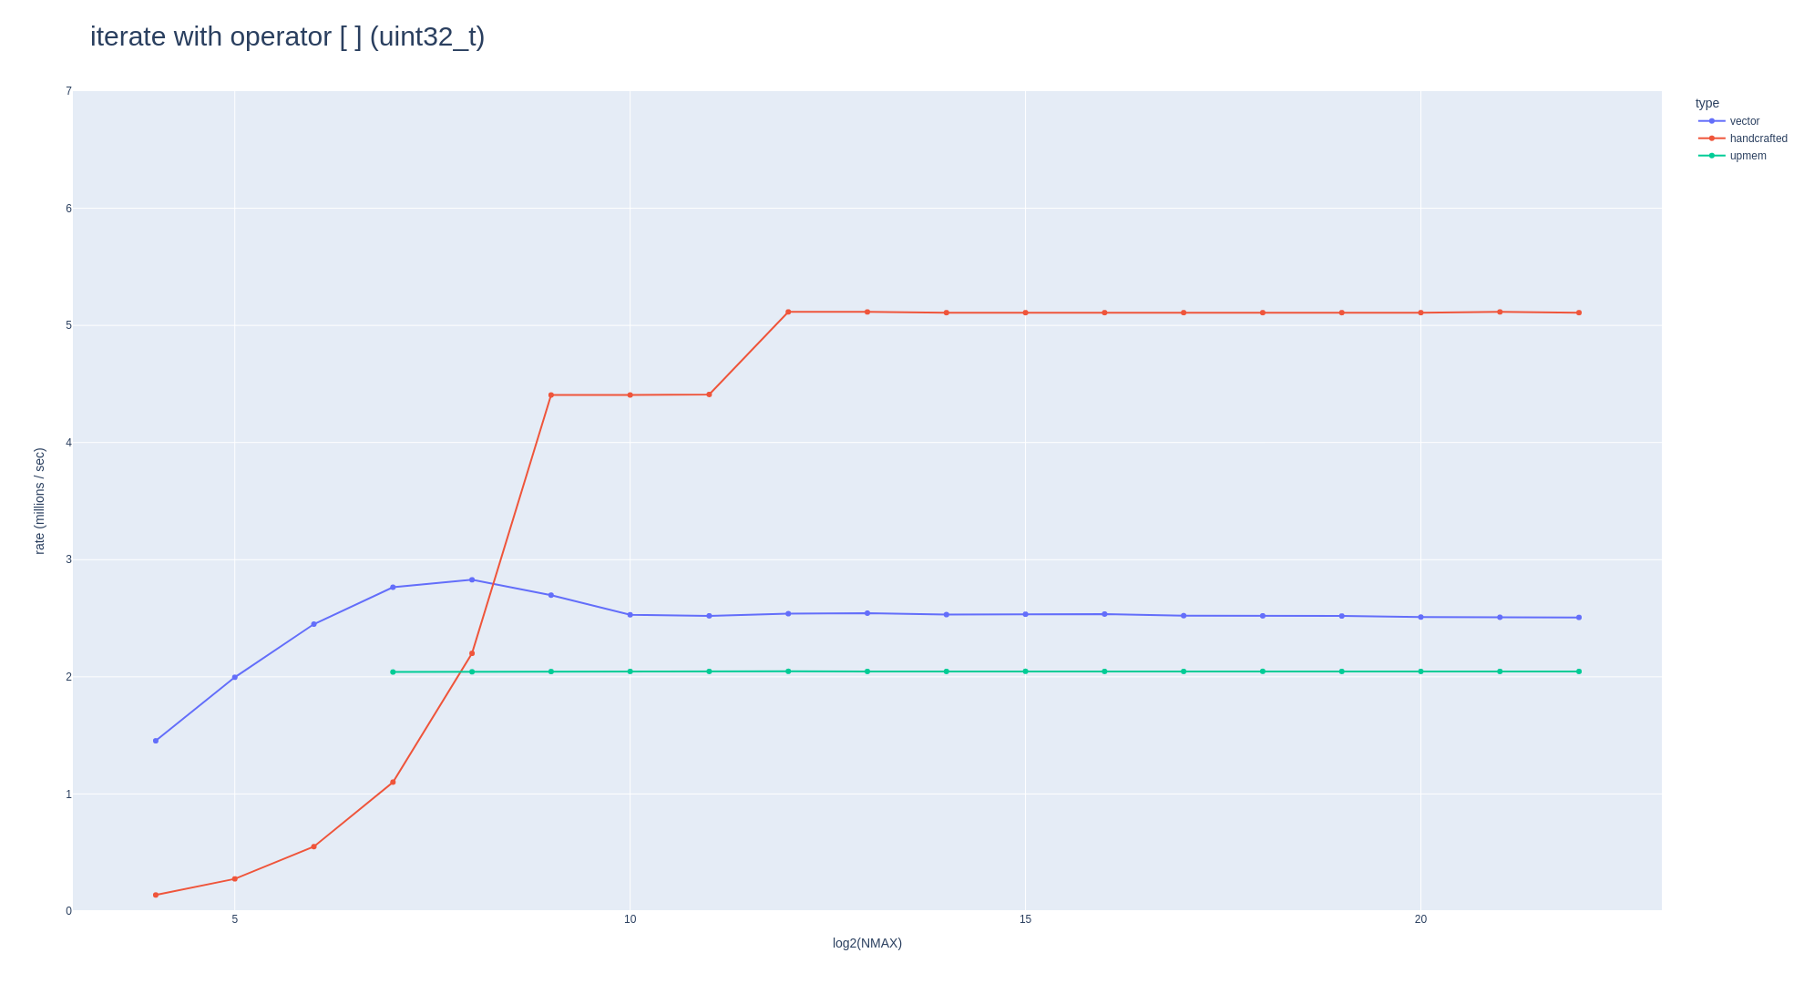
Benchmark: iterate with [ ] (increasing)

Slide 38
i3
0
i2
0
1
2
3
i1
0
1
2
3
0
1
2
3
0
1
2
3
0
1
2
3
i0
0
1
2
3

