Slide 1




Dealing with Data with the Digital Research Services
Dealing with Data | School of Biological Sciences
Dr André Vieira | Research Facilitator, CSE

Slide 2


INTRODUCTION
How can the DRS help?
We act as a focal point for all the data and computing services available to researchers at the UoE.
Dr André Vieira | Research Facilitator, CSE

Slide 3
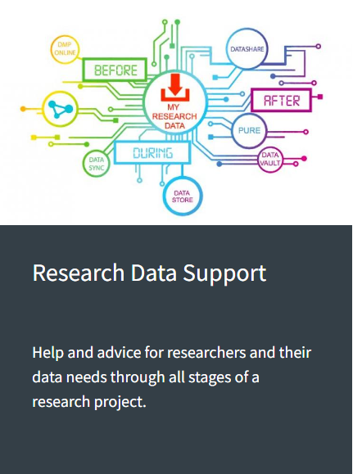





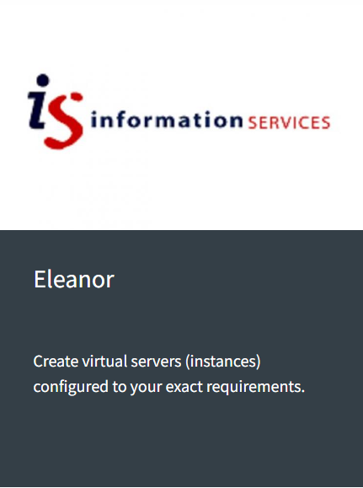
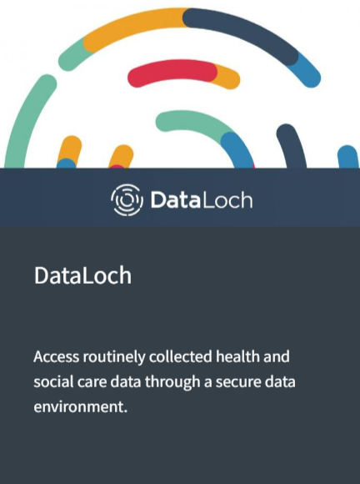




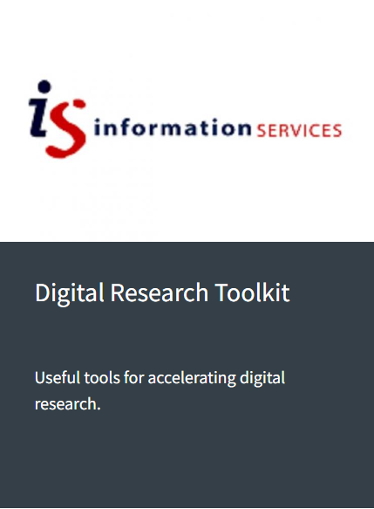




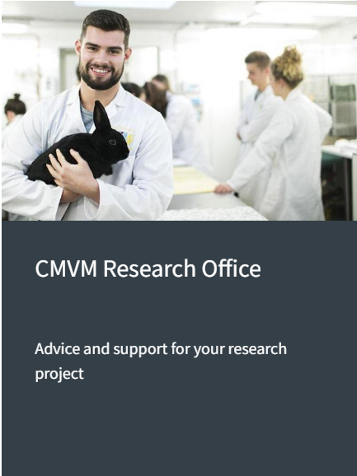
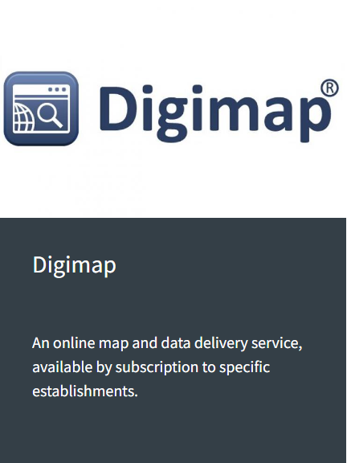
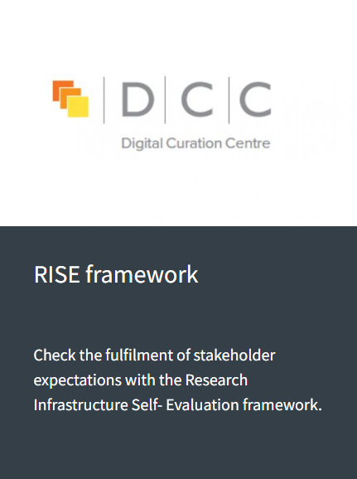





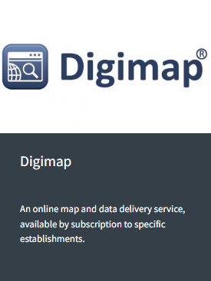



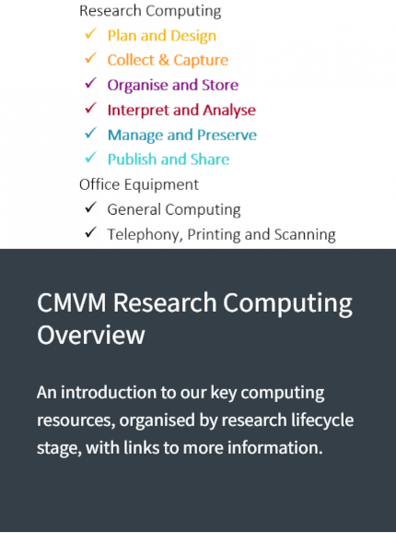


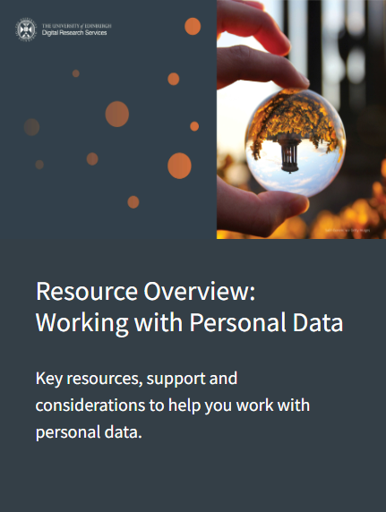


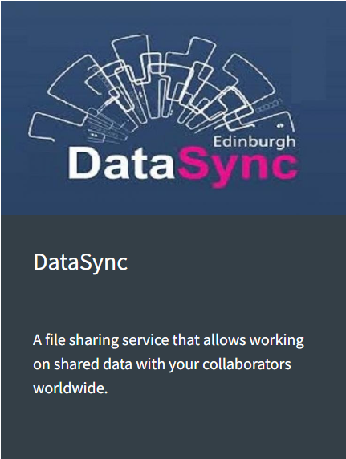



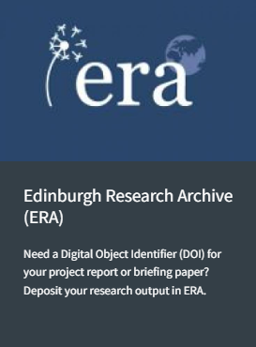
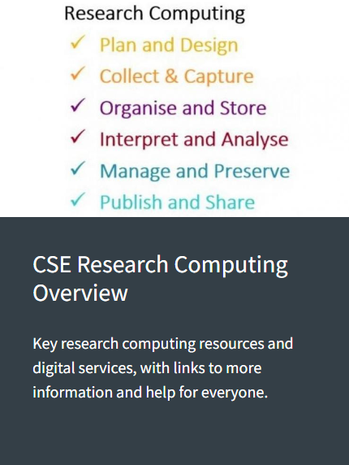

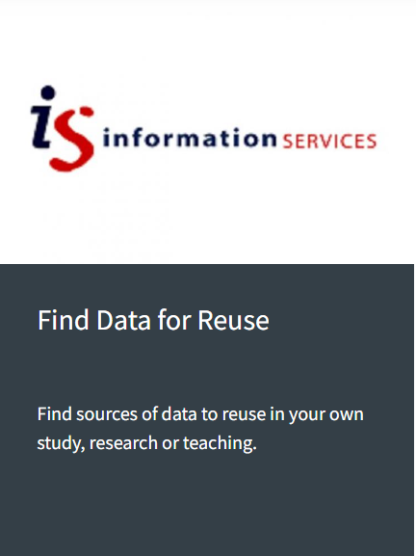


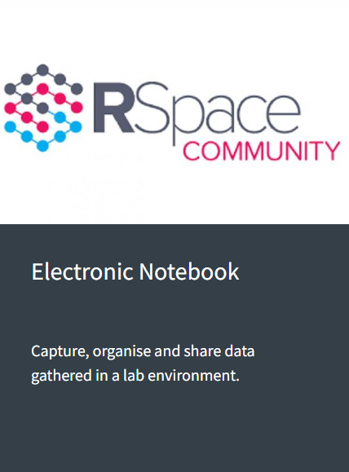

Slide 4

DIGITAL RESEARCH SERVICES
7.
Discover
and Re-use
1.
Plan
and Design
2.
Collect
and Capture
6.
Publish
and Share
3.
Organise
and Store
5.
Manage
and Preserve
4.
Interpret
and Analyse
Dr André Vieira | Research Facilitator, CSE

Slide 5
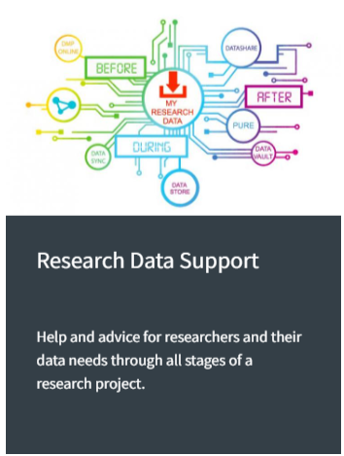

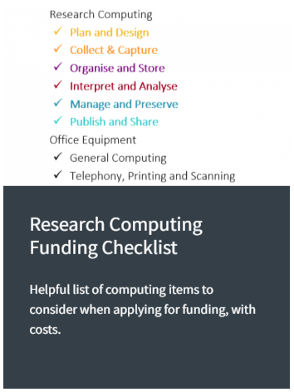

DIGITAL RESEARCH SERVICES
1.
Plan
and Design
Dr André Vieira | Research Facilitator, CSE

Slide 6


DIGITAL RESEARCH SERVICES
2.
Collect
and Capture
Dr André Vieira | Research Facilitator, CSE

Slide 7

DIGITAL RESEARCH SERVICES
3.
Organise
and Store
Dr André Vieira | Research Facilitator, CSE

Slide 8


DIGITAL RESEARCH SERVICES
4.
Interpret
and Analyse
Dr André Vieira | Research Facilitator, CSE

Slide 9

DIGITAL RESEARCH SERVICES
5.
Manage
and Preserve
Dr André Vieira | Research Facilitator, CSE

Slide 10


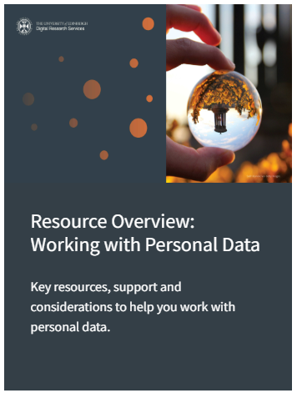


DIGITAL RESEARCH SERVICES
6.
Publish
and Share
Dr André Vieira | Research Facilitator, CSE

Slide 11

DIGITAL RESEARCH SERVICES
7.
Discover
and Re-use
Dr André Vieira | Research Facilitator, CSE

Slide 12
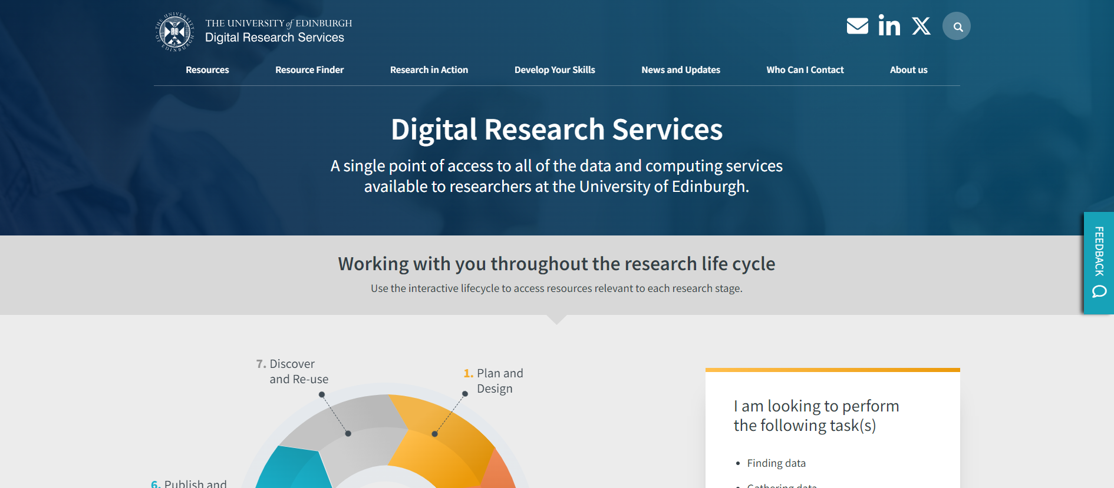

Slide 13









KEEP IN TOUCH
https://mlist.is.ed.ac.uk/lists/subscribe/digitalresearch
https://uoe.sharepoint.com/sites/DRSFacilitation
https://www.digitalresearchservices.ed.ac.uk/
https://www.linkedin.com/company/DRS_UoE
digitalresearchservices@ed.ac.uk
https://www.instagram.com/drs_uoe/
https://linktr.ee/digitalresearchservices

Slide 14
Dealing with Data with the Digital Research Services
Dealing with Data | School of Biological Sciences
Dr André Vieira | Research Facilitator, CSE

