Slide 1
Single-molecule and bulk experiments mEos4b red form
23/08/2017

Slide 2
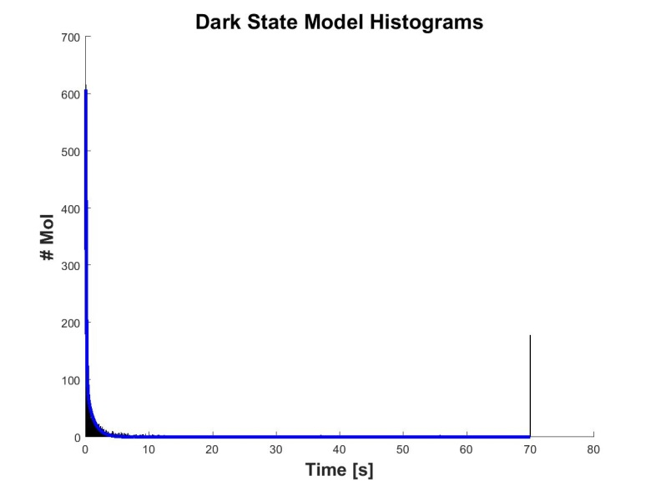
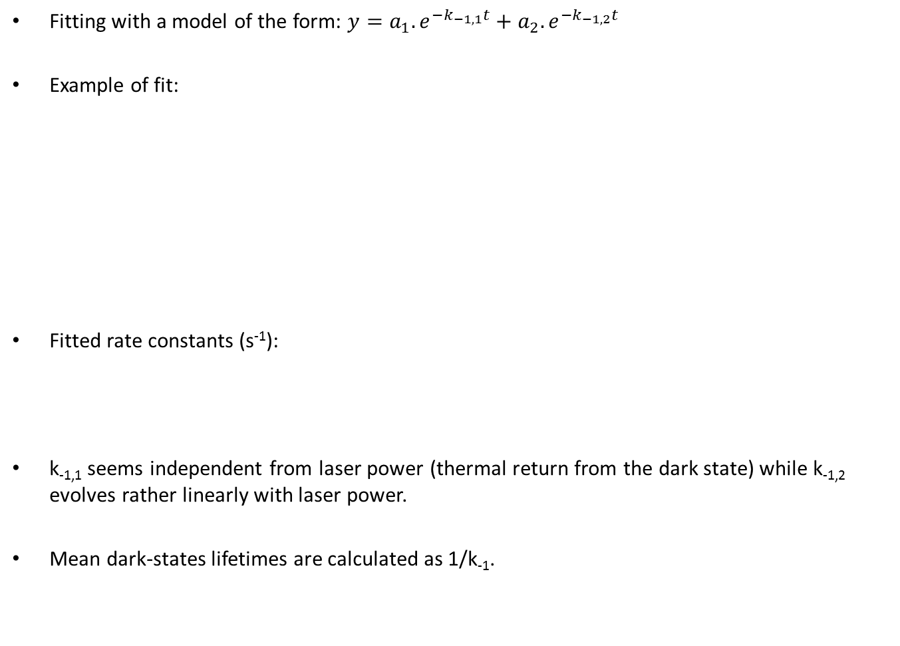
Single-molecule experiments
Fitting with a model of the form: $y=a_{1}.e^{−k_{−1,1}t}+a_{2}.e^{−k_{−1,2}t}$
Example of fit:
Fitted rate constants (s⁻¹):
k_{-1,1} seems independent from laser power (thermal return from the dark state) while k_{-1,2} evolves rather linearly with laser power.
Mean dark-states lifetimes are calculated as 1/k₋₁.
 | Mean lifetimes (s)
Laser power (mW) | D1 | D2
15,4 | 0,07 | 1,4
7,9 | 0,08 | 1,8
3,9 | 0,07 | 3,0
Laser power (mW) | Mean k-1, 1 | SD k-1, 1 | Mean k-1, 2 | SD k-1, 2
15,4 | 13,7 | 1,3 | 0,74 | 0,02
7,9 | 12,2 | 0,6 | 0,55 | 0,12
3,9 | 15,0 | 2,0 | 0,33 | 0,00

Slide 3
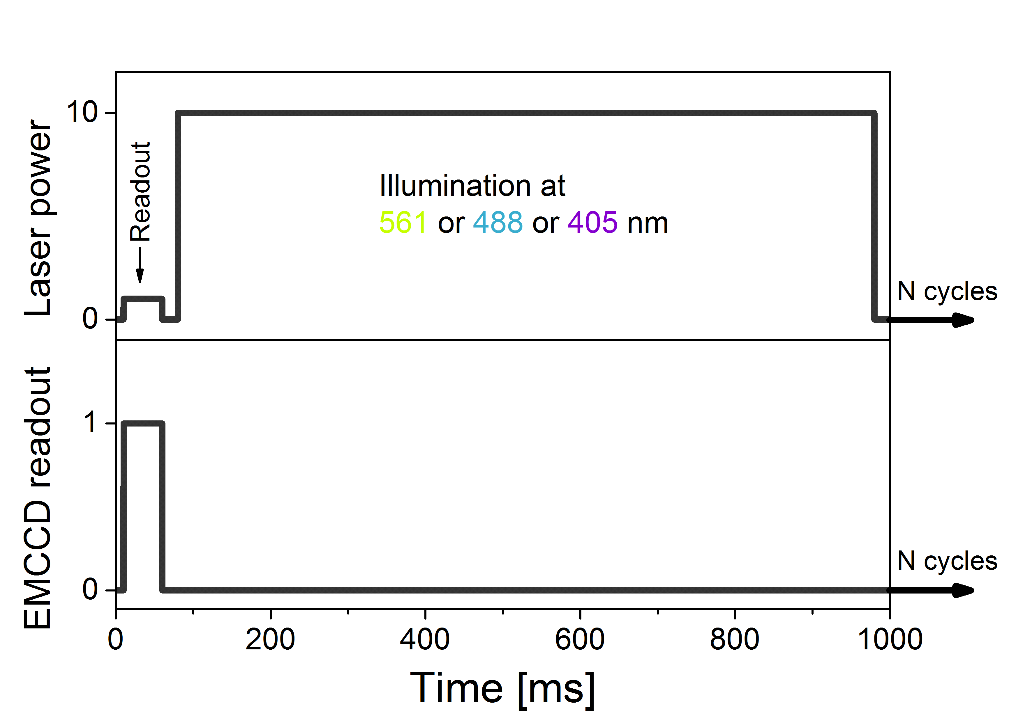
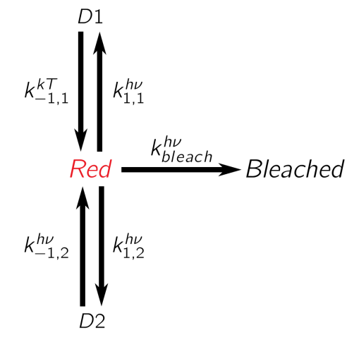
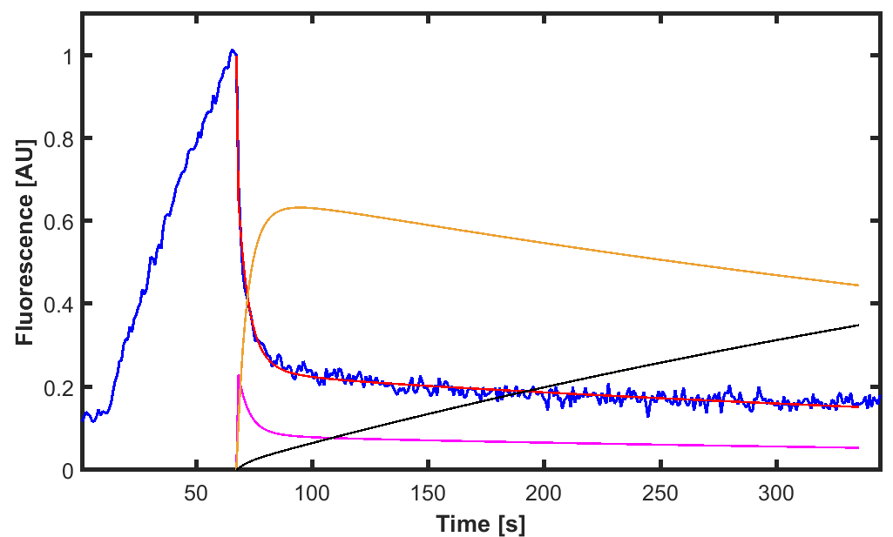
Bulk experiments
Experimental procedure: fluorescence readout and actinic 405- or 561-nm light are applied separately:
Fitting with a kinetic model: (k_{-1,1} is fixed to the mean value of single-molecule experiments)
Example of fit:
Red: red form
Black: bleached
Magenta: D1 (with rates k_{1,1} and k_{-1,1})
Orange: D2 (with rates k_{1,2} and k_{-1,2})

Slide 4
Bulk experiments
Fitted rate constants (s⁻¹):
Laser power (µW) | Mean k-1, 2 | SD k-1, 2
158 | 0,063 | 0,011
81 | 0,037 | 0,002
40,5 | 0,025 | 0,003
14,5 | 0,013 | 0,001
Laser power is much lower than in single-molecule, otherwise the decay is too short to be fitted properly.
Power dependence seems ok.
 | Mean lifetime (s)
Laser power (µW) | D2
158 | 16
81 | 27
40,5 | 40
14,5 | 77

Slide 5
Coherence between bulk and single-molecule experiments
Single-molecule
Mean k_{-1,1} (thermal): 13,6 s⁻¹
After correction of bulk rates for laser power:
There is roughly a factor 10 between k_{-1, 2} determined in single-molecule and in ensemble.
  I think single-molecule experiments are very sensitive to the signal-to-noise ratio, whereas it’s not so important in bulk experiments. This might explain the difference in k_{-1,2}? In which case, the rates determined in bulk measurement would be more reliable than in single-molecule.
  Second hypothesis is that the rate does not evolve linearly anymore if laser power is too low, but I see no reason for this?
Bulk
k_{-1,1} fixed to 13,6 for fitting
Laser power (mW) | Mean k-1, 1 | Mean k-1, 2
15,4 | 13,7 | 0,74
7,9 | 12,2 | 0,55
3,9 | 15,0 | 0,33
Laser power (µW) | Mean k-1, 2
158 | 0,063
81 | 0,037
40,5 | 0,025
14,5 | 0,013
Laser power (mW) | k-1, 1 Single-mol | k-1, 2 Single-mol | k-1, 1 Bulk (fixed) | k-1, 2 Bulk
15,4 | 13,7 | 0,74 | 13,6 | 6,14
7,9 | 12,2 | 0,55 | 13,6 | 3,61
3,9 | 15,0 | 0,33 | 13,6 | 2,41
1,5 | ND | ND | 13,6 | 1,30

Slide 6
Bulk experiments mEos4b green form

Slide 7
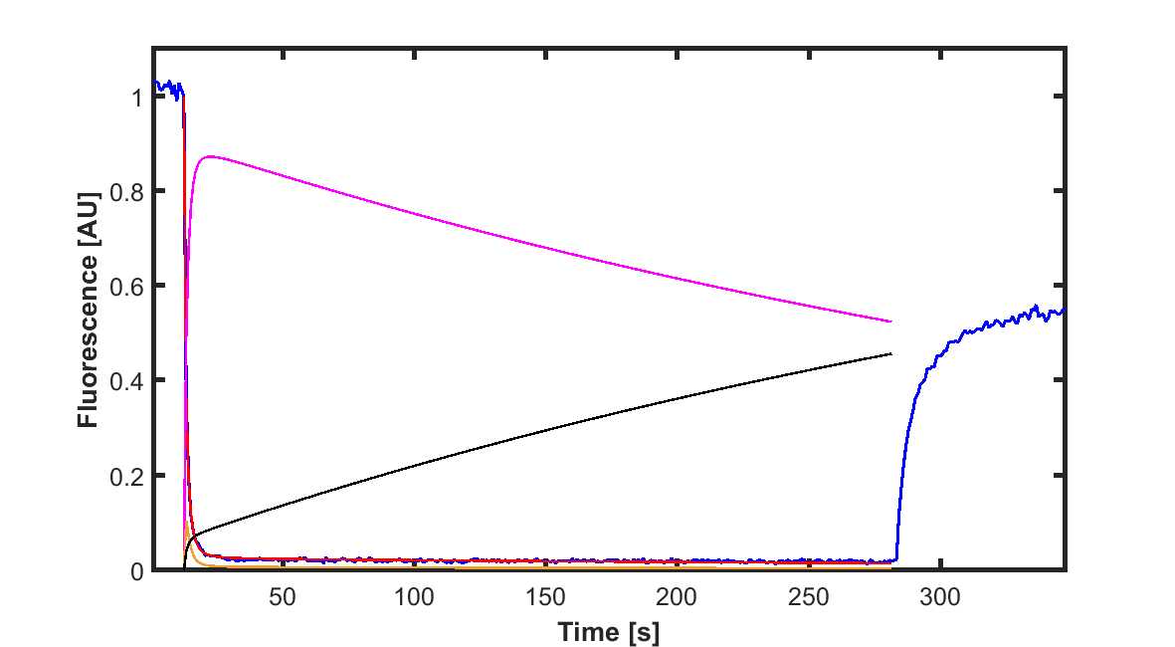
Bulk experiments (green mEos4b)
Laser wavelength: 488 nm
Fitted rate constants (s⁻¹):
Example of 488-nm switching + 405-nm recovery
Laser power (µW) | Mean km1 | SD km1 | Mean km1_2 | SD km1_2
165 | 0,024 | 0,002 | 1,003 | 0,295
85 | 0,015 | 0,001 | 0,570 | 0,046
44 | 0,008 | 0,000 | 0,363 | 0,055
 | Mean dark-states lifetimes (s)
Laser power | D1 | D2
165 | 41 | 1,0
85 | 65 | 1,8
44 | 120 | 2,8
488 nm 165 µW
405 nm 0.25 µW

