Slide 1
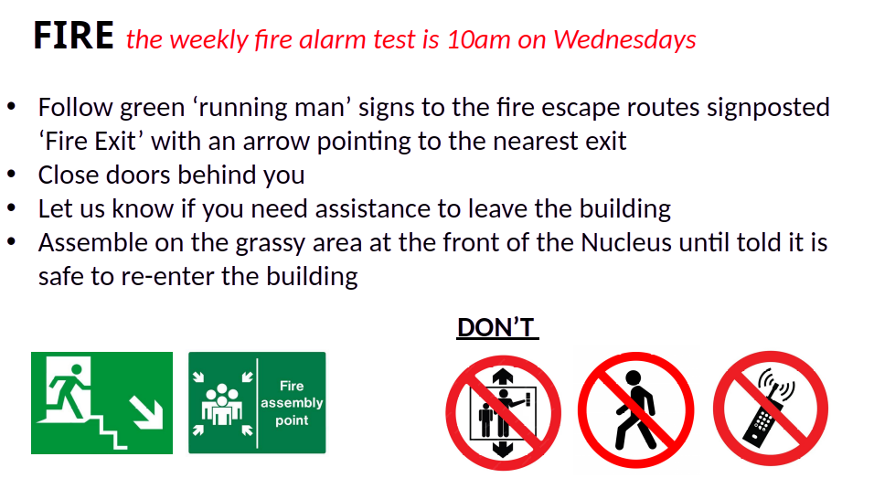
Tuesdays

Slide 2
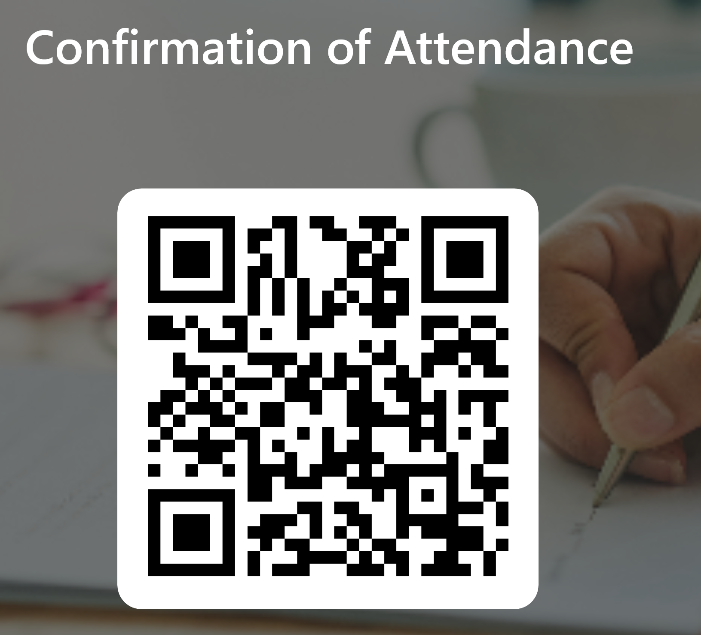
Please confirm your attendance here (for Graduate school):

Slide 3



BioRDM
Biological Research Data Management Team
Welcome to
Dealing With Data
SBS PhD Induction – October 2026
Livia Scorza – BioRDM Data team lead
Daniel Thédié – BioRDM Research software specialist
Juliana Rodríguez Cubillos – BioRDM PhD Candidate: AI / metadata
bio_rdm@ed.ac.uk

Slide 4

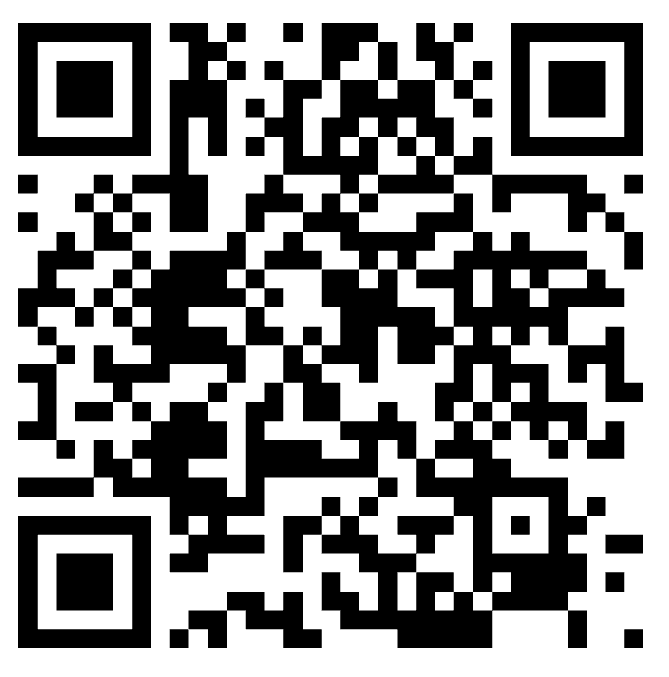


Slide 5

Why are we here?
Your data, your responsibility
Learn how to manage data so you and others can:
Find your data easily when needed
Understand what you did in the past and reproduce if needed
Avoid data loss and duplicated data
Have datasets that are ready to publish
Data must be available to all
Publish data that is reproducible and reusable

Slide 6

Course overview
Open Science and FAIR principles
Collecting FAIR data
Managing Interoperable data
Managing FAIR data records
Planning ahead: writing a DMP
Data-related resources at the University

Slide 7


Materials
BioRDM/SBS-PhD-Induction-Dealing_with_data/2026

Slide 8
Open Science and FAIR principles
Sharing research data as a goal

Slide 9
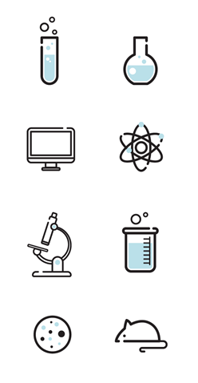
FAIR
framework
What is data?
Biological data is diverse!
Data can be defined as facts, figures, or information that is collected, used and stored for reference or analysis
Information about physical samples:
animal/ plant (live, cell cultures, frozen tissues, etc)
patient information
bacterial / yeast stocks
Quantitative / numerical data: Spreadsheets (tables), csv files
Images (pictures, microscopy images, 3D scans)
Code (Software programs, analysis codes, algorithms)
DNA, RNA, protein sequences (plasmids, NGS sequencing files, etc)
Protocols (recipes, laboratory and measurement protocols)
Designed by Anindyanfitri / Freepik

Slide 10
Open Science
FAIR
framework
Open science is the movement to make scientific research outputs
accessible to all levels of society
general public
amateurs
professionals
students
teachers
Publications
Datasets
Software / code
Metadata
Digital technologies for diffusing knowledge
Notes:
Removed physical samples, added metadata
Policies on OS normally do not apply to physical samples

Slide 11
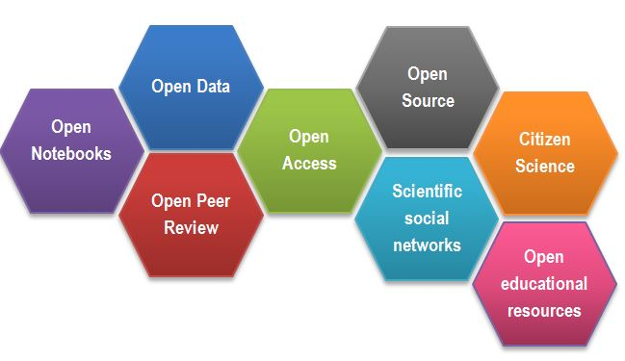

Open Science
FAIR
framework
As Open as Possible, as Closed as Necessary
Publicly funded data should be shared with minimal restrictions
Exceptions
Sensitive data
IP
CREDITS Open Science facets as a beehive by Gema Bueno de la Fuente licenced under CC-BY

Slide 12
Common Issues in Data Sharing
FAIR
framework
No numerical data available / only averages
Incomplete datasets
No / little supporting information about the data
Vendor-specific file formats.
Links to non-existing group websites/databases.
Data / Code “on request”.
Data available but not reusable!
Notes:
Removed data tables as pdf as this is probably not a reality anymore. Added incomplete datasets
Added: incomplete supporting information about the data

Slide 13

FAIR
framework
Wilkinson et al. The FAIR Guiding Principles for scientific data management and stewardship. Sci Data 3, 160018 (2016). https://doi.org/10.1038/sdata.2016.18

Slide 14

FAIR principles
FAIR
framework
Findable:
Data must be easily findable by humans and computers
  Datasets must be deposited in a data repository and have a persistent identifier (DOI)
Accessible:
Data must be easily retrieved
Metadata (data description) available even when the data are not
Interoperable:
Allow integration with other data
Data must be saved in open/common format (interpretable for various tools)
Re-usable:
data should be well-described so that they can be replicated and/or combined in different settings
conditions of the reuse should be stated with a clear license
Notes:
The first step in (re)using data is to find them.
Once the user finds the required data, she/he/they need to know how they can be accessed, possibly including authentication and authorisation.
The data usually need to be integrated with other data.
The ultimate goal of FAIR is to optimise the reuse of data. To achieve this, metadata and data should be well-described so that they can be replicated and/or combined in different settings.

Slide 15

How can you achieve FAIR data?
FAIR
framework
Reusability
Interoperability
Well-described, organised, and standardised datasets
Notes:
As students, how can you work to achieve FAIR data? While working, our focus will be on collecting and analysing data and reusable and interoperable way

Slide 16

Collecting FAIR data
Making Interoperable and Reusable and data records
Metadata
File Naming
Data Structure
Notes:
Managing findable data or Managing data to make it findable?
Persistent identifiers (PID)
Rich metadata! (but this is also related to Reusable)

Slide 17
Collecting FAIR data
Metadata

Slide 18

Collecting FAIR data
What is metadata?
Metadata is the data about data!
Description/information of the data
DATA
The data has little or no meaning without metadata
METADATA
It should be continuously added to your research data
(not just at the beginning or end of a project!)
Metadata plays a significant role in making your data FAIR.
“Iceberg image designed by pikisuperstar / Freepik"

Slide 19
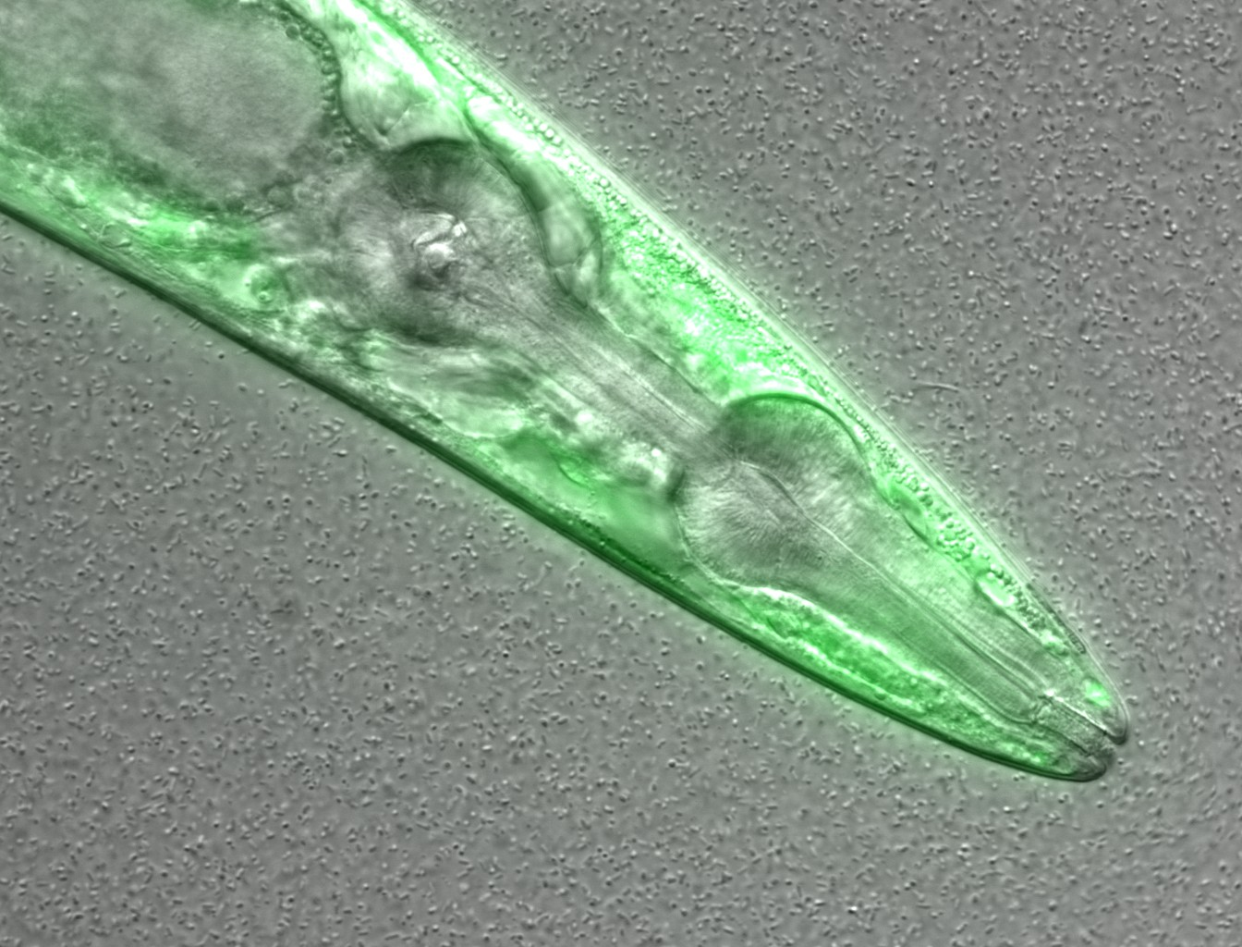
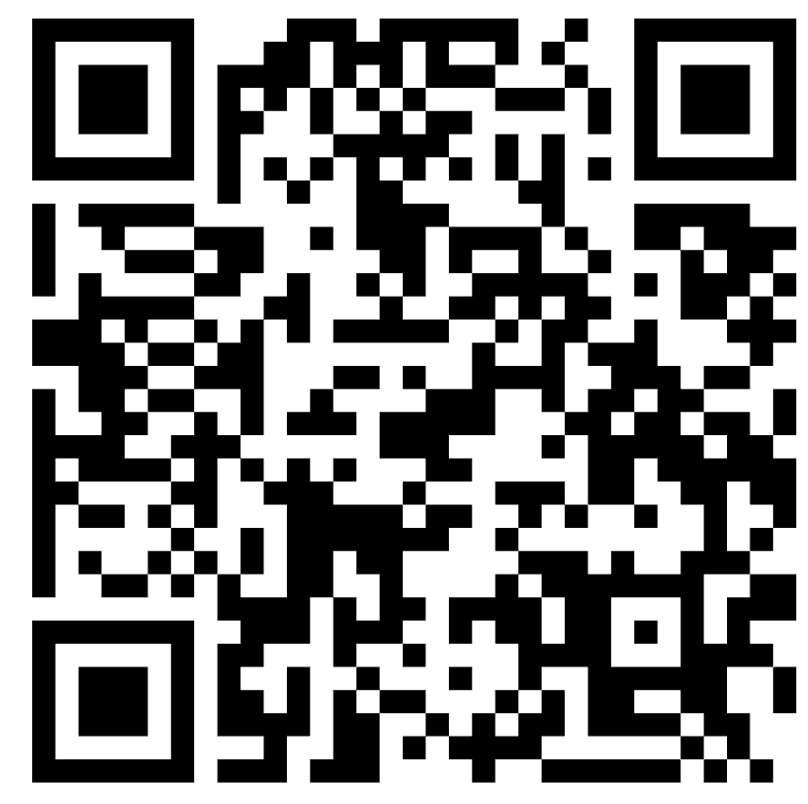

Collecting FAIR data
What information would you need to re-use this data?
Figure credits: María Eugenia Goya
Notes:
Image metadata
Name: OP50 D10Ad_06.czi Image ID: 3485 Owner: Maria Eugenia Goya ORCID: 0000-0002-5031-2470
Acquisition Date: 2018-12-12 17:53:55 Import Date: 2020-04-30 22:38:59 Dimensions (XY): 1344 x 1024 Pixels Type: uint16 Pixels Size (XYZ) (µm): 0.16 x 0.16 x 1.00 Z-sections/Timepoints: 56 x 1 Channels: TL DIC, TagYFP ROI Count: 0
Tags: time course; day 10; adults; food switching; E. coli OP50; NL5901; C. elegans
Dataset metadata
Name: Figure2_Figure2B Dataset ID: 263 Owner: Maria Eugenia Goya ORCID: 0000-0002-5031-2470
Description: The datasets contains a time course of α-syn aggregation in NL5901 C. elegans worms after a food switch at the L4 stage:
E. coli OP50 to OP50 Day 01 adults Day 03 adults Day 05 adults Day 07 adults Day 10 adults Day 13 adults
E. coli OP50 to B. subtilis PXN21 Day 01 adults Day 03 adults Day 05 adults Day 07 adults Day 10 adults Day 13 adults
Images were taken at 6 developmental timepoints (D1Ad, D3Ad, D5Ad, D7Ad, D10Ad, D13Ad)
* Some images contain more than one nematode.
Each image contains ~30 (or more) Z-sections, 1 µmeters apart. The TagYFP channel is used to follow the alpha-synuclein particles. The TL DIC channel is used to image the whole nematode head.
These images were used to construct Figure 2B of the Cell Reports paper (https://doi.org/10.1016/j.celrep.2019.12.078).
Creation date: 2020-04-30 22:16:39
Tags: protein aggregation; time course; E. coli OP50 to B. subtilis PXN21; food switching; E. coli OP50; 10.1016/j.celrep.2019.12.078; NL5901; C. elegans

Slide 20
Collecting FAIR data
Metadata
Think as a consumer of your data, not the producer!
What information would another researcher need to understand or reproduce your data?
Name of data creator/ Title
Project purpose and experimental hypothesis
Biological material, context, details on data acquisition, experimental conditions, etc.
+ Other datasets and publications associated with this image/ dataset (DOIs, links, etc).

Slide 21
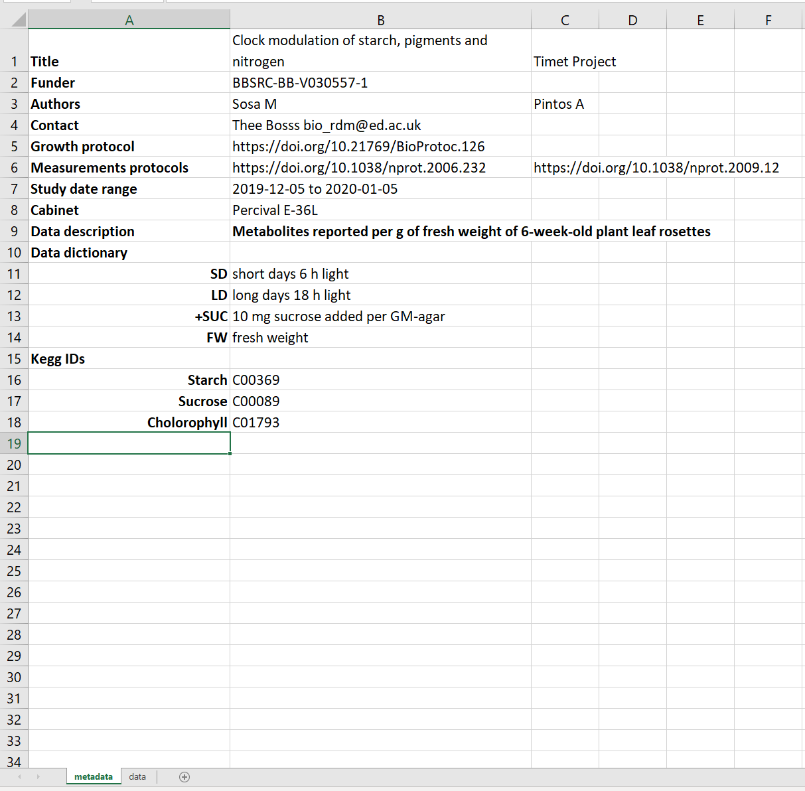

Collecting FAIR data
Metadata
Metadata in Excel
Notes:
KEGG ID is an identifier used in the Kyoto Encyclopedia of Genes and Genomes (KEGG), a comprehensive database that connects biological pathways, genes, compounds, diseases, and drugs

Slide 22
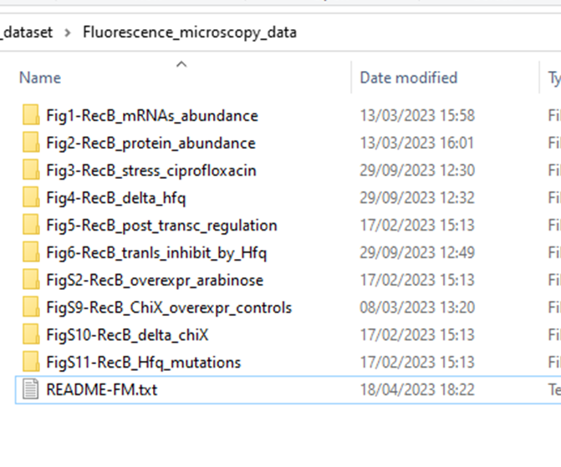

Collecting FAIR data
Metadata
Metadata in README files

Slide 23
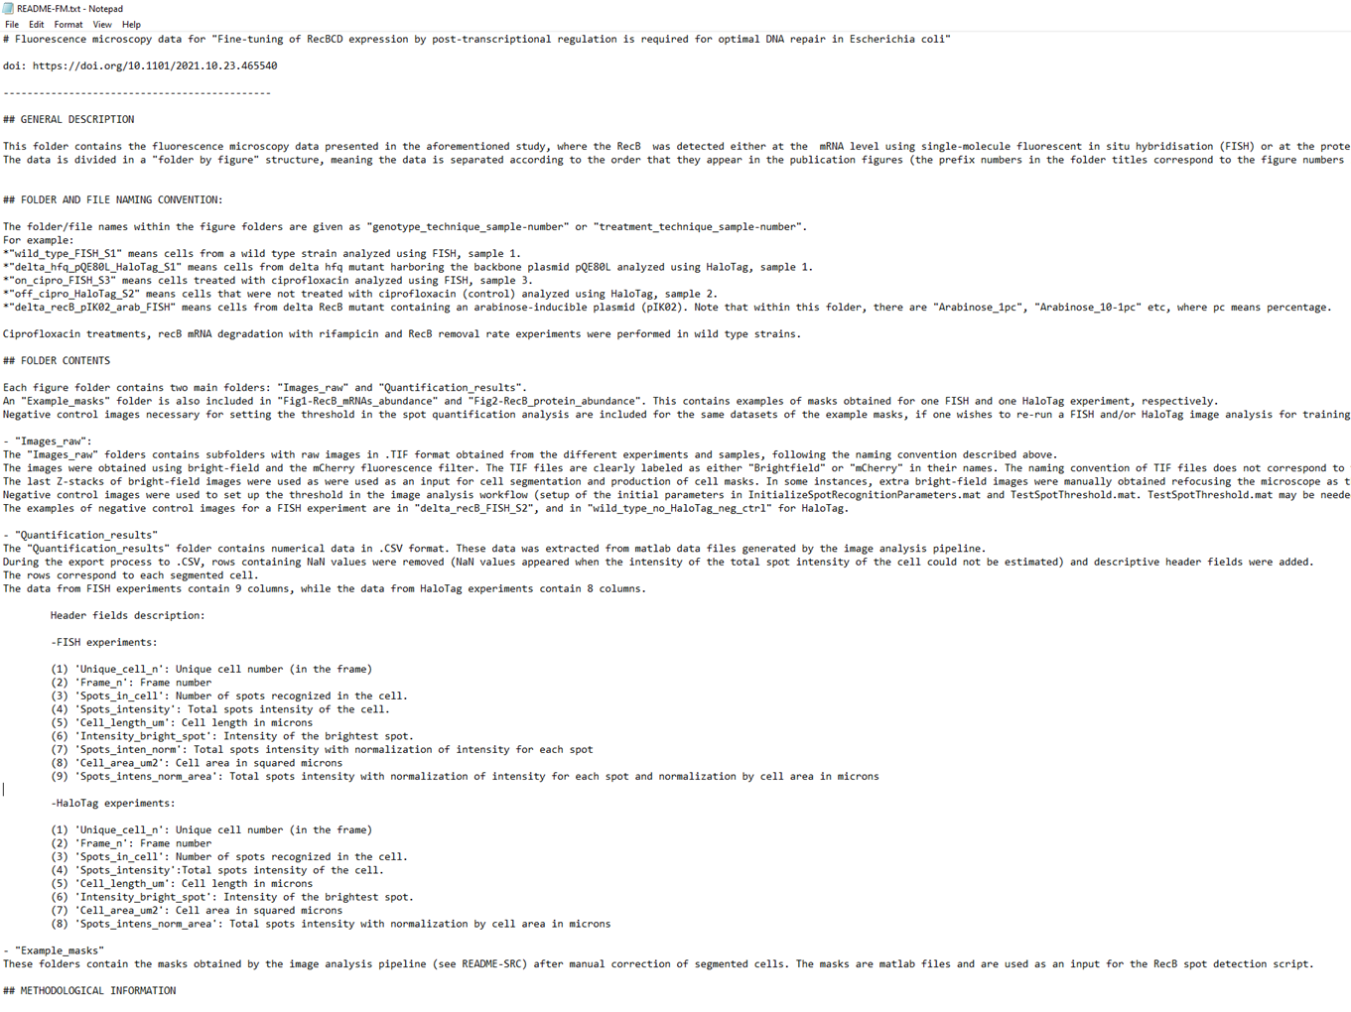
Collecting FAIR data
README files
Notes:
README files should be together with metadata.

Slide 24
Collecting FAIR data
File Naming

Slide 25
File Naming
Collecting FAIR data
Naming + Organisation Goals
Standardised Naming Conventions are…
Find files quickly
Ability to tell the file content without opening it
Consistent.
Encoding of experimental factors.
Meaningful to you and your collaborators.
Give you a sense of the content.
Easily identify if something is missing.

Slide 26

File Naming
Collecting FAIR data
File names include:
Date → ISO format: YYYY-MM-DD or YYYYMMDD (e.g. 20241106)
Version Number → Use leading zeroes (e.g. v005 instead of v5)
Prefix for Numerical Value → e.g. S003, TR005
Add the date at the end of the file UNLESS you organise files chronologically

Slide 27
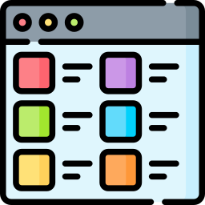
File Naming
Collecting FAIR data
File names include:
Relevant Biological or Experimental Info
e.g.:
Species name, Genotypes, Site, Patient ID, Drug treatments/ Doses, Environmental conditions, Markers, Technique.
Data operation (normalized, cleaned, detrended, clustered)

Slide 28
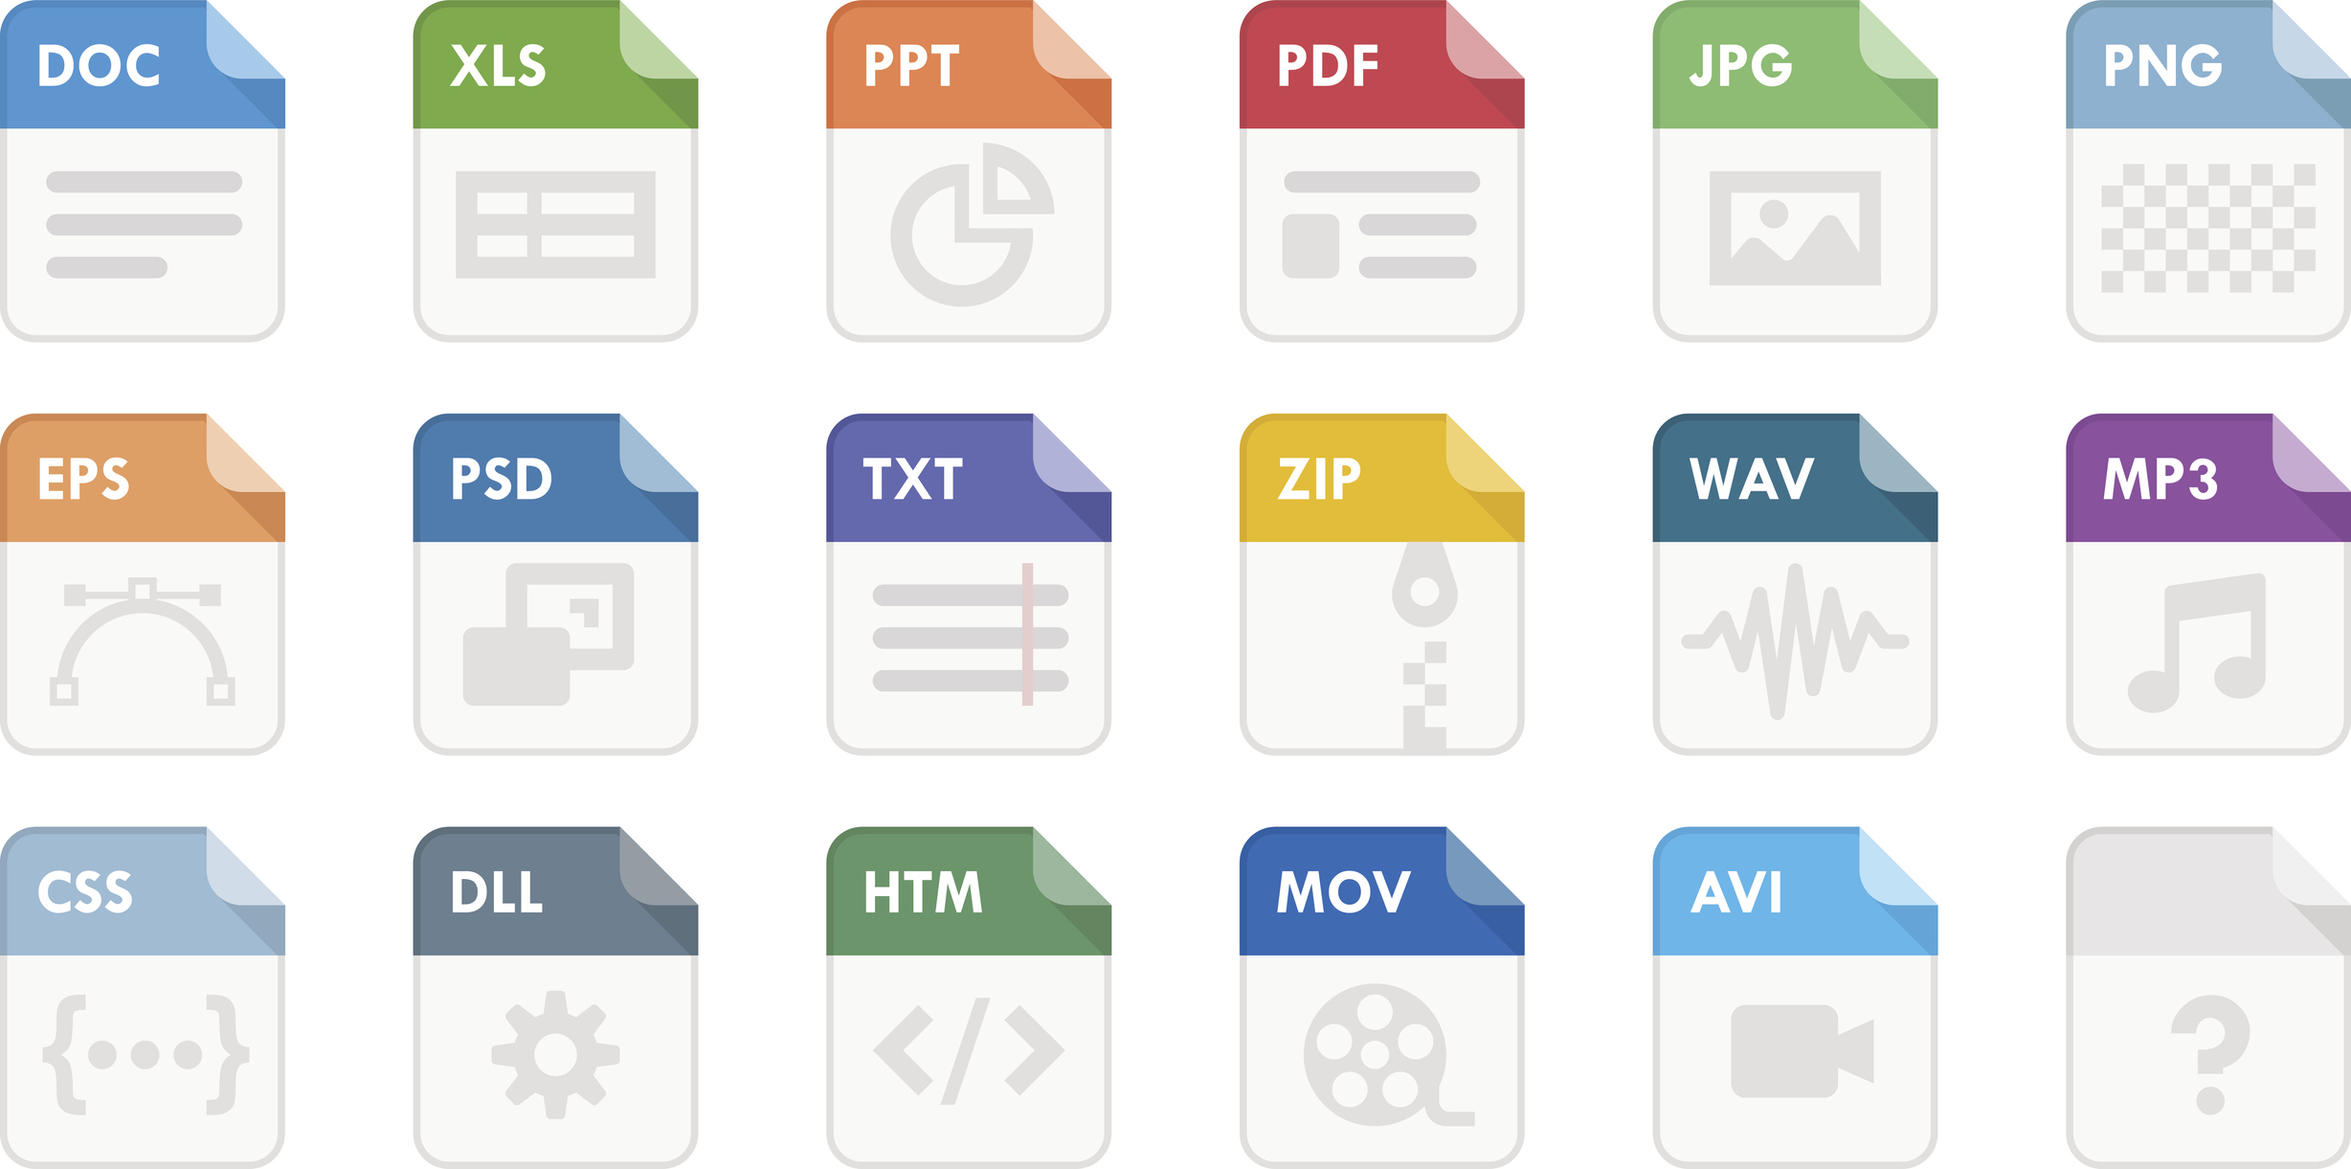
File Naming
Collecting FAIR data
File names include:
File Format Extension → e.g.: .docx, .xlsx, .mov, .tiff
https://dragondatarecovery.co.uk/what-are-file-types-and-how-to-identify-them/

Slide 29

File Naming
Collecting FAIR data
An excellent example:
LD_phyA_off_t04_2020-08-12_norm.xlsx
We know that the file is…
  from an experiment long day (LD).
  for genotype phyA.
  with media without sucrose (off).
  at timepoint 4 (t04).
  normalised data (norm).

Slide 30

File Naming
Collecting FAIR data
Best to avoid the following:
Spaces → use _ or - instead
Commas + Special Characters → e.g. ~ ! @ # $ % < > ?[ ] { } ‘
Language-specific characters → e.g. ó ę ż ï ň ũ
Long names → fewer than 30 characters
Deep Paths with Long Names → i.e. deeply nested folders with long names
Parent Element Info →
ELN_MI_20200101.tiff in Electron_Microscopy folder

Slide 31
Collecting FAIR data
Data Structure

Slide 32
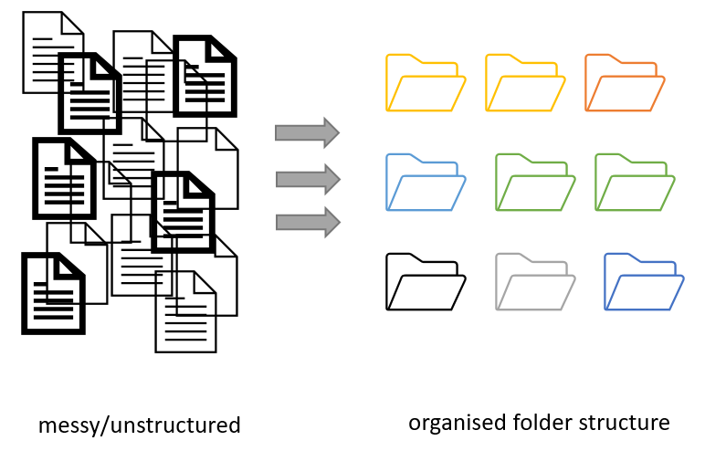
Collecting FAIR data
Project organization
Folders vs Files
Folders permit grouping relevant data together
Folders help to keep files names short
Figure credits: Andrés Romanowski

Slide 33
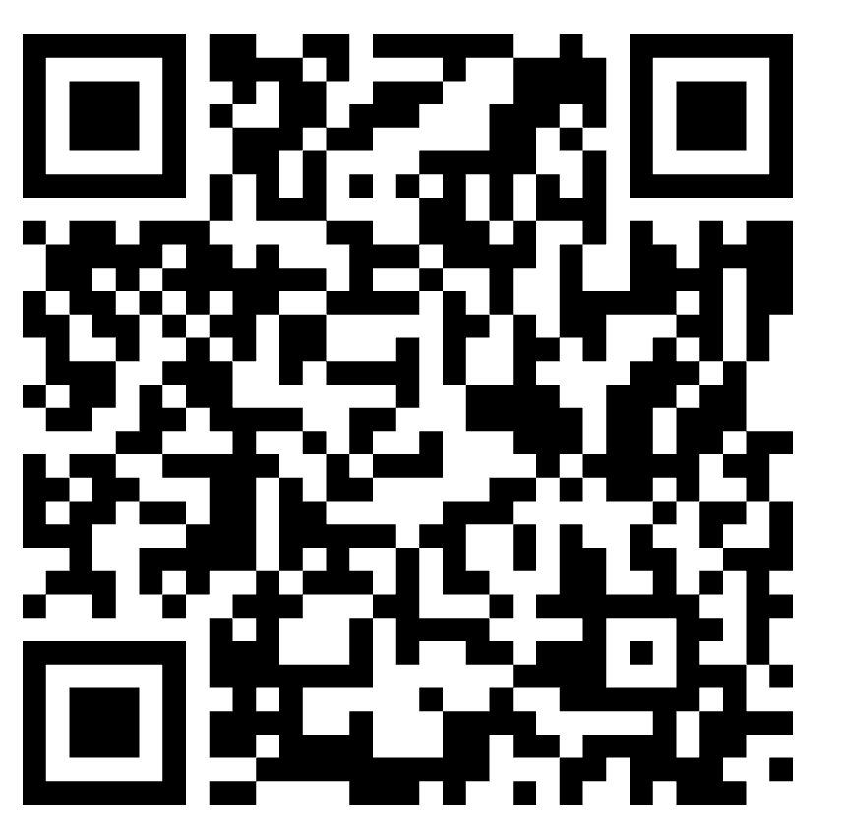

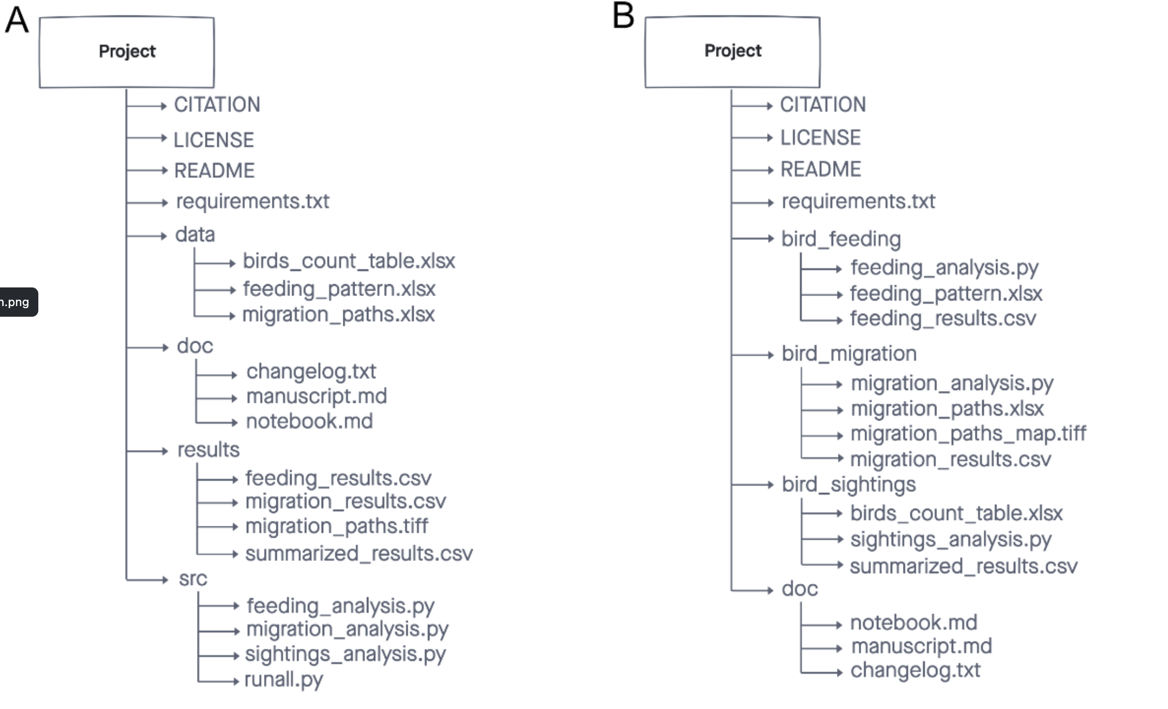
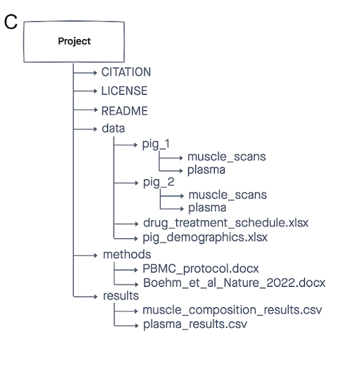
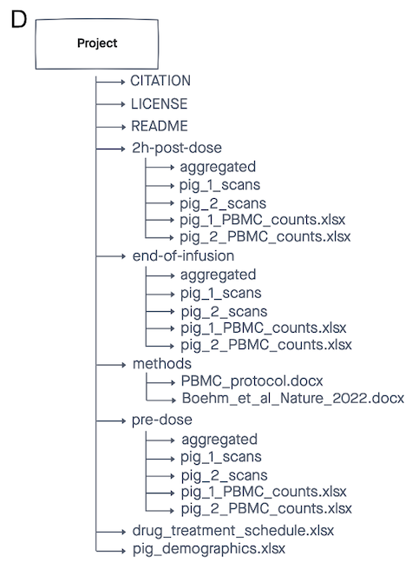
Collecting FAIR data
Project organization
Notes:
Make an exercise to vote which one is good for what

Slide 34
Collecting FAIR data
Project organization
Good enough practice in scientific computing
Organise by analysis or by figure
Brain imaging data structure
Outcomes of experimental conditions
Notes:
Make an exercise to vote which one is good for what

Slide 35
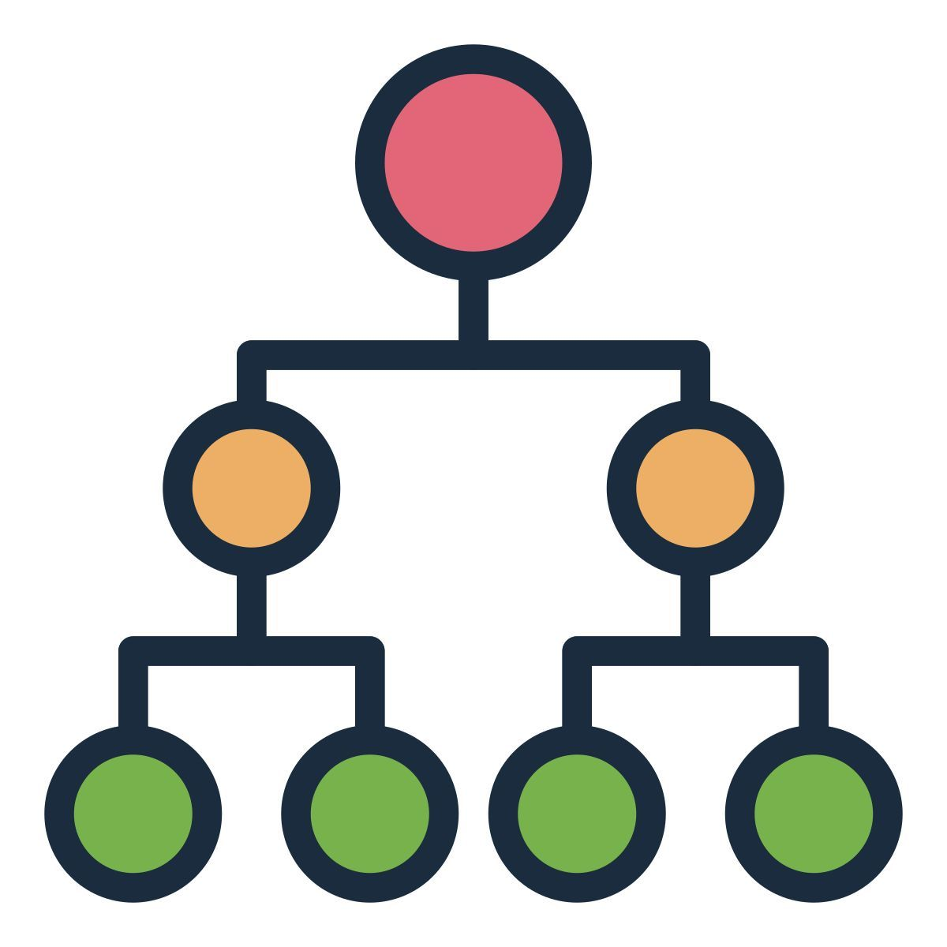
Record your data structure in a README
Collecting FAIR data
Add to your dataset directory
PROJECT_STRUCTURE (README) file → naming convention, directory structure and abbreviations
Metadata in README files

Slide 36
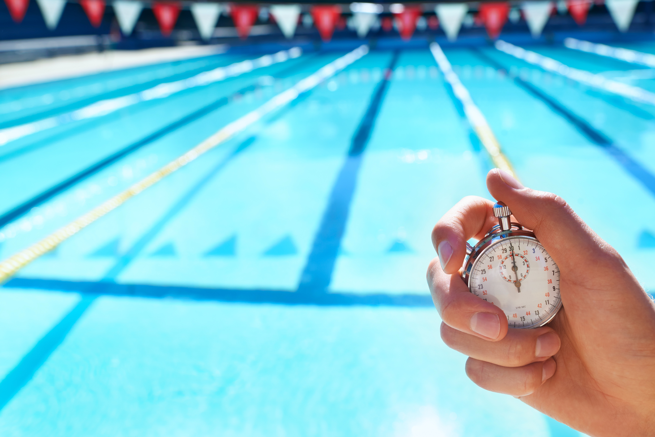
Exercise #1
Collecting FAIR data
Resource: Trainee’s Personal Data Files or Provided Data Files
  Exercise materials
Task A: Edit file names and folder structure according to best practices
Task B: Edit the ReadMe file with the following info:
  Folder description
  Author(s) info
  Description of folder contents
  Naming conventions used
Output: Basic folder stub
Meaningful_name_date.extension
Notes:
Task A – ok
Task B – consider removing

Slide 37

Enduring Understanding
Finding your data and is impacted by file naming, metadata, and folder structure.
(Meta)data that cannot be found cannot be reused or shared
Practical Applications
Understand your own work in 2 years time!
Interlinking data analysis results to original raw datasets
Make it easier to pass on your work when you leave the lab
Make your data sharing-ready

Slide 38

Please confirm your attendance here (for Graduate school):
Break 1
(10 min)

Slide 39
Managing INTEROPERABLE Data
In what ways and why is data interoperability arguably the most complex aspect of FAIR practice?
File Formatting + Types

Slide 40
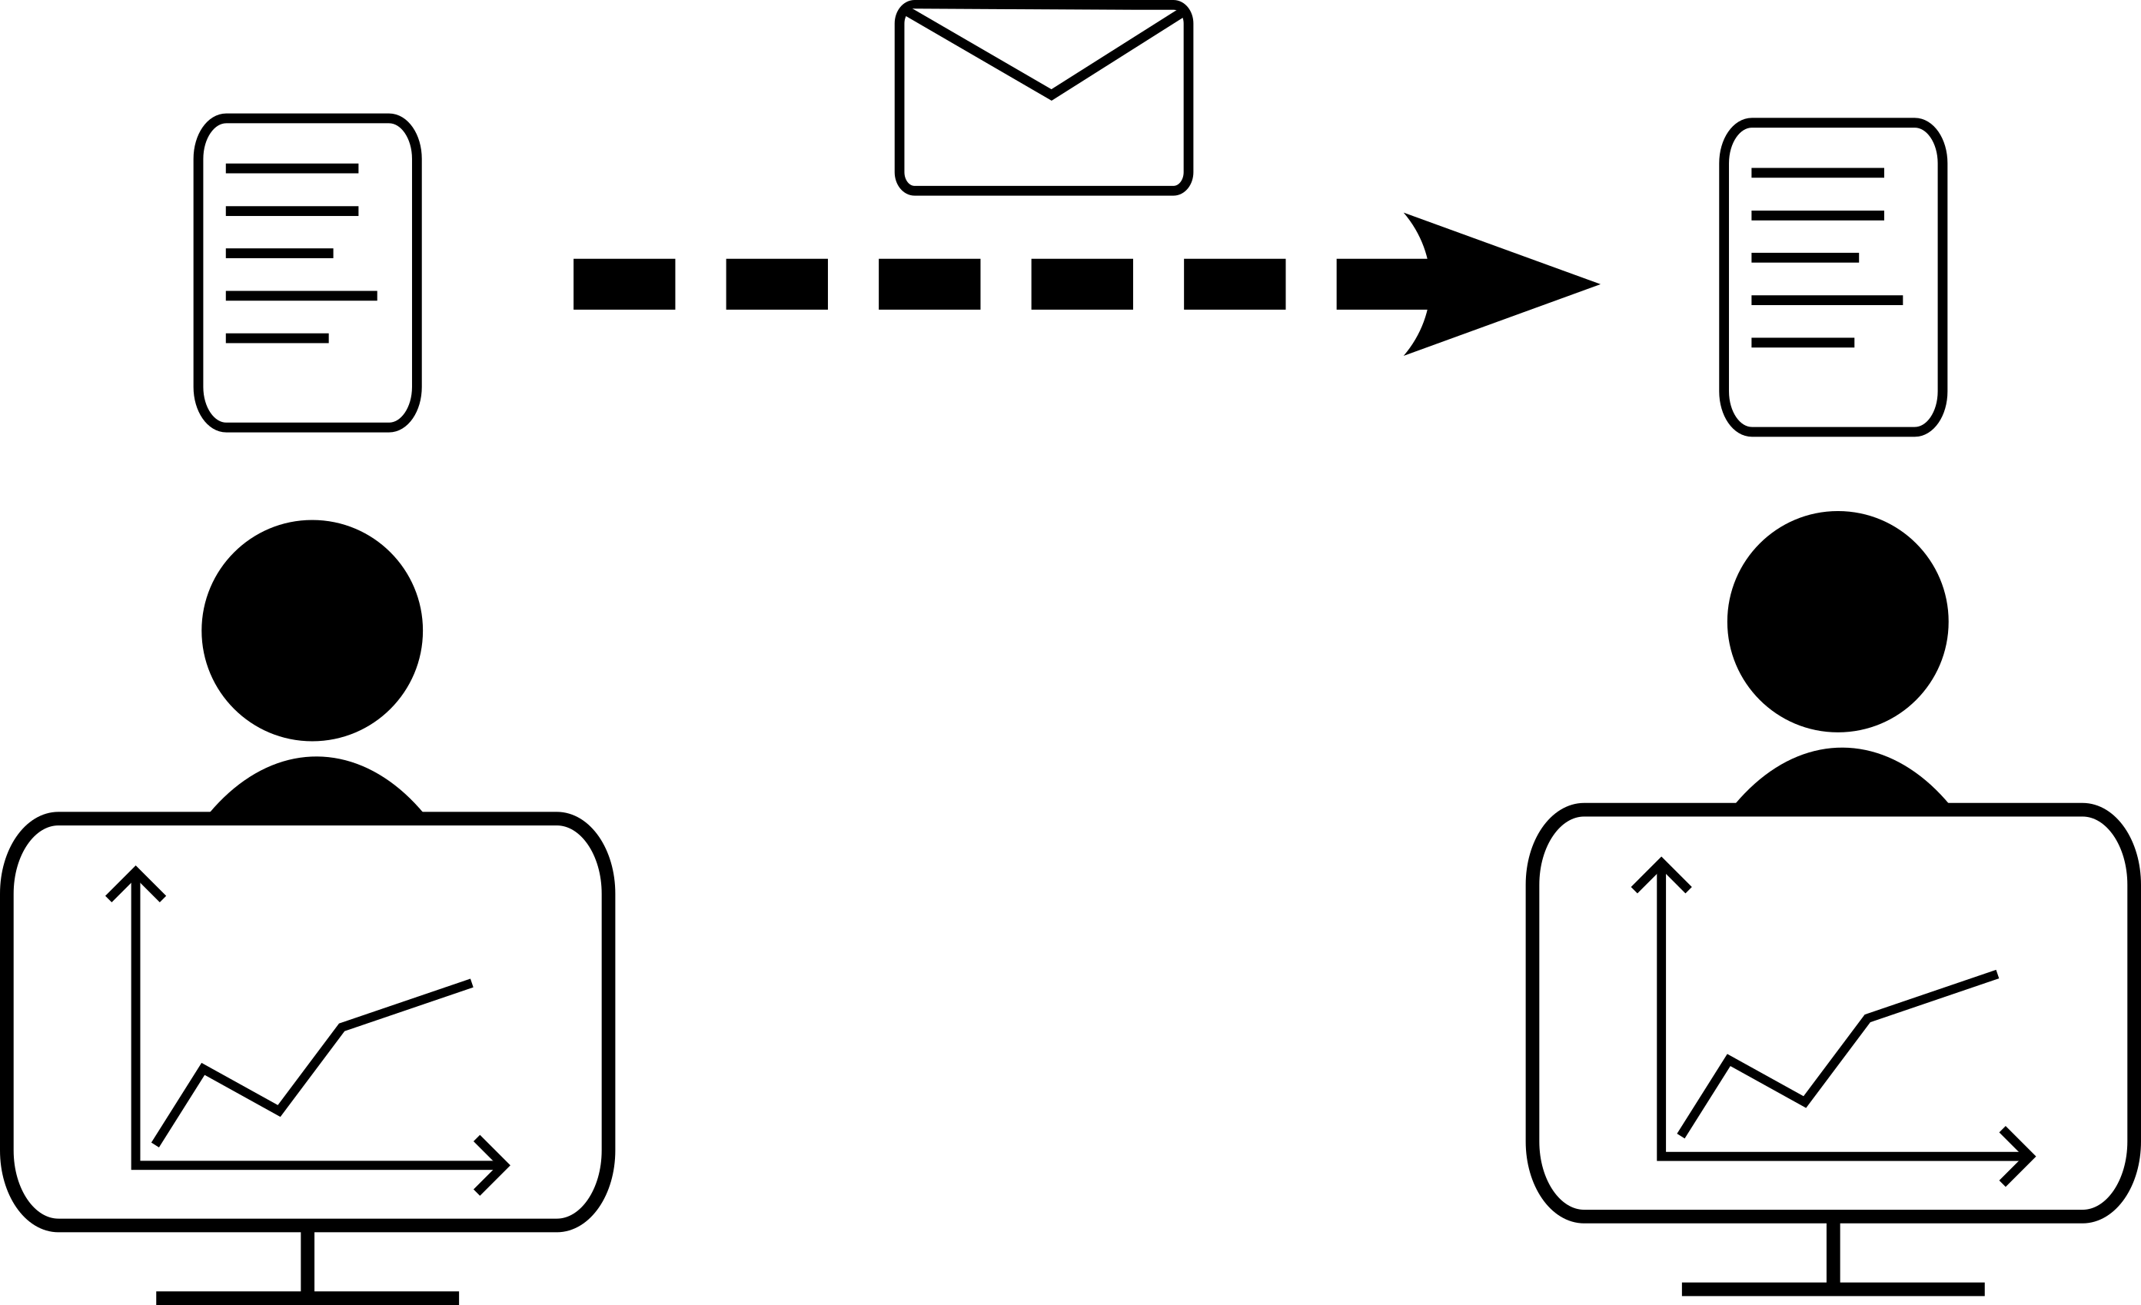

Interoperable
Data
What is data interoperability?
The ability to exchange and use data across multiple systems
The ability of diverse datasets to be merged and aggregated in meaningful ways
0.5L milk
3 eggs
150g flour
+
1 gallon milk
200g egg
3oz flour
=

Slide 41
Interoperable
Data
File Types and Formatting

Slide 42
FAIR file formats in biological practice
Interoperable
Data
Use .csv or .xls files for numerical data. Never share data tables as word or pdf
1
Provide underlying numerical data for all plots and graphs
2
Use common file formats (domain specific)
3
Convert proprietary binary formats to open ones. For example convert Snapgene to Genbank/SBOL, microscopy multistack images to OME-TIFF
4

Slide 43
Interoperable
Data
Data formatting
Use standard formats wherever possible
  Dates in ISO8601 format: 2025-10-16 14:53:02
Be consistent!
  For a variable with two levels: TRUE/FALSE, 0/1, Yes/No,…?
  Use the same units (often standard within a field)
Think ahead
  Every time you change your data formatting, you will either break interoperability with previous data, or generate work to re-format it

Slide 44
Exercise #2
Interoperable
Data
(10 min)
Resource: File examples
  Exercise materials
Task A: Which of these file formats are interoperable or not?
Try to copy the "Supplementary_table.pdf" data into Excel
Try to open "SI_fig_1.opj"
Is "Fitting_model.png" interoperable?
Is the example Python script interoperable?
Open the "Ens_data.xlsx" file: is it interoperable?
Task B: What alternative file formats would increase interoperability?
Output: Context about the interoperability of different file formats

Slide 45
Enduring Understanding
Interoperable
Data
At any scale, data interoperability can be logistically challenging (i.e. between different software) and conceptually challenging (i.e. removing data from its original context may yield different findings).
Practical Applications
Let other people reuse your data (and cite you for it!)
Facilitate collaborations
Keep access to your data if you lose access to software

Slide 46
Managing FAIR data records
Using digital tools to make data FAIR
Electronic Notebooks
Jupyter Notebooks
Repositories: making your data Findable and Accessible!

Slide 47
Electronic Lab Notebooks

Slide 48

FAIR data
records
Good Lab Records
Laboratory Notebooks
Contain all relevant details (what, who, when, why and how)
Which project(s) is the record part of
Information on lot/batch numbers
What happened and what did not happen (data, including images)
How you processed and analysed the data
Your interpretation (and the interpretations of others if important) and next steps in the project based on these results
Should be well organised for ease of navigation (indexed, labelled, catalogued)
Accurate and complete: include all original data and important study details (metadata).
REMEMBER!
Both protocols and laboratory records need to be detailed, accurate and complete.

Slide 49
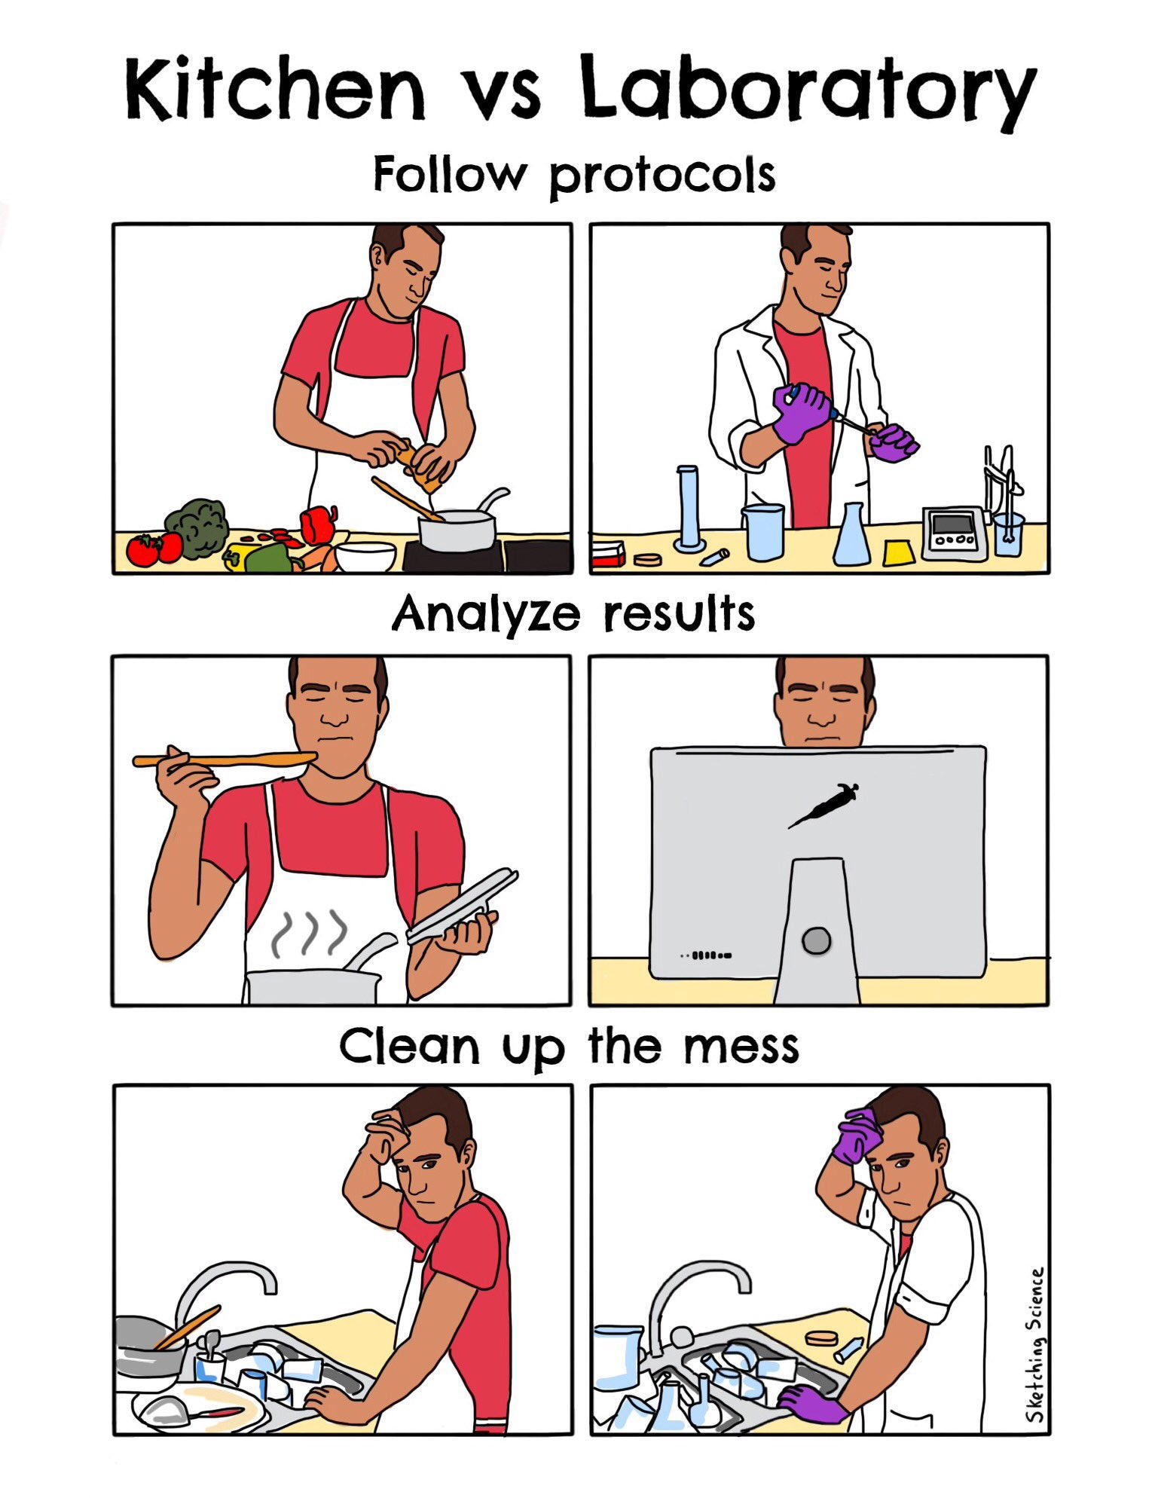
FAIR data
records
Good Lab Records
Protocols
Give credit to the person who created the protocol, if it was not you.
Complete and detailed instructions describing why and how to do an experiment
What special materials and instruments are being used and where they were obtained
Health and safety advice and how to dispose of waste
Allow repetition of your procedures and studies by yourself and others
Figure credits @sketchscience

Slide 50
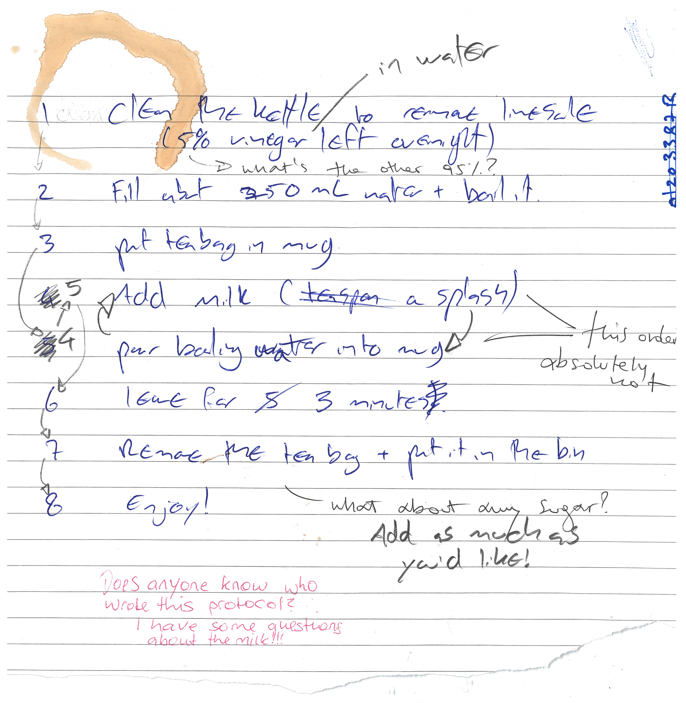
ELNs
FAIR data
records
Let’s make ourselves a cup of tea.
Here’s a peer-reviewed protocol
for making tea
Figure credits: Dr Ines Boehm and Ben Thomas

Slide 51

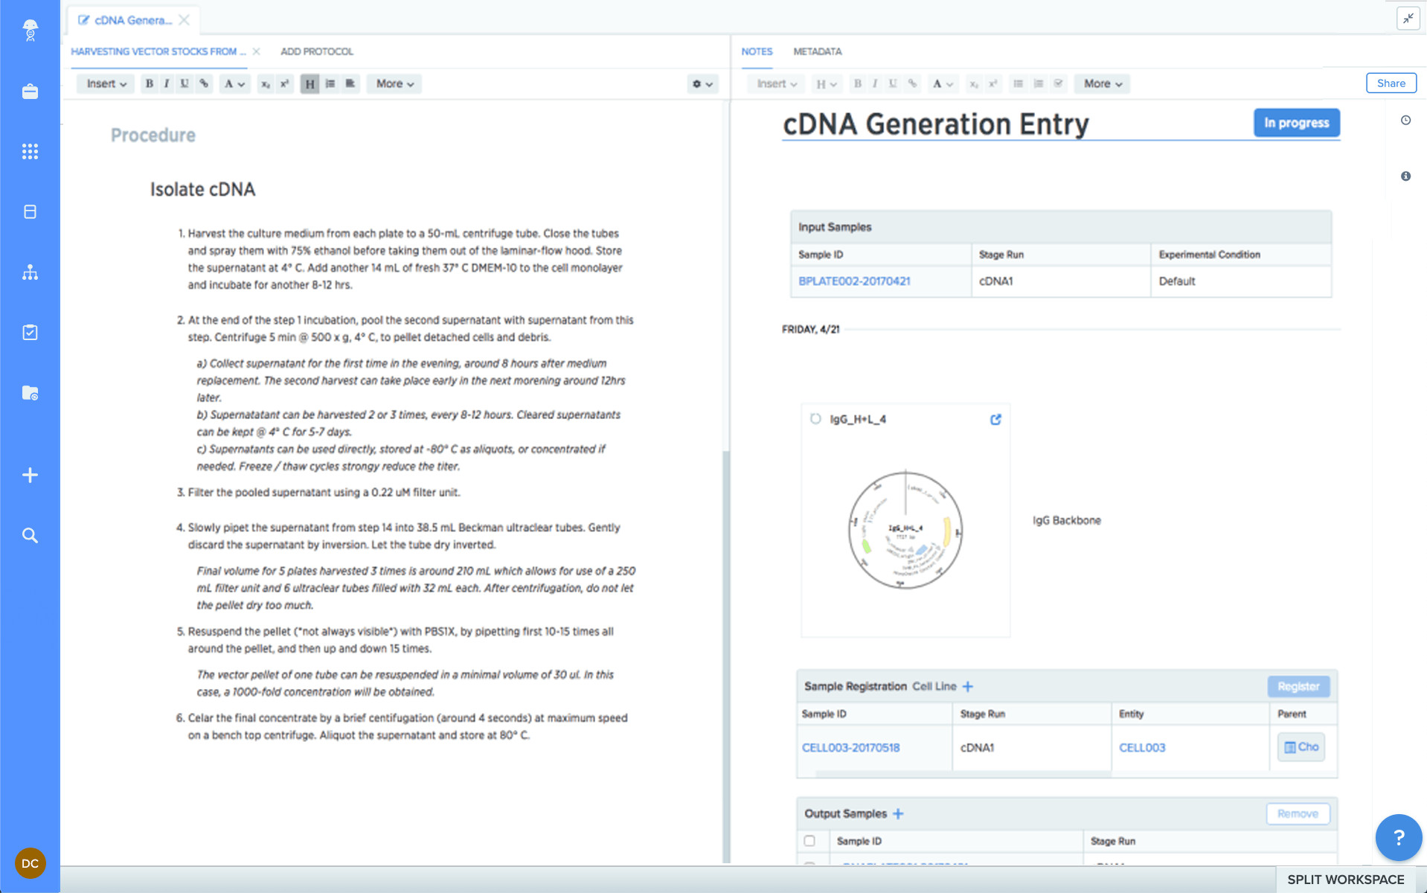
Paper
FAIR data
records
ELN
Your data is organised and searchable.​
Allows off-site archiving​.
You can have templates (e.g.: protocols/assay / entries )​ - Easy to copy data entries
Can be shared instantly; global access within a group​.
Doesn’t take up physical space (no record rooms/folders)​
Regular backups​.
It does not require the internet.​
Directly draw on your records.​
Pros
​Can be lost or damaged​
Handwriting is not always intelligible ​
Hard to edit and share​
Hard to reuse information​
Not findable/ accessible
Cons
Pros
Requires internet access​
Better if you have a laptop or tablet
Cons

Slide 52

How do I choose an ELN?
FAIR data
records
Does my group already use one?
Yes
No
Use that one!
Things to consider:
Cost
Traceable? (data cannot be deleted and is time-stamped)
Where are the servers located?
Can the data be downloaded?
What happens to the data when someone leaves the group?
Notes:
Acquire description at earlier stages, split over the stages

Slide 53

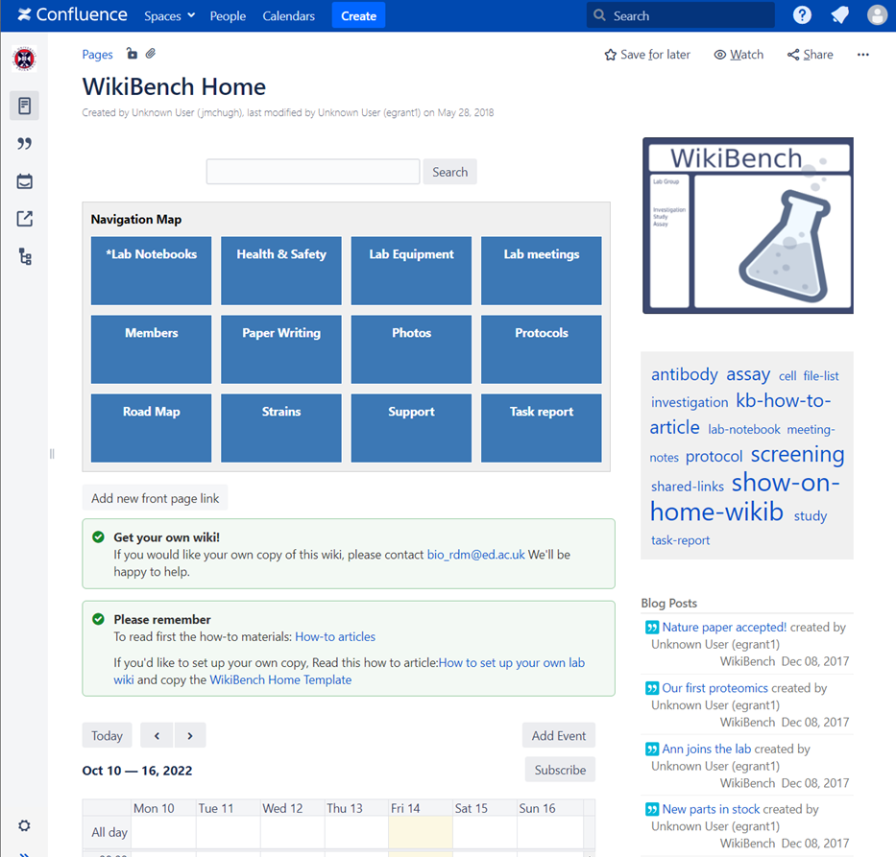




Which ELNs are used in SBS?
FAIR data
records
WikiBench (UoE Wiki)
For code
For keeping/sharing protocols
Notes:
The University of Edinburgh-hosted RSpace service benefits from integration with local infrastructure, allowing researchers to log in with their University login (EASE), link to files on DataStore, and archive data in DataShare.
The University has a discounted licence agreement with RSpace to provide the standard RSpace Enterprise edition.
LabArchives has a free version 1GB per user – with SnapGene & GraphPad Prism Integrations
Jupyter notebooks – very good for people who frequently use R or python scripts as it has an interface that integrates notebooks, code, and data. - Free

Slide 54
Example of good record keeping
FAIR data
records
Aims of the experiment
Samples are described
Protocols are written down and referenced
Result figures and description
What worked and what did not; potential solutions
Final conclusions
Issues accessing the link? Please let us know ☺
https://benchling.com/s/etr-0FdV1H0rpWeHk4H72NOg/edit

Slide 55


ELNs Resources from BioRDM
FAIR data
records
https://www.wiki.ed.ac.uk/x/f0SkGw
Hands-on tutorial on Benchling:
https://www.wiki.ed.ac.uk/spaces/RDMS/pages/463750251/Benchling+quick+tutorial
bio_rdm@ed.ac.uk​
Notes:
Acquire description at earlier stages, split over the stages

Slide 56

FAIR data
records
Demo
  Demo materials

Slide 57

FAIR data
records
Version control
If you are producing code, you must use version control Git
https://swcarpentry.github.io/git-novice/

Slide 58
Exercise #3
FAIR data
records
(15 min)
Resource: Wet lab protocol or Piece of Code
  Exercise materials
Task Option A: Create a protocol on an ELN
  Create an account at: benchling.com
  Follow the instructions in the "colony_PCR_protocol.docx" file.
Task Option B: Complete the task in the Jupyter notebook.
1. Access to the server: http://mango.bio.ed.ac.uk/jupyter
Password: FAIR2025
2. Create a copy with your name and start editing.
Outputs: Registered ELN account and protocol stub or commented Jupyter Notebook

Slide 59
FAIR data
records
Repositories

Slide 60
Repositories
FAIR data
records
Findable
Deposit data to an external, reputable public repository.
Repositories provide persistent identifiers (PIDs), catalogue options, advanced metadata searching, and download statistics.
Uploading data to a repository requires rich metadata
Accessible

Slide 61
FAIR data
records
Repositories
Some repositories can also host private data or provide embargo periods, meaning access to all data can be delayed.
There are general “data agnostic” repositories, for example: Dryad, Zenodo, FigShare and UoE’s own DataShare .
Or domain specific, for example: UniProt – protein data, GenBank – sequence data, MetaboLights – metabolomics data.

Slide 62
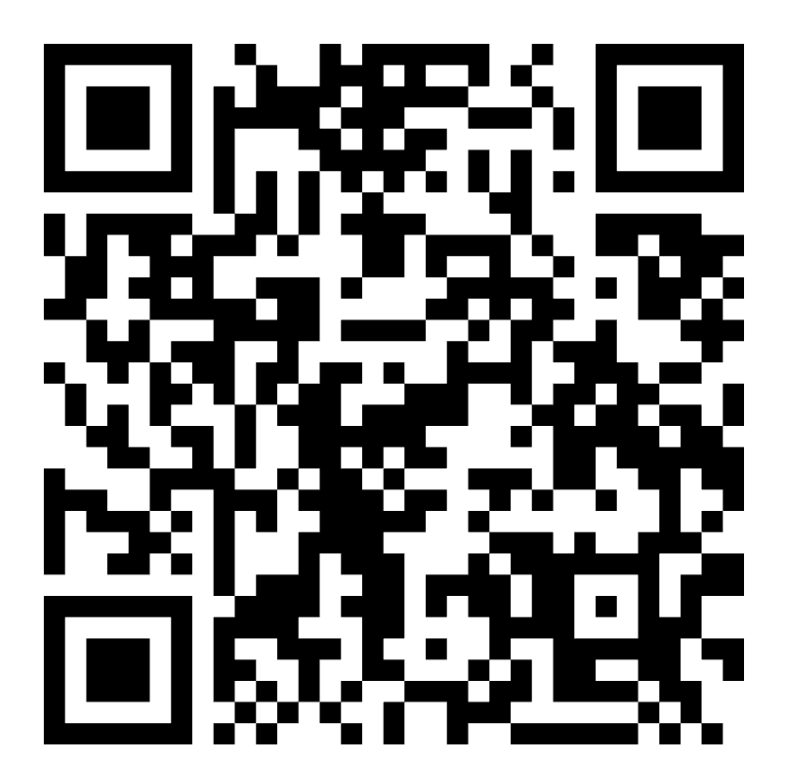


Exercise #4
FAIR data
records
(5 min)
Resource: https://zenodo.org/records/6349579
Task: Identify the elements that make a dataset record FAIR in the Zenodo record.
Outputs: Practical knowledge about the FAIR elements in a public repository.

Slide 63
Enduring Understanding
Digital tools like ELNs are imperative for data reusability and to boost collaborative work.
Depositing data in a repository will make your data findable and accessible, but you need to describe/organize/ format it appropriately to make it interoperable and reusable
Practical Applications
Facilitate work within your team
Keep reliable records of your work
Find information quickly
Share FAIR data
Notes:
Changed enduring understanding
Data accessibility is facilitated via ELNs, file types, and repositories. Embedded levels of openness (i.e. format, file type, publishing) make data accessible, not simply openness of FAIR practice alone.
Accessible is something more technical related to repos.
What we want here is reusability

Slide 64
Please confirm your attendance here (for Graduate school):
Break 2
(10 min)

Slide 65
Planning ahead
To what extent is reusable data consequential and for whom?
Data Sharing Cycle
Data Management Plans
Research Outputs

Slide 66
Reusable
Data Sharing Cycle

Slide 67
Sharing as part of the workflow
Planning
ahead
CREATING DATA
RE-USING DATA
PROCESSING DATA
Time and effort
SHARING
DATA
ANALYSING DATA
PRESERVING DATA
work necessary to make outputs suitable for sharing

Slide 68
Sharing as part of the workflow
Planning
ahead
CREATING DATA
RE-USING DATA
PROCESSING DATA
Time and effort
SHARING
DATA
ANALYSING DATA
PRESERVING DATA
work necessary to make outputs suitable for sharing
standard research operations

Slide 69
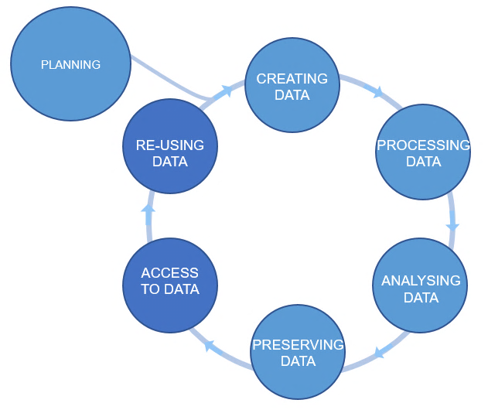

Planning
ahead
Plan ahead
Data management plans
(DMPs)
Figure credits: Tomasz Zieliński and Andrés Romanowski

Slide 70
Planning
ahead
Data Management Plans

Slide 71
Data Management Planning: What? How? Where?
Planning
ahead
What: thinking about what data you will generate.
Types of data, format, and volume of the data
How: thinking about how you will:
Organise, describe, securely store, and back up your data.
Where: to ensure your data is available for replication and reuse.
Archiving, publishing, and conditions of re-use.
Notes:
How manage: organise, document, store, back-up.
How share and preserve: make data available for verification, replication, re-use.
Plan to prevent loss: HD failure, accidental delete, cat peeing on laptop.
Plan to prevent unauthorised access of sensitive/personal data.
DMPOnline:
Funder Templates
Plan broken down into sections:
data creating/collecting: size, format, type
documentation and metadata
quality assurance processes/standards
storage and back up plans
security measures for sensitive data
how, where, when share it (on publication)
how preserve
Includes lots of guidance for each section : funders / UoE /Data Curation Centre.

Slide 72

Writing a DMP for your Research
Planning
ahead
Tools and courses
DMPOnline https://dmponline.ed.ac.uk
Digital Research Services (RDS) Hands-on workshop(s)
  Understand the necessity/benefits of producing a DMP.
  Discover how to register for and use DMPonline.
  Draft a basic DMP!
https://library.ed.ac.uk/research-support/research-data-service/research-data-training-skills/workshops-courses

Slide 73

Planning
ahead
BioRDM DMP advice
https://www.wiki.ed.ac.uk/display/RDMS/Data+Management+Plans

Slide 74
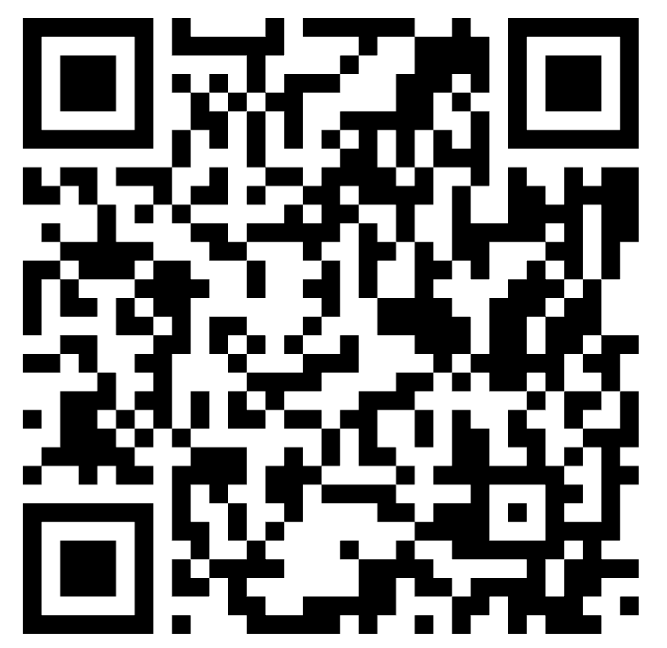

Exercise #5
Planning
ahead
Resource: PhD project background info
Task A: Answer or reflect on the following questions on WooClap
  What data types do you expect to generate?
  What file formats will you work with?
  How much data do you expect to generate over your whole PhD?
  Where will you store the data?
  How will you transfer data (e.g. to collaborators)?
  What folder structure will you use for your projects?
  Will the data be made publicly available at the end of your project?
    If yes: on which repository could you make the data available?
Output: Preliminary Data Management Plan

Slide 75
Planning
ahead
Research Outputs

Slide 76
Planning
ahead
Your musts
According to policies (the School, the University and the funders):
You are responsible for the safety of your data
(both storage and access)
Back up (almost) everything created by a human or recorded by a machine as soon as it is created.
Physical HDs only are a failure-prone option and are not a valid solution for backup of scientific data
Always backup your files in 3 places, at least one should be off-site.
A robust backup cannot be achieved manually – the University gives you DataStore

Slide 77

Planning
ahead
Your musts
According to policies (the School, the University and the funders):
You need a DMP for your project
You have to publish Open Access
You have to make available all the data underlying publications

Slide 78
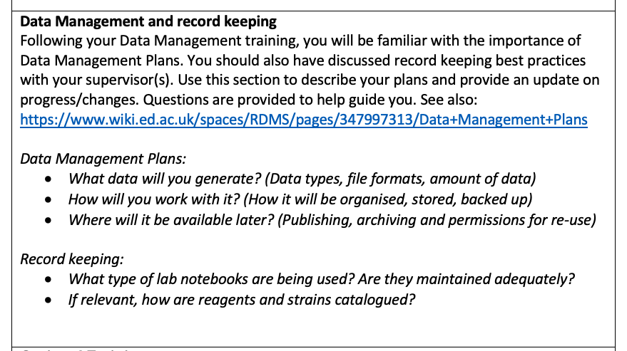
Planning
ahead
Writing a DMP for your Research
Annual Review: You must write a basic DMP for your project

Slide 79
For your narrative CVs…
Planning
ahead
… you need to have as many public outputs as possible:
Datasets in public repositories
Public protocols
Code packages
Public engagement, industry
Involvement in committee work, student groups etc.
(BioPod, Doors Open Day, Festivals, etc)
Notes:
CV format that uses storytelling to explain how and why you achieved your results, rather than just listing publication metrics, job titles, or dates

Slide 80

Outcomes of Openness
Collaboration
Speed
Unpublished / negative results
Re-use
Learn by example
Feedback
Notes:
Might move this to the end

Slide 81
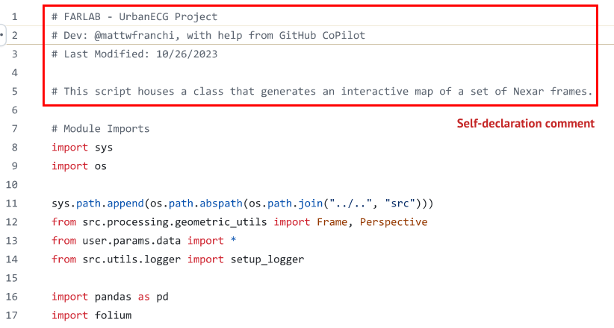
Let's talk about the use of AI
Planning
ahead
Uploading data to AI tools (do not do).
Edinburgh Language Model (ELM):
  Explore the tool and the variety of models.
  Guidance
Follow university guidance: Using generative AI in your studies: guidelines for students
  ALWAYS declare the use of AI.
  If you have doubts, always check with your supervisors.
  Examples:
    “I used OpenAI o4 Mini via ELM to check grammar and spelling throughout my thesis. I also used the Create Image function in ChatGPT to generate the image on page 2. I used ELM to generate initial ideas for pathways to impact for my research."
    For code: Include model and version as a comment

Slide 82
Enduring Understanding
Planning
ahead
Planning ahead how you will manage your data – making data FAIR - is the cornerstone of data sharing
Openness can promote collaboration and career progression.
Practical Applications
Make it easy to share data at the end of a project
Support your CV by sharing meaningful outputs
Contribute to data re-use and experimental reproducibility!

Slide 83

In Conclusion

Slide 84
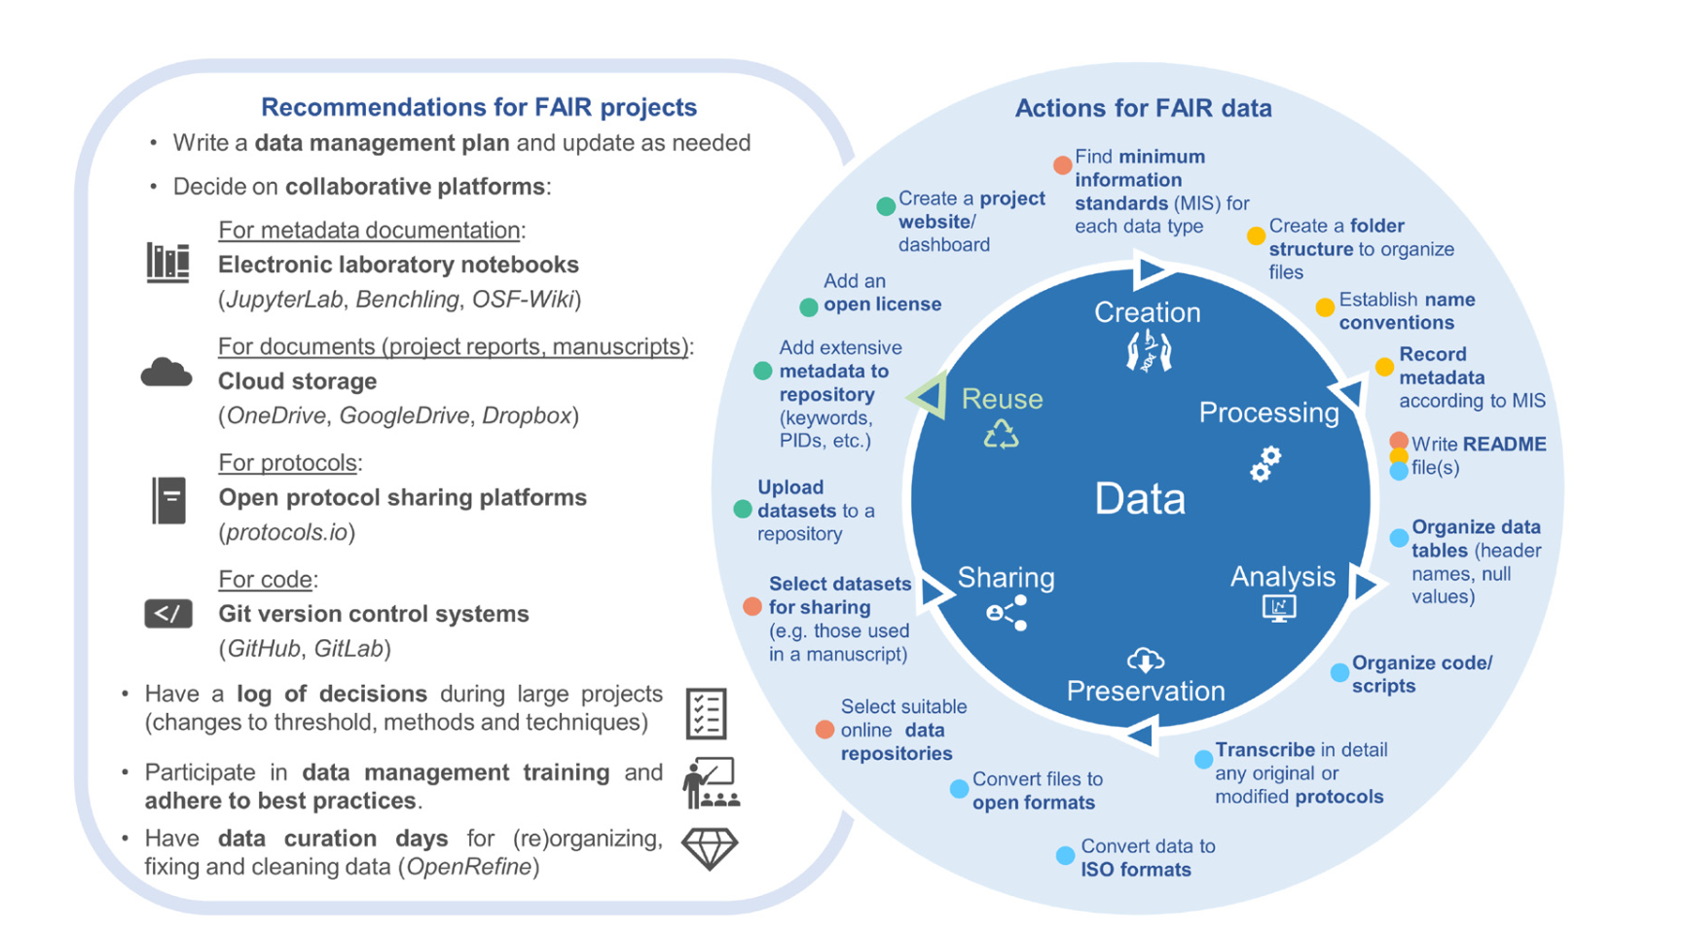
Summary
Scorza LCT et al. Daily life in the Open Biologist’s second job, as a Data Curator- Wellcome Open Res 2024, 9:523 (https://doi.org/10.12688/wellcomeopenres.22899.1)

Slide 85
Data-related resources at the University
All the resources to manage your data through the PhD journey
Storage
Collaboration
Code
Protocols
Repositories
Additional Information
Notes:
Managing findable data or Managing data to make it findable?
Persistent identifiers (PID)
Rich metadata! (but this is also related to Reusable)

Slide 86
University resources for data management
Resources
BioRDM wiki
https://www.wiki.ed.ac.uk/display/RDMS
DRS page – Digital research services
https://digitalresearchservices.ed.ac.uk/
Dr Burak Ozyurt – CSE Research Facilitator
RDS – Research data service page (UoE Central Service)
https://www.ed.ac.uk/information-services/research-support/research-data-service

Slide 87
University resources - Storage
Resources
UoE DataStore – for your active research data
It looks like your computer disk (a network drive)
Free (250GB + 250GB per student)
Accessible from all computers
Off-site backup and versioning/history of the files
Easy sharing within the University
Dropbox like access via DataSync
https://library.ed.ac.uk/research-support/research-data-service/during/data-storage

Slide 88
University resources - Storage
Resources
UoE DataStore – for your active research data
It looks like your computer disk (a network drive)
Free (250GB + 250GB per student)
Accessible from all computers
Off-site backup and versioning/history of the files
Easy sharing within the University
Dropbox like access vis DataSync
Please Use DataStore
https://library.ed.ac.uk/research-support/research-data-service/during/data-storage

Slide 89
University resources - Storage
Resources
UoE DataStore – for your active research data
Two areas
Group space
(\\csce.datastore.ed.ac.uk\csce\biology\groups\YOUR-GROUP)
Private
(\\csce.datastore.ed.ac.uk\csce\biology\users\YOUR_LOGIN)
Use group space for data!
(request access through your PI and information services)

Slide 90
University resources - Storage
Resources
UoE DataStore – How to use
You need VPN to connect from home
How to connect:
https://www.ed.ac.uk/information-services/computing/desktop-personal/connect-uni-file-storage

Slide 91
University resources - Collaboration
Resources
Sharepoint / OneDrive (1TB)
https://uoe-my.sharepoint.com
For documents, presentations, reports, etc.
Excellent for collaborative work on shared documents
Online versions of Word / Excel
Your desktop office can directly sync with sharepoint files
DON’T bounce emails with your PI – co-edit on sharepoint!!!

Slide 92
University resources - Collaboration
Resources
UoE WIKI
https://www.wiki.ed.ac.uk
Projects’ websites,
Making notes, organizing files,
Even a simple ELN (can be private or public)
https://www.wiki.ed.ac.uk/display/RDMS

Slide 93

University resources - Protocols
Resources
Protocols.io
https://www.protocols.io/
private and public (creates DOI) – free version – 2 private protocols
versioning / forking
collaboration
good for group SOPs
Notes:
On the 31st December 2024 our subscription to protocols.io will end and we have taken the difficult decision not to renew it. The reason for this is that in 2023 the company that developed protocols.io sold it to the academic publisher Springer Nature and they have decided to impose an increase in subscription cost of over 700% for 2025.

Slide 94
University resources - CODE
Resources
If you code (script) you should use GIT
(you need to learn it though)
Free GitHub (https://github.com)
Free GitLab (supported by UoE - UoE GitLab )

Slide 95
University resources - Repositories
Resources
Choosing domain specific repository
BioRDM wiki:
https://www.wiki.ed.ac.uk/spaces/RDMS/pages/424280992/Suggested+data+repositories
Fairsharing.org

Slide 96
University resources - Repositories
Resources
UoE DataShare
https://datashare.ed.ac.uk/
for sharing public datasets (possible embargo period)
unlimited, free storage (250GB per dataset)
DOI
automatically creates records in your personal profile
(UoE PURE)

Slide 97
Learning
Resources
Practical recipes and guides:
https://faircookbook.elixir-europe.org/
https://rdmkit.elixir-europe.org/
Training
Ed-DASH https://edcarp.github.io/Ed-DaSH/index.html
UoE RDS https://www.ed.ac.uk/information-services/research-support/research-data-service
Digital Research Services: https://digitalresearchservices.ed.ac.uk/news-and-updates/

Slide 98


Slide 99
BioRDM
Biological Research Data Management Team
Thank you!
Best of luck in your PhD journey
Alli Spring, PhD. - aspring@ed.ac.uk
Daniel Thédié, PhD. - daniel.thedie@ed.ac.uk
Juliana Rodríguez Cubillos. - Juliana.Rodriguez@ed.ac.uk
bio_rdm@ed.ac.uk

