Slide 1

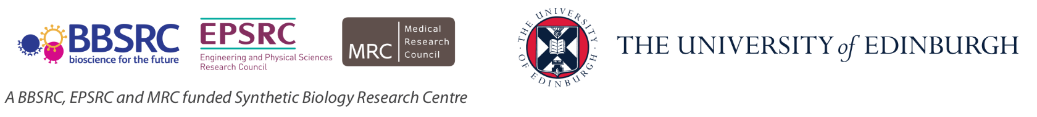
Biological Research
Data Management Team
SBS Staff Induction Working with data
Dr Livia Scorza
Dr Tomasz Zieliński
bio_rdm@ed.ac.uk

Slide 2
Workshop Content
Why you are here: Narrative CVs and Policies
Open Science and FAIR Principles
Data Management Planning
Active Data Storage
Data-related resources at the University
Notes:
Alternative to learning objectives

Slide 3

DORA
Declaration on Research Assessment
the need to eliminate the use of journal-based metrics, such as Journal Impact Factors, in funding, appointment, and promotion considerations;
the need to assess research on its own merits rather than on the basis of the journal
the need to capitalise on the opportunities provided by online publication (such as relaxing unnecessary limits … exploring new indicators of significance and impact)
CREDITS [5] CC BY

Slide 4
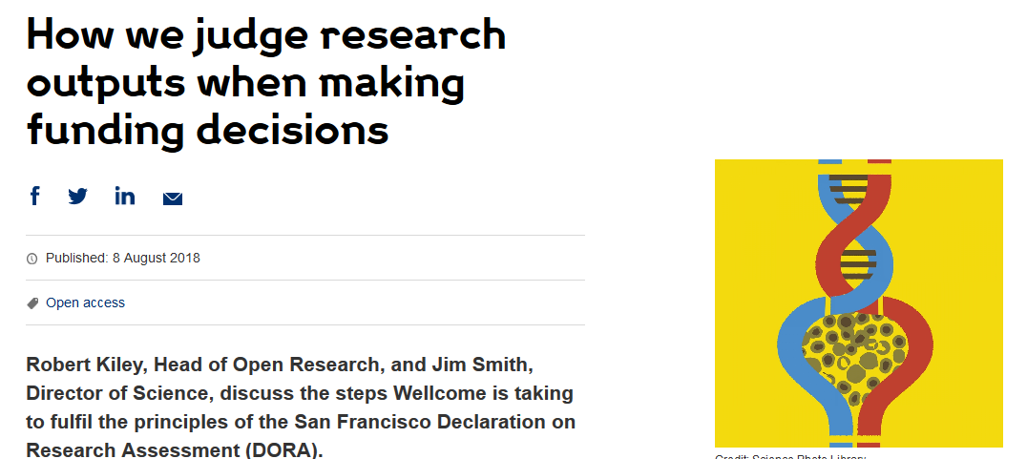
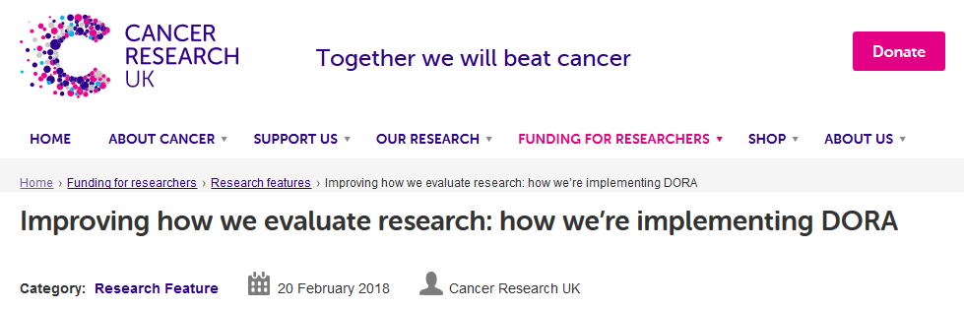
DORA: Funders adoption
Wellcome
London, United Kingdom
Cancer Research UK
London, UK
Application includes:
List of research outputs
Summary of 3-5 achievements
Space to describe other measures of impact
Reminds peer reviewers and committee
members of DORA principles throughout
funding process
Application includes:
List of research outputs
Contributions to mentorship
Output sharing plan to advance potential health benefits
Plans for public engagement
Guidance provided to advisory panel members
CREDITS [5] CC BY
Notes:
Wellcome example: https://wellcome.ac.uk/news/how-we-judge-research-outputs-when-making-funding-decisions
Cancer Research UK example: https://www.cancerresearchuk.org/funding-for-researchers/research-features/2018-02-20-improving-research-evaluation-dora

Slide 5
Narrative CV
Generation of Knowledge
Development of Individuals and Collaborations
Supporting Broader Society and the Economy
Supporting the Research Community

Slide 6
Narrative CV
A broad definition of ‘output’ is used, such as datasets, patents and software.
Special attention is paid to Open Science, which outputs are openly available.
New metrics: retweets, online views and downloads, discussions, presence in mass media technology platforms

Slide 7
It is easier to be prepared than to fake it
It takes time to make the outputs public
The quality of open outputs is easy to assess
Timestamps

Slide 8
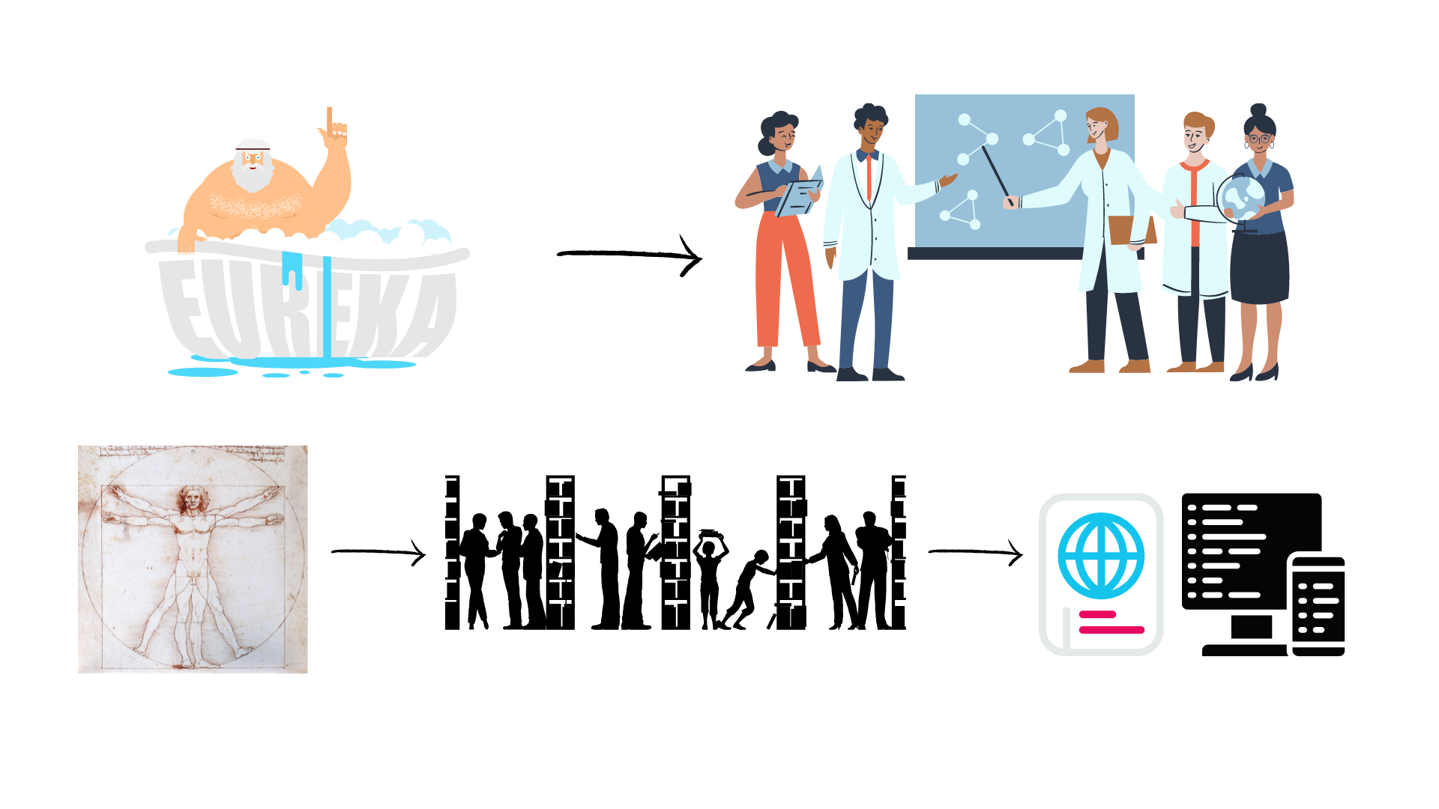
Evolution of Open Science
Level of openness in research

Slide 9

Open Science
Open science is transparent and accessible knowledge
that is shared and developed
through collaborative networks.

Slide 10






Open Science
Open science is the movement to make scientific research accessible to all levels of society
general public
amateurs
professionals
students
teachers
publications
data
physical samples
software
Digital technologies for diffusing knowledge

Slide 11
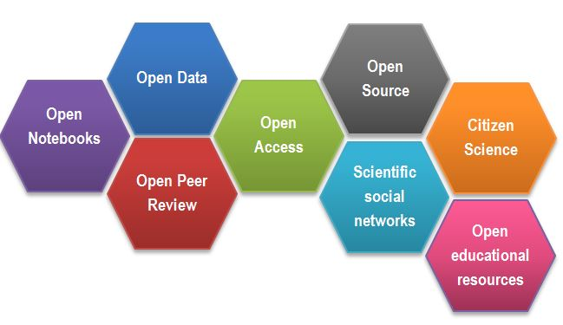
Open Science
CREDITS [1] CC BY

Slide 12
Outcomes of Openness
Speed
Unpulished / negative results
Re-use
Collaboration
Learn by example
Feedback

Slide 13
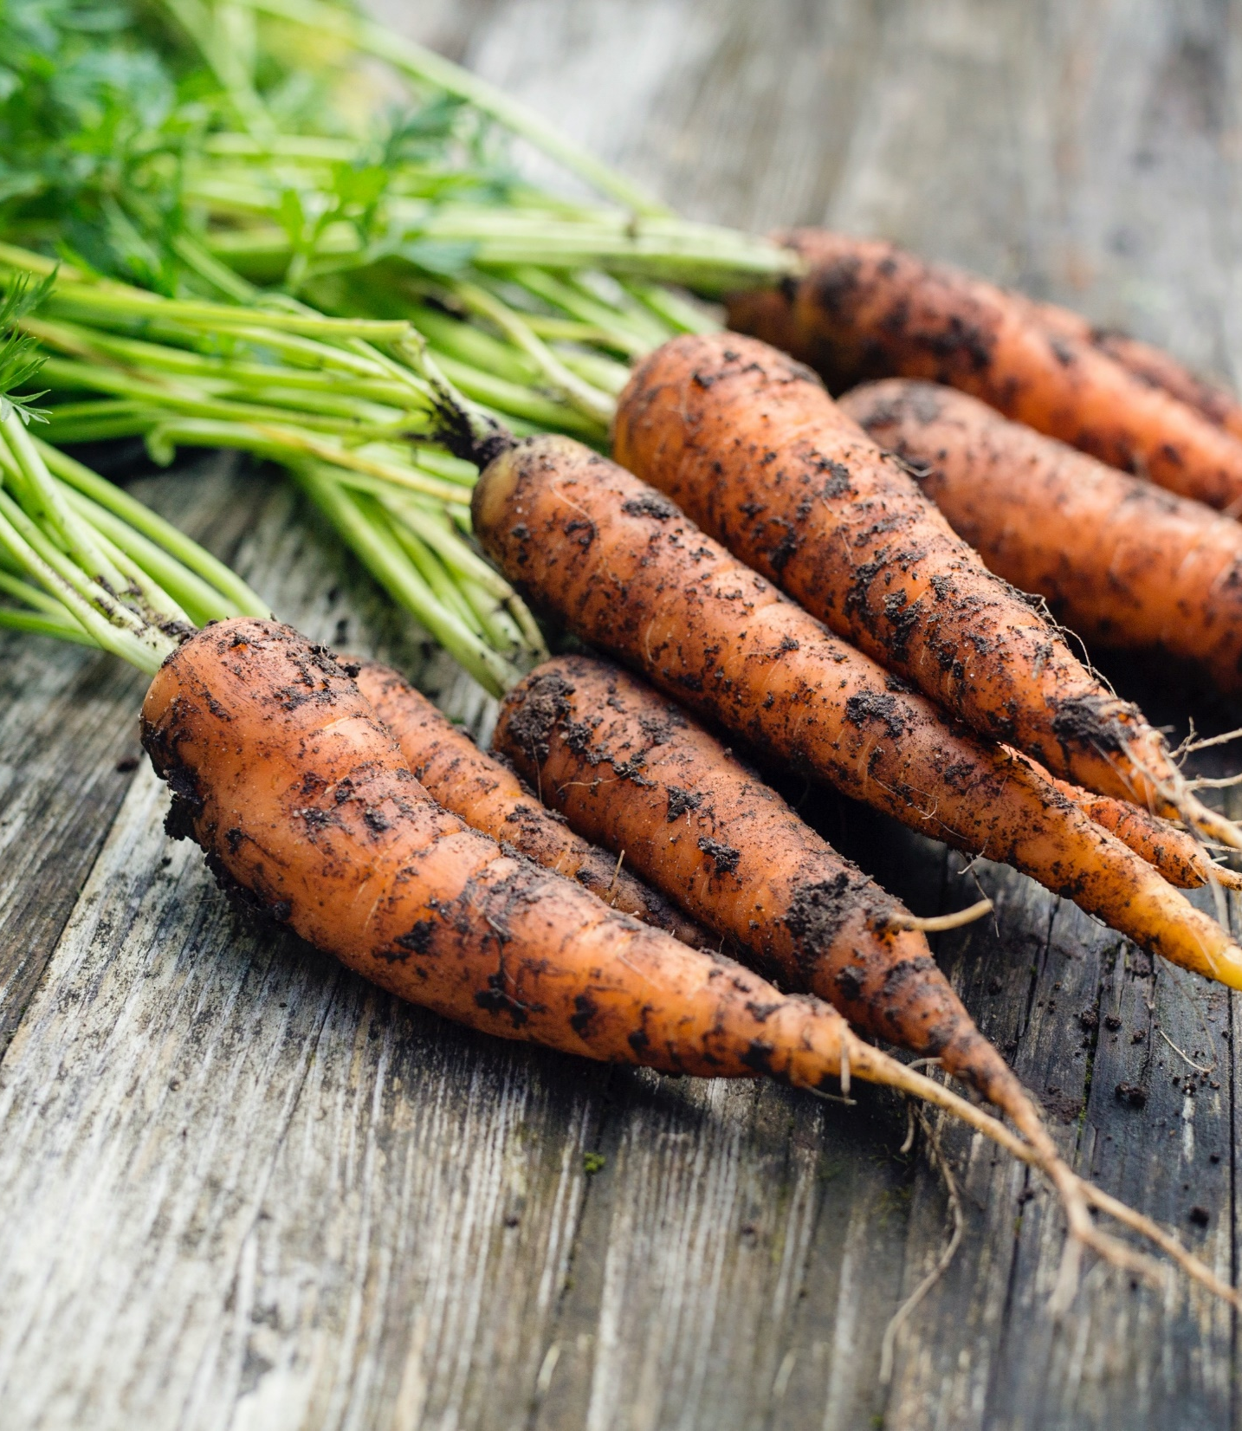
Motivation
“stick”
Large UK funding bodies such as The Wellcome Trust are big supporters of Open Science
“carrot”
….

Slide 14
Your motivators
….

Slide 15
But how (not) to share in practice

Slide 16
Common problems with “shared” data
Only averaged data available
No numerical data available
Data tables as PDF files in supporting information
Vendor specific file formats
Links to non existing group websites / databases
Data / Code “on request”

Slide 17

FAIR principles
CREDITS [5] CC BY

Slide 18
FAIR principles
Findable:
persistent identyfiers pointing to the data
descriptions that allow dscovery by both humans and computers
Accessible:
(meta)data retrieval by standard protocols (http)
metadata available even when the data are not
Interoperable:
(meta)data saved in open/common format (interpretable for various tools)
(meta)data should use vocabularies that follow FAIR principles.
Re-usable:
data should be well-described so that they can be replicated and/or combined in different settings
conditions of the reuse should be stated with a clear license

Slide 19
FAIR in biological practice
Findable & Accessible
Deposit data to an external, reputable public repository.
Repositories provide persistent identifiers (PIDs), catalogue options, advanced metadata searching, and download statistics. Some repositories can also host private data or provide embargo periods, meaning access to all data can be delayed.
There are general “data agnostic” repositories, for example: Dryad, Zenodo, FigShare, Dataverse and THE UNIVERSITY’s own DataShare .
Or domain specific, for example: UniProt – protein data, GenBank – sequence data, MetaboLights – metabolomics data.

Slide 20
FAIR in biological practice
Interoperable
Use .csv or .xls files for numerical data. Never share data tables as word or pdf
Provide underlying numerical data for all plots and graphs
Use common file formats (domain specific)
Convert proprietary binary formats to open ones. For example convert Snapgene to Genbank/SBOL, microscopy multistack images to OME-TIFF

Slide 21
FAIR in biological practice
Reusable
describe your data well (good metadata)
write a README file describing the data
provide as many details as possible (prepare good metadata)
use descriptive column headers for the data tables
tidy data tables, make them analysis friendly
use (meta)data formats (e.g. SBML, SBOL)
use commonly known terms and PIDs in descriptions
follow Minimum Information Standards
attach license files

Slide 22
FAIR and You
Citable
Track & Countable
Intelligible
Reproducible
CREDITS [5] CC BY

Slide 23
FAIR example
What makes it FAIR
https://doi.org/10.5281/zenodo.6339631
CREDITS [5] CC BY

Slide 24
Break

Slide 25
Sharing as part of the workflow
CREATING DATA
RE-USING DATA
PROCESSING DATA
Time and effort
SHARING
DATA
ANALYSING DATA
PRESERVING DATA
work necessary to make outputs suitable for sharing

Slide 26
Sharing as part of the workflow
CREATING DATA
RE-USING DATA
PROCESSING DATA
Time and effort
SHARING
DATA
ANALYSING DATA
PRESERVING DATA
work necessary to make outputs suitable for sharing
standard research operations

Slide 27
Things to consider
ELN or NOT
Tidy data tables
Naming files and folders structure
Data security
Python/R for plotting and analysis
Jupyter notebooks, R markdown
Version Control == Git
How describe == metadata standards
Where to deposit == public repositories
Notes:
Do you know how and where to keep 3 copies of your data which are always up to date?
Secure data preservation is very difficult to achieve without institutional support and know-how. One option is cloud storage, but not all data may be put in a public cloud.
You should always check your institutional guidelines and what solutions are available in your organisation.

Slide 28
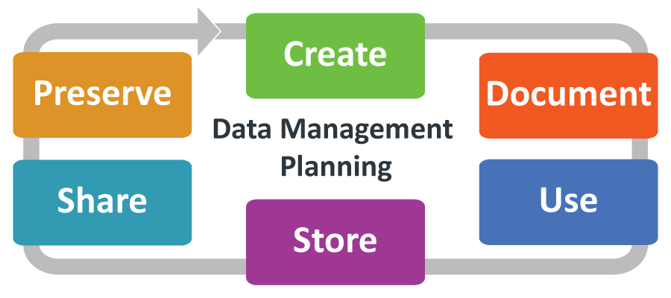
Data Management Planning
Notes:
UK Data Service Research Data Management guidance: https://ukdataservice.ac.uk/learning-hub/research-data-management/

Slide 29
Data Management Planning: What? Why? How?
What: thinking what data you will generate
Types of data, format, volume of the data
How: thinking about how you will
Organise, describe, securely store, and back your data up
Where: to ensure your data is available for replication re-use:
archiving, publishing, conditions of re-use
Notes:
How manage: organise, document, store, back-up.
How share and preserve: make data available for verification, replication, re-use.
Plan to prevent loss: HD failure, accidental delete, cat peeing on laptop.
Plan to prevent unauthorised access of sensitive/personal data.
DMPOnline:
Funder Templates
Plan broken down into sections:
data creating/collecting: size, format, type
documentation and metadata
quality assurance processes/standards
storage and back up plans
security measures for sensitive data
how, where, when share it (on publication)
how preserve
Includes lots of guidance for each section : funders / UoE /Data Curation Centre.

Slide 30
Writing a DMP for your Research
Tool: DMPOnline https://dmponline.ed.ac.uk
RDS Hands-on workshop(s)
Understand the necessity/benefits of producing a DMP!
Discover how to register for and use DMPonline!
Draft a basic DMP!
https://www.ed.ac.uk/is/data-training
BioRDM workshop end of November

Slide 31
Your musts
According to policies (the School, the University and the funders):
You are responsible for safety of your data (both storage and access)
You have to have DMP for your project
You have to publish with Open Access
You have to make available all the data underlying publications

Slide 32
You want to
Have as many public outputs as possible:
Datasets in public repositories
Public protocols
Code packages
Public engagement
Involvment in Community groups, student groups etc
for your Narrative CVs

Slide 33
University resources for data management

Slide 34

Keeping safe your project files and folders
Back up (almost) everything created by a human or recorded by a machine as soon as it is created.
Always backup your files in 3 places, at least one should be off-site.
USB sticks are a failure-prone option and are not a valid solution for backup of scientific data
A robust backup cannot be achieved manually – the University gives you DataStore
Notes:
Do you know how and where to keep 3 copies of your data which are always up to date?
Secure data preservation is very difficult to achieve without institutional support and know-how. One option is cloud storage, but not all data may be put in a public cloud.
You should always check your institutional guidelines and what solutions are available in your organisation.

Slide 35
University resources - Storage
UoE DataStore
it looks like your computer disk (a network drive)
free (250GB + 250GB per student)
accessible from all computers
off-site backup and versioning/history of the files
easy sharing within the University
Dropbox like access vis DataSync

Slide 36
University resources - Storage
UoE DataStore
it looks like your computer disk (a network drive)
free (250GB + 250GB per student)
accessible from all computers
off-site backup and versioning/history of the files
easy sharing within the University
Dropbox like access vis DataSync
Please Use DataStore

Slide 37
University resources - Storage
UoE DataStore - using
Two areas
Group space (\\csce.datastore.ed.ac.uk\csce\biology\groups\YOUR-GROUP)
Private (\\csce.datastore.ed.ac.uk\csce\biology\users\YOUR_LOGIN)
Use group space for data!

Slide 38
University resources - Storage
UoE DataStore - using
You need VPN to connect from home
Depending on network speed, using it may be tricky for very large files
Instructions how to use:
https://www.ed.ac.uk/information-services/computing/desktop-personal/connect-uni-file-storage
BioRDM wiki (recipies for difficult use-cases)

Slide 39
University resources - Collaboration
Sharepoint / OneDrive
https://uoe-my.sharepoint.com
For documents, presentations, raports etc
Excellent for collaborative work on shared documents
Online versions of Word / Excel
Your desktop Word can directly sync with sharepoint files
DON’T bounce emails with your PI – co-edit on sharepoint!!!

Slide 40
University resources - Collaboration
UoE WIKI
https://www.wiki.ed.ac.uk
projects’ websites,
making notes, organizing files,
even a simple ELN
(can be private or public)
https://www.wiki.ed.ac.uk/display/RDMS

Slide 41

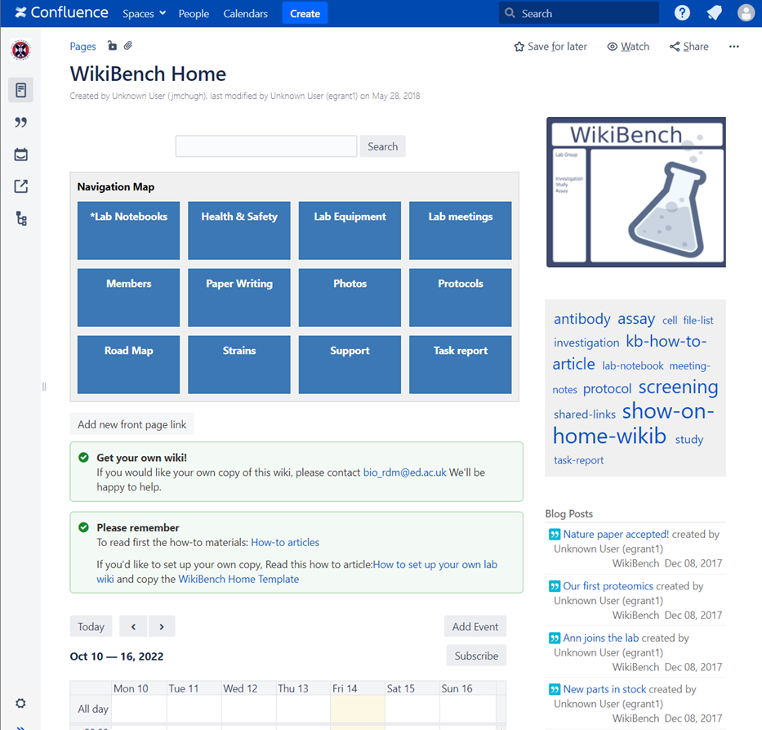



Which ELNs are used in SBS?
WikiBench (UoE Wiki)

Slide 42
University resources - protocols
Protocols.io
https://www.protocols.io/
(university pays for full version)
private and public (creates DOI)
versioning / forking
collaboration
good for group SOPs

Slide 43
University resources - DMP
DMPOnline
https://dmponline.ed.ac.uk
BioRDM wiki
https://www.wiki.ed.ac.uk/display/RDMS
ready to use paragraphs
recommended repositories

Slide 44
University resources - CODE
If you code (script) you should use GIT
(you need to learn it though)
Free github (https://github.com)
The University one (https://git.ecdf.ed.ac.uk)

Slide 45
University resources - repositories
Choosing domain specific repository
BioRDM wiki
Fairsharing.org

Slide 46
University resources - repositories
UoE DataShare
https://datashare.ed.ac.uk/
for sharing public datasets (possible embargo period)
unlimited, free storage (250GB per dataset)
DOI
automatically creates records in your personal profile (UoE PURE)

Slide 47
University resources - information
RDS page
https://www.ed.ac.uk/information-services/research-support/research-data-service
BioRDM wiki
https://www.wiki.ed.ac.uk/display/RDMS
(demo)

Slide 48
Learning
Practical recipes and guides:
https://faircookbook.elixir-europe.org/
https://rdmkit.elixir-europe.org/
Training
Ed-DASH https://edcarp.github.io/Ed-DaSH/index.html
UoE RDS https://www.ed.ac.uk/information-services/research-support/research-data-service

Slide 49
FAIR in (bio) practice - workshop
Introduction to Open Science and FAIR
IP, Licensing and Openness
Metadata
Ontologies
(Meta)data in Excel
Record keeping
Working with files
Reusable analysis - Jupyter
Version control
Templates
Public repositories
Writing Data Management Plans

Slide 50
BioRDM workshop
FAIR in (bio) practice
22-25 November in the afternoons
https://edcarp.github.io/2022-11-22_ed-dash_fair-bio-practice/

Slide 51
Research culture
Learn what you group does (does not) and why
Remember many early adopters got burnt
Do not be complicit in bad practices
Trigger change by example
Look for help (BioRDM)

Slide 52
Quiz and the feedback
at the end of the pad

Slide 53
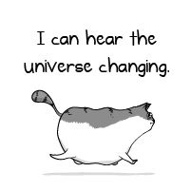
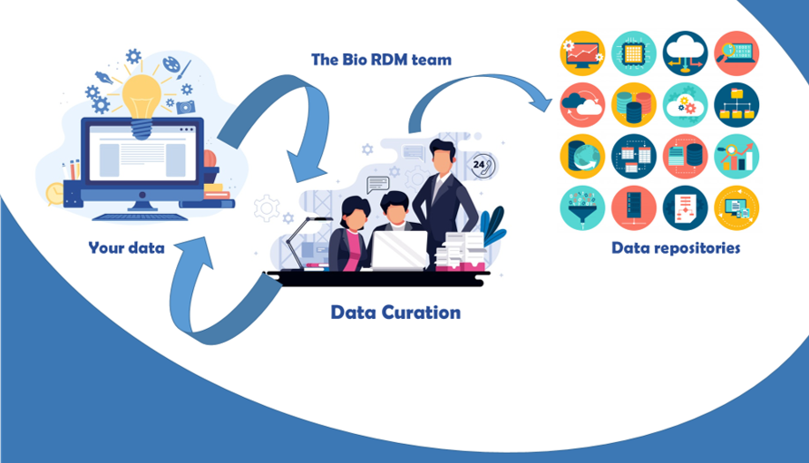
Need help? Just come talk to us!
Biological Research
Data Management Team
RDM as part of the workflow
bio_rdm@ed.ac.uk
https://www.wiki.ed.ac.uk/display/RDMS/
Notes:
Acquire description at earlier stages, split over the stages

