Slide 1
Introduction to Open Science

Slide 2
Open Science
Open science is the movement to make scientific research (including publications, data, physical samples, and software) and its dissemination accessible to all levels of an inquiring society, amateur or professional.
Open science is transparent and accessible knowledge that is shared and developed through collaborative networks.
Open Science represents a new approach to the scientific process based on cooperative work and new ways of diffusing knowledge by using digital technologies and new collaborative tools

Slide 3
Open Science
Using web-based tools to facilitate information exchange and scientific collaboration
Transparency in experimental methodology, observation, and collection of data
Public availability and reusability of scientific data
Public accessibility and transparency of scientific communication

Slide 4
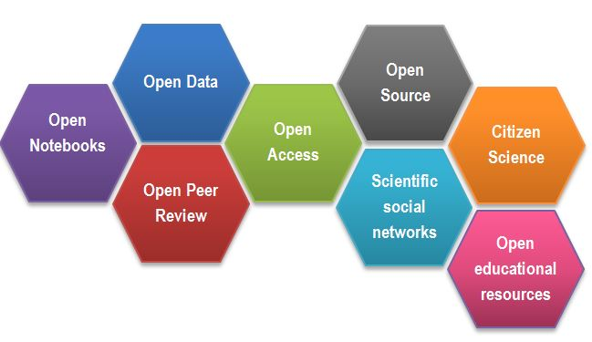
Open Science
CREDITS [1] CC BY

Slide 5
Consequences of Openness
Open educational resources:
makes quality teaching materials widely available
permits collaborative development of courses
improves teachers/instructors skills by sharing ideas

Slide 6
Consequences of Openness
Exercise

Slide 7
Open Science Motivation: Money
Scientific knowledge is a product of social collaboration and its ownership belongs to the community.
From an economic point of view, scientific outputs generated by public research are a public good that everyone should be able to use at no cost.
€10.2bn lost every year cause of not accessible data (plus addition 16 bn if accounting for re-use and research quality).
Source: Credits [2]

Slide 8
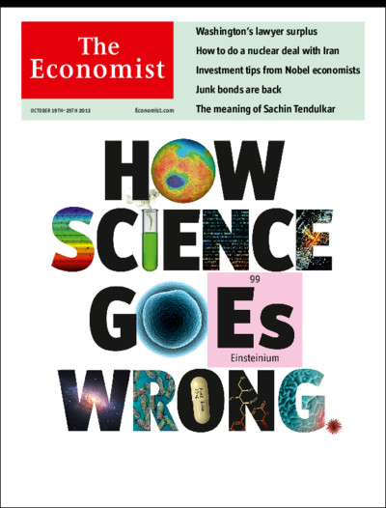
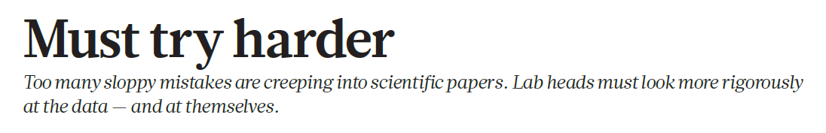
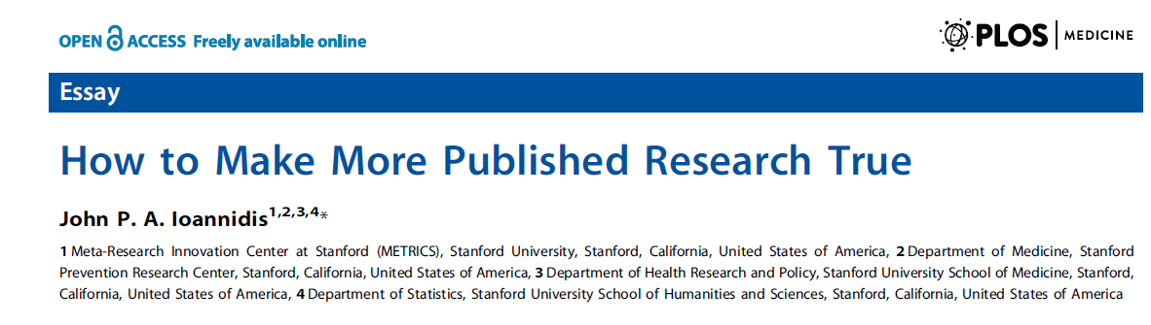
Open Science Motivation: Reproducibility

Slide 9
Motivation
“stick”
Large UK funding bodies such as The Wellcome Trust are big supporters of Open Science
“carrot”
….

Slide 10
Success story – Open Access
The initiative to move to Open Access publishing is known as Plan S
Publications available immediately and under open licences, either in:
quality Open Access platforms or journals
as a copy deposited with your home institution.
Details of funding bodies requirements can be found at Plan S/cOAlition S.
cOAlition S journal checker tool to assess compliance
the Directory of Open Access Journals (DOAJ) helps finding OA journals

Slide 11
Why we are not doing Open Science already
….

Slide 12
Why we are not doing Open Science already
sensitive data
misuse (fake news)
lack of confidence (the fear of critics)
the costs in $ and in time
IP

Slide 13
Intellectual property
Intellectual property is something that you create using your mind - for example, a story, an invention, an artistic work or a symbol.
You can use a patent to protect your (technical) invention. You can control copying, making, using, selling or importing
Discoveries, mathematical methods, computer programs are not regarded as inventions. Therapeutic procedures, diagnostic methods and new plant or animal varieties are completely excluded from patentability.

Slide 14
Intellectual property
Patents are granted only for inventions that are new and were not known to the public in any form.
Publishing in a journal or presenting in a conference information related to the invention completely prevents the inventor from getting later a patent!.

Slide 15
Intellectual property
In general, software cannot be patented
Software code is copyrighted. Copyright prevents people from:
copying your work
distributing copies of it, whether free of charge or for sale.
Data cannot be patented, and in general, it cannot be copyrighted. It is not possible to copyright facts!

Slide 16
Open Science and IP
timeline matters
(opinion) you are more likely to benefit from new collaborations, industrial partnerships, consultations which are acquired by openness, than from patent related royalties

Slide 17
Open Science and Money
incentive structures are beginning to support Open Science practices:
Universities signing up to the Declaration on Research Assessment (DORA)
the Wellcome Trust funding proposals that increase Open Science or evidence of OS activities for new grant applications

Slide 18
Open Science Quiz
…

