Slide 1
Methods of period analysis

Slide 2
Period
t
t
t
t
t
F(x + t) = F(x)

Slide 3
t
t
t
t
t
F(x + t) = F(x)

Slide 4
t
t
t
t
t
F(x + t) = F(x)

Slide 5
Period
F(x + t) = F(x)

Slide 6
Curve fitting
t
t
F(x) ≈ cos(α∙t)

Slide 7
Curve fitting
t
t
F(x) ≈ cos(α∙t)

Slide 8
Curve fitting
F(x) ≈ cos(α∙t)

Slide 9
Curve fitting
F(x) ≈ cos(α∙t)

Slide 10
Curve fitting
F(x) ≈ cos(α∙t) + cos(β)+cos(ρ)+…

Slide 11
Curve fitting
F(x) ≈ cos(α∙t) + cos(β)+cos(ρ)+…

Slide 12
Curve fitting
F(x) ≈ cos(α∙t) + cos(β)+cos(ρ)+…

Slide 13
Curve fitting
F(x) ≈ cos(24) + cos(11)+cos(9)+cos(186)

Slide 14
Phase
F(x) ≈ cos(α∙t-P)

Slide 15
What is phase?

Slide 16
What is phase?

Slide 17
What is phase?

Slide 18
What is phase?

Slide 19
PBM – phase by max

Slide 20
PBM – spline inter

Slide 21
PBM – spline inter

Slide 22
PBM

Slide 23
PBF – phase by fit

Slide 24
PBF – phase by fit

Slide 25
PBF

Slide 26
PBF

Slide 27
PBF

Slide 28
PBF

Slide 29
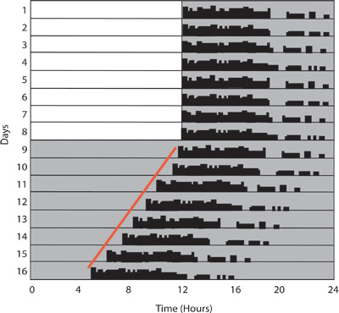
DOI:10.3791/2463

Slide 30
Methods
Cosinor – fitting one cos (org with period 24)

Slide 31
MFourFit
Using sin(ax) and cos(ax) and their harmonics
scanning throug expected periods

Slide 32
MFourFit
Using sin(ax) and cos(ax) and their harmonics
scanning throug expected periods

Slide 33
FFT NLLS
Non linear fitting (we find period, phase and amp at the same time)
Needs good starting points as candidate periods
Does FFT to find the main frequencies (periods)
Fitts up to 5 cos curves

Slide 34
FFT

Slide 35
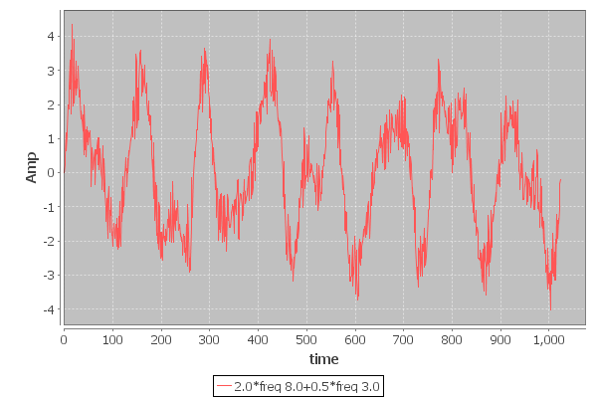
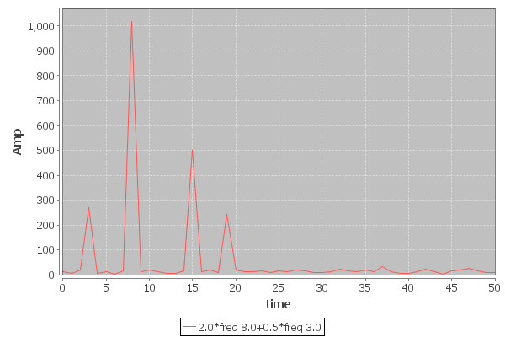

Slide 37
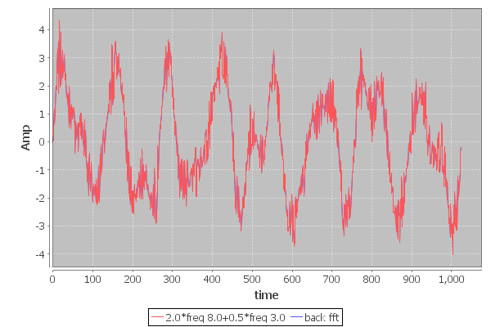

Slide 38
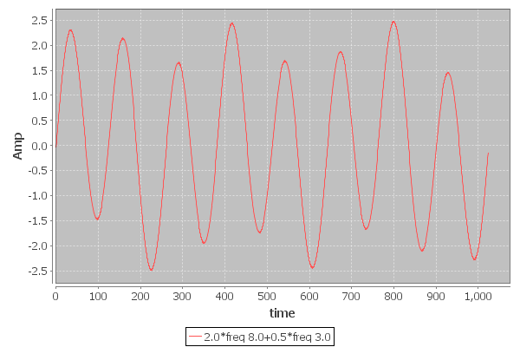
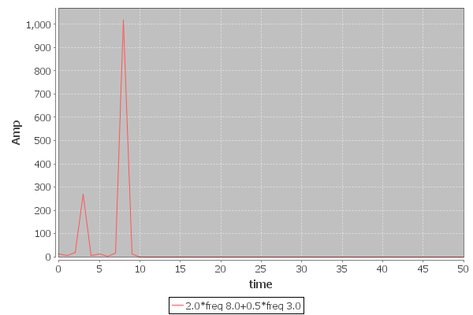

Slide 39
LS Periodogram
Non evenly spaced data

Slide 40
MESA
X[t] = a1X[t-1]+ a2X[t-2]+ a3X[t-3]+ ...+anX[t-N]+ η
„Magically” we get spectrum from the a1, a2 ... values

