Slide 1

Keeping track of changes

Slide 2
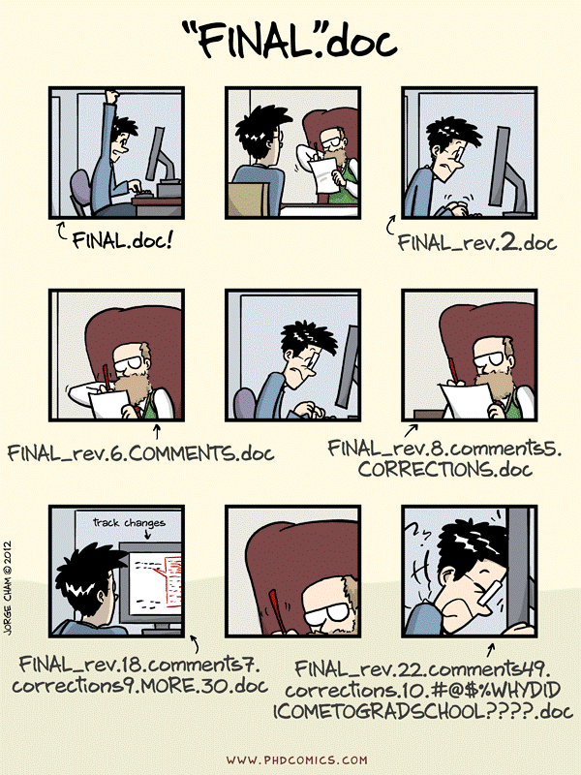

Slide 3
Projects are not static, and actions introduce changes.
add new files
add data entries to files
modify manuscripts / methods
reformat / reorganize data tables
reanalyse data / update figures
experiment with data cleaning / processing / visualization
share and co-edit data or text file

Slide 4
Exercise 1:
Problems with a change

Slide 5
When introducing changes to files and their content, we:
overwrite old content or loose whole files
may introduce side effects, e.g. renaming files may break analysis pipelines
introduce multiple changes to multiple files which should be treated as one change,
need to collate concurrent changes from collaborators e.g. “resolve conflicts”

Slide 6
Addressing those issues by tracking changes is called version control. .
With version control, file names do not reflect their changes.
Information about versions and changes are kept separate from the files.

Slide 7
Manual versioning
Add a file called ’CHANGELOG.txt’ to the project's subfolder, and make dated notes about changes in reverse chronological order.
## 2016-04-08
* Switched to cubic interpolation as default.
* Moved question about family's TB history to end of questionnaire.
## 2016-04-06
* Added option for cubic interpolation.
* Removed question about staph exposure (can be inferred from blood test results).

Slide 8
Manual versioning
Copy the entire project whenever a significant change is made, and store in a sub-folder.
.
|-- project_name
| -- current
| -- ...project content as described earlier...
| -- 2016-03-01
| -- ...content of 'current' on Mar 1, 2016
| -- 2016-02-19
| -- ...content of 'current' on Feb 19, 2016
Data is Cheap, Time is Expensive

Slide 9
Manual versioning
Keep changes small.
Store each project in a folder that is mirrored off the researcher's working machine
Share changes frequently.

Slide 10
Exercise 2:
Manual versioning

Slide 11
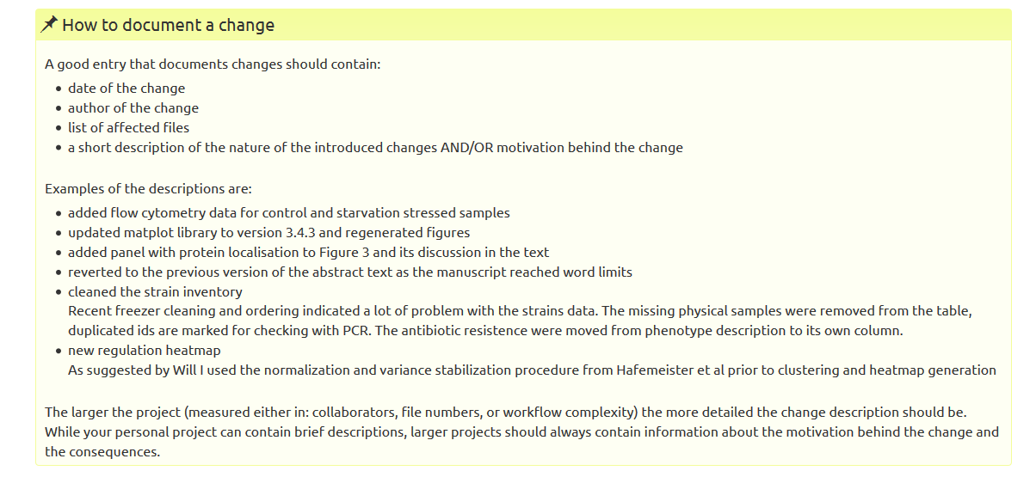

Slide 12
Exercise 3:
Changelog in action

Slide 13
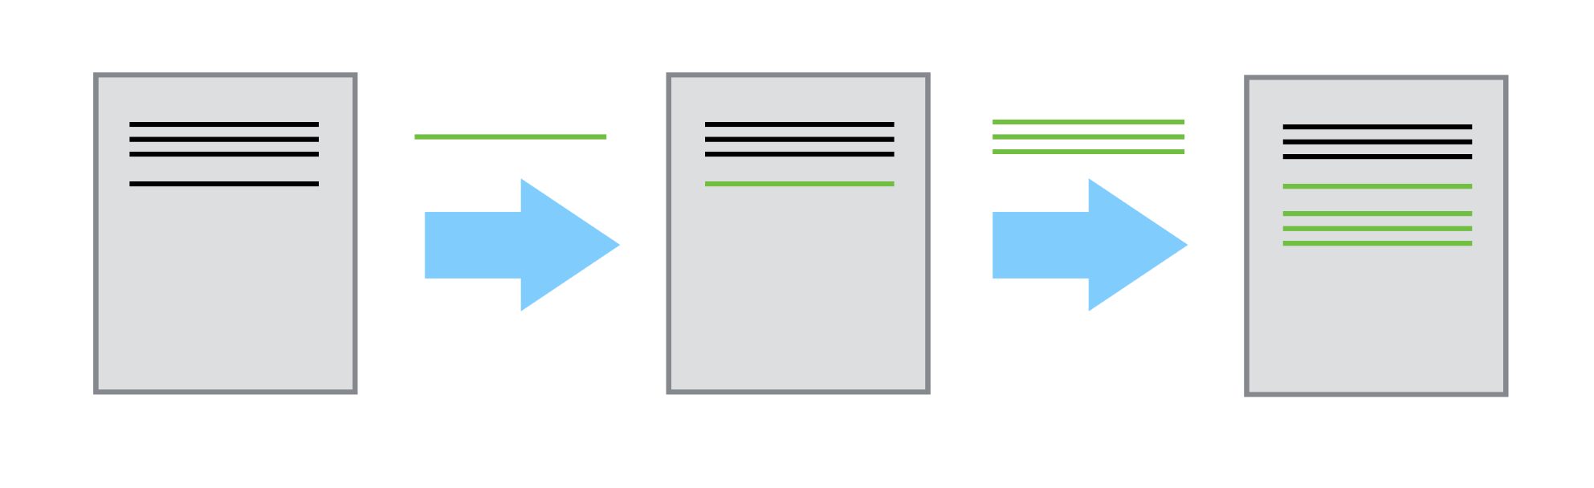
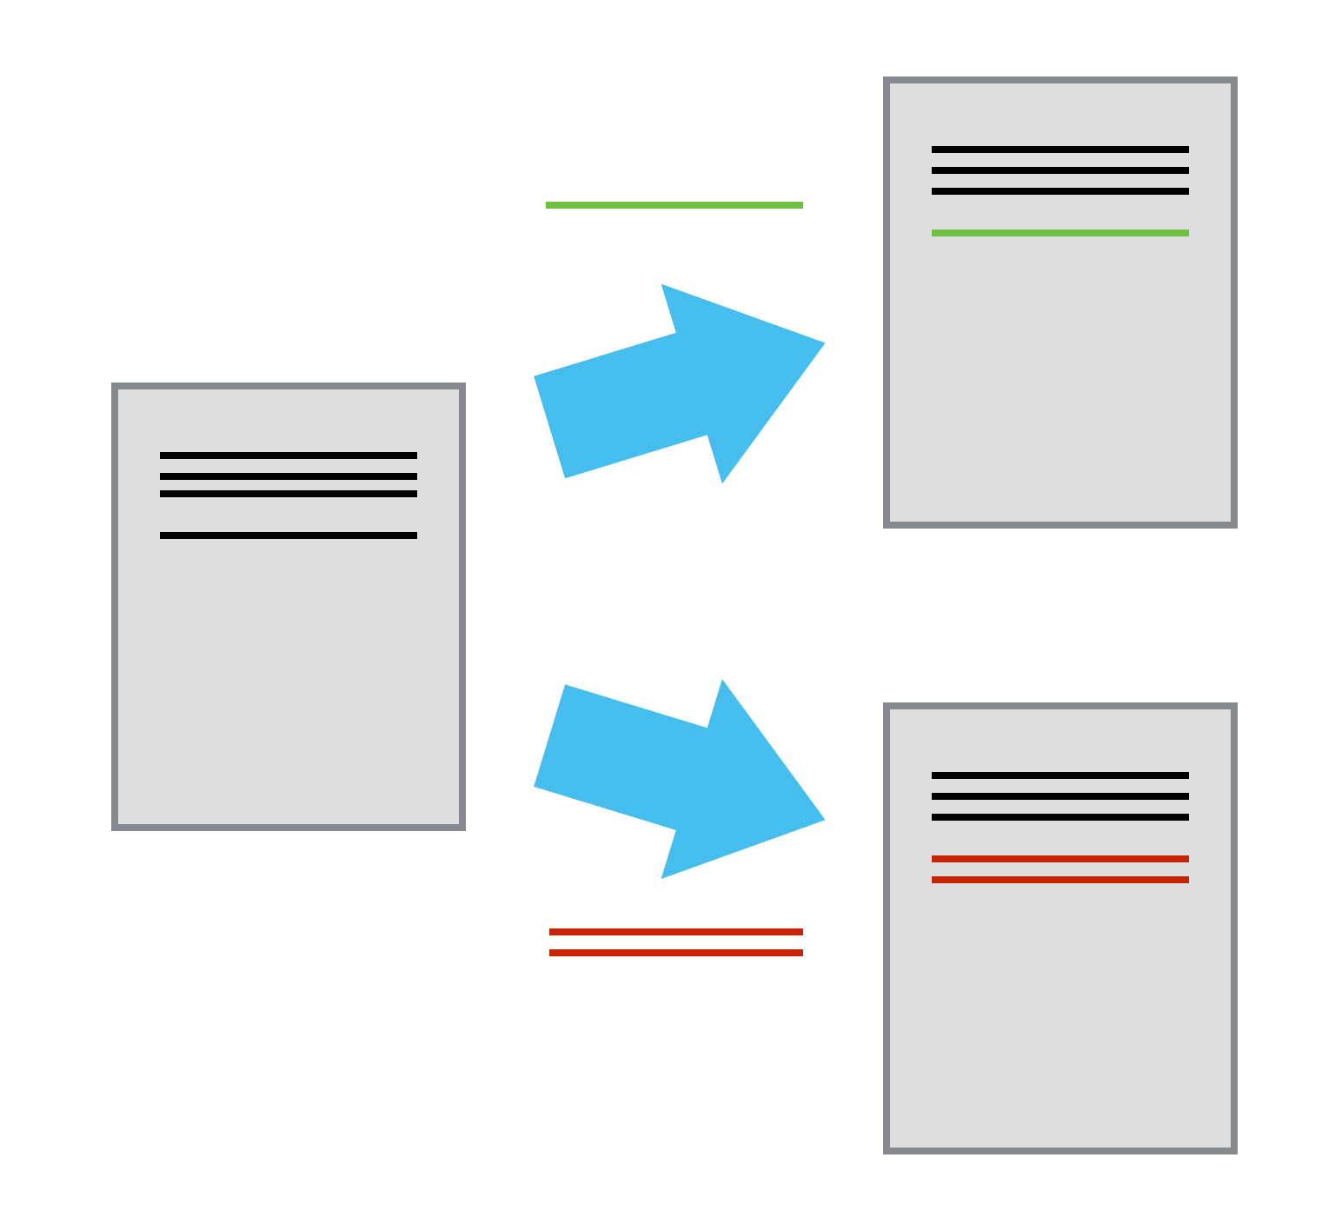
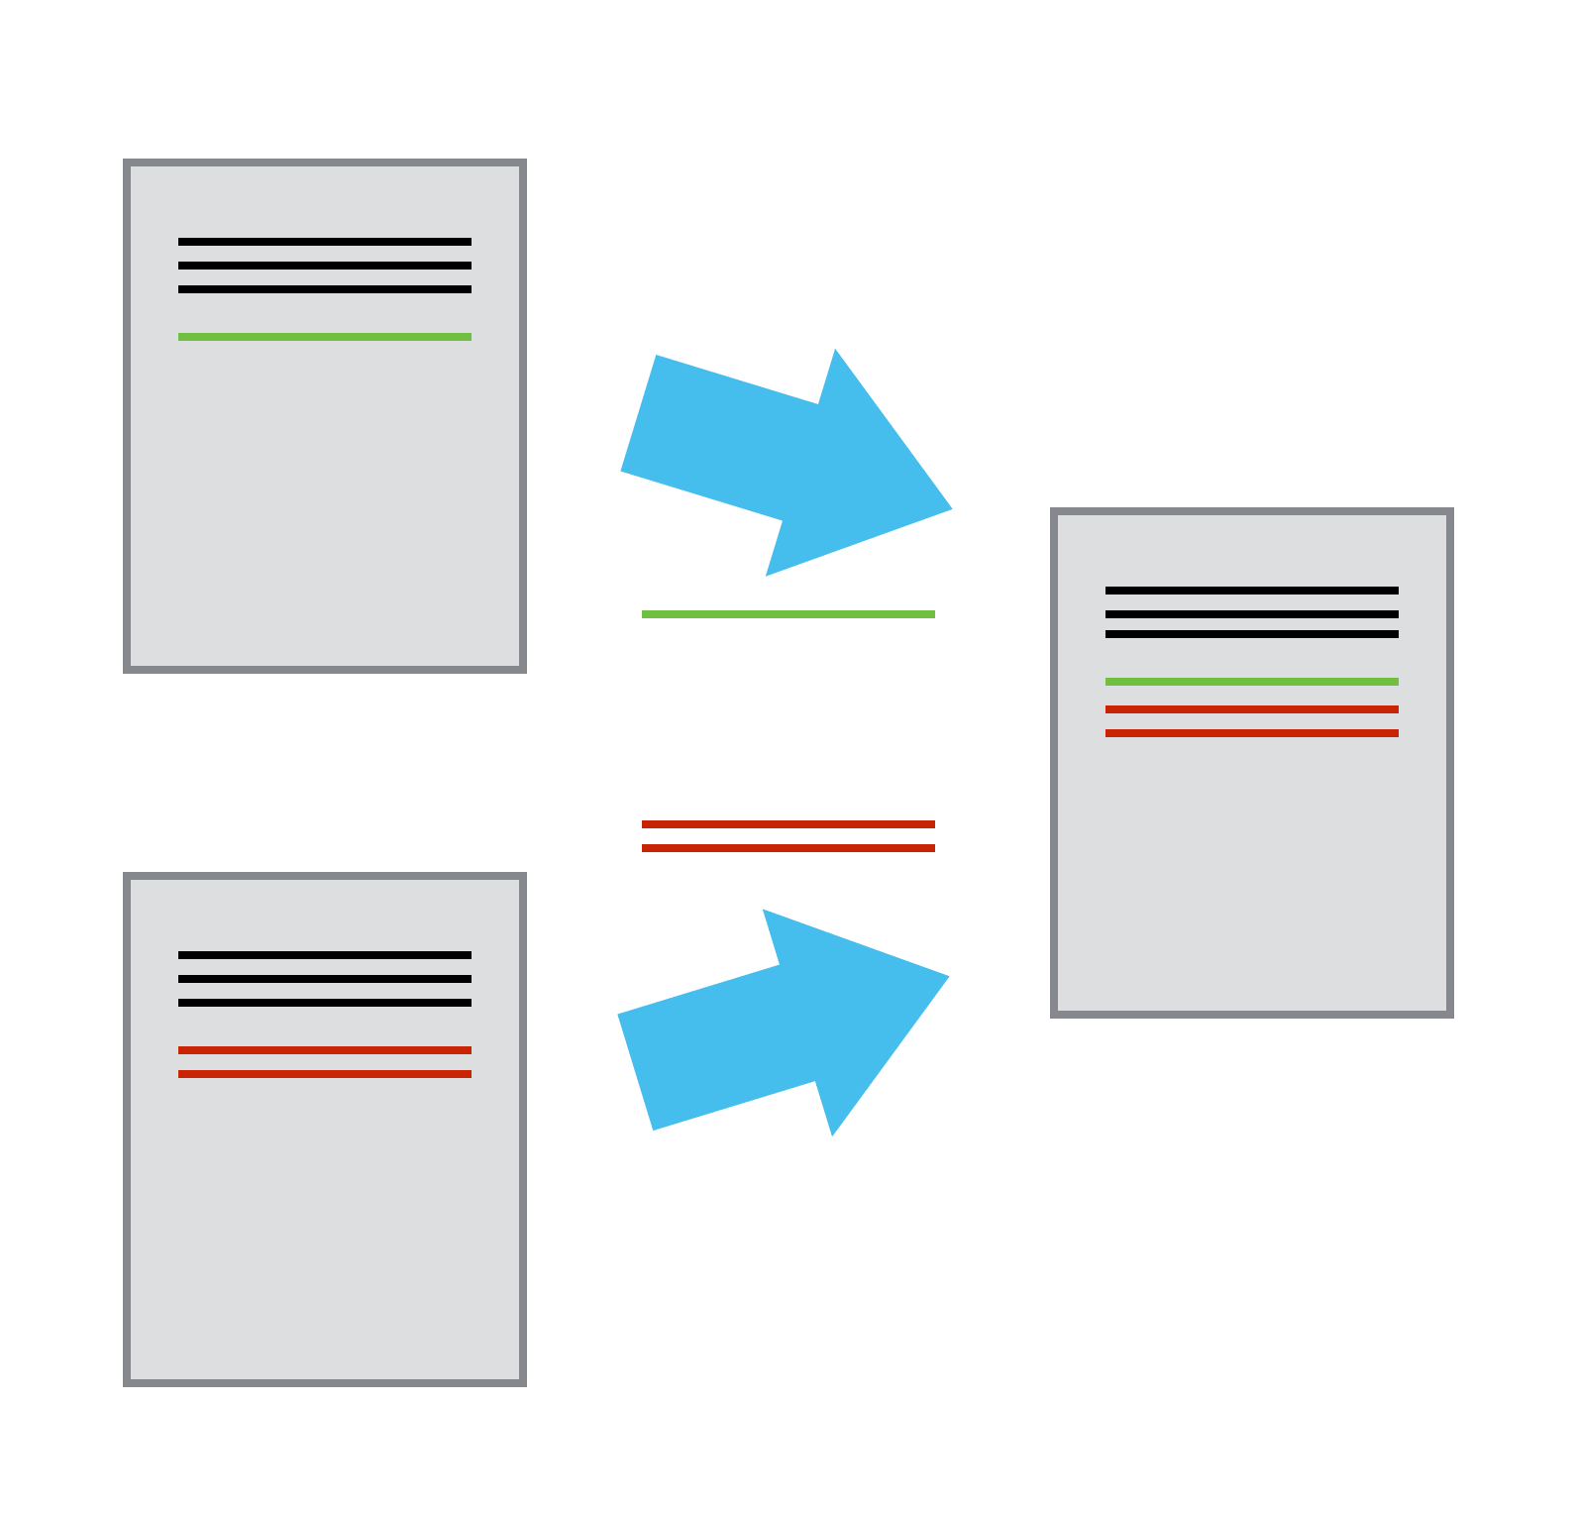
Version control systems

Slide 14
Version control systems
Keeps track of changes for us and helps us version and merge our files;
Allows you to decide which changes makes the next version (commit) and keeps metadata about them;
The complete history of commits for a particular project and their metadata make up a repository;
Timestamps saved changes automatically
Repositories can be kept in sync – facilitates collaboration

Slide 15
Exercise 4:
Looking at the reasons to use a version control system (VCS) in research, how does using VCS help in being FAIR?
Notes:
Online respository is a Findable and Accessible resource (also Trackable).
Online repositories are also interoperable since they can be accessed from anywhere (with internet) and are not restricted to your local hard drive.
The 'telling story' and being able to travel back in time helps in reuse and reproducibility.

Slide 16
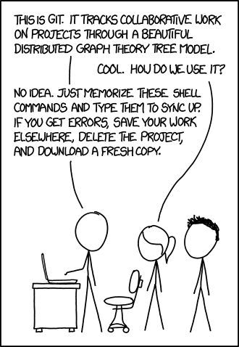
Learning git
a must for computing
a worthy skill for everyone

Slide 17
Learning git
Software Carpentry git workshop https://swcarpentry.github.io/git-novice/
Edinburgh Carpentries runs courses: https://edcarp.github.io/
https://ourcodingclub.github.io/tutorials/git/
Crash course on youtube: https://youtu.be/SWYqp7iY_Tc
Learn git branching: https://learngitbranching.js.org/
Learn git-game: https://github.com/git-game/git-game

Slide 18
Semantic versioning
a particular point in time (a set of changes) has its logical meaning
the “official” point in time (especially if it is meant to be consumed by others) is called release.
you may not always want to use the latest version of a software.
the potential issue when using the “newest version” of a library is well known and called “dependency hell”.

Slide 19
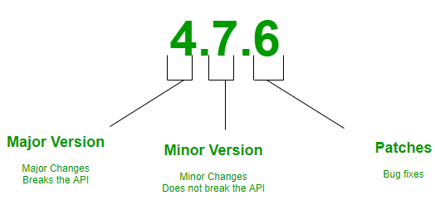
Semantic versioning

Slide 20
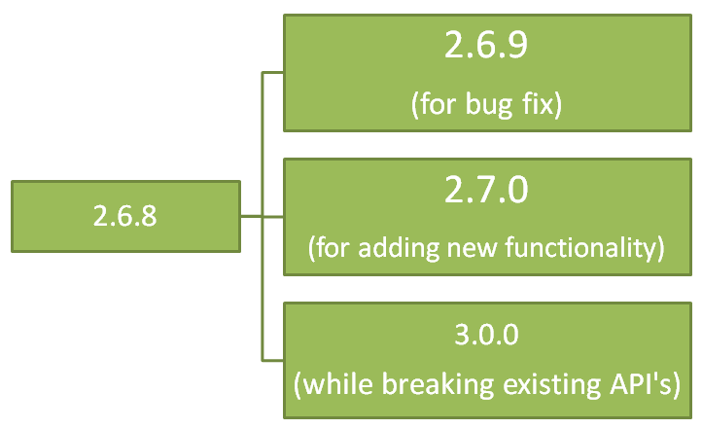
Semantic versioning
for small edits
and corrections
for adding new data or details
for re-writes, reformating, renaming

Slide 21
Semantic versioning
See how the sorted versions look like
1.91.12
1.91.8
2.13.3-alpha
2.14-alpha
2.15-beta
3.0.923

Slide 22
Semantic versioning
Exercise 5

Slide 23
Semantic versioning
Exercise 5 - answers
c
b
b
a
c

