Slide 1
Being precise

Slide 2
Metadata should be interoperable
It should be:
formal
accessible
shared
and use broadly applicable terms/language

Slide 3
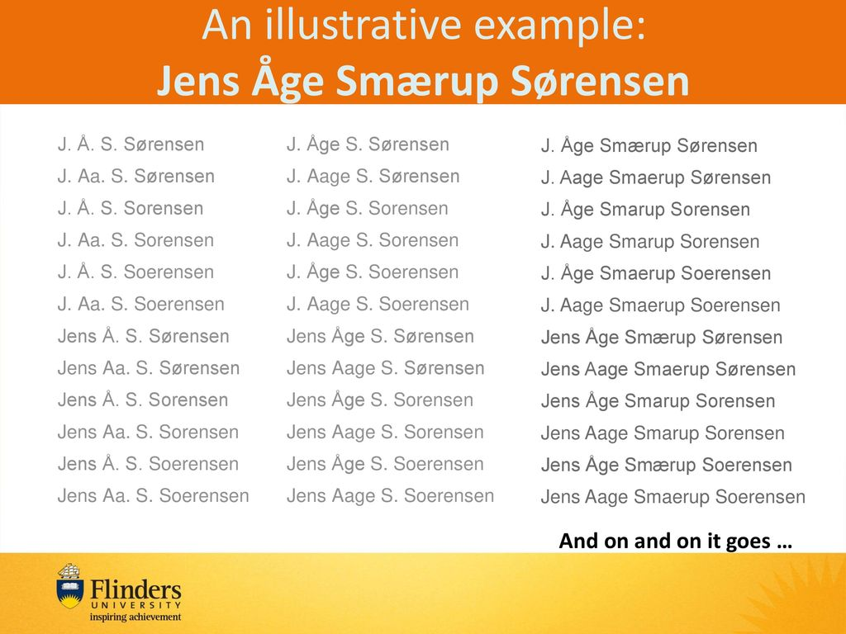
After Libarary Carpentry FAIR Data

Slide 4

Free, unique, and persistent identifier which you control
https://orcid.org/
Notes:
Have you ever done a search in pubmed and found that you have doppelganger? So how can you uniquely associate something you created to just you and no other researcher that has the same name?
ORCID iD is a free, unique, persistent identifier that you own and control—forever. It distinguishes you from every other researcher across disciplines, borders, and time.
ORCIDs of authors of this episode are:
0000-0002-0194-5706
0000-0003-0737-2408
You can connect your iD with your professional information—affiliations, grants, publications, peer review, and more. You can use your iD to share your information with other systems, ensuring you get recognition for all your contributions, saving you time and hassle, and reducing the risk of errors.
If you do not have an ORCID, you should register to get one!

Slide 5
Exercise 1
ORCID in action
https://doi.org/10.12688/wellcomeopenres.15341.2
Notes:
The second metadata example (the Excel table) contains two other types of public IDs. Can you find them? Can you find the meaning behind those Ids?
The metadata example contains genes IDs from The Arabidopsis Information Resource TAIR and metabolites IDs from KEGG

Slide 6
Similarly, other registries can be used to identify many biological concepts and entities:
species e.g. NCBI taxonomy https://www.ncbi.nlm.nih.gov/Taxonomy
chemicals e.g. ChEBI https://www.ebi.ac.uk/chebi
proteins e.g. UniProt https://www.uniprot.org/
genes e.g. GenBank https://www.ncbi.nlm.nih.gov/genbank/
metabolic reactions, enzymes e.g KEGG https://www.genome.jp/kegg/
NCBI or BioPortal are good places to start searching for a registry or a term.
Notes:
Have you ever done a search in pubmed and found that you have doppelganger? So how can you uniquely associate something you created to just you and no other researcher that has the same name?
ORCID iD is a free, unique, persistent identifier that you own and control—forever. It distinguishes you from every other researcher across disciplines, borders, and time.
ORCIDs of authors of this episode are:
0000-0002-0194-5706
0000-0003-0737-2408
You can connect your iD with your professional information—affiliations, grants, publications, peer review, and more. You can use your iD to share your information with other systems, ensuring you get recognition for all your contributions, saving you time and hassle, and reducing the risk of errors.
If you do not have an ORCID, you should register to get one!

Slide 7
Finding registries or terms
[BioPortal] - (https://bioportal.bioontology.org/)
[NCBI] - (https://www.ncbi.nlm.nih.gov/)
Notes:
Have you ever done a search in pubmed and found that you have doppelganger? So how can you uniquely associate something you created to just you and no other researcher that has the same name?
ORCID iD is a free, unique, persistent identifier that you own and control—forever. It distinguishes you from every other researcher across disciplines, borders, and time.
ORCIDs of authors of this episode are:
0000-0002-0194-5706
0000-0003-0737-2408
You can connect your iD with your professional information—affiliations, grants, publications, peer review, and more. You can use your iD to share your information with other systems, ensuring you get recognition for all your contributions, saving you time and hassle, and reducing the risk of errors.
If you do not have an ORCID, you should register to get one!

Slide 8
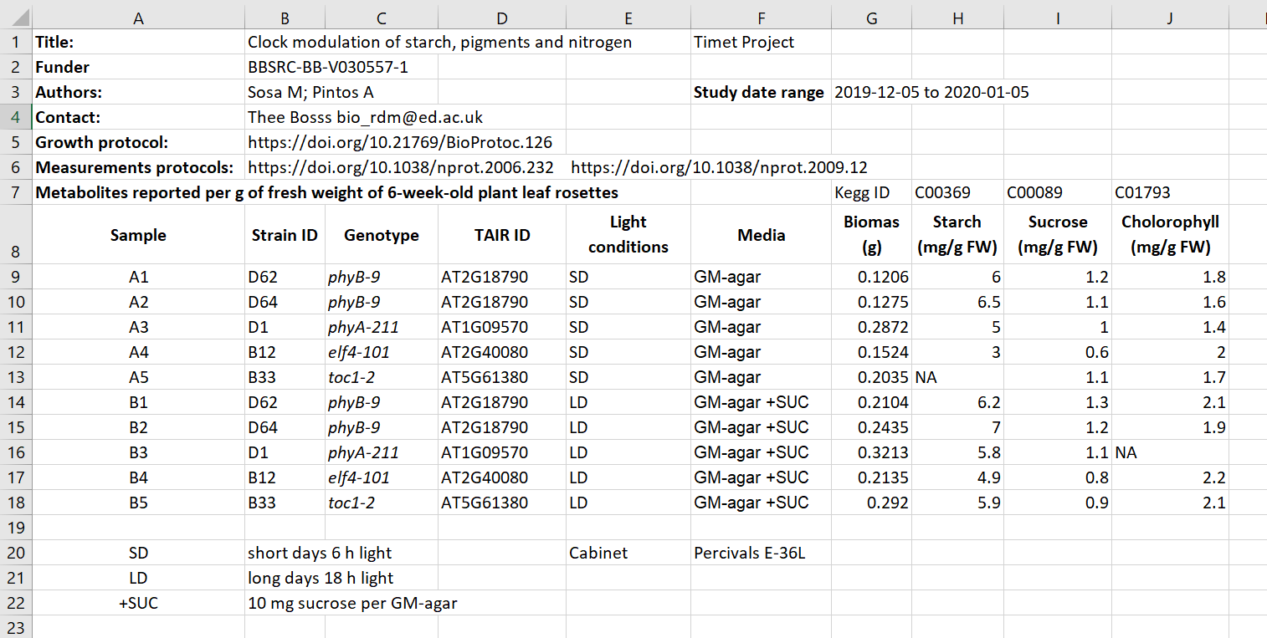
Exercise:
Public ID in action
Figure credits: Tomasz Zielinski and Andrés Romanowski
Notes:
In groups, identify different types of metadata (administrative, descriptive, structural) present in this example.

Slide 9
Exercise/challenge 2:
Public ID in action
Notes:
The second metadata example (the Excel table) contains two other types of public IDs. Can you find them? Can you find the meaning behind those Ids?
The metadata example contains genes IDs from The Arabidopsis Information Resource TAIR and metabolites IDs from KEGG

Slide 10

Disambiguation
Escherichia coli
EColi
E. coli
E. Coli
Kanamycin A
Kanamycin
Kanam.
Kan.

Slide 11
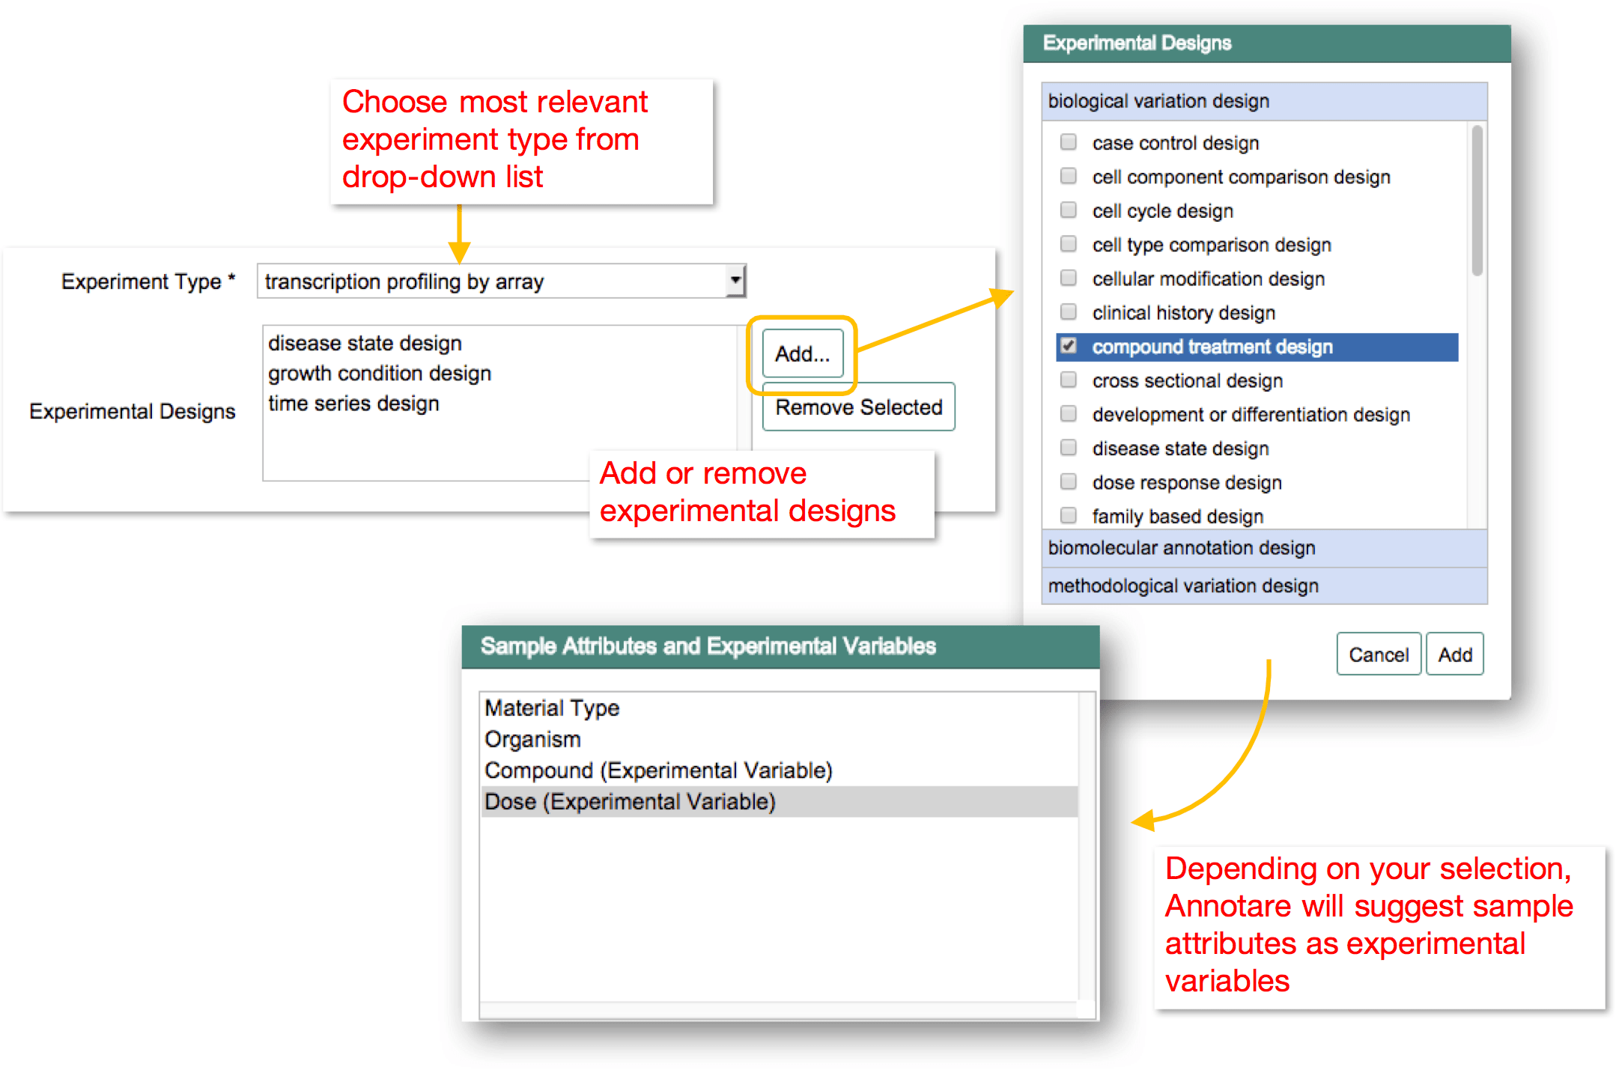
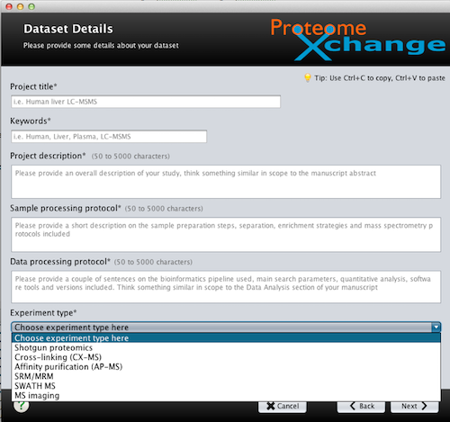
List of options == Controlled Vocabulary
Notes:
Example of graphical user interfaces with controlled vocabularies

Slide 12

Controlled Vocabulary
Definition:
Any closed, prescribed list of terms
Key Features:
Terms are not usually defined
Relationships between the terms are not usually defined
Simplest form is a list
Example:
E. coli
Drosophila melanogaster
Homo sapiens
Mus musculus
Salmonella

Slide 13
Taxonomy
Definition:
Any controlled vocabulary that is arranged in a hierarchy
Key Features:
Terms are not usually defined
Relationships between the terms are not usually defined
Terms are arranged in a hierarchy
Example:
Bacteria
E. coli
Salmonella
Eucariota
Mammalia
Homo sapiens
Mus musculus
Insecta
Drosophila melanogaster

Slide 14
Ontology
Definition:
A formal conceptualization of a specified domain
Key Features:
Terms are defined
Relationships between terms are defined, allowing logical inference and sophisticated data queries
Terms are arranged in a hierarchy
Expressed in a knowledge representation language such as RDFS, OBO, or OWL
Example:
Bacteria
E. coli
Salmonella
Eucariota
Mammalia
Homo sapiens
Mus musculus
Insecta
Drosophila melanogaster

Slide 15
Ontology
Definition:
A formal conceptualization of a specified domain
Relationships between terms are defined, allowing logical inference
Example:
Bacteria
E. coli
Salmonella
Eucariota
Mammalia
Homo sapiens
Mus musculus
Insecta
Drosophila melanogaster
nucleus
has_part
has_part
placenta

Slide 16
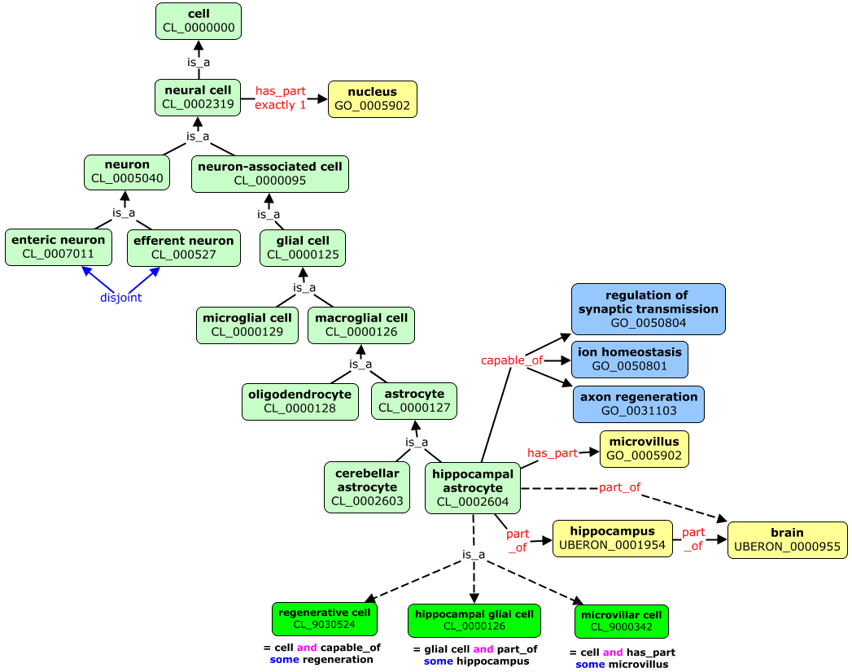
Ontologies

Slide 17
Ontologies

Slide 18
Ontologies

Slide 19
Where to find terms / ontologies
https://bioportal.bioontology.org/
https://obofoundry.org/

Slide 20
Explore ontolgies (code-along)
https://bioportal.bioontology.org/ontologies/SO?p=classes&conceptid=http://purl.obolibrary.org/obo/SO_0000167#details
https://bioportal.bioontology.org/ontologies/ZFA/?p=classes&conceptid=http%3A%2F%2Fpurl.obolibrary.org%2Fobo%2FZFA_0001109#details
https://bioportal.bioontology.org/ontologies/CL?p=classes&conceptid=CL:0000129#details

Slide 21
Conclusions
Using broadly applicable, standardised terms
Ensures clarity, avoids ambiguity;
Facilitates Interoperability and integration: enables different systems, databases and disciplines to interpret metadata consistently;
Improves discoverability (Findable).

Slide 22
Credits
BD2K Open Educational Resources: BDK14 Ontologies 101,
Nicole Vasilevsky,
https://github.com/OHSUBD2K/BDK14-Ontologies-101

