Slide 1
Introduction to Open Science

Slide 2

Open Science
Open science is transparent and accessible knowledge
that is shared and developed
through collaborative networks.

Slide 3
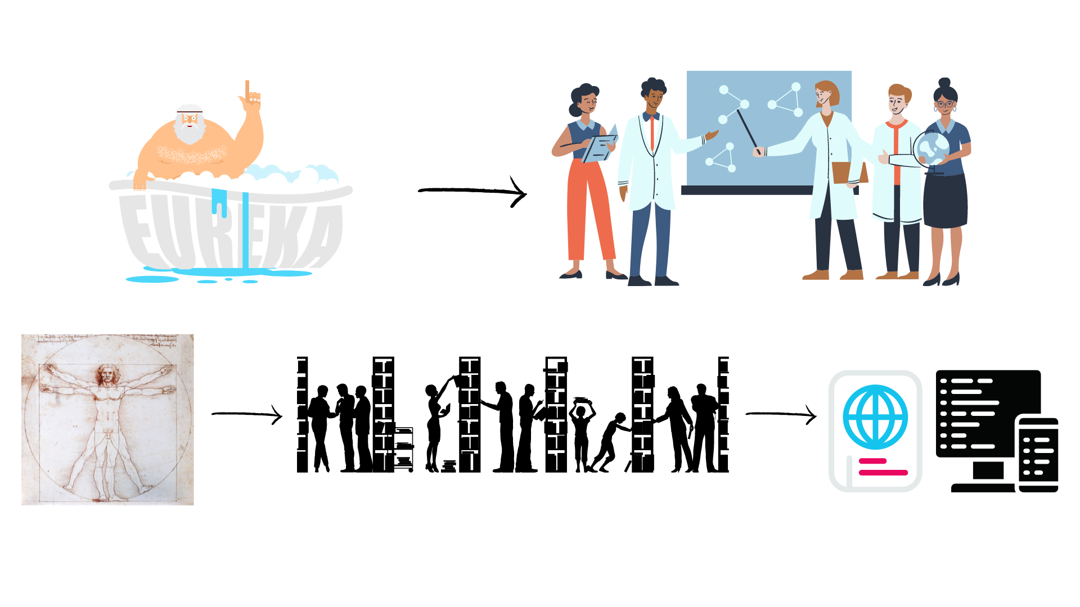
Evolution of Research
Level of openness in research

Slide 4






Open Science
Open science is the movement to make scientific research accessible to all levels of the society
general public
amateurs
professionals
students
teachers
publications
data
physical samples
software

Slide 5
Open Science
New approach to the scientific process based on:
digital technologies for diffusing knowledge
cooperative work and collaborative tools

Slide 6
Open Science - Charactersitics
Web-based tools to facilitate information exchange collaboration
Transparency in experimental methodology, observation, and collection of data
Public availability and reusability of scientific data, methods and communications

Slide 7
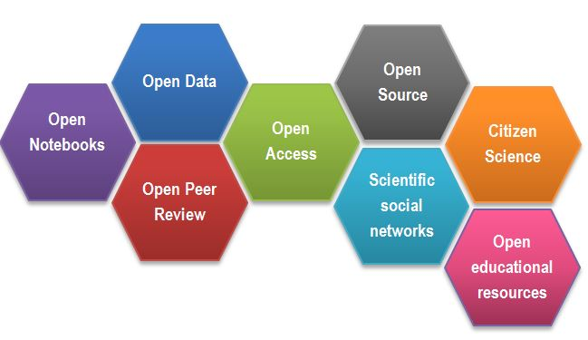
Open Science
CREDITS: BOOk, Mbajiorgu, Ngozika, 2019/12/10, Open science: Leaving no one behind (Click Here)

Slide 8
Success story – Open Access
The initiative to move to Open Access publishing is known as Plan S
Publications available immediately and under open licences, either in:
quality Open Access platforms or journals
as a copy deposited with your home institution.
Details of funding bodies requirements can be found at Plan S/cOAlition S.
cOAlition S journal checker tool to assess compliance
the Directory of Open Access Journals (DOAJ) helps finding OA journals

Slide 9
Outcomes of Openness
Open Access:
speed of work and knowledge distribution
levelling field for underfunded sites
increasing chance for collaboration, exposure & citations
new metrics of impact: views, downloads, tweets etc
access to work by lay audiences, thus increases social exposure of research

Slide 10
Outcomes of Openness
Exercise 1

Slide 11

Outcomes of Openness
Collaboration
Speed
Unpublished/negative results
Re-use
Learn by example
Feedback

Slide 12
Open Science motivation: Money
Scientific knowledge is a product of social collaboration and its ownership belongs to the community.
From an economic point of view, scientific outputs generated by public research are a public good that everyone should be able to use at no cost.
€10.2bn lost every year because of not accessible data (plus additional 16bn if accounting for re-use and research quality).
Source: Cost-benefit analysis for FAIR research data - Publications Office of the EU

Slide 13
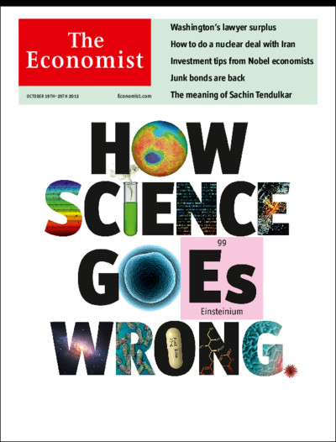
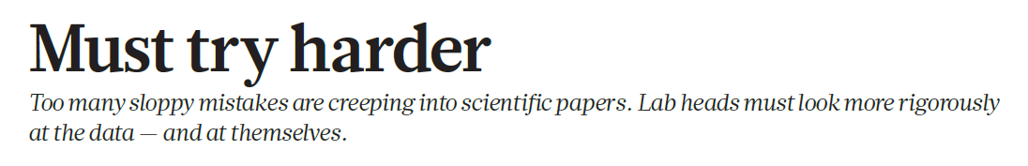
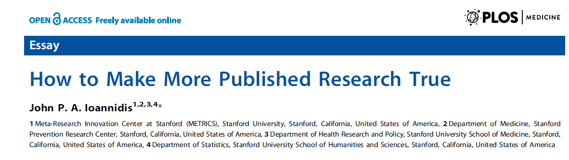
Open Science Motivation: Reproducibility

Slide 14

Motivation
“stick”
Large UK funding bodies such as The Wellcome Trust are big supporters of Open Science
“carrot”
Exercise 2

Slide 15

Why we are not doing Open Science already
…. Exercise 3

Slide 16
Why we are not doing Open Science already
lack of expertise
sensitive data
misuse (fake news)
lack of confidence (the fear of critics)
the costs in $ and in time
IP

Slide 17
Open Science - get involved!
incentive structures are beginning to support Open Science practices:
Universities signing up to the Declaration on Research Assessment (DORA)
the Wellcome Trust funding proposals that increase Open Science or evidence of OS activities for new grant applications

Slide 18

DORA
Declaration on Research Assessment
the need to eliminate the use of journal-based metrics, such as Journal Impact Factors, in funding, appointment, and promotion considerations;
the need to assess research on its own merits rather than on the basis of the journal
the need to capitalise on the opportunities provided by online publication (such as relaxing unnecessary limits … exploring new indicators of significance and impact)
CREDITS: About DORA | DORA

Slide 19
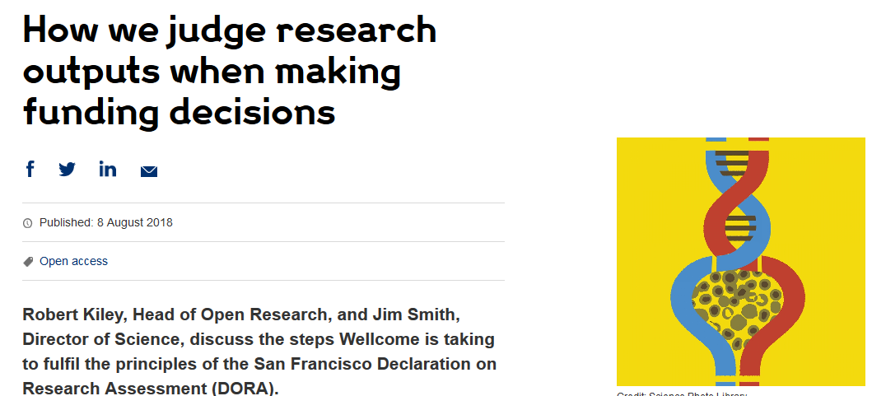
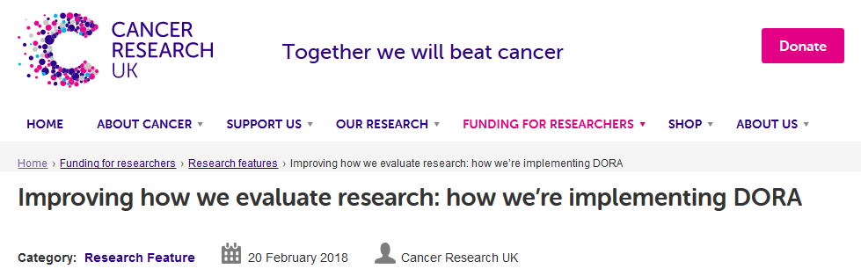
DORA: Funders adoption
Wellcome
London, United Kingdom
Cancer Research UK
London, UK
Application includes:
List of research outputs
Summary of 3-5 achievements
Space to describe other measures of impact
Reminds peer reviewers and committee
members of DORA principles throughout
funding process
Application includes:
List of research outputs
Contributions to mentorship
Output sharing plan to advance potential health benefits
Plans for public engagement
Guidance provided to advisory panel members
CREDITS [5] CC BY
Notes:
Wellcome example: https://wellcome.ac.uk/news/how-we-judge-research-outputs-when-making-funding-decisions
Cancer Research UK example: https://www.cancerresearchuk.org/funding-for-researchers/research-features/2018-02-20-improving-research-evaluation-dora

Slide 20
Narrative CV
Definition:
A narrative CV is defined by the Declaration on Research Assessment (DORA) as a CV format that provides a structured written description of a person’s contributions and achievements that reflects a broad range of relevant skills and experiences, more than can often be seen in a traditional academic CV.
Generation of Knowledge
Development of Individuals and Collaborations
Supporting Broader Society and the Economy
Supporting the Research Community

Slide 21
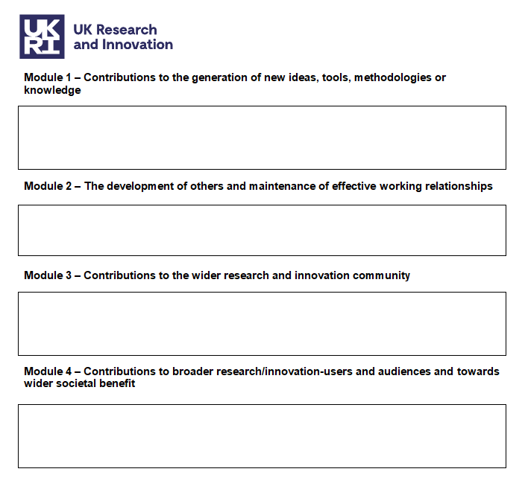
UKRI- Narrative CV – R4RI
New Concept of Outputs
Management/Mentoring/Teaching
Activities/ Workshops/Reviewing
Policies/partnerships/PPI/Actions

Slide 22
Narrative CV -
A broad definition of ‘output’ is used, such as: Publications- Conference publications - datasets – patents- Evidence Synthesis (SR)- software – Products – media
Special attention is paid to Open Science, which outputs are openly available.
New metrics: retweets - online views and downloads - discussion – mentorships - presence in mass media technology platforms

Slide 23
Tips
Remember to focus on quality over quantity.
Demonstrate your commitment to open and transparent research practices, including in how you manage and share data, methods, and findings.
Go beyond a list of the numbers of people you have supervised or mentored. For example, how did you help them to develop and what did they go on to achieve?
How did a research or innovation community benefit from your activity?
Consider the activity you undertook, but emphasise the resulting change
Consider the scale and depth of the benefit

Slide 24
Where to next
Challenges & benefits of OS https://doi.org/10.1371/journal.pbio.3000246
Centre for Open Science https://www.cos.io/
Ted talk supporting OS https://youtu.be/c-bemNZ-IqA

Slide 25
Take-home Message
Open Science makes research transparent, accessible, and reproducible, benefiting both science and society.
Sharing your work openly drives innovation, builds trust, and increases impact.
Personal benefits include higher citations, collaborations, and stronger reputations in the research community.
Overcoming challenges like data sensitivity, costs, and time investment helps build a more equitable and efficient scientific future.
By embracing Open Science, you become a pioneer in transforming research for the better.

Slide 26
Open Science Quiz
Exercise 4

