Slide 1
Your way to FAIR

Slide 2
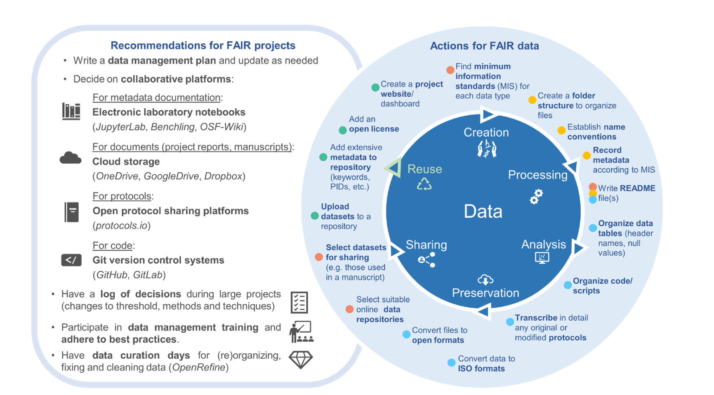
Your actions from now…
Scorza LCT et al. Daily life in the Open Biologist’s second job, as a Data Curator- Wellcome Open Res 2024, 9:523 (https://doi.org/10.12688/wellcomeopenres.22899.1)

Slide 3
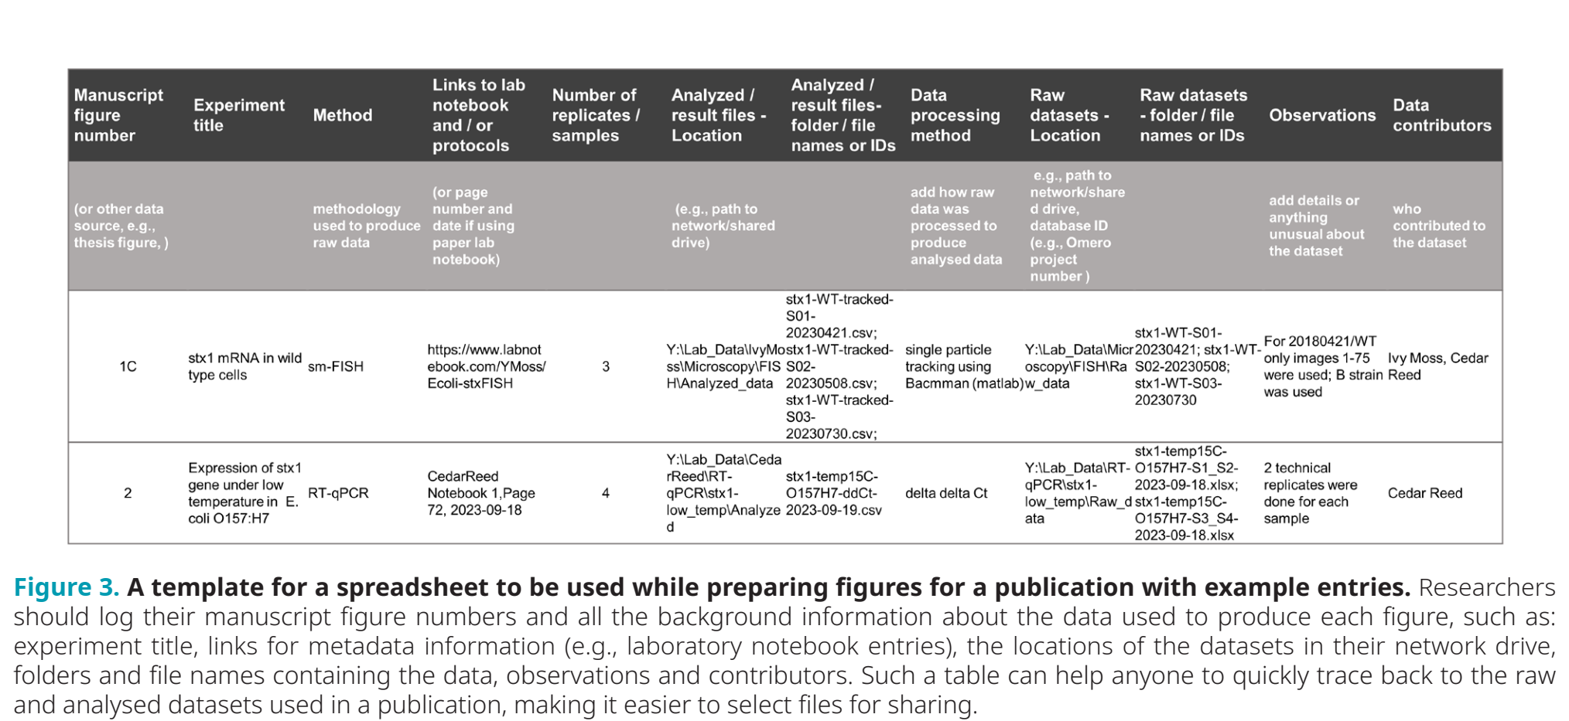
Don’t get lost with your data while writing

Slide 4
It is easier to be prepared than to fake it
It takes time to make the outputs public
The quality of open outputs is easy to assess
Timestamps

Slide 5
Keeping safe your project files and folders
Back up (almost) everything created by a human or recorded by a machine as soon as it is created.
Always backup your files in 3 places, at least one should be off-site.
USB sticks are a failure-prone option and are not a valid solution for backup of scientific data
A robust backup cannot be achieved manually – your University / Institution should provide a safe network storage solution for data
Notes:
Do you know how and where to keep 3 copies of your data which are always up to date?
Secure data preservation is very difficult to achieve without institutional support and know-how. One option is cloud storage, but not all data may be put in a public cloud.
You should always check your institutional guidelines and what solutions are available in your organisation.

Slide 6
Your musts According to policies (University / funders):
You are responsible for safety of your data (both storage and access)
Back up (almost) everything created by a human or recorded by a machine as soon as it is created.
USB sticks are a failure-prone option and are not a valid solution for backup of scientific data
Always backup your files in 3 places, at least one should be off-site.
A robust backup cannot be achieved manually
Your University / Institution should provide you a safe network file storage service solution

Slide 7
Your musts According to policies (University / funders):
You need a DMP for your project
You have to publish Open Access
You have to make available all the data underlying publications

Slide 8
You want to
Have as many public outputs as possible:
Datasets in public repositories
Public protocols
Code packages
Public engagement
Involvement in community groups, student groups etc
(podcasts, University Open Day, Science Festivals, etc)
for your Narrative CVs (new metrics for evaluating researchers!)

Slide 9
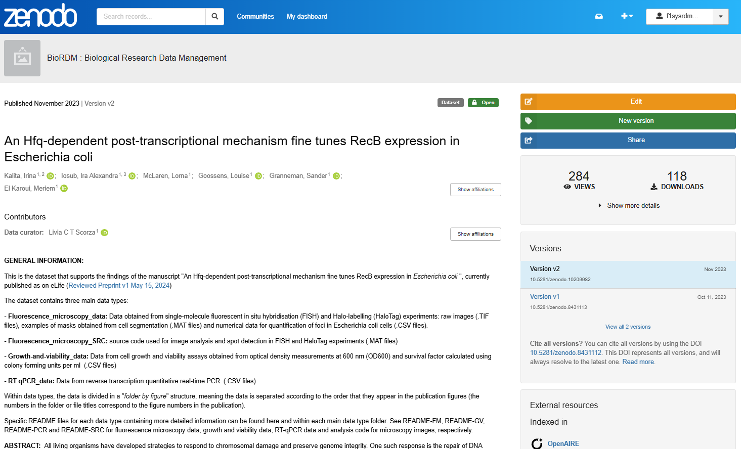
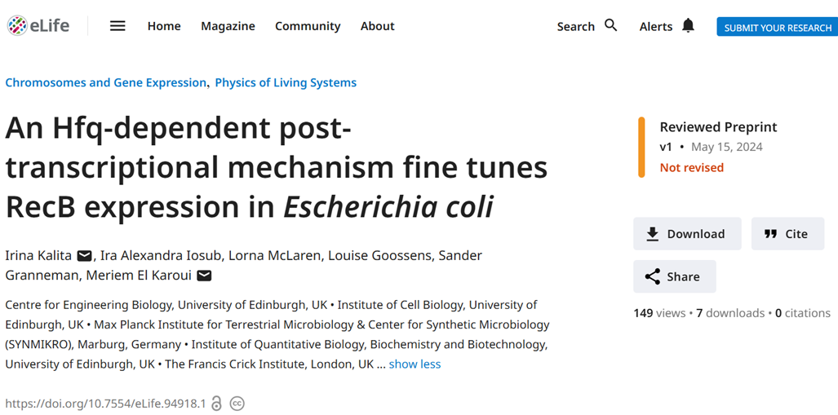
Example of dataset impact
Dataset
Publication

Slide 10
What about sharing data as “Supplementary Information”?
- Limited amount of data that can be uploaded
Dataset not easily discovered on its own
Publication might not be OA
Does not provide a DOI for the dataset
Repositories hold records that are not related to publications

Slide 11
Resources for data management
List of suggested training materials for Open and FAIR data
BioRDM wiki
https://www.wiki.ed.ac.uk/display/RDMS
DMPOnline
https://dmponline.dcc.ac.uk
Jupyter notebook
https://jupyter.org/
Benchling
https://www.benchling.com/
Protocols.io
https://www.protocols.io/
Zenodo
https://zenodo.org/
FAIRification of you project (FAIR cookbook)
https://faircookbook.elixir-europe.org/
Github/ GitLab
https://github.com/
https://git.ecdf.ed.ac.uk/
Version control with Git - self paced course
https://swcarpentry.github.io/git-novice/
FAIR in (biological) Practice | https://carpentries-incubator.github.io/fair-bio-practice/
The Turing Way guide for reproducible research | https://book.the-turing-way.org/reproducible-research/ reproducible-research/
Good enough practices in scientific computing | https://carpentries-lab.github.io/good-enough-practices/
Escape from spreadsheet hell | https://instr.iastate.libguides.com/spreadsheets/home
Library Carpentry: Tidy data for Librarians | https://librarycarpentry.org/lc-spreadsheets/
Version control with Git | https://swcarpentry.github.io/git-novice/
Data cleaning with OpenRefine for Ecologists | https://datacarpentry.org/OpenRefine-ecology-lesson/
ELIXIR guidelines and best practices | https://elixir-europe.org/what-we-offer/guidelines https://faircookbook.elixir-europe.org/ https://rdmkit.elixir-europe.org/
Bringing data to life: Data management for the biomolecular sciences | https://www.ebi.ac.uk/training/online/courses/bringing- data-to-life-data-management/

Slide 12


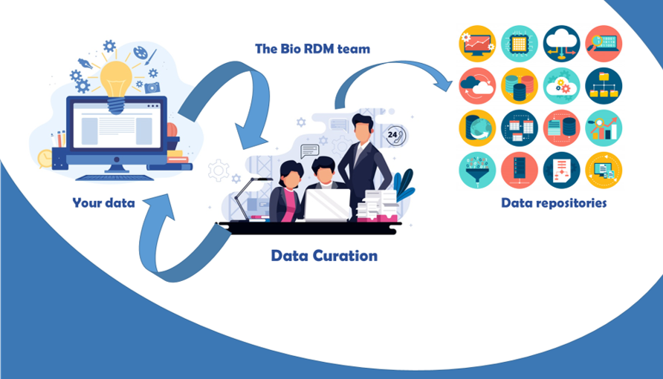
Need help? Just come talk to us!
Biological Research
Data Management Team
RDM as part of the workflow
bio_rdm@ed.ac.uk
https://www.wiki.ed.ac.uk/display/RDMS/
Notes:
Acquire description at earlier stages, split over the stages

