Slide 1
Methods of period analysis

Slide 2

Period, Phase, Amplitude of cosine
P
2*A
T
F(x) = $Acos\left(\frac{2π}{T}\left(x−P\right)\right)$
T – period, P – phase, A – amplitude

Slide 3
Period
t
t
t
t
t
F(x + t) = F(x)

Slide 4
t
t
t
t
t
F(x + t) =? F(x)

Slide 5
t
t
t
t
t
F(x + t) =? F(x)

Slide 6
Period
F(x + t) =? F(x)

Slide 7

Curve fitting
T
T
F(x) ≈ $cos\left(\frac{2π}{T}x\right)$

Slide 8
Curve fitting
T
T
F(x) ≈ $cos\left(\frac{2π}{T}x\right)$

Slide 9

Curve fitting
F(x) ≈ $A_{1}cos\left(\frac{2π}{24}x −5\right)$, T = 24

Slide 10
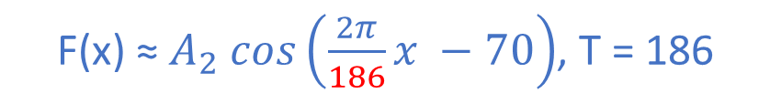
Curve fitting
F(x) ≈ $A_{2} cos\left(\frac{2π}{186}x −70\right)$, T = 186

Slide 11

Curve fitting
F(x) ≈ $A_{3} cos\left(\frac{2π}{11}x −5\right)$, T = 11

Slide 12
Curve fitting
F(x) ≈ $A_{1}cos\left(\frac{2π}{24}x −5\right)$+ $A_{2} cos\left(\frac{2π}{186}x −70\right)$+ $A_{3} cos\left(\frac{2π}{11}x −5\right)$

Slide 13
Curve fitting
F(x) ≈ $A_{1}cos\left(\frac{2π}{24}x −5\right)$+ $A_{2} cos\left(\frac{2π}{186}x −70\right)$+ $A_{3} cos\left(\frac{2π}{11}x −5\right)$

Slide 14
Curve fitting
F(x) ≈ $A_{1}cos\left(\frac{2π}{24}x −5\right)$+ $A_{2} cos\left(\frac{2π}{186}x −70\right)$+ $A_{3} cos\left(\frac{2π}{11}x −5\right)$ + $A_{4} cos\left(\frac{2π}{9}x −10\right)$

Slide 15
Curve fitting
F(x) ≈ cos(24) + cos(11)+cos(9)+cos(186),
where cos(24) means cos of period 24, $A_{1}cos\left(\frac{2π}{24}x −5\right)$

Slide 16
Phase
F(x) ≈ cos(α∙t-P)

Slide 17
What is phase?

Slide 18
What is phase?

Slide 19
What is phase?

Slide 20
What is phase?

Slide 21
PBM – phase by max

Slide 22
PBM – spline inter

Slide 23
PBM – spline inter

Slide 24
PBM

Slide 25
PBF – phase by fit

Slide 26
PBF – phase by fit

Slide 27
PBF

Slide 28
PBF

Slide 29
PBF

Slide 30
PBF

Slide 31
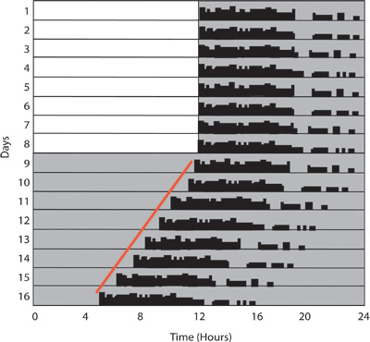
Onset /Offset of activity
DOI:10.3791/2463

Slide 32
Methods
Cosinor – fitting one cos (org with period 24)

Slide 33
MFourFit
Using sin(ax) and cos(ax) and their harmonics
scanning throug expected periods

Slide 34
MFourFit
Using sin(ax) and cos(ax) and their harmonics
scanning throug expected periods

Slide 35
FFT NLLS
Non linear fitting (we find period, phase and amp at the same time)
Needs good starting points as candidate periods
Does FFT to find the main frequencies (periods)
Fitts up to 5 cos curves

Slide 36
FFT

Slide 37
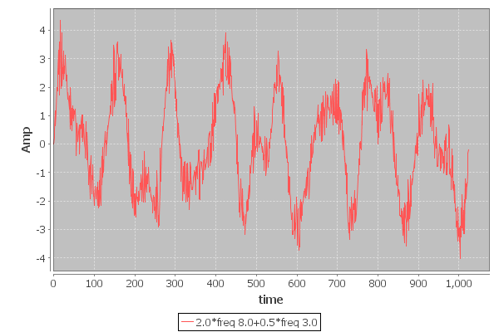
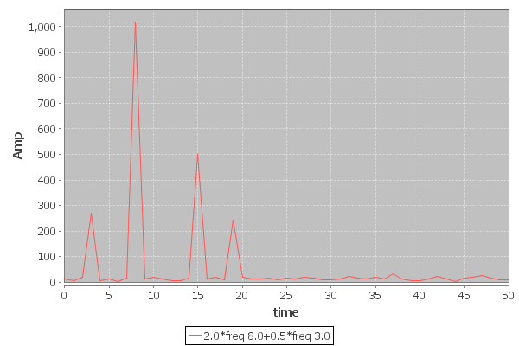

Slide 39
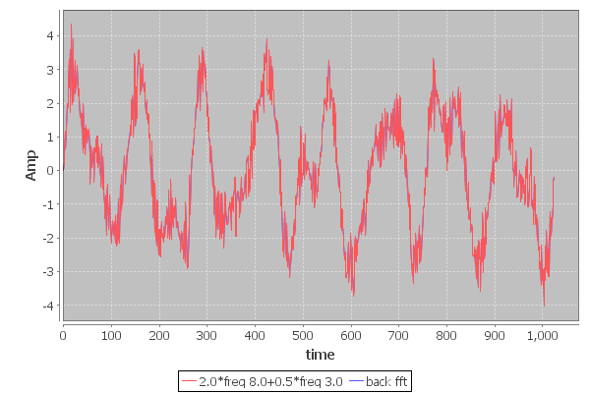

Slide 40
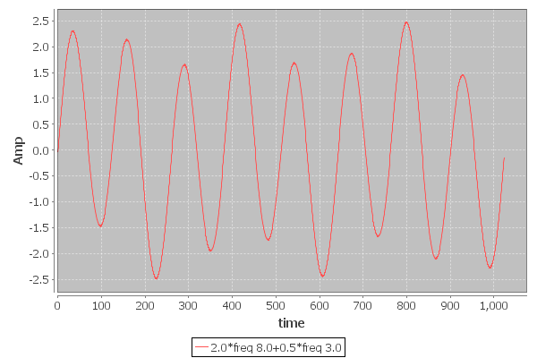
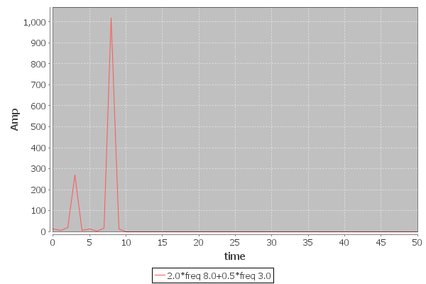

Slide 41
LS Periodogram
Non evenly spaced data

Slide 42
MESA
X[t] = a1X[t-1]+ a2X[t-2]+ a3X[t-3]+ ...+anX[t-N]+ η
„Magically” we get spectrum from the a1, a2 ... values

