Slide 1
What do you call data that describes data?
Metadata

Slide 2
Metadata is data about the data!
Metadata is the description of data
permits understanding and interpretation of data
as important as your data
It should be continuously added to your research data
Metadata can be produced in an automated way or manually
Notes:
Metadata are data about data. They play an important role in making your data FAIR. Metadata have to be added continuously to your research data, not just at the beginning or at the end of a project. Metadata can be added manually or automatically, and preferably according to a disciplinary standard. From a FAIR perspective, metadata are more important than your data, because metadata would always be openly available and they link research data and publications in the Internet of FAIR Data and Services.
While data documentation is meant to be read and understood by humans, metadata (which are sometimes a part of the documentation) are primarily meant to be processed by machines.

Slide 3
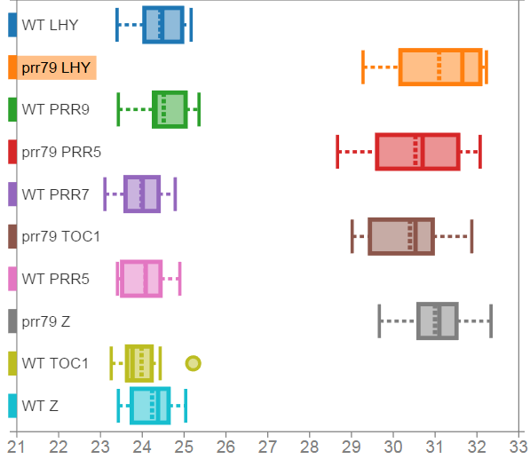
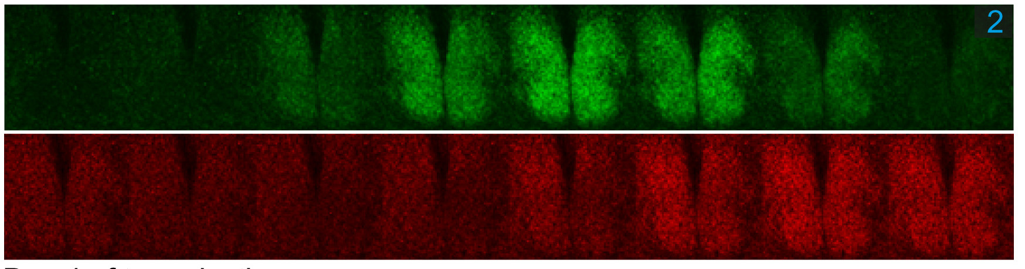
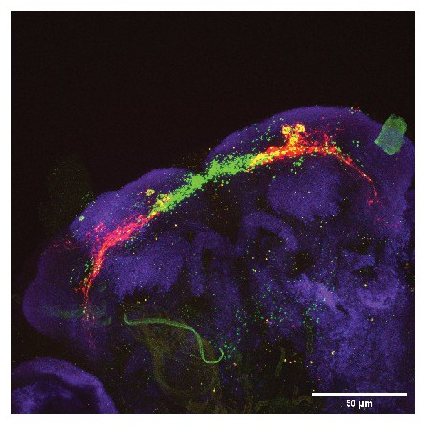
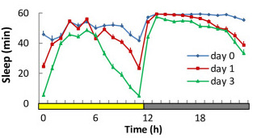
Data without metadata
C)
A)
D)
B)

Slide 4
Data without metadata
C)
A)
What information can you guess without the associated description (metadata)?
D)
B)

Slide 5
Data without metadata
C)
Confocal images of mice SCN slices taken every 3 hours
PER2::Venus knock-in, transfected with vector carrying CRY1::mRuby3, showing PER2 (top) CRY1 (bottom) oscilations https://doi.org/10.1073/pnas.2113845119
A)
D)
B)
Sleep patterns D. Melan. flies in 0,1 and 3 days affter the eclossion. Sleep defined and 5 minutes or more of inactivity (monitored with infrared beam)
https://doi.org/10.1371%2Fjournal.pbio.3001324
Fly brain slice, DN1p presynaptic (green) and postsynaptic (red) neurons
https://doi.org/10.7554/eLife.74327

Slide 6
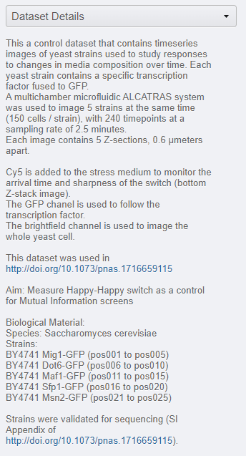
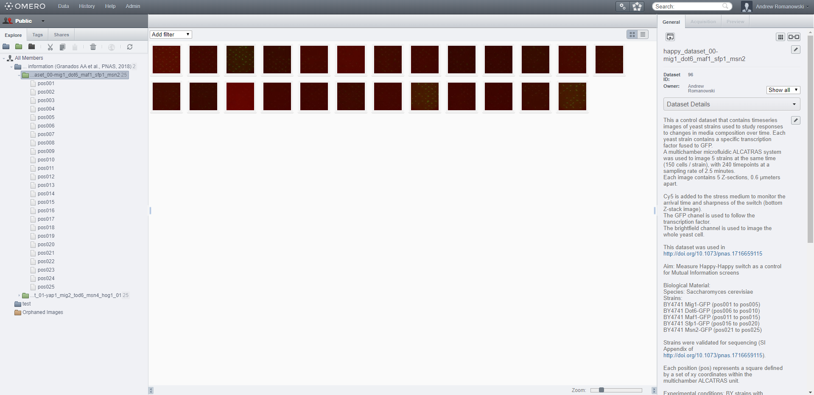
Dataset structure and associated metadata
Notes:
The details section of the dataset should contain multiple sections:
Dataset content: Describe what the dataset contains
Aim Briefly explain the aim of the dataset
Biological material List which species and strains were used in the dataset (if applicable)
Experimental conditions List the experimental protocols used to generate the dataset.
Additional Comments Include any comments you believe are important regarding the experimental conditions used to generate the dataset (if applicable)

Slide 7

Types of metadata
Administrative: relevant to managing it
e.g. Experimental code, PI
Descriptive/citation: assists with discovery/identity
e.g. Authors, persistent identifier
Structural: how the data came about & is structured
e.g. Collection method, folder structures
Notes:
Administrative metadata are data about a project or resource that are relevant for managing it; for example, project/ resource owner, principal investigator, project collaborators, funder, project period, etc. They are usually assigned to the data, before you collect or create them.
Descriptive or citation metadata are data about a dataset or resource that allow people to discover and identify it; for example, authors, title, abstract, keywords, persistent identifier, related publications, etc.
Structural metadata are data about how a dataset or resource came about, but also how it is internally structured. Structural metadata describe, for example, the unit of analysis, collection method, sampling procedure, sample size, categories, variables, etc. Structural metadata have to be gathered by the researchers according to best practice in their research community and will be published together with the data. Descriptive and structural metadata should be added continuously throughout the project.

Slide 8
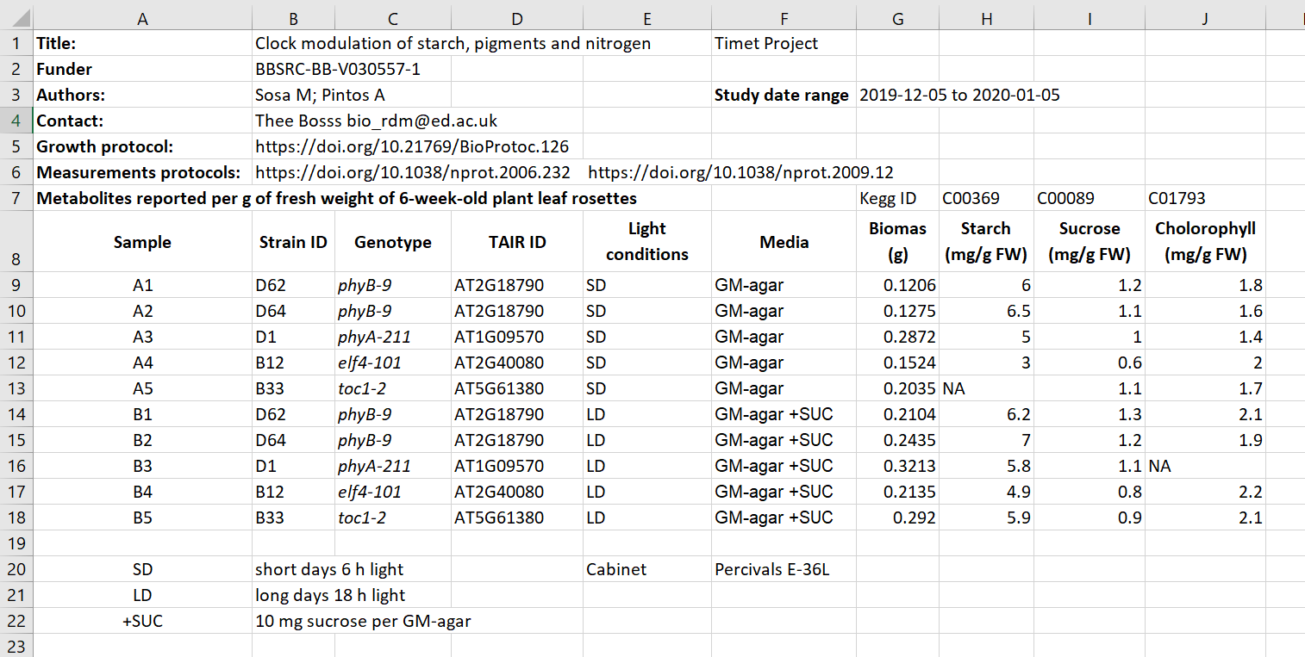
Exercise/challenge 1:
Identifying metadata types
Figure credits: Tomasz Zielinski and Andrés Romanowski
Notes:
In groups, identify different types of metadata (administrative, descriptive, structural) present in this example.

Slide 9
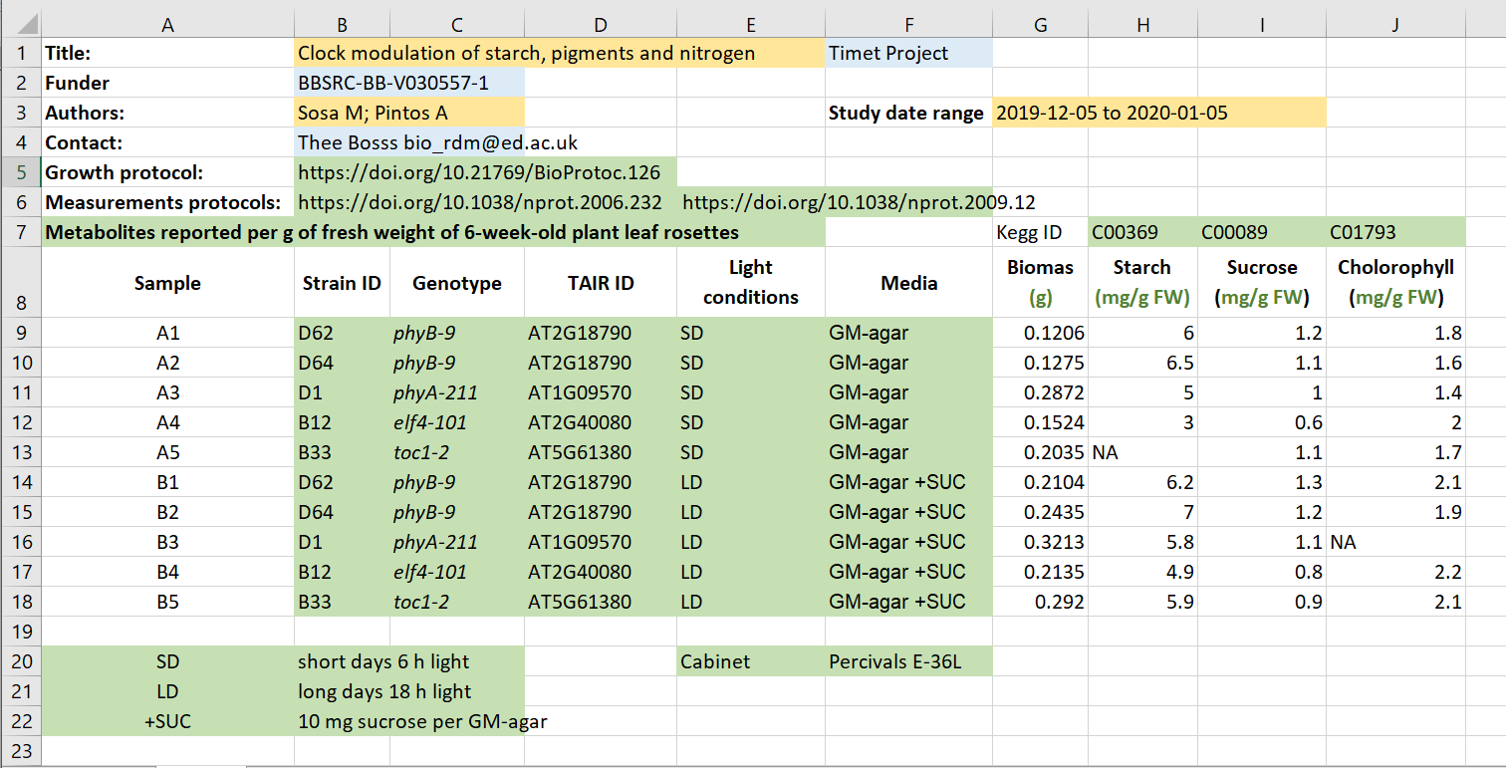
Exercise/challenge 1:
Identifying metadata types
Administrative
Descriptive
Structural
Figure credits: Tomasz Zielinski and Andrés Romanowski

Slide 10
Where does data end and metadata start?
What is "data" and what is "metadata" can be a matter of perspective:
Some researchers' metadata can be other researchers' data.
Think of an example from our „excel” table
Notes:
The distinction between data and metadata is not ontological, but it is grounded in use. What is “data” and what is “metadata” is thereby a matter of perspective: Some researchers’ metadata can be other researchers’ data.

Slide 11
Figure credits: Tomasz Zielinski and Andrés Romanowski
Notes:
In groups, identify different types of metadata (administrative, descriptive, structural) present in this example.

Slide 12

What to include in metadata
The minimum information standard
set of guidelines for reporting data derived by relevant methods in biosciences
ensures that the data can be easily verified, analysed and clearly interpreted by the community.
Minimum Information for Biological and Biomedical Investigations (MIBBI)
is the collection of the most known standards:
https://fairsharing.org/collection/MIBBI
Notes:
As we saw metadata can take many forms from as simple as including a ReadMe.txt file, by embedding them inside the Excel files, to using domain specific metadata standards and formats.
But,
What should be included in metadata?
What terms should be used in descriptions?
For many assay methods and experiment types, there are defined recommendations and guidelines called Minimal Information Standards.

Slide 13
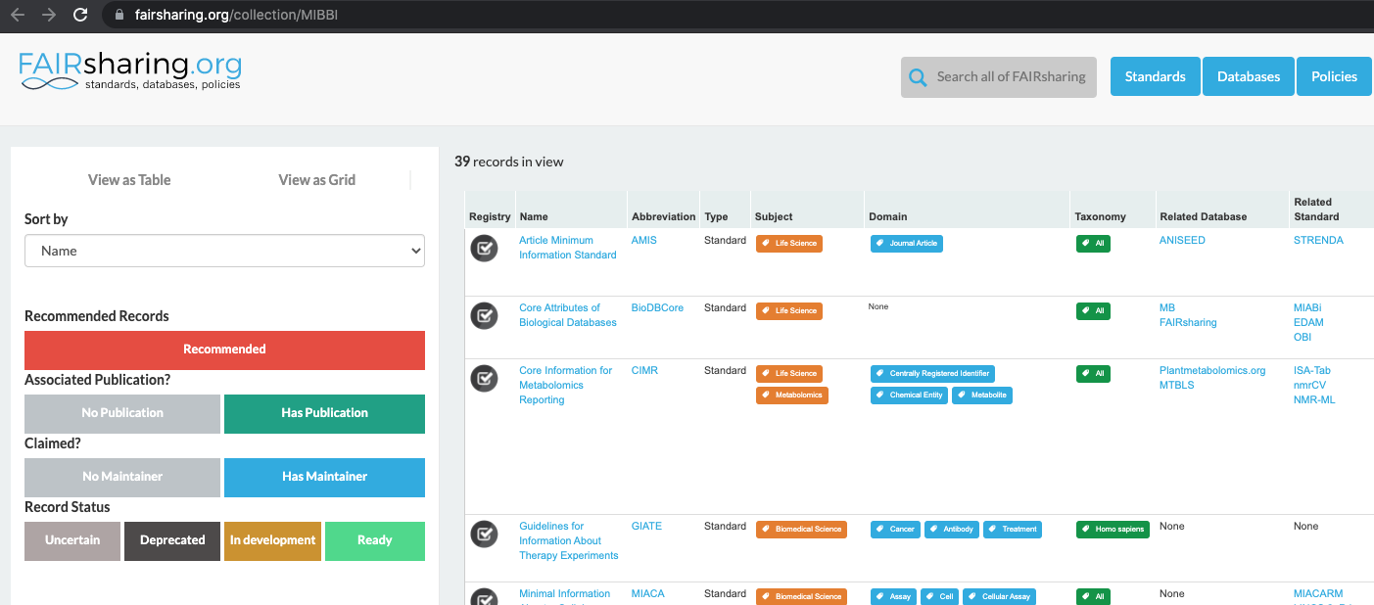
Minimum information standards
Notes:
The minimum information standard is a set of guidelines for reporting data derived by relevant methods in biosciences. If followed, it ensures that the data can be easily verified, analysed and clearly interpreted by the wider scientific community. Keeping with these recommendations also facilitates the foundation of structuralized databases, public repositories and development of data analysis tools. Individual minimum information standards are brought by the communities of cross-disciplinary specialists focused on issues of the specific method used in experimental biology.
Minimum Information for Biological and Biomedical Investigations (MIBBI) is the collection of the most known standards.
FAIRSharing offers excellent search service for finding standards

Slide 14

Exercise: Minimal information example
Minimum Information about a Neuroscience Investigation (MINI) Electrophysiology
https://www.nature.com/articles/npre.2008.1720.1.pdf
Notes:
Scroll to Reporting requirement and decide which of the points 1-8 are:
a) important for understanding and reuse of data
2, 3, 4, 5, 6, 8
b) important for technical replication
2, 3, 7
c) could be applied to other experiments in neuroscience
1, 2, 3, 4, 5, 6, 8
Structural metadata!!!

Slide 15
What can you do if there are no metadata standards defined for your data/field of research?
Think about the minimum information that someone else (from your lab or from any other lab in the world) would need to know about your dataset to be able to work with it without any further inputs from you.
Think as a consumer about your data not the producer!
Notes:
What can you do if there are no metadata standards defined for your data / field of research?
Think about the minimum information that someone else (from your lab or from any other lab in the world) would need to know about your dataset to be able to work with it without any further inputs from you.
Think as a consumer of your data not the producer!

Slide 16
Exercise
What to include
Notes:
Some typical elements are:
biological material, e.g. Species, Genotypes, Tissue type, Age, Health conditions
biological context, e.g. speciment growth, entrainment, samples preparation
experimental factors and conditions, e.g. drug treatments, stress factors
specifics of data acquisition
specifics of data processing and analysis

Slide 17
What to include
C)
A)
D)
B)

Slide 18
Metadata and FAIR guidelines
Metadata provides extreme valuable information for us and others to be able to interpret, process, reuse and reproduce the research data it accompanies.
Because metadata are data about data, all of the FAIR principles i.e. Findable, Accessible, Interoperable and Reusable apply to metadata.
Ideally, metadata should not only be machine-readable, but also interoperable so that they can interlink or be reasoned about by computer systems.

Slide 19

Quiz

