Slide 1
Signal Transduction!

Slide 2
Here is a Cell.

Slide 3
Is this cell alone in the universe?

Slide 4
There are many things happening around the cell.
Heat
Photons
Chemicals
Mechanical Pressure
Sound Waves

Slide 5
Does the cell just sit there?
Heat
Photons
Chemicals
Mechanical Pressure
Sound Waves

Slide 6
How might it respond?
Heat
Photons
Chemicals
Mechanical Pressure
Sound Waves

Slide 7
How might it respond?
Heat
Photons
Chemicals
Gene Expression
Protein Conformational Changes
Protein Regulation
Mechanical Pressure
Sound Waves

Slide 8
HOW DOES IT KNOW
What's out there?
What to do?
Heat
Photons
Chemicals
Gene Expression
Protein Conformational Changes
Protein Regulation
Mechanical Pressure
Sound Waves

Slide 9
HOW DOES IT KNOW
What's out there?
Heat
Photons
Receptors -->
Chemicals
Gene Expression
Protein Conformational Changes
Protein Regulation
Mechanical Pressure
Sound Waves

Slide 10
HOW DOES IT KNOW
What to do?
Heat
Signaling
molecules
Photons
Receptors -->
Chemicals
Gene Expression
Protein Conformational Changes
Protein Regulation
Mechanical Pressure
Sound Waves

Slide 11
HOW DOES IT KNOW
What to do?
Heat
Signaling
molecules
Photons
Receptors -->
Chemicals
Gene Expression
Protein Conformational Changes
Protein Regulation
Mechanical Pressure
Sound Waves

Slide 12
HOW DOES IT KNOW
What to do?
Heat
Signaling
molecules
Photons
Receptors -->
Chemicals
Effectors!
Gene Expression
Protein Conformational Changes
Protein Regulation
Mechanical Pressure
Sound Waves

Slide 13
HOW DOES IT KNOW
What to do?
Heat
Signaling
molecules
Photons
Receptors -->
Chemicals
Effectors!
Gene Expression
Protein Conformational Changes
Protein Regulation
Mechanical Pressure
Sound Waves

Slide 14
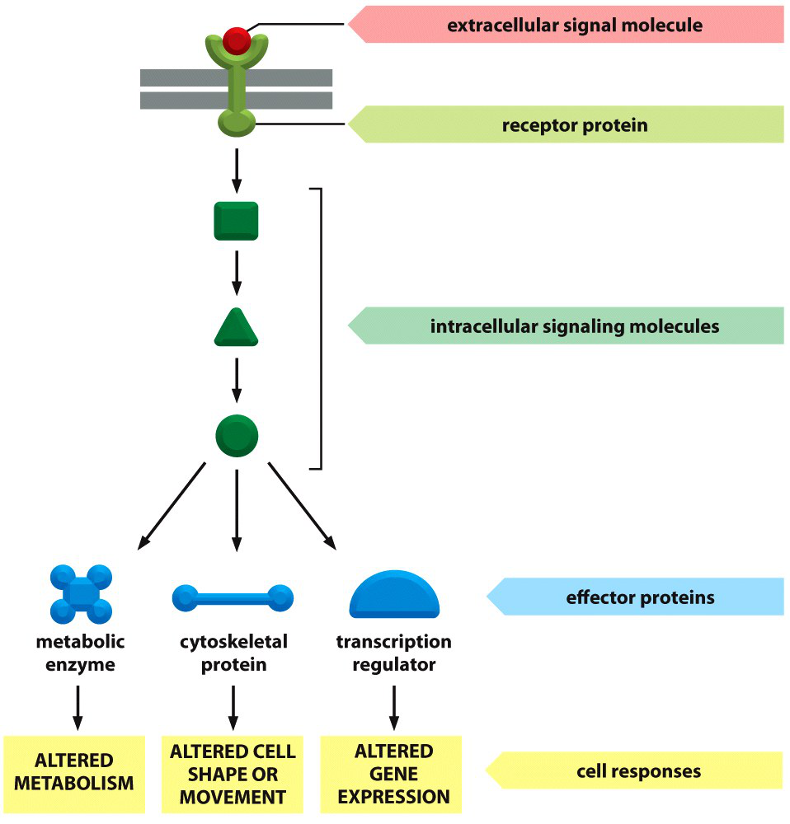
Figure 16-12 Essential Cell Biology (© Garland Science 2010)

Slide 15
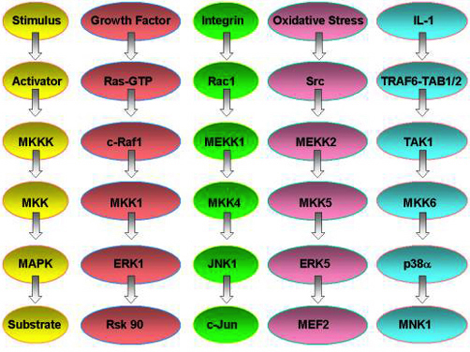
MAPK Signaling pathways are everywhere!1!1! O_o
http://youtu.be/oDjDUUhGVsI

Slide 16
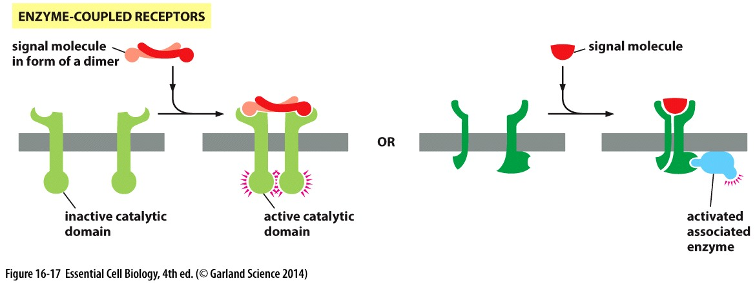
Receptors
Structure
How they work
Example Signaling pathway

Slide 17
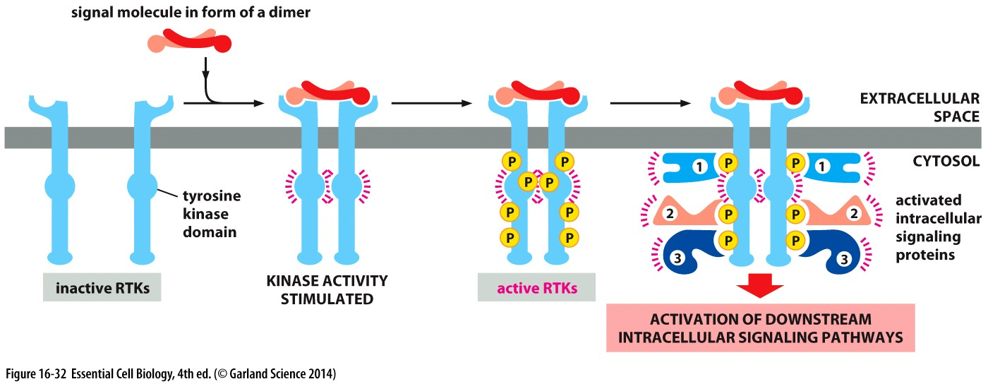
Receptor Tyrosine Kinase

Slide 18
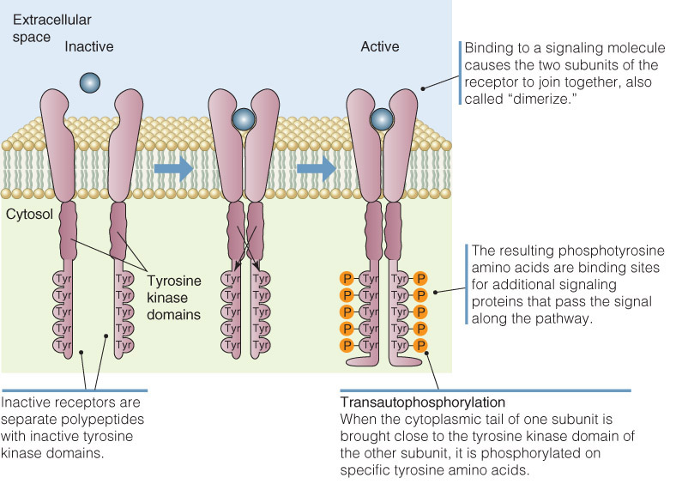
Figure 11.05: Model of growth factor receptor activation.

Slide 19
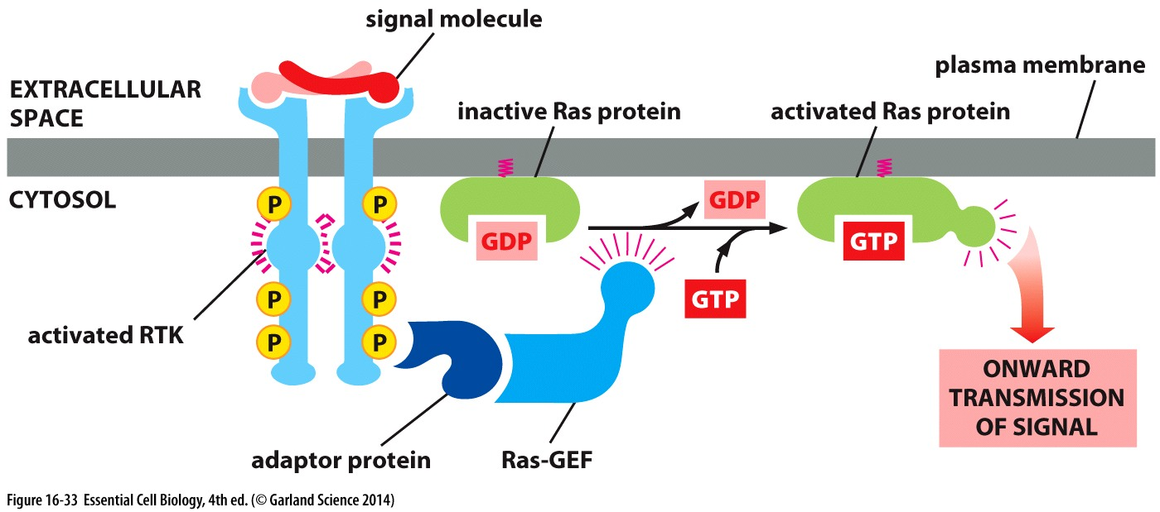
MAPK Signaling Pathway
(mitogen activated protein kinase)
mitogens stimulate mitosis

Slide 20
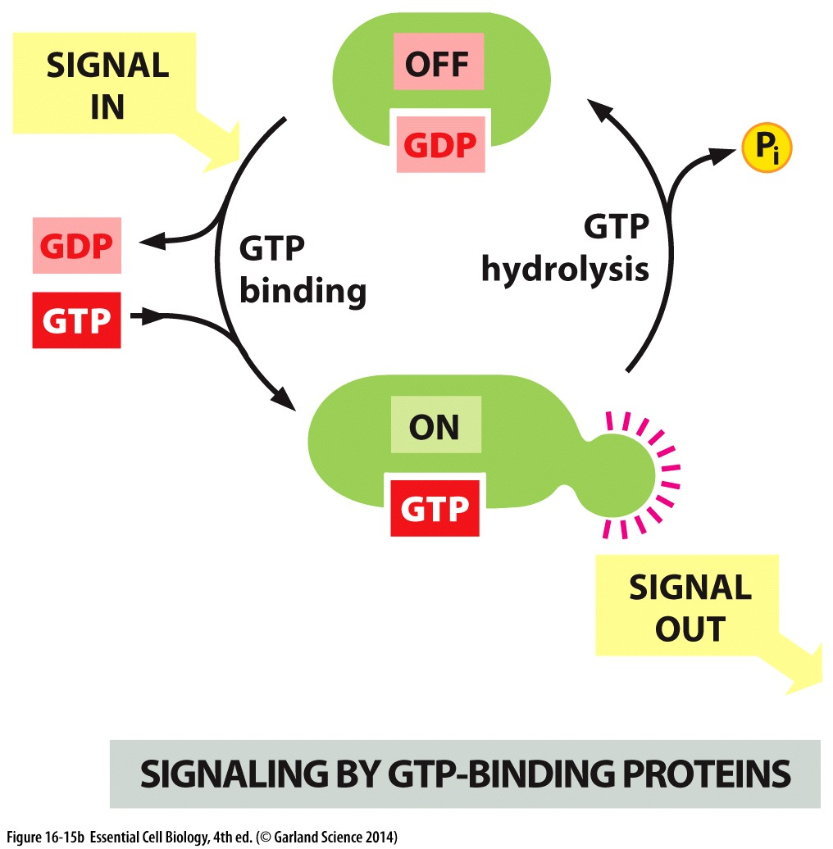
G-Proteins

Slide 21
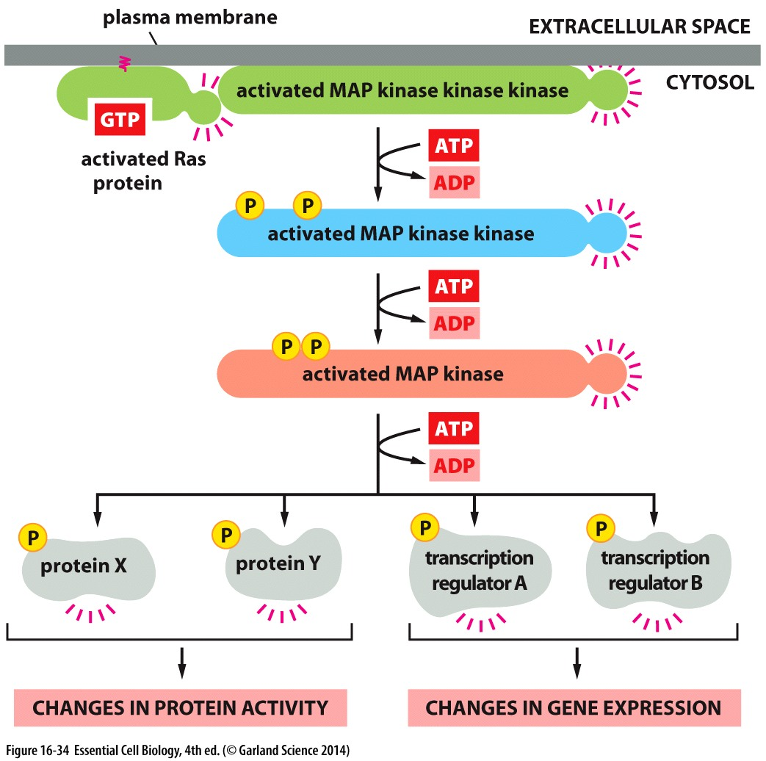


Slide 22
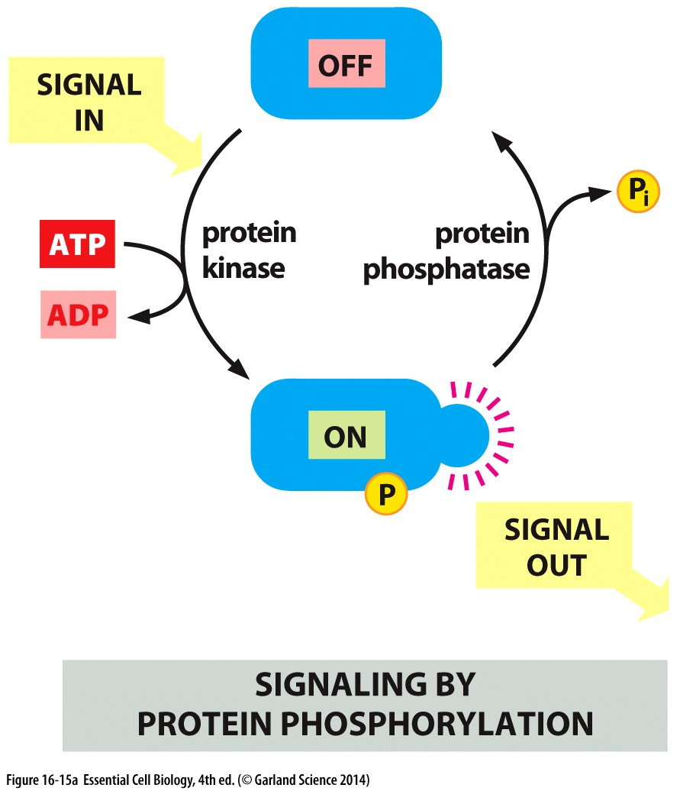

Slide 23
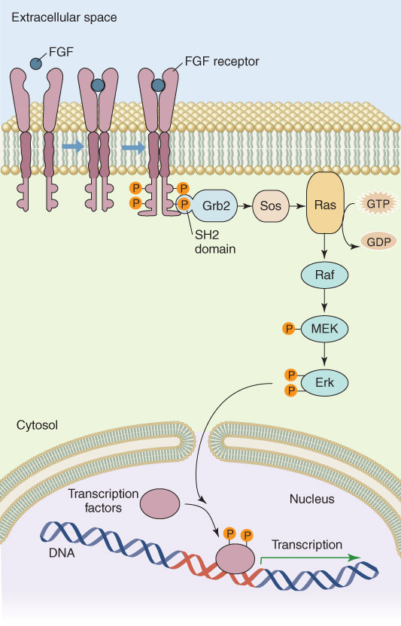
fibroblast growth factor
receptor tyrosine kinase
adaptor
GEF
monomeric G-protein

Slide 24
serine/threonine kinase
tyrosine and threonine kinase
serine/threonine kinase

Slide 25
signal to polymerize actin filaments
Dimerizes
CREB
CREB
regulate entry into S phase
http://youtu.be/oDjDUUhGVsI

Slide 26
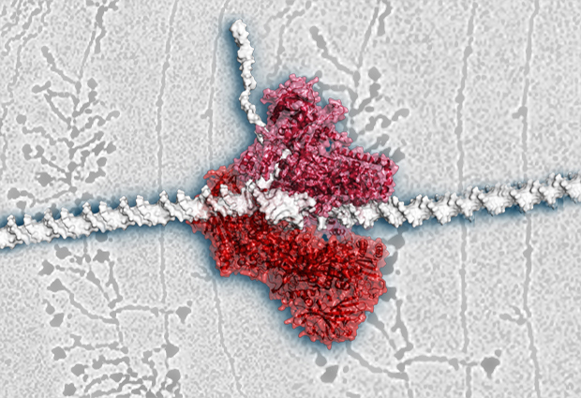
RNA Polymerase
Fernández-Tornero, C., Moreno-Morcillo, M., Rashid, U.J., Taylor, N.M.I, Ruiz, F.M., Gruene, T., Legrand, P., Steuerwald, U. & Müller, C.W. Crystal structure of the 14-subunit RNA polymerase I. Published online in Nature on 23 October 2013. DOI: 10.1038/nature12636.

Slide 27
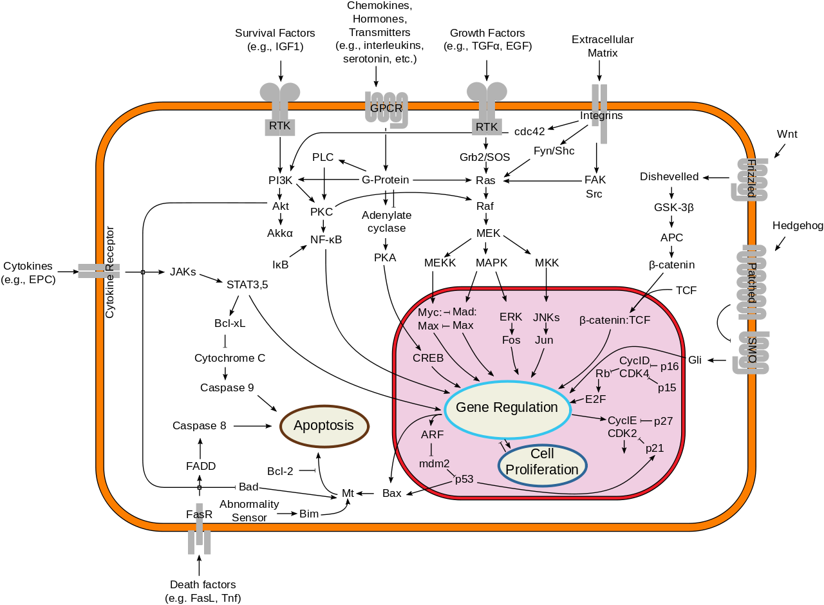
Now we can really start talking.

