Slide 1
BioRube Bot Team
Status of activities

Slide 2
Major Tasks
Set up Development Environments
Unity
Git
Visual Studio
Snap a baseline
A clean, building copy of the most up-to-date code
Allows us to start from where it was left off last
Ensures no functionality developed is left behind by starting from an old set of code

Slide 3
Challenges We’ve Faced
Taking a long time to determine the status of the repo
The Summer 2019 team created a new repo rather than branching in current
The Summer 2019 team did not merge their changes into the master repo

Slide 4
Accomplishments
Each team member has development environment set up
Merged changes from 2019 development into dev repository
Figured out a way to merge the Summer 2019 team changes into the master, retaining history
Determined cause of game not running
Unity libraries are out-of-date, and updated IOS breaks the game

Slide 5
Continued Challenges
The repo is a mess
3rd party and unity-controlled files under version control
System auto-generated files under version control
Being unfamiliar with previous development, hard to separate what is under our control and what is not
We have been unable to open the project without any errors
Unity creates duplicate files (prefabs, code, other assets) when opening
After removing the duplicates, we are still left with a lingering error
Prevents us from running the game to see if we have everything

Slide 6
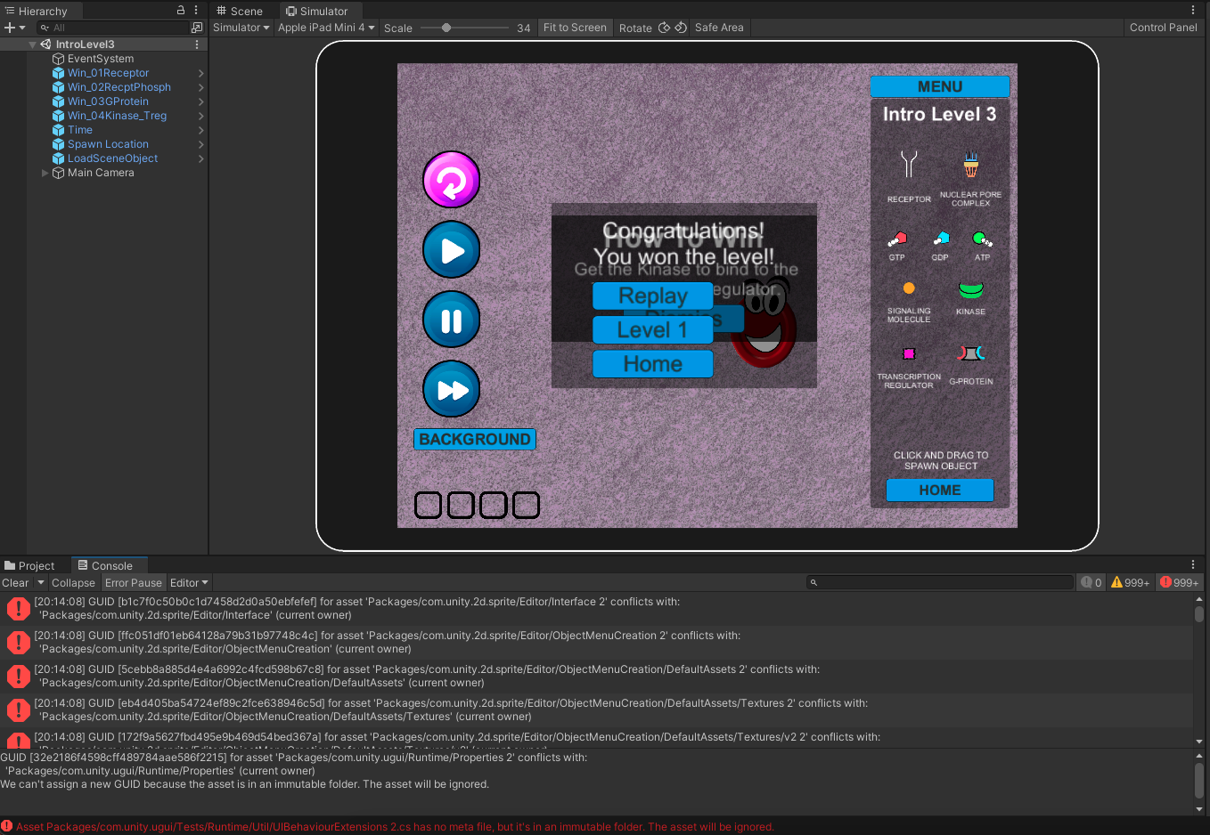
Screenshots

Slide 7
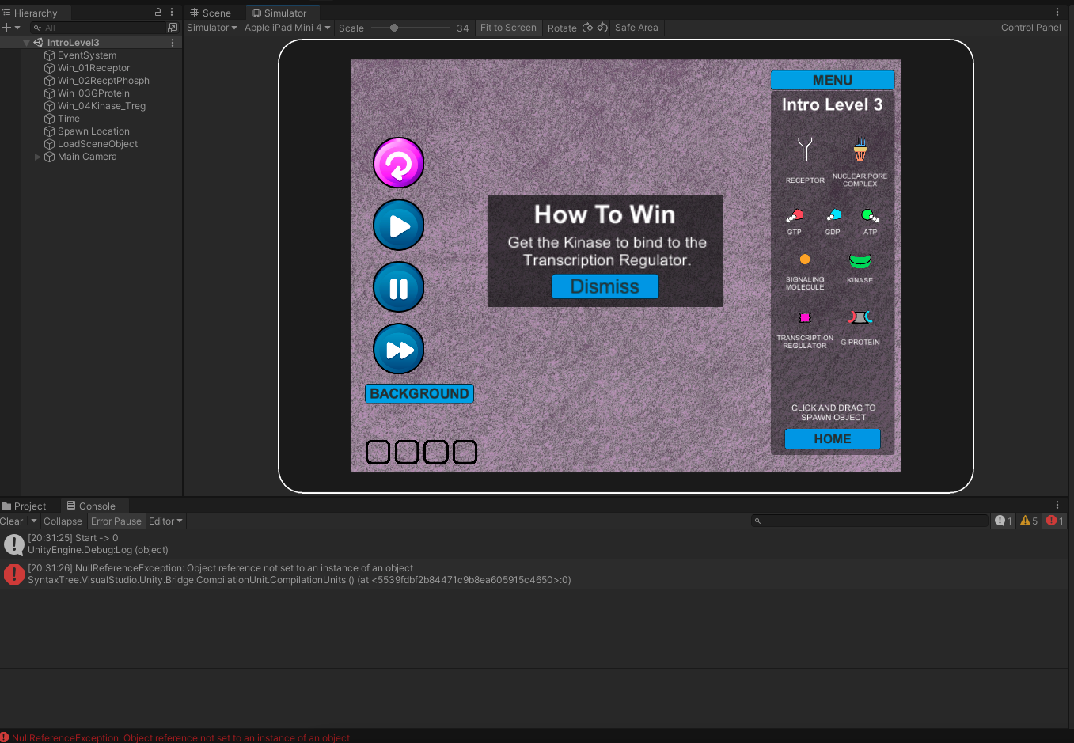
Screenshots

