Slide 1




BioSB Summer School
‘Advanced Machine Learning and AI for Life Sciences’
This course is made possible thanks to support of the TDCC-LSH
Ministry of Education, Culture and Science, 2022:
10 year project funding for three Thematic Digital Competence Centres (3 TDCCs) that focus on domain specific challenges

Slide 2

https://www.dtls.nl/biosb/courses/
BioSB - Bioinformatics and Systems Biology research school
The Network of Dutch Bioinformatics and Systems Biology research groups
Dynamic Modeling in Systems Biology (F)
Machine Learning (F)
Advanced Machine Learning and AI for Life Sciences (A)
Algorithms for Biomolecular Networks (A)
Algorithms for Genomics (A)
Bulk and Single-Cell RNA-seq Data Analysis (A)
Computational Metagenomics (A)
Constraint-Based Modelling (A)
Knowledge Graphs in the Life Sciences (A)
Multi-Omics and Data Sciences in Complex Diseases (A)
Spatial Omics Analysis (A)
Statistics for Omics (A)
Systems Medicine (A)
EDUCATION
RESEARCH
INFRASTRUCTURE
Annual 2-day conference: BioSB 2027 11&12 May, Baarlo
HotTopics: Genomic Sequence Models, 10 Sept, Leiden
In collaboration with NWO RC-5, Health-RI
BioSB Faculty Group: experts from the field

Slide 3
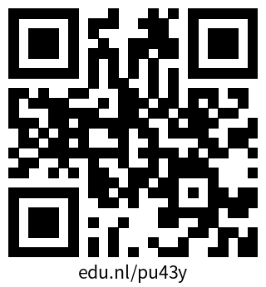
BioSB - Bioinformatics and Systems Biology research school
Do you want to know more?
…. or contact the community manager:
biosb-education@googlegroups.com

Slide 4
BioSB Summer School: some practical matters
Poster sessions: Monday and Tuesday, 17:00-18:30, 7 posters each, room ‘Water’
Pub quiz: Tuesday, 20:00 - …, room ‘Fire 2’
Outdoor activity: Wednesday, 17:00-19:00, mountain biking/climbing/guided walk
De Werelt: swimming pool, sauna, cinema, forest all around, ...
Evaluation form
Certificate

