Slide 1




Validating Bioschemas markup
Alban Gaignard
CNRS, ELIXIR-FR
Institut du Thorax, Nantes, France

Slide 2
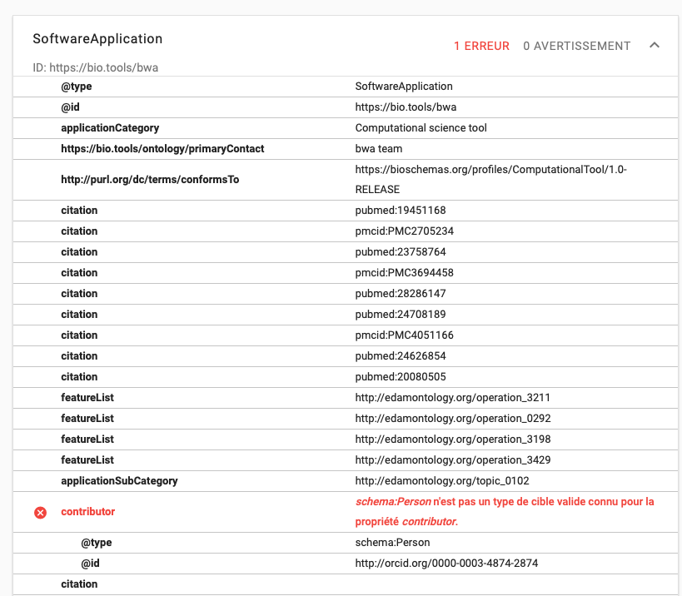
schema.org validator
checks the syntax
https://validator.schema.org/#url=http%3A%2F%2Fbio.tools%2Fbwa

Slide 3
Bioschemas profiles

Slide 4
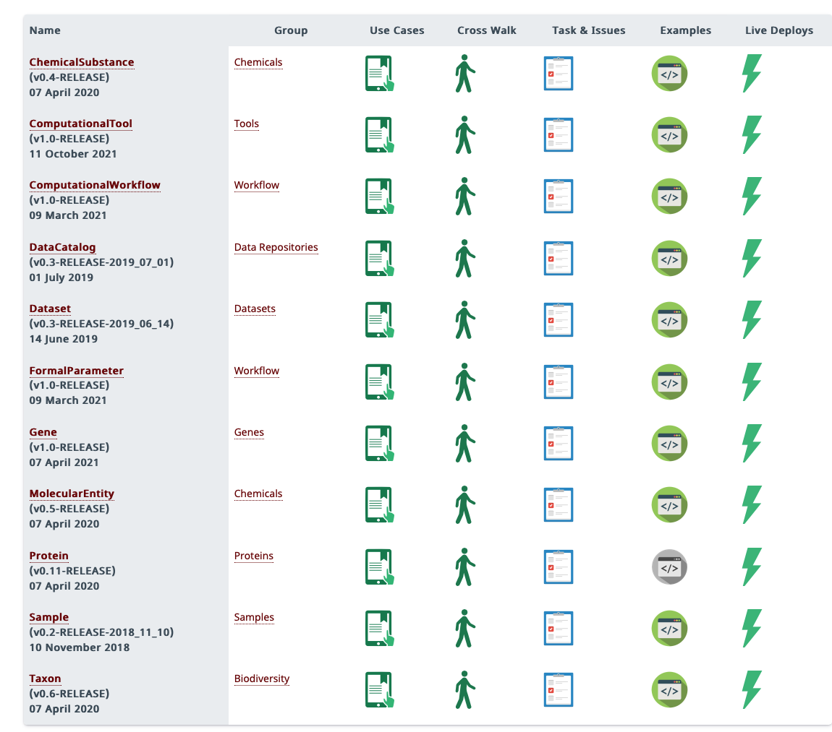
37 profiles
different use of schema.org classes and properties
Communities agree on minimal/recommended/optional annotation

Slide 5
Bioschemas profiles
Profiles ≠ Classes (types)
Bioschemas profiles specify
which RDF triples are expected to describe specific entities
which ontology classes or properties should be used (mostly from Schema.org)
different marginalities / priorities (minimal, recommended, optional)
different cardinalities (one or many) for predicates

Slide 6
Profiles are useful for

Slide 7
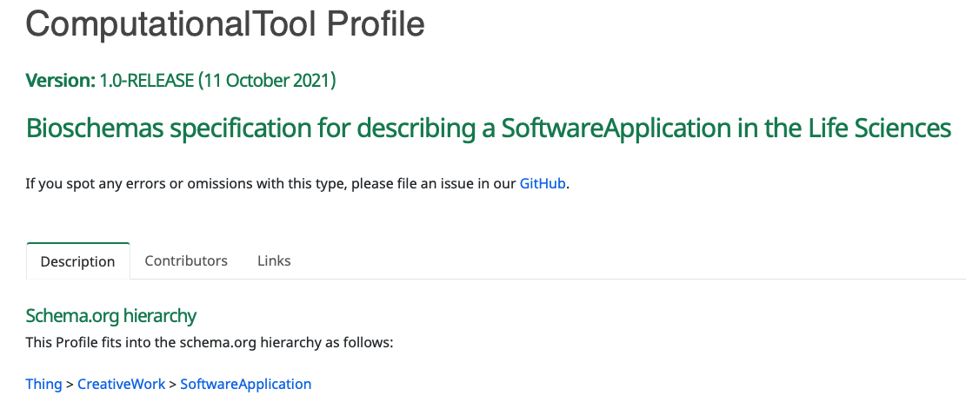
Example
ex:myTool rdf:type schema:SoftwareApplication .

Slide 8
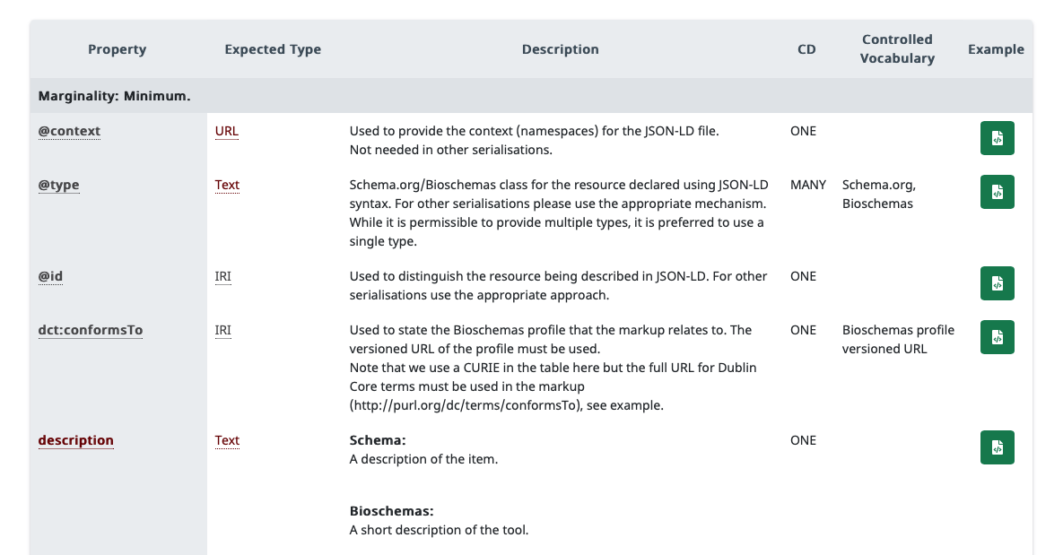

Example
[…]
[…]
ex:myTool rdf:type schema:SoftwareApplication, prov:SoftwareAgent ; schema:description "This tool does … " ; schema:license <https://spdx.org/licenses/MIT.html> ; schema:codeRepository <http://github.com/...> .

Slide 9
Manually checking conformance
ex:myTool rdf:type schema:SoftwareApplication, prov:SoftwareAgent ; schema:description "This tool does … " ; schema:license <https://spdx.org/licenses/MIT.html> ; schema:codeRepository <http://github.com/...> .
Major issues
This markup is missing dct:conformsTo properties as well as schema:name and schema:url …
Minor issues
This markup should also contains schema:author, schema:citation, etc.
Not realistic from a human point of view → automation needed !

Slide 10
Supporting automated Bioschemas validation with SHACL

Slide 11
SHACL
Stands for "SHApes Constraint Language".
W3C recommendation (July 2017) aimed at validating RDF graphs.
Similar to the ShEx (Shape Expressions) initiative.
Shape = pattern / constraints for an RDF graph
SHACL shapes are written with RDF triples
Shape graph
Validation engine
Validation report graph
Data graph

Slide 12

Shape graphs
SHACL provides a controlled vocabulary to describe the topology/structure of RDF graphs.
constraints on specific graph nodes
constraints on specific graph edges
ns:shape_1 a sh:NodeShape ; sh:targetClass sc:SoftwareApplication ; sh:property [ sh:path sc:description ; sh:minCount 1 ; sh:severity sh:Violation ] .

Slide 13
Target nodes / classes
A "node shape" can be bound to
a specific class instance (sh:targetNode)
all instances of a given class (sh:targetClass)
all nodes subject of a given predicate (sh:targetSubjectsOf)
all nodes object of a given predicate (sh:targetObjectsOf)

Slide 14

Validation report
Depending on the evaluation engine, you can get a textual report:
Yes/No answer for the global validation
One message per error
Source shape leading to the error
Focus node breaking tha validatin
Validation Report
Conforms: False
Results (2):
Constraint Violation in MinCountConstraintComponent (http://www.w3.org/ns/shacl#MinCountConstraintComponent):
Severity: sh:Violation
Source Shape: [ sh:minCount Literal("1", datatype=xsd:integer) ; sh:path sc:name ; sh:severity sh:Violation ]
Focus Node: ex:myTool
Result Path: sc:name
Message: Less than 1 values on ex:myTool->sc:name
Validation Result in MinCountConstraintComponent (http://www.w3.org/ns/shacl#MinCountConstraintComponent):
Severity: sh:Warning
Source Shape: [ sh:minCount Literal("1", datatype=xsd:integer) ; sh:path sc:citation ; sh:severity sh:Warning ]
Focus Node: ex:myTool
Result Path: sc:citation
Message: Less than 1 values on ex:myTool->sc:citation

Slide 15

Validation report
The report is generated from the validation report graph.
SHACL provides a controlled vocabulary to describe validation reports in RDF.
Validations report can be shared and queried on the web following Linked Data principles.
@prefix sc: <http://schema.org/> .
@prefix sh: <http://www.w3.org/ns/shacl#> .
@prefix xsd: <http://www.w3.org/2001/XMLSchema#> .
[] a sh:ValidationReport ;
sh:conforms false ;
sh:result [ a sh:ValidationResult ;
sh:focusNode <http://bioschemas.validation.tutorial/myTool> ;
sh:resultMessage "Less than 1 values on ex:myTool->sc:citation" ;
sh:resultPath sc:citation ;
sh:resultSeverity sh:Warning ;
sh:sourceConstraintComponent sh:MinCountConstraintComponent ;
sh:sourceShape [ sh:minCount 1 ;
sh:path sc:citation ;
sh:severity sh:Warning ] ],
[ a sh:ValidationResult ;
sh:focusNode <http://bioschemas.validation.tutorial/myTool> ;
sh:resultMessage "Less than 1 values on ex:myTool->sc:name" ;
sh:resultPath sc:name ;
sh:resultSeverity sh:Violation ;
sh:sourceConstraintComponent sh:MinCountConstraintComponent ;
sh:sourceShape [ sh:minCount 1 ;
sh:path sc:name ;
sh:severity sh:Violation ] ] .

Slide 16

To go further …
José Emilio Labra Gayo, Eric Prud'hommeaux, Iovka Boneva and Dimitris Kontokostas. “Validating RDF Data.” Validating RDF Data (2017).
Online version: https://book.validatingrdf.com
ISWC 2020 tutorial, Jose Emilio Labra Gayo: http://www.validatingrdf.com/tutorial/iswc2020/

Slide 17
Tools

Slide 18
FAIR-Checker
Aim 1: evaluating FAIR metrics with semantic web technologies
Aim 2: empowering data providers to inspect and improve the quality of metadata
http://fair-checker.france-bioinformatique.fr still under active development

Slide 19
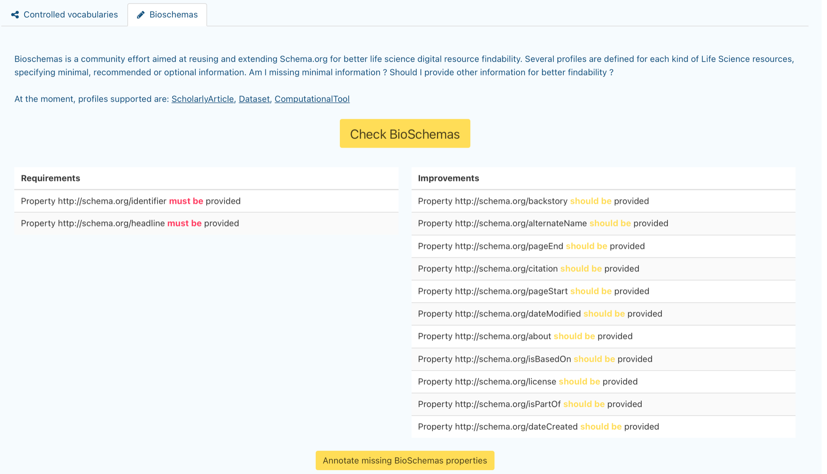
Screenshots

Slide 20
Bioschemas-SHACL-validation
Developed during the Elixir BioHackathon 2021
Aim: instrumenting Bioschemas profiles with a generic validation tool
  main ?  python main.py -u "http://bio.tools/bwa" ✔  3.9.7 (bioschemas-valid) Py  6345  15:07:20
Trying to validate https://bio.tools/bwa as a(n) http://schema.org/SoftwareApplication resource
Generating SHACL shape for sc:SoftwareApplication
ERROR: Property http://schema.org/name must be provided for https://bio.tools/bwa
ERROR: Property http://schema.org/description must be provided for https://bio.tools/bwa
ERROR: Property http://schema.org/url must be provided for https://bio.tools/bwa
WARNING: Property http://schema.org/additionalType should be provided for https://bio.tools/bwa
WARNING: Property http://schema.org/applicationCategory should be provided for https://bio.tools/bwa
WARNING: Property http://schema.org/author should be provided for https://bio.tools/bwa
WARNING: Property http://schema.org/license should be provided for https://bio.tools/bwa
WARNING: Property http://schema.org/softwareVersion should be provided for https://bio.tools/bwa
Supported profiles: CreativeWork, SoftwareApplication, Dataset, ScholarlyArticle, MolecularEntity, Gene, Study, Person, SoftwareSourceCode, Protein, SequenceAnnotation, SequenceRange
https://github.com/BioSchemas/bioschemas-validation

Slide 21
SHACL vs SHEx ?
Both are very similar
When we started this project, SHACL was more stable in terms of W3C standardization process

Slide 22
Hands-on

Slide 23
Hands-on session
Agenda
Loading Bioschemas markup into an RDF Knowledge Graph with Jupyter notebook, Python, RDFLib
Writing a simple SHACL shape
Evaluating it through the PySHACL library
Generate a human-friendly validation result
Try the Bioschemas SHACL validator on some examples
(If we have time) Use a textual template engine to generate SHACL shapes

Slide 24
Questions ?
https://github.com/BioSchemas/bioschemas-validation
https://mybinder.org/v2/gh/BioSchemas/bioschemas-validation/HEAD

