Slide 1
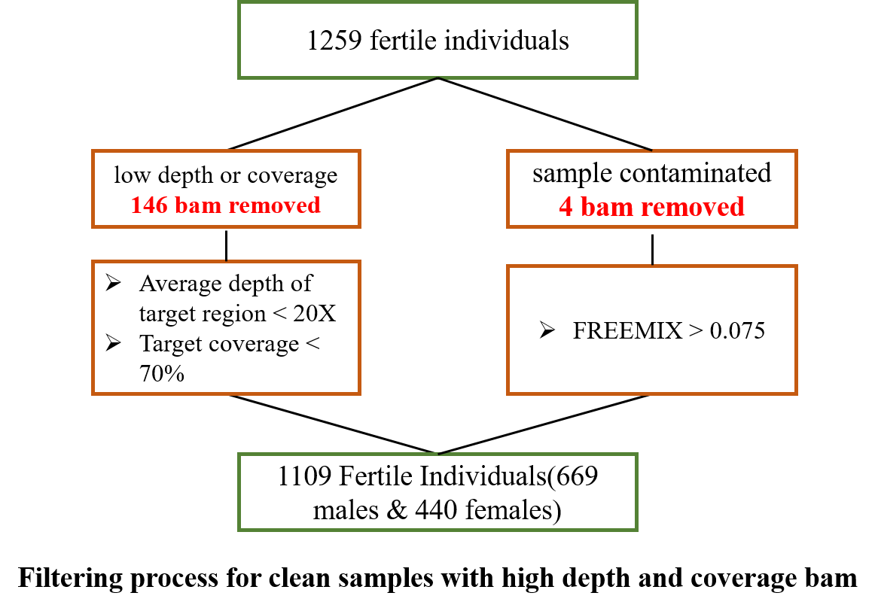
Source | Fertile Samples (Male / Female) | Sequencing Strategy
In house | 184 (118 / 66) | WES
SRA | 71 (36 / 35) | WES
SSC | 321 (163 / 158) | WES
PPMI | 533 (352 / 181) | WES
Total | 1109 (669 / 440) | WES

Slide 2
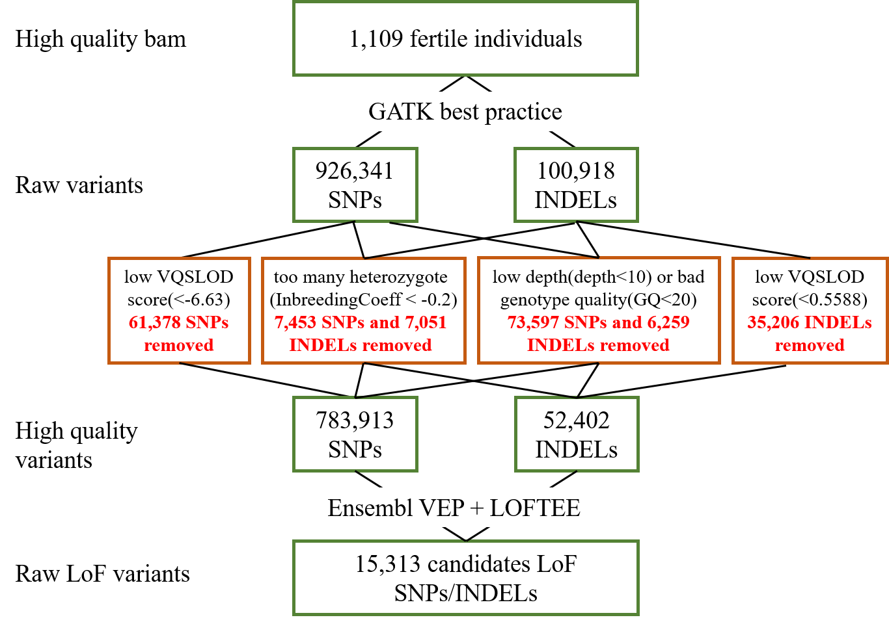
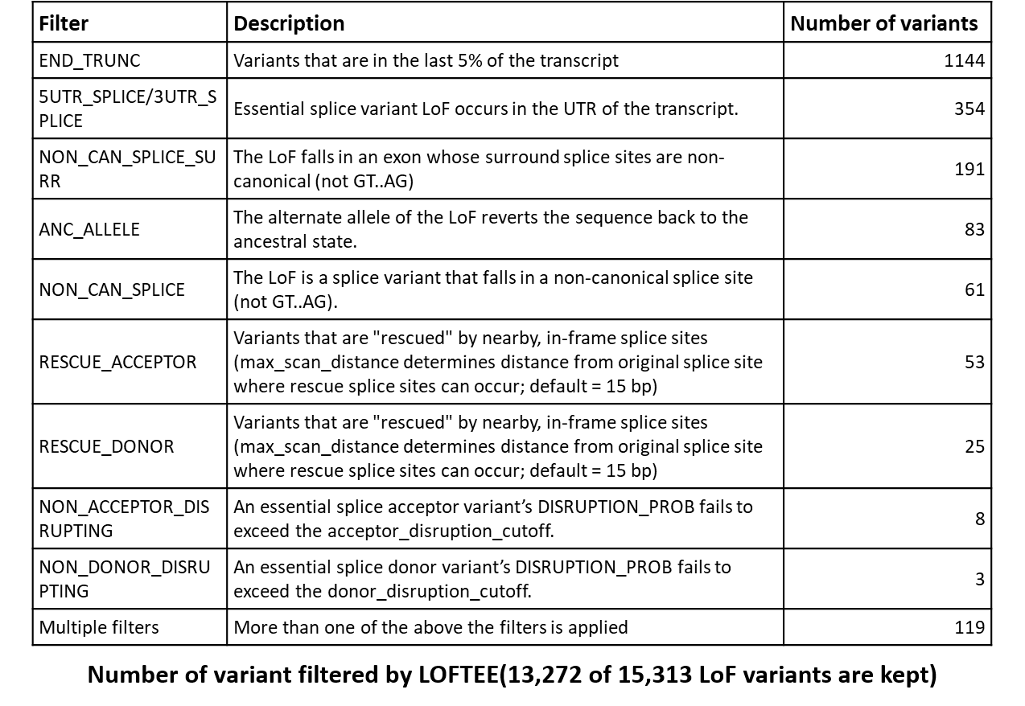
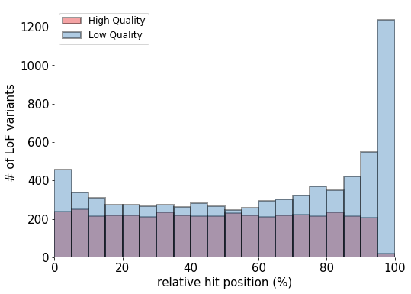
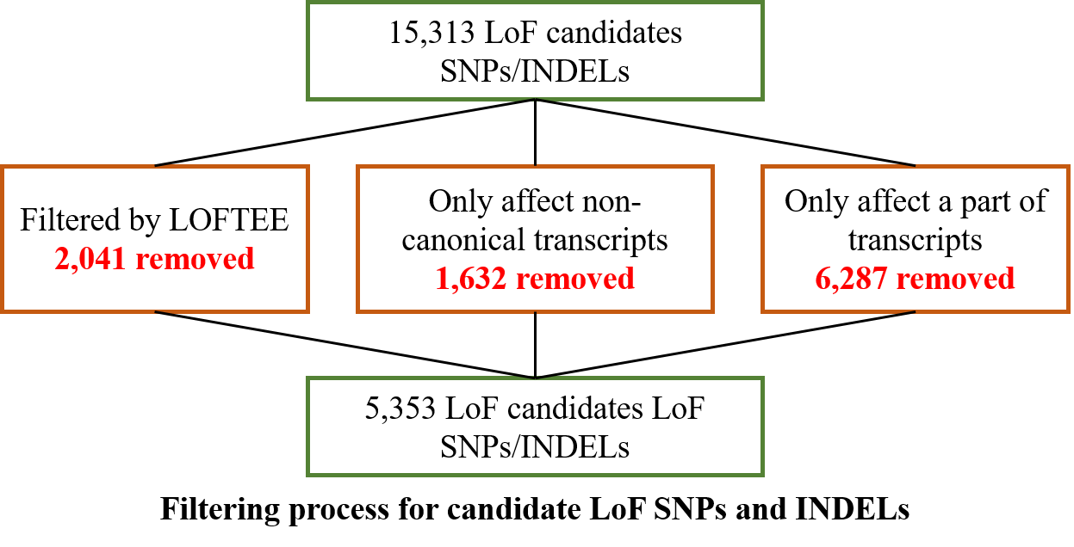

Slide 3
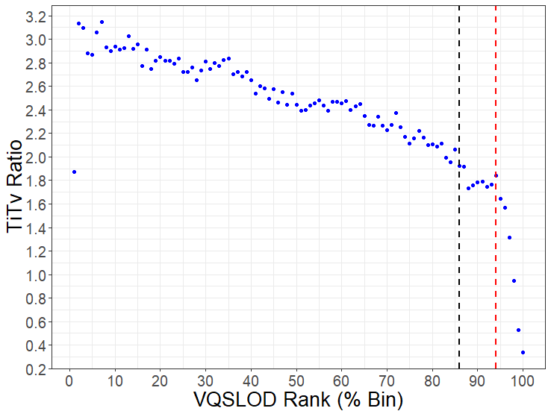
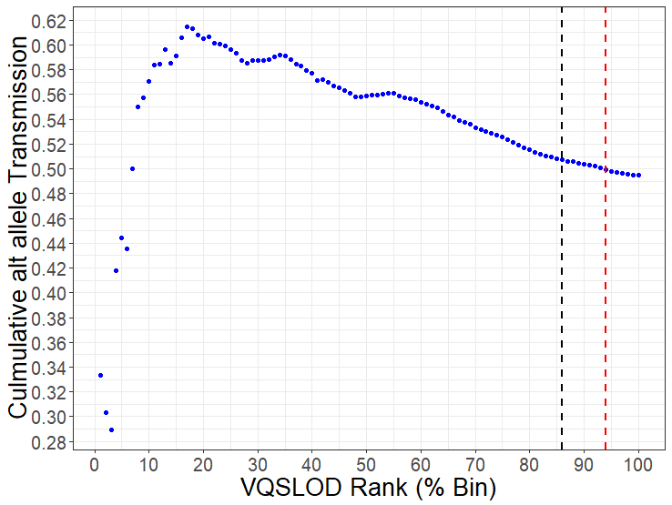
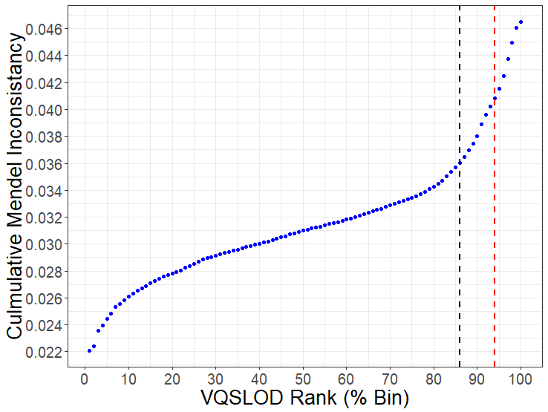
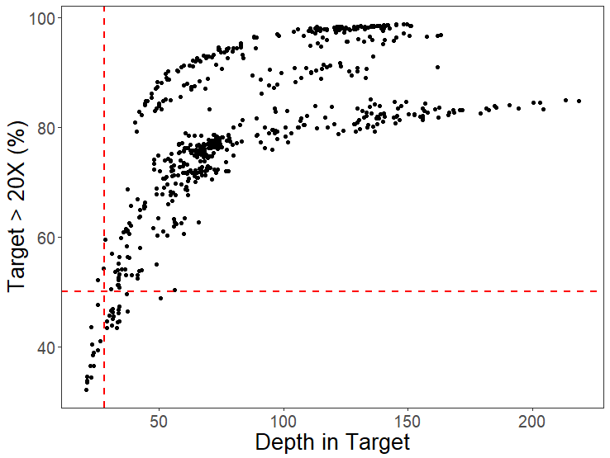
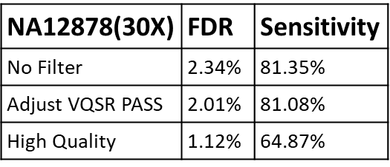
NA12878(30X)

Slide 4
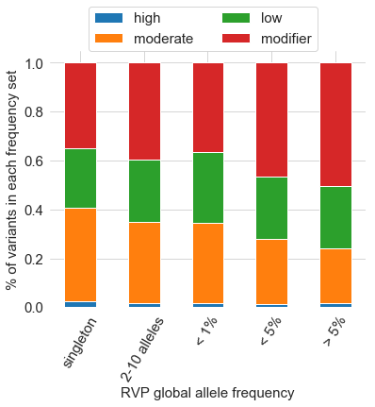
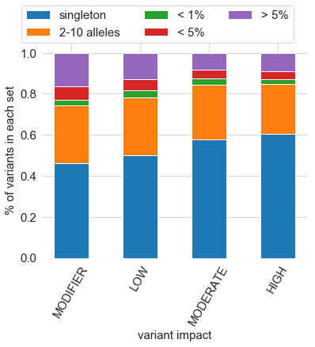
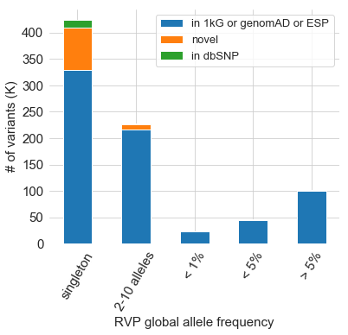
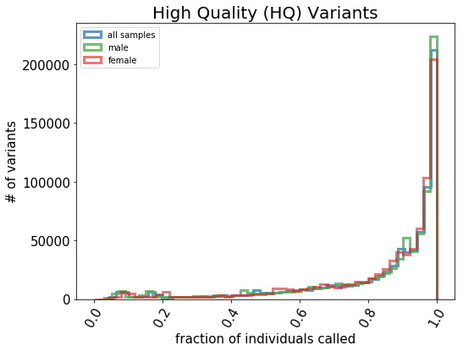
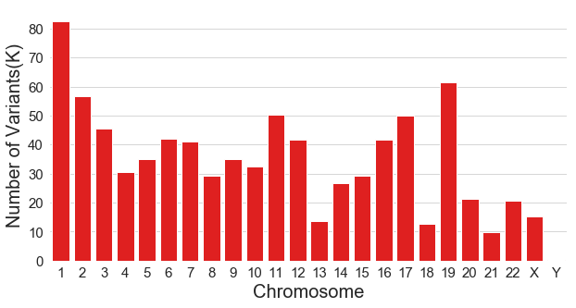

Slide 5
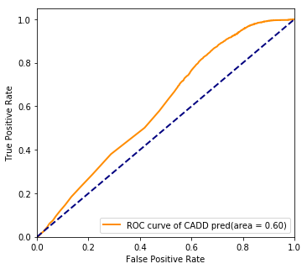
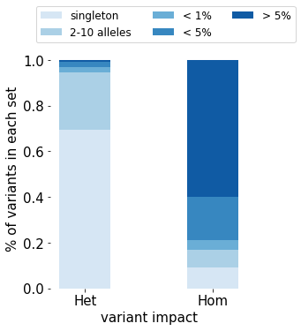
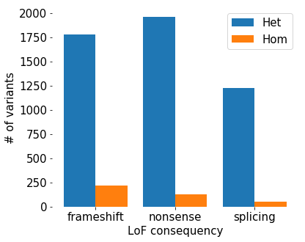
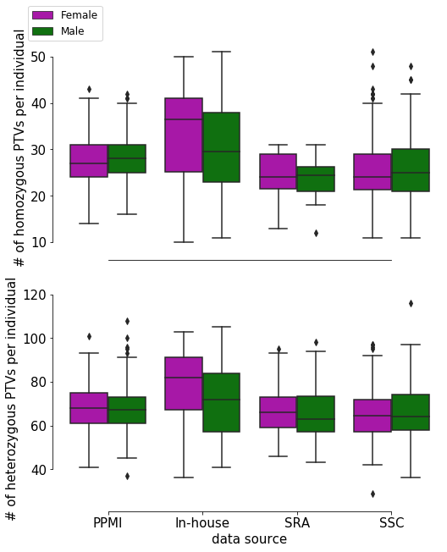
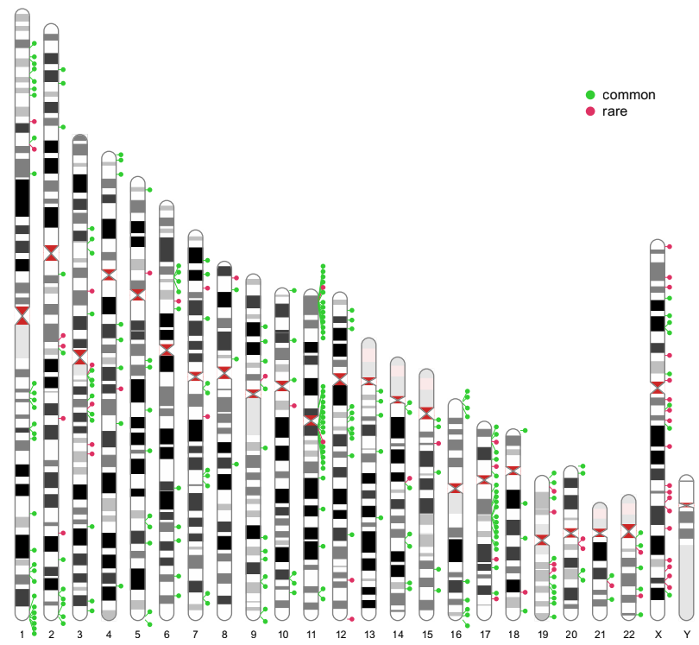
 |  | Mean | 1st quartile | 3rd quartile
Het | rare | 8.85(8.69) | 6(6) | 11(11)
 | common | 59.4(51.1) | 52(46) | 66(56)
 | all | 68.3(59.7) | 59(53) | 76(66)
Hom | rare | 0.1(0.1) | 0(0) | 0(0)
 | common | 27.5(24.6) | 23(21) | 31(28)
 | all | 27.6(24.7) | 23(21) | 31(28)
GO term | q value
olfactory receptor activity (GO:0004984) | 1.86E-28
sensory perception of chemical stimulus (GO:0007606) | 6.2E-27
sensory perception of smell (GO:0007608) | 5.37E-24
detection of chemical stimulus involved in sensory perception (GO:0050907) | 2.42E-05

Slide 6
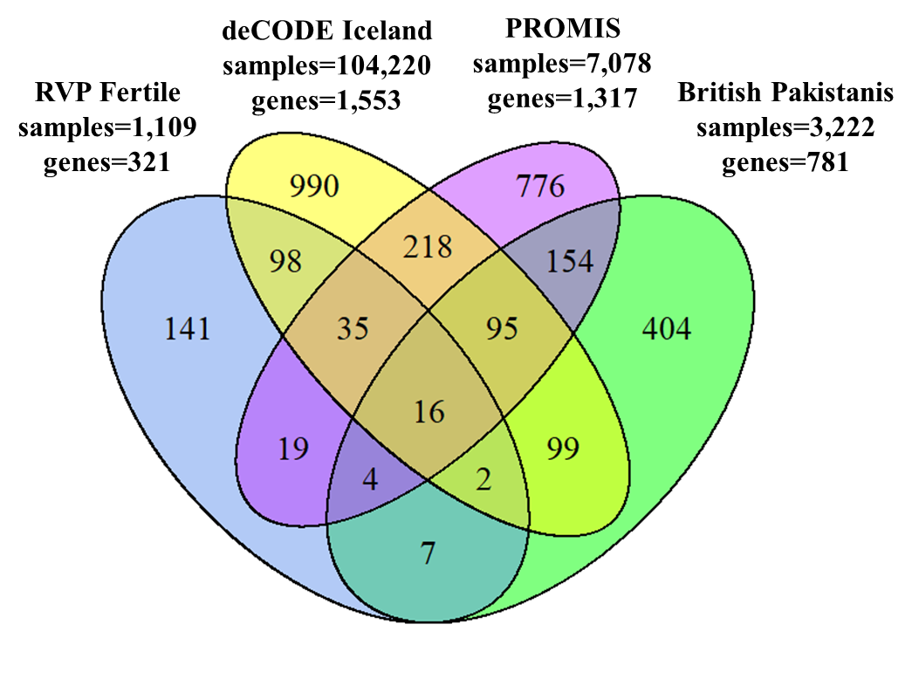


Slide 9
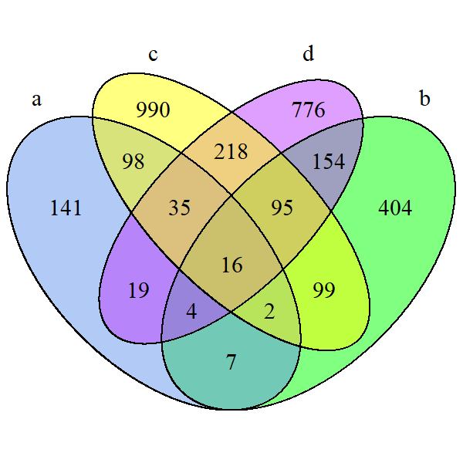
deCODE Iceland
samples=104,220
genes=1,553
PROMIS
samples=7,078
genes=1,317
RVP Fertile
samples=1,109
genes=321
British Pakistanis
samples=3,222
genes=781

