Slide 1
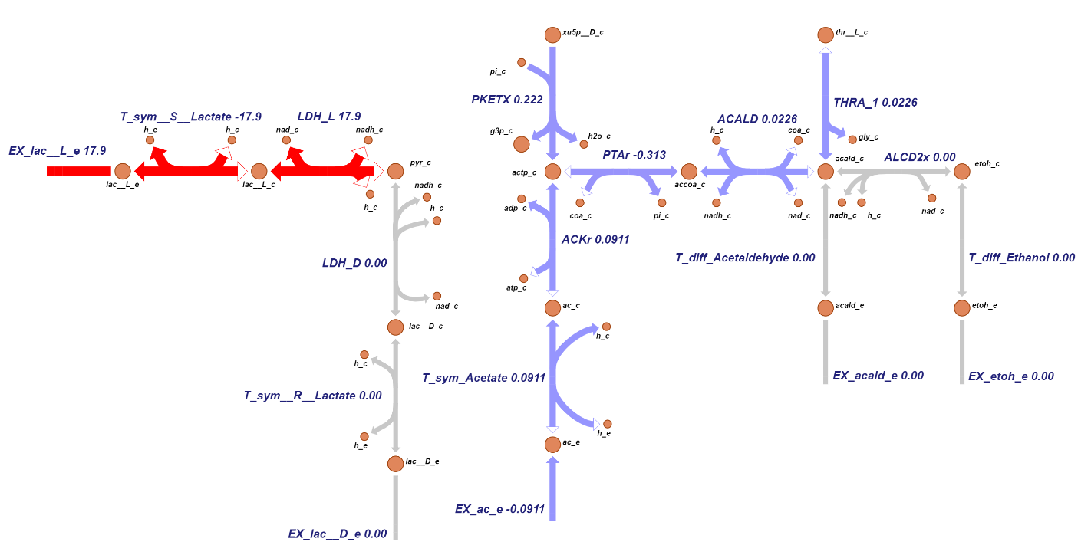
Notes:
icc389

Slide 2
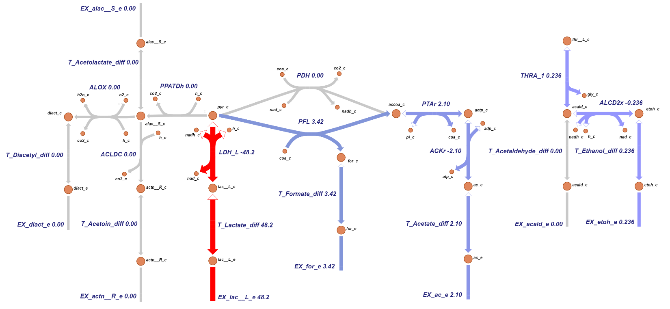
Notes:
icc431

Slide 3
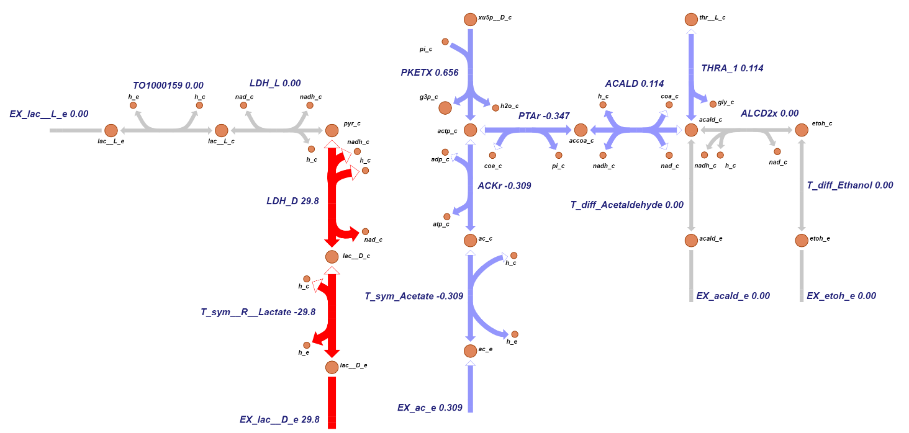
Notes:
icc470

Slide 4
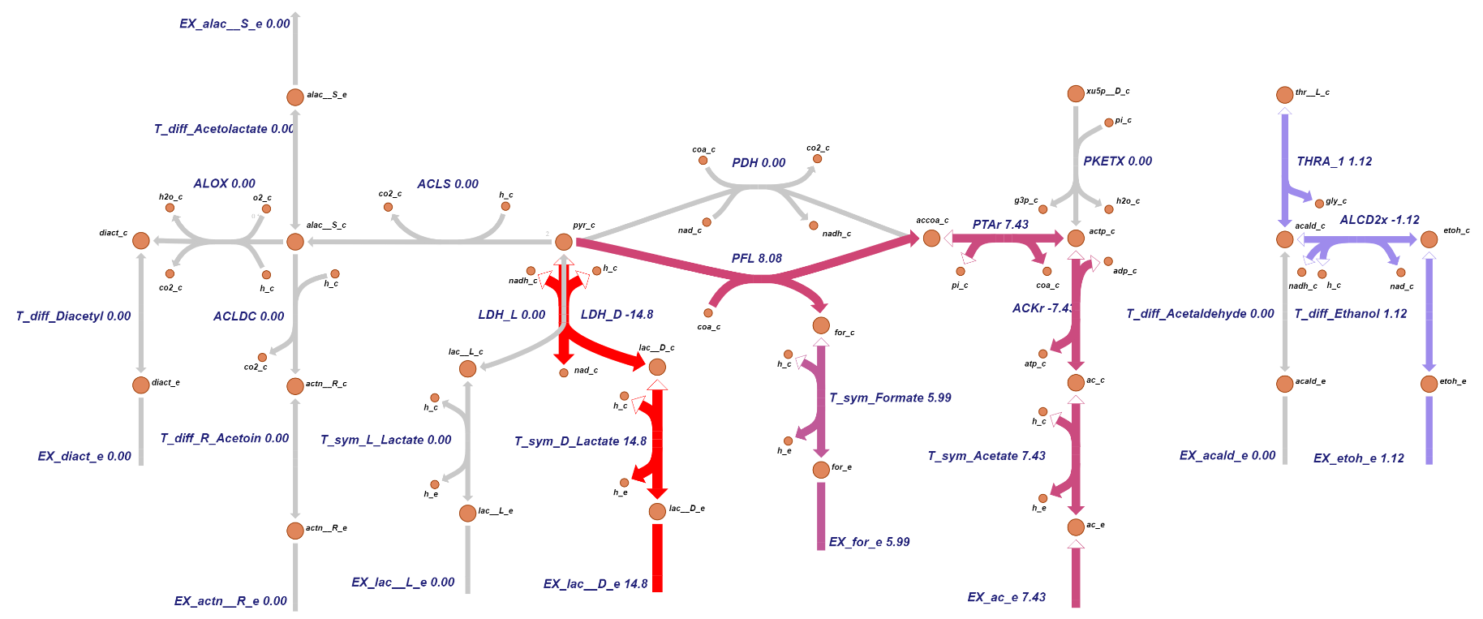
Notes:
icc651

