Slide 1
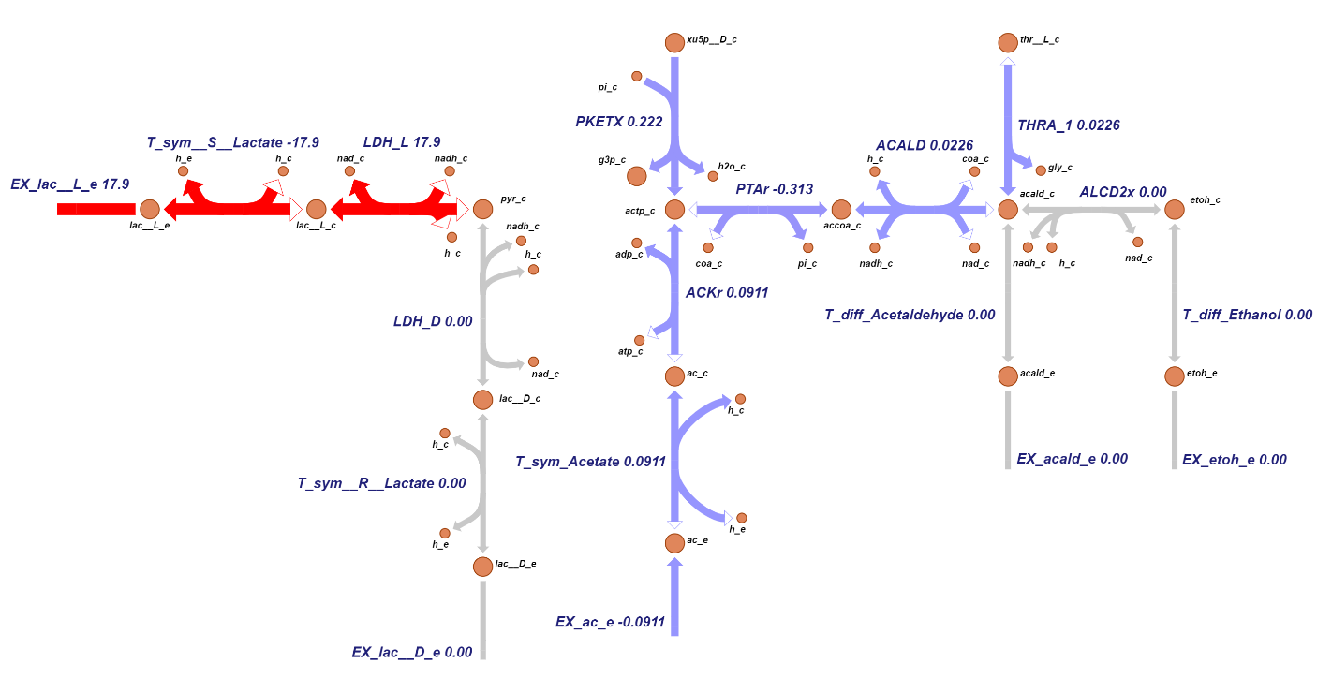
Notes:
icc390

Slide 2
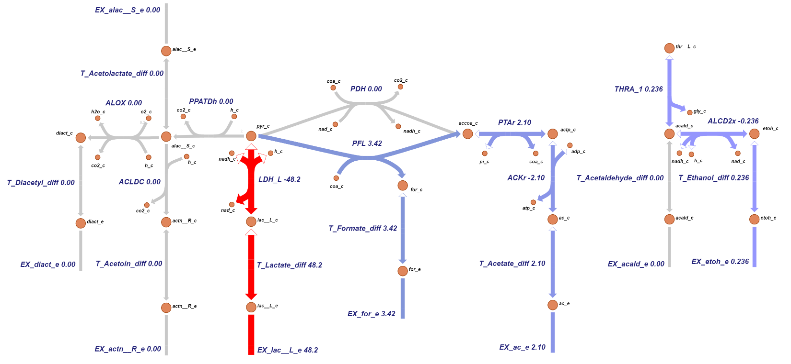
Notes:
icc431

Slide 3
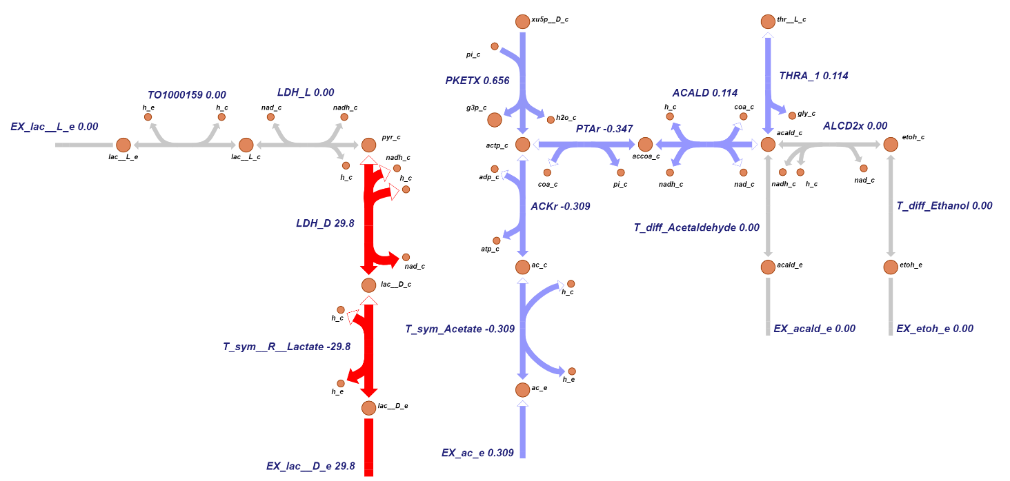
Notes:
icc464

Slide 4
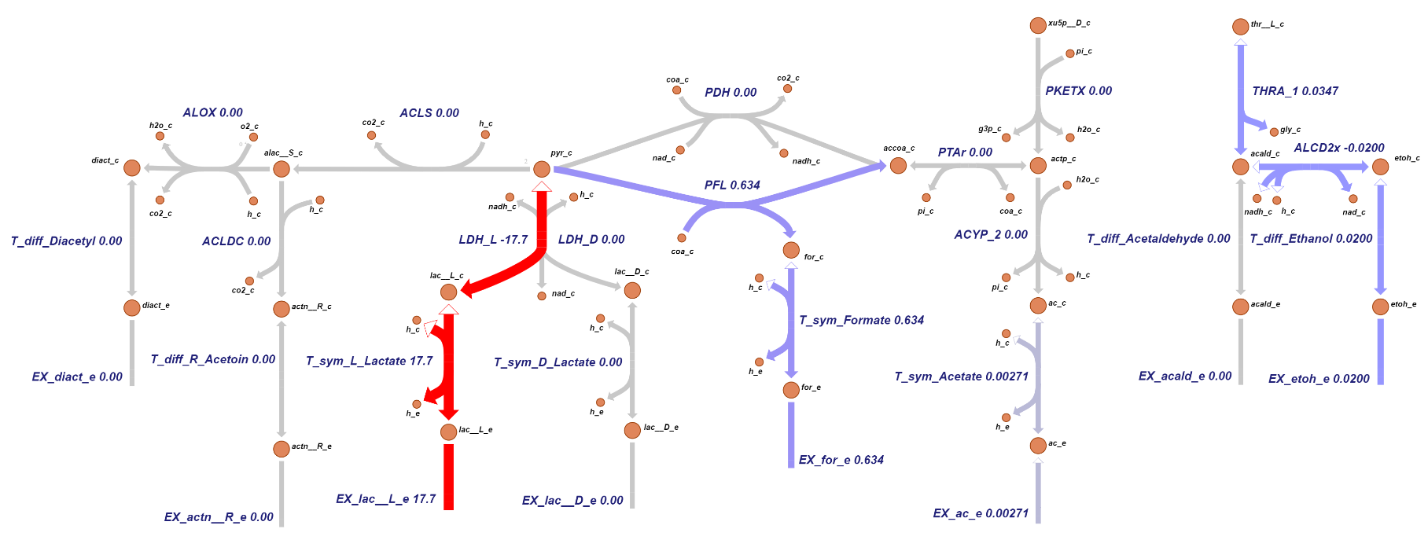
Notes:
icc644

