Slide 1



Practical 4 – de novo assembly of short reads using Velvet
Nick Loman

Slide 2
Velvet
One of the first short read assemblies
Developed by Daniel Zerbino of EBI
A de Bruijn graph assembler, like:
SOAPdenovo (Panda)
ABYSS
ALLPATHS
Etc.

Slide 3
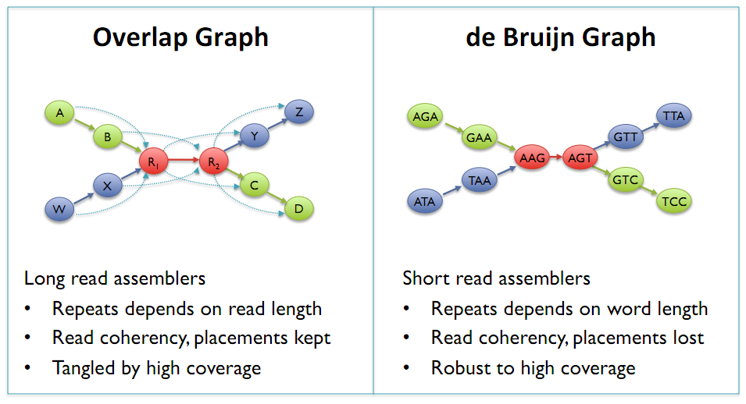
de Bruijn Graphs
Mike Schatz

Slide 4
K-mers and K
there is no magical value of k which gives best assemblies
depends on genome sequenced and the sequencing run
rules
k must be less than the read length
k can't be an even number (can produce palindromes)
Bigger k – fewer overlaps, lower k-mer coverage
Lower k – more overlaps, more coverage
The relation between k-mer coverage Ck and standard (nucleotide-wise) coverage C is Ck = C ∗ (L−k +1)/L where k is your hash length, and L your read length.

Slide 5
Exp_cov
Can make a big difference to your assembly if you have long (e.g. 2*k) or paired-reads
But can also introduce misassemblies if set too high
Velvet can estimate it for you (auto)
But the estimate may not always be best
Assumes even coverage – won’t work with transcriptomes or ChIP-seq

Slide 6
Cov_cutoff
Simplifies the assembly graph by removing nodes with less than a given cut-off
Removes low frequency k-mers which may result from sequencing error
Higher cov_cutoff gives more stringent assembly

Slide 7
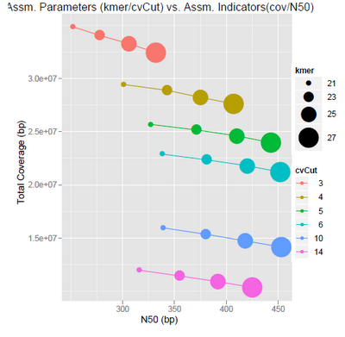

Slide 8
Comes back to question: what do I want from my assembly?
Max coverage
Max accuracy
Max contiguity
You can have some .. But perhaps not all!

Slide 9
Insert size
Experimental evidence
Allow Velvet to guess
Map reads and calculaet

Slide 10
Mate-pair data
Orientation different
Read contamination
PE => insert <=
mate-pair <= insert =>

Slide 11
Useful scripts for Velvet
http://code.google.com/p/standardized-velvet-assembly-report/

Slide 12
Software derived from Velvet
Meta Velvet
For meta genomic assemblies
OASES
For transcriptome assemblies

Slide 13
Advanced technique
Gap closing for finishing
Add Sanger reads
32kb limit
Does not work well with 454 reads
http://www.baseclear.com/landingpages/sspacev12/

