Slide 1



Practical 3 Newbler output

Slide 2
Learning objectives
be able to locate relevant metrics
454NewblerMetrics.txt file
assemblathon script
be able to find contigs and scaffold
be able to inspect alignments
Tablet

Slide 3
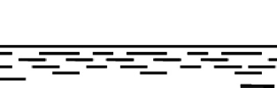
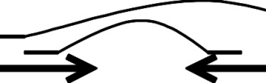
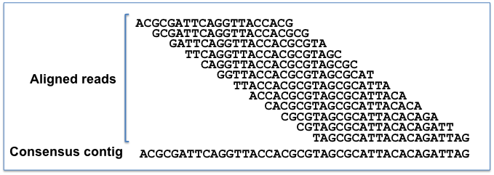
What do you get?

Slide 4
Metrics
contigs
how many
total bases
N50
scaffolds
how many
total bases
N50
how many gaps
total gap bases

Slide 5
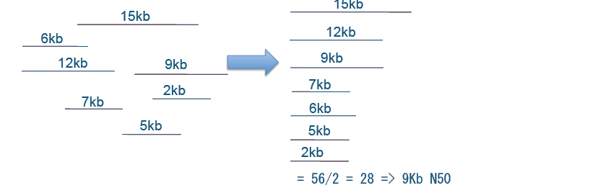
N50
Size of contig such that 50% of total bases are in contigs of this length or more
Sum of lengths: 56 kb
Thomas Keane and Jan Aerts, Wellcome Trust Sanger

Slide 6
N50
Size of contig such that 50% of total bases are in contigs of this length or more
OR
Shortest of the longest contigs that together make up 50% of the assembly

Slide 7
N50
Size of contig such that 50% of total bases are in contigs of this length or more
longer N50 is better
N50 count:
number of contigs of at least N50 size

Slide 8
N50 – NG50
N50:
Size of contig such that 50% of total bases are in contigs of this length or more
NG50:
Replace 'total bases' with 'genome length'

Slide 9
N50
Minimum contig length influences N50
Take away shorter contigs → N50 goes up

Slide 10
N50
High N50 → better assembly
BUT
says nothing of quality

Slide 11
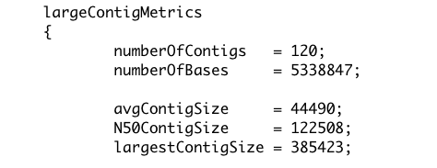
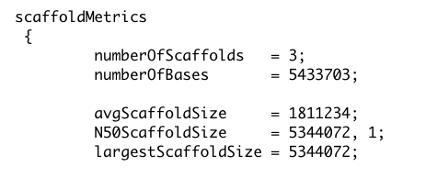
Newbler
Reports contig N50
minimum length 500 bp
so-called 'large' contigs
reports scaffold N50

Slide 12
Newbler
Newbler scaffolds
two or more contigs with gap(s)
unscaffolded contigs of at least 2 kb

Slide 13
Assemblathon
assemblathon_stats.pl script
→ many metrics

Slide 14
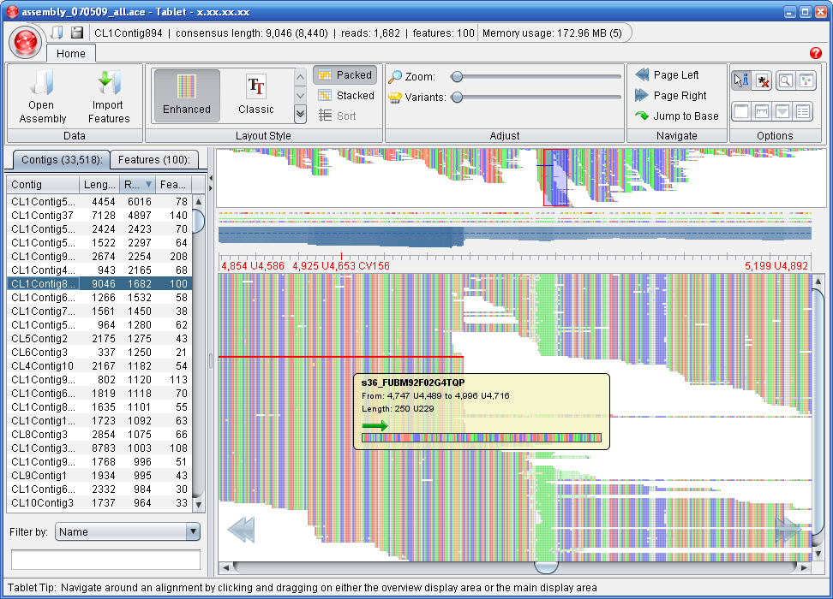
Assembly viewing
We will use Tablet
http://bioinf.scri.ac.uk/tablet/

Slide 15
Assembly viewing
Uses the 'ace' file
contigs
read alignments
read sequences
no scaffolding info

Slide 17
Homopolymer errors
Undercall
in two reads
Overcall
in three reads
AGAAAGTCAGCGGCAAATTTGGTTTTAGACGAA-TTGTCCCTTTGACATAACGACTAAAGG
AGAAAGTCAGCGGCAAATT-GGTTTTAGACGAA-TTGTCCCTTTGACATAACGACTAAAGG
AGAAAGTCAGCGGCAAATTTGGTTTTAGACGAAATTGTCCCTTTGACATAACGACTAAAGG
AGAAAGTCAGCGGCAAATTTGGTTTTAGACGAA-TTGTCCCTTTGACATAACGACTAAAGG
AGAAAGTCAGCGGCAAATTTGGTTTTAGACGAA-TTGTCCCTTTGACATAACGACTAAAGG
AGAAAGTCAGCGGCAAATTTGGTTTTAGACGAAATTGTCCCTTTGACATAACGACTAAAGG
AGAAAGTCAGCGGCAAATTTGGTTTTAGACGAA-TTGTCCCTTTGACATAACGACTAAAGG
AGAAAGTCAGCGGCAAATTTGGTTTTAGACGAAATTGTCCCTTTGACATAACGACTAAAGG
AGAAAGTCAGCGGCAAATT-GGTTTTAGACGAA-TTGTCCCTTTGACATAACGACTAAAGG
AGAAAGTCAGCGGCAAATTTGGTTTTAGACGAAATTGTCCCTTTGACATAACGACTAAAGG
AGAAAGTCAGCGGCAAATTTGGTTTTAGACGAA-TTGTCCCTTTGACATAACGACTAAAGG
AGAAAGTCAGCGGCAAATTTGGTTTTAGACGAA-TTGTCCCTTTGACATAACGACTAAAGG
Consensus

