Slide 1



Practical 2 De novo assembly of 454 reads with Newbler

Slide 2
Learning objectives
be able to start a newbler assembly
basic understanding of parameters

Slide 3
Newbler
Check out my blog ('manual') at
contig.wordpress.com
input
parameters
output
much much more

Slide 4
Practical 2
Data
1) GS FLX+ reads → peak at 800 bases
2) 8 kb Paired End (Mate Pair) run
Newbler 2.6
→ can we get one scaffold per chromosome?

Slide 5
Practical 2
Start your assembly
around 45 minutes
while we wait:
more slides on newbler

Slide 6
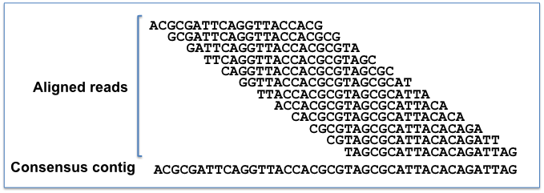
Read alignment
Stringency
Read 1
Read 2
Overlap

Slide 7
Read alignment
Stringency
minimum overlap length
-ml
default 40 (bases)
can be anything of at least 1 bases
OR
% of the read length (1-100%)

Slide 8
Read alignment
Stringency
minimum overlap length
-mi
default 90 (%)
can be anything between 1-100%

Slide 9
Read alignment
Examples
runAssembly -o stringent -ml 100 -mi 98% /data/*.sff
runAssembly -o loose -ml 30 -mi 80% /data/*.sff

Slide 10
Read alignment
When to use
contaminated datasets
too low coverage

Slide 11
Read trimming
removing unwanted reads
→ contamination
removing unwanted parts of reads
→ e.g. adaptors

Slide 12
Read trimming
removing unwanted reads
→ 'vector screening' -vs
removing unwanted parts of reads
→ 'vector trimming' -vt

Slide 13
Read trimming
Examples
Trimming 'database' fasta file: adaptors.fasta
runAssembly -o trim1 –vs adaptors.fasta /data/*.sff
Screening 'database' fasta file: ecoli_genome.fasta
runAssembly -o trim2 –vs ecoli_genome.fasta /data/*.sff

Slide 14
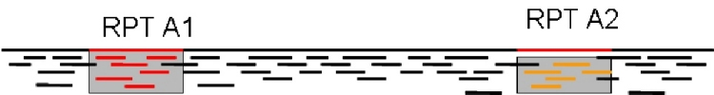
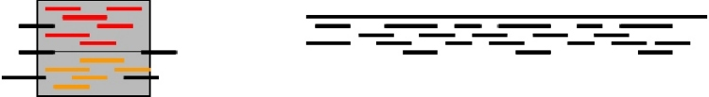
Scaffold gap filling
-scaffold option
Repeat copy 1
Repeat copy 2
Contig orienation?
Contig order?
Collapsed repeat consensus
http://www.cbcb.umd.edu/research/assembly_primer.shtml

Slide 15
Scaffold gap filling
-scaffold option
adds repeat consensus sequence in gaps

