Slide 1



Lecture 1 Principles and problems of de novo genome assembly
Lex Nederbragt
Norwegian High-Throughput Sequencing Centre (NSC)
and
Centre for Ecological and Evolutionary Synthesis (CEES)

Slide 2
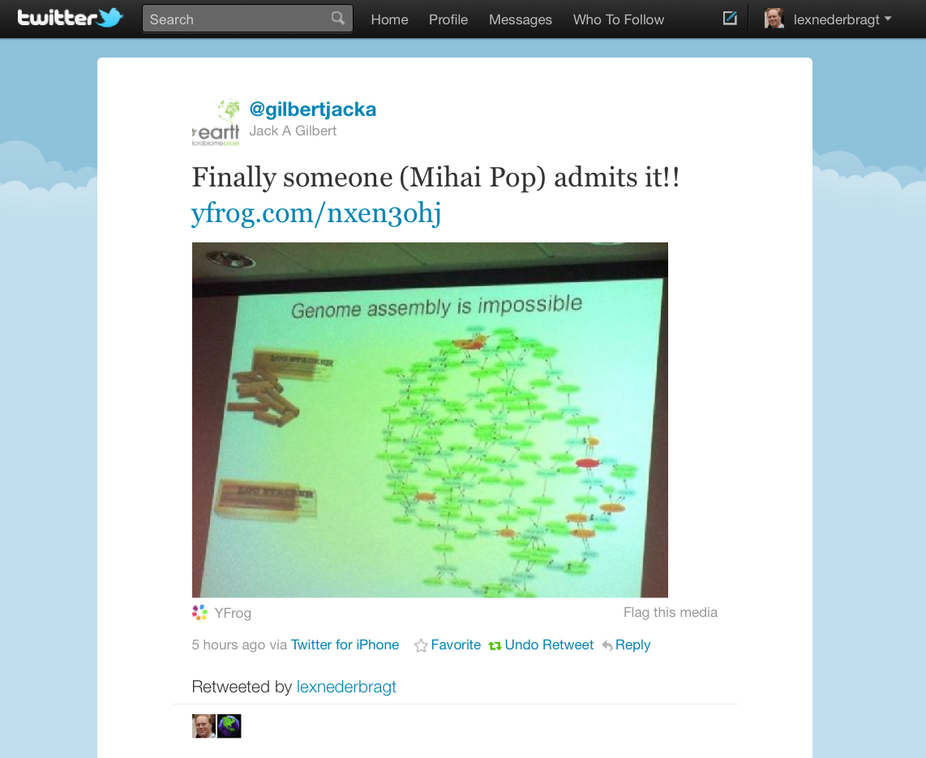

Slide 3
What is a genome assembly?
A hierarchical data structure
that maps the sequence data
to a putative reconstruction of the target
Miller et al 2010, Genomics 95 (6): 315-327

Slide 4
Hierarchical structure
reads
contigs
scaffolds

Slide 5
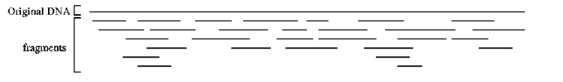
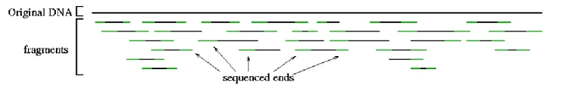
Sequence data
reads
contigs
scaffolds
Reads
http://www.cbcb.umd.edu/research/assembly_primer.shtml

Slide 6
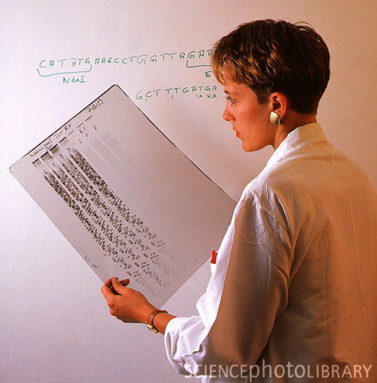
Reads!
reads
contigs
scaffolds
http://www.sciencephoto.com/media/210915/enlarge

Slide 7
Contigs
reads
contigs
scaffolds
Building contigs

Slide 8
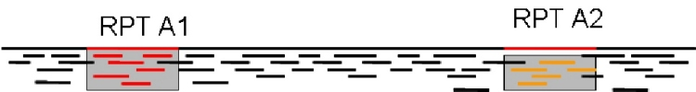
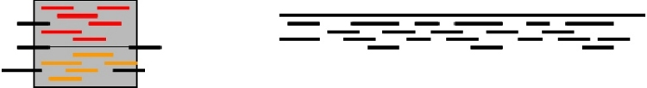
Contigs
reads
contigs
scaffolds
Building contigs
Repeat copy 1
Repeat copy 2
Contig orienation?
Contig order?
Collapsed repeat consensus
http://www.cbcb.umd.edu/research/assembly_primer.shtml

Slide 9
Contigs
reads
contigs
scaffolds
Repeats: major problem
Repeat copy 1
Repeat copy 2
http://www.cbcb.umd.edu/research/assembly_primer.shtml

Slide 10
Mate pairs
reads
contigs
scaffolds
Other read type
Repeat copy 1
Repeat copy 2
(much) longer fragments
mate pair reads

Slide 11
Mate pairs
Paired end reads → 100-500 bp insert
Mate pairs → 2-20 kb insert
Repeat copy 1
Repeat copy 2
mate pair reads

Slide 12
Paired ends
Illumina
50-500 bp insert
454
2-20 kb
→ should have been called mate pairs!

Slide 13
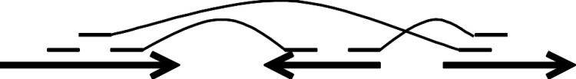
Scaffolds
reads
contigs
scaffolds
Ordered, oriented contigs
mate pairs
contigs
gap size estimate

Slide 14
Hierarchical structure
reads
contigs
scaffolds

Slide 15
Assembly
How to do this?
Algorithms

Slide 16
Algorithms
All are graph-based
Read 1
Read 2
Overlap
Graph-theory!

Slide 17
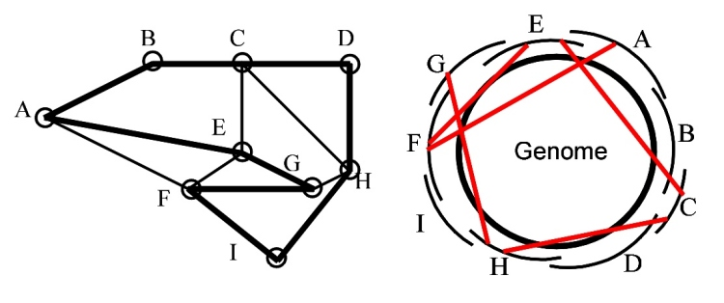
Algorithms
Hamiltonian path
a path that contains all the nodes
http://www.cbcb.umd.edu/research/assembly_primer.shtml

Slide 18
Algorithms
Overlap calculation (alignment)
computationally intensive
Read 1
Read 2
Overlap

Slide 19
Algorithms
Path through the graph
→contig
Read 1
Read 2
Read 3
Read 4
Overlap
Overlap
Overlap

Slide 20

Algorithms
Many flavors
Two most used
Overlap Layout Consensus
de Bruijn graph
http://www.waialuasodaworks.com/images/flavors2009.jpg

Slide 21
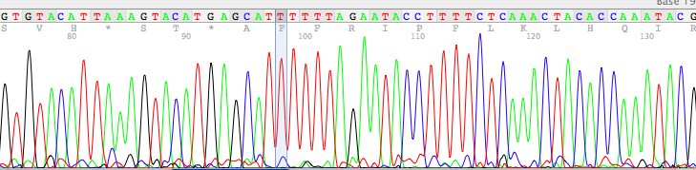
Overlap-Layout-Consensus
Typical for Sanger-type reads
also used by newbler from 454 Life Sciences

Slide 22
Overlap-Layout-Consensus
Steps
Overlap computation
Layout: graph simplification
Consensus: sequence

Slide 23
Overlap-Layout-Consensus
Overlap phase:
K-mer seeds initiate overlap
ACGCGATTCAGGTTACCACG

Slide 24
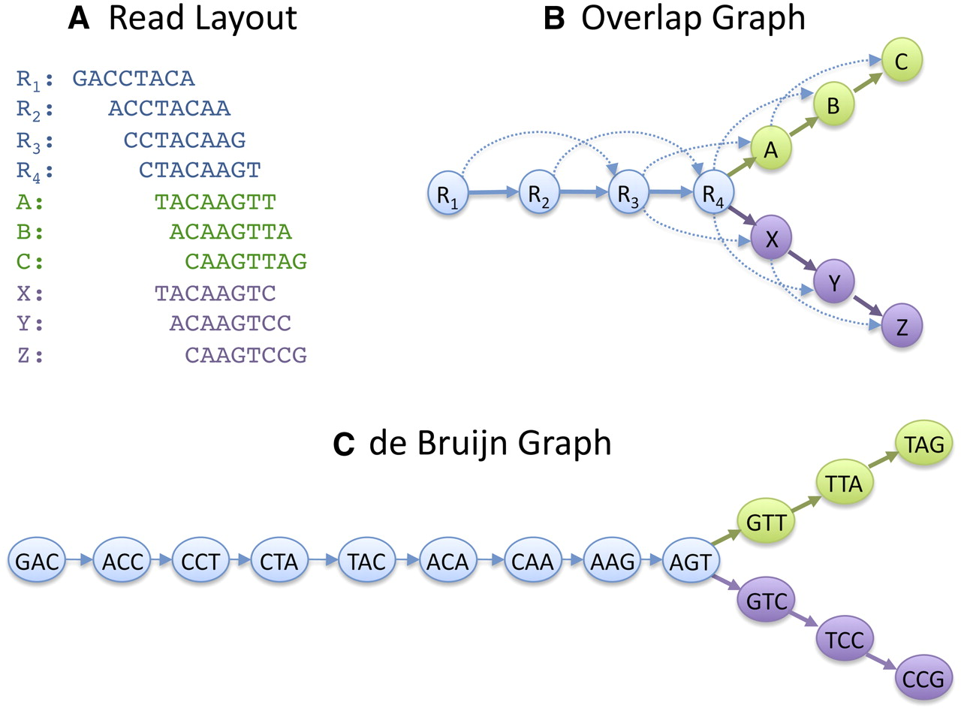
Overlap-Layout-Consensus
Schatz M C et al. Genome Res. 2010;20:1165-1173

Slide 25

de Bruijn graphs
Developed outside of DNA-related work
Best solution for very short reads ≤100 nt
Read
GACCTACA
GAC
ACC
CCT
CTA
TAC
ACA
de Bruijn graph
K-mers (K=3)
K-1 bases overlap

Slide 26
Graphs
Schatz M C et al. Genome Res. 2010;20:1165-1173

Slide 27

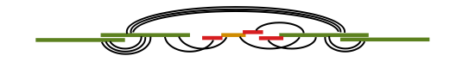
Graphs
Simplify the graph
Add scaffolding information

Slide 28
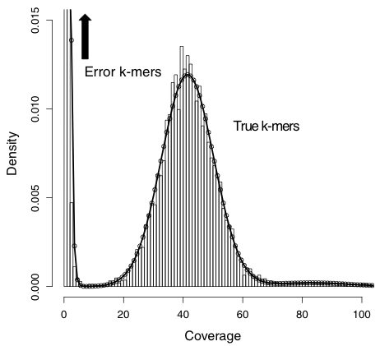
Sequence data
Sequencing errors
add complexity to graph
create new k-mers
Correction of errors
k-mer frequency
Kelley et al. Genome Biology 2010 11:R116

Slide 29
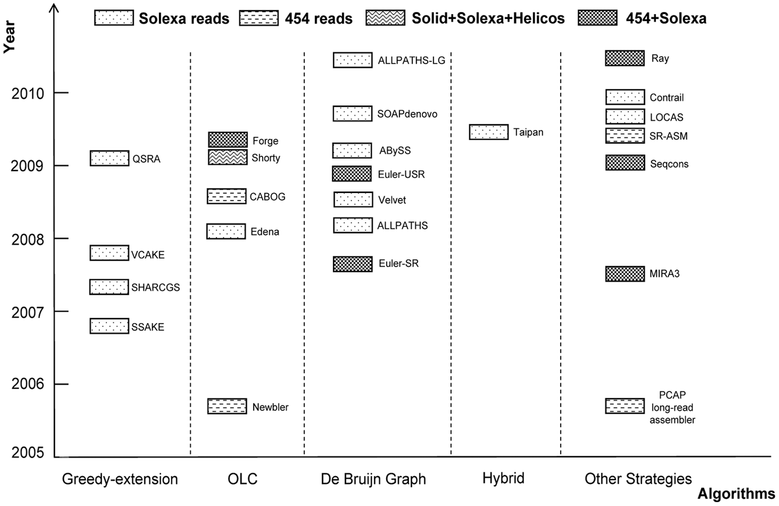
Many programs to choose from
Zhang et al. PLoSOne 2011

Slide 30
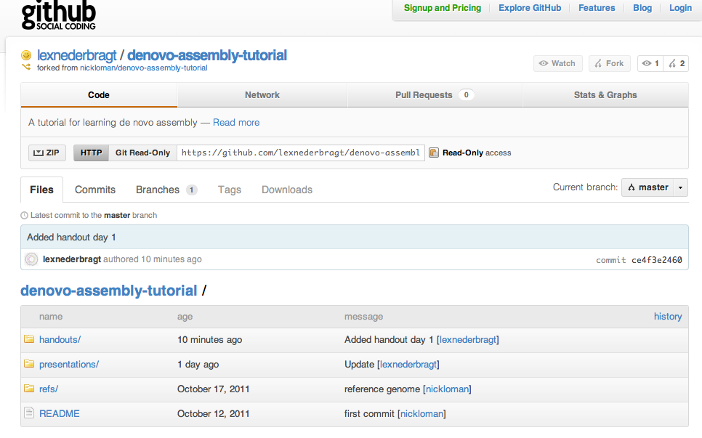
Course website
https://github.com/lexnederbragt/denovo-assembly-tutorial
Twitter:
#nsccourse
@lexnederbragt
@pathogenomenick

