Slide 1



Practical 5 Hybrid de novo assembly

Slide 2
Learning points
How to add miseq reads to a 454 read dataset using newbler
How to judge the effect

Slide 3
Hybrid assembly
using different technologies
for one assembly
Sanger, 454, Illumina, PacBio, ...

Slide 4
Hybrid assembly
Challenge: short read + long reads
use de Bruijn graph?
use Overlap Layout Consensus?

Slide 5
Hybrid assembly
Use a single program with all data
OR
Correct assembly with data from other technology/technologies
OR
Use different programs for each dataset
merge into one

Slide 6
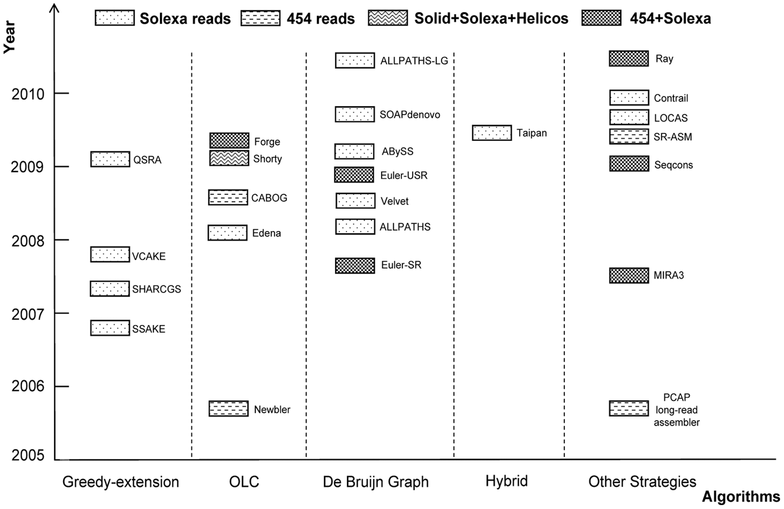
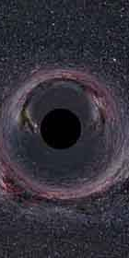
Hybrid assembly
http://www.crystalinks.com/blackholeeye350.jpg
Zhang et al. PLoSOne 2011

Slide 7
Hybrid assembly options
Celera
→ sanger, 454 and Illumina (forthcoming)
Ray, Abyss, ...
→ 454 and Illumina
Newbler
→ 454
→ Illumina?

Slide 8
Hybrid assembly
Does it work?
Are we there yet?

Slide 9
Practical 6
datasets
454 as before
miseq as before
Program
→ newbler

Slide 10
Practical 6
newbler with 454 + illumina
=
longer running time!

