Slide 1



Planning a sequencing project
Nick Loman
University of Birmingham

Slide 2
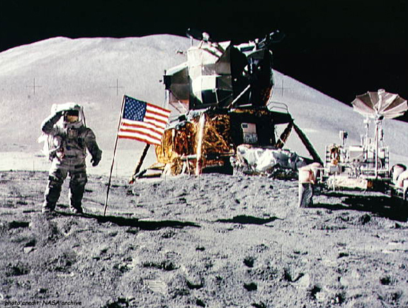

We’re on a mission
2001
2011

Slide 3

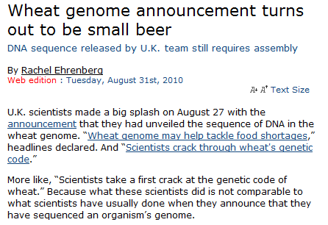

Hang on!

Slide 4
Generating sequence is easy

Slide 5
Assembly is difficult … because of
Repeats
Ploidy
Size
Contamination

Slide 6
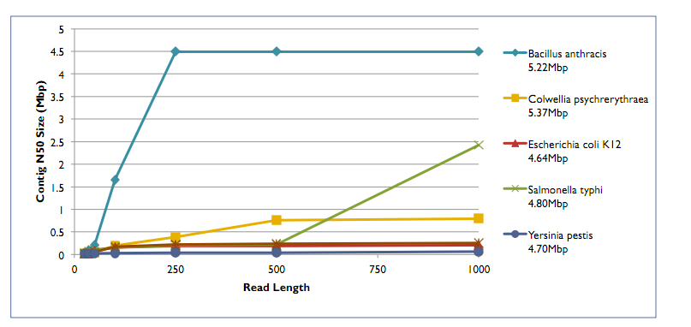
Repeats and read length
Mike Schatz

Slide 7
Difficulty levels
Easy
Chlamydia genome (small, no repeats)
E. coli (small, some repeats)
Small eukaryotic
Large, diploid (Homo sapiens)
Large, polyploid (wheat)
Hard

Slide 8

Biology comes first
How long do you want to spend on this?
Where’s the value to you?
Gene finding only (RNA-Seq, very draft WGS)
Draft incomplete
Draft complete
Contiguous / circular complete
Finished – the holy grail

Slide 9
Resources to help you decide
What have others done already?
Close reference available?
What’s your budget?
What’s your timescale?
What are your bioinformatics resources?
What choice of sequencing technology?

Slide 10
Choosing technologies
Strengths/weaknesses
“Cut your cloth to suit your purse”
454
Long reads
Low throughput
Homopolymeric tract errors
Expensive!

Slide 11
Choosing technologies
Illumina, short reads (but getting longer)
High throughput
Cheap
Short reads (2x150 best)
SOLiD – NO!
Ion Torrent – short reads, low throughput, medium-cost

Slide 12
Mate-pairs
454: 3, 8, 20kb protocols
Illumina 2, 6, other
PacBio very long reads up to 20kb
Circular consensus for accuracy

Slide 13
Bioinformatics
Large assemblies require large amount of memory
Estimating requirements may be difficult
Sometimes still not possible – wheat
Hybrid assemblies not always straight-forward

Slide 14
Group Exercise
What genome(s) do you want to assemble?
What size is it?

Slide 15
What size is it?
How many sequencing reads to you need?
Rule of thumb: 30x for short reads, 10x for long reads

Slide 16
What is the repeat structure?
Transposons
LINEs
SINEs
IS elements
Number, length, size
Best read length
Determine mate-pair strategy, or decide to give up on completeness!

Slide 17
What is the minimum information I need?
Genes
Regulatory regions
Contiguous chromosomes
Finished

Slide 18
Basic recipes for genome
Bacterial - 454
some shotgun (~10x)
8kb PE library (low coverage)
→ should give 1 scaffold per chromosome
Homopolymer errors
Bacterial – Illumina
Paired-end reads required
the more mate pair libraries, the better

Slide 19
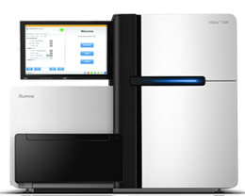
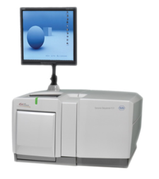
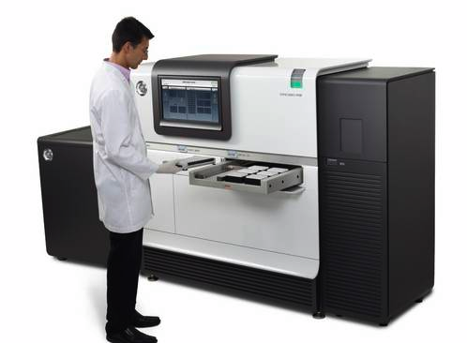
How to sequence a genome
Eukaryote
Foundation of Illumina data
100x coverage Paired End reads (2x100bp)
several Mate Pair libraries
2kb, 3kb, 8k, 10kb, bigger?
this is now very cheap!
Fill gaps with long reads
454 or PacBio

Slide 20

How to sequence a genome
Add lots of bioinformatics...
http://cores.montana.edu/index.php?page=bioinformatics-core-facility

