Slide 1



Practical 4 – de novo assembly of short reads using Velvet
Nick Loman

Slide 2
Velvet
One of the first short read assemblers
Developed by Daniel Zerbino of EBI
A de Bruijn graph assembler, like:
SOAPdenovo (Panda)
ABYSS
ALLPATHS
Etc.

Slide 3
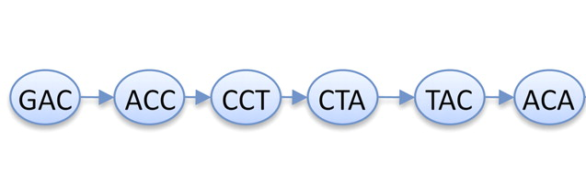
K-mers again
Read
GACCTACA
GAC
ACC
CCT
CTA
TAC
ACA
de Bruijn graph
K-mers (K=3)
K-1 bases overlap

Slide 4
Counting k-mers
Plotting k-mer frequencies is a quick and easy way of:
Estimating genome size
Seeing copy number variation in genome
Estimating sequence read error
Planning a short-read assembly

Slide 5
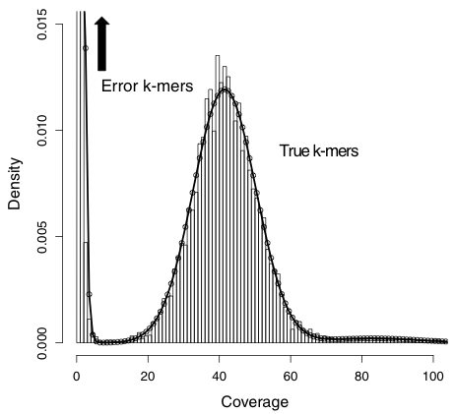
Idealised k-mer plot

Slide 6
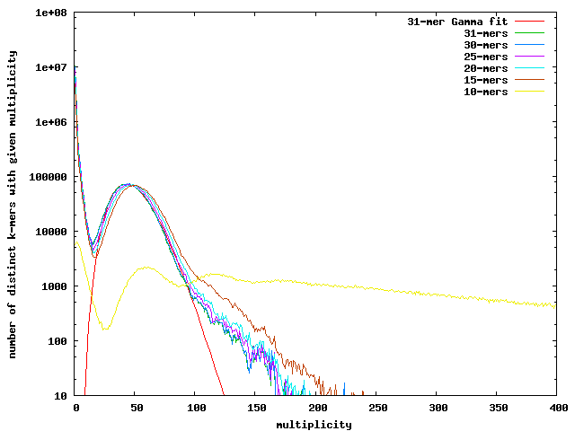
A simple K-mer plot
https://banana-slug.soe.ucsc.edu/bioinformatic_tools:jellyfish

Slide 7
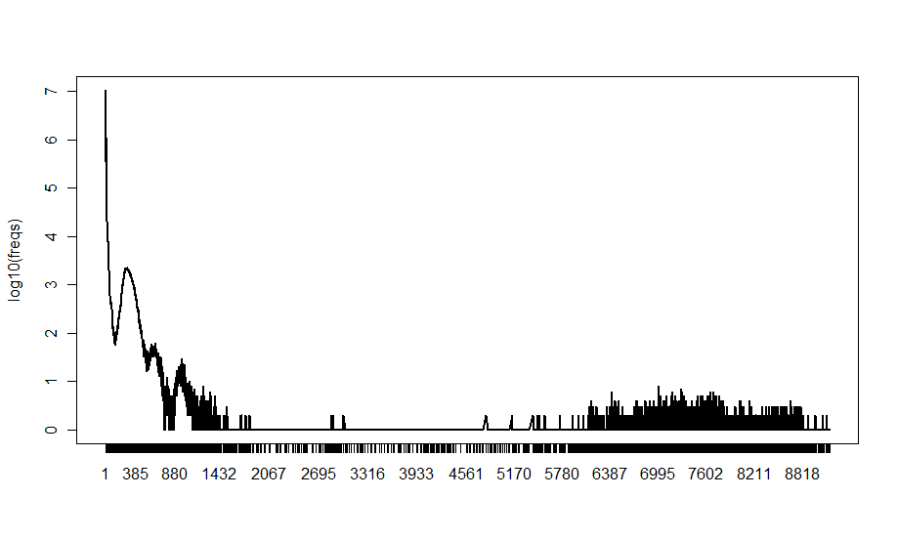
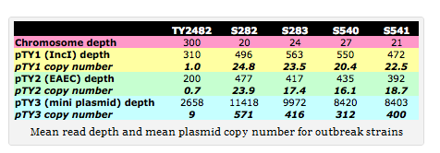

Slide 8
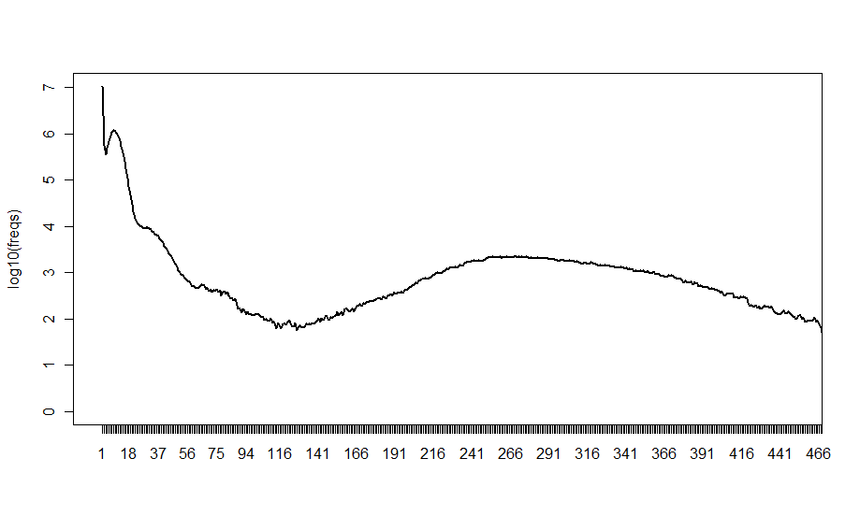

Slide 9
K-mers and K
There is no magical value of k which gives best assemblies
Depends on read length, sequencing error, rate of polymorphism, coverage
But some rules:
k must be less than the read length
k can't be an even number (can produce palindromes)
Bigger k – fewer overlaps, lower k-mer coverage
Lower k – more overlaps, more coverage

Slide 10
Part 2

Slide 11
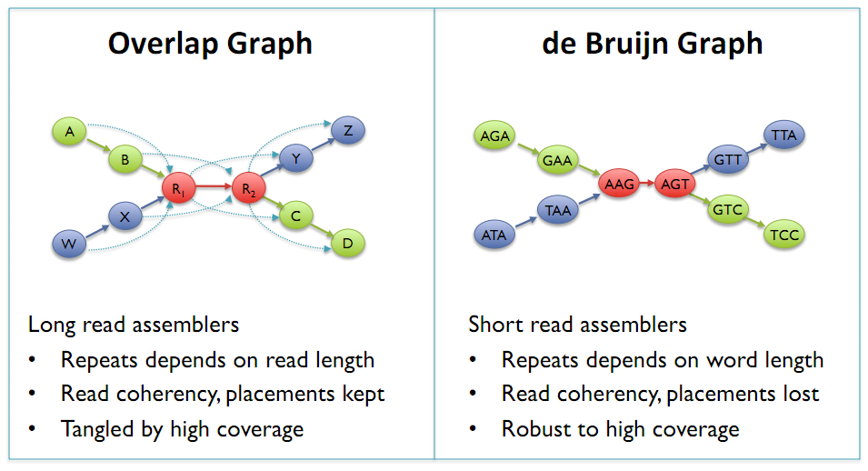
de Bruijn Graphs
Mike Schatz

Slide 12
K-mer coverage
The relation between k-mer coverage Ck and standard (nucleotide-wise) coverage C is Ck = C ∗ (L−k +1)/L where k is your hash length, and L your read length.

Slide 13
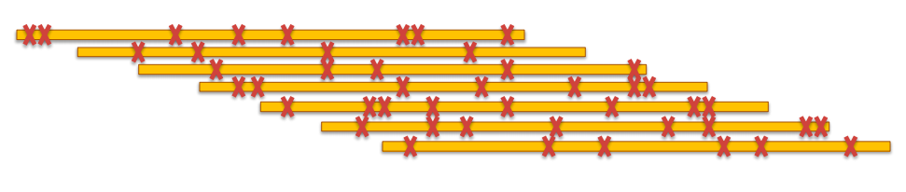
More errors require shorter k-mers

Slide 14
Exp_cov
Can make a big difference to your assembly if you have long (e.g. 2*k) or paired-reads
But can also introduce misassemblies if set too high
Velvet can estimate it for you (auto)
But the estimate may not always be best
Assumes even coverage – won’t work with transcriptomes or ChIP-seq

Slide 15
Cov_cutoff
Simplifies the assembly graph by removing nodes with less than a given cut-off
Removes low frequency k-mers which may result from sequencing error
Higher cov_cutoff gives more stringent assembly

Slide 16
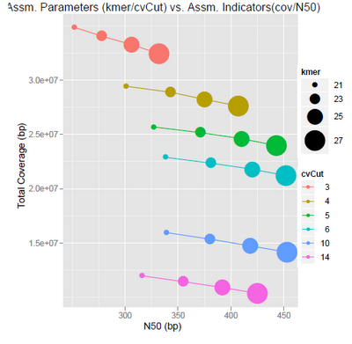

Slide 17
Comes back to question: what do I want from my assembly?
Max coverage
Max accuracy
Max contiguity
You can have some .. But perhaps not all!

Slide 18
Insert size
Experimental evidence
Allow Velvet to guess
Map reads and calculaet

Slide 19
Mate-pair data
Orientation different
Read contamination
PE => insert <=
mate-pair <= insert =>

Slide 20
Useful scripts for Velvet
http://code.google.com/p/standardized-velvet-assembly-report/

Slide 21
Software derived from Velvet
Meta Velvet
For meta genomic assemblies
OASES
For transcriptome assemblies

Slide 22
Advanced technique
Gap closing for finishing
Add Sanger reads
32kb limit
Does not work well with 454 reads
http://www.baseclear.com/landingpages/sspacev12/

