Slide 1
Tools for detecting insertions, deletions, and other CNVs using Illumina data
Josie Reinhardt
BYOB – April 29, 2014

Slide 2
Terminology
SNP – individual variation in sequence identity
Indel (Insertion-deletion) – individual variation in the presence of a gene/sequence (e.g. 0 copies versus 1+)
CNV (copy number variant) – individual variation in the number of copies of a gene/sequence (1 copy versus 2+)
SV (structural variant) – individual variation in the location / arrangement of a gene/sequence
These categories overlap (a segmental duplication is an Indel as well as a CNV, and could be considered an SV)

Slide 3
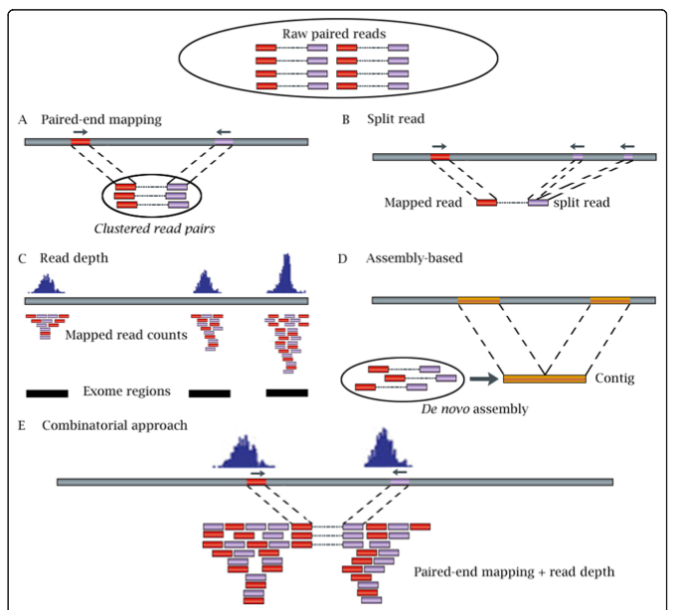
Strategies for CNV / SV detection

Slide 4
Summary of tools
Read depth (DoC) tools
15 total,

Slide 5
My data
2 pools of individuals carrying either a meiotic drive causing X chromosome (X^{SR}) or not, approx 20 individuals per pool
WGS, 150bp PE, 420bp inner insert approximately 20x coverage
Stalk-eyed fly genome, N50 of ~80k
We are most interested in the fixed SVs between the drive X and the nondrive X (so having pools may not be that important)

Slide 6
Tools I tried
Program | Type | Language | Compatable platforms | Algorithm
Breakdancer | PEM only | Perl, cpp | Perl version, any. CPP version linux only | Looks for unusual insert size, then counts reads voting for the same region
CNVnator | DoC only | C++ | Any Unix (in theory) | sliding window / mean shift algorithm
SVDetect | PEM + DoC | Perl | Any | Separate analysis of PEM and DoC. Output is similar for both so you can look for overlap between PEM and DoC
Hydra | PEM + de novo assembly | Python | Any unix (in theory) | Takes the discordant pairs, then does a local de novo assembly to finely map the breakpoints

Slide 9
Breakdancer

Slide 10
CNVnator

