Slide 1
DELLY
Structural variant discovery by integrated paired-end and split-read analysis
Josie Reinhardt BYOB April 20, 2015

Slide 2
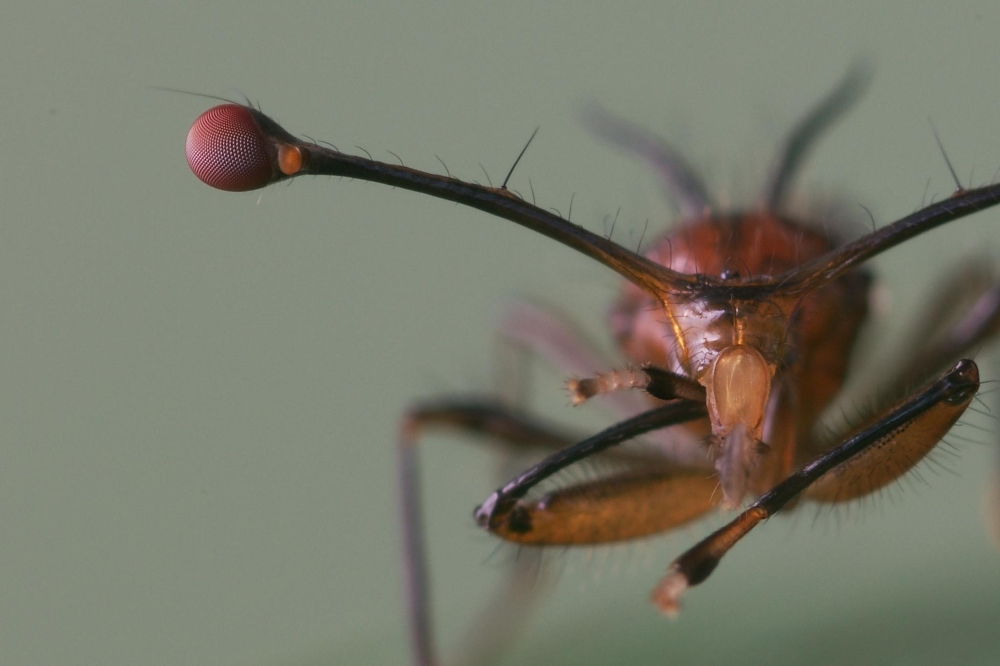
Stalkies
Hmmm... where are my SVs???

Slide 3
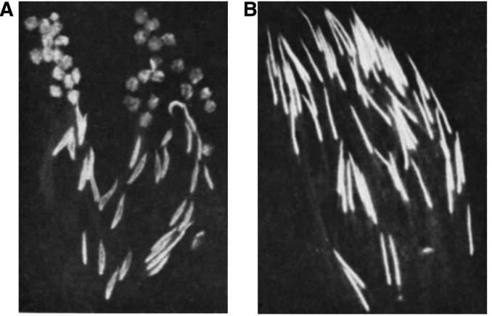
Meiotic drive
Wikipedia: “...simply, meiotic drive is when one copy of a gene is passed on to offspring more than the expected 50% of the time.”
SR/ST
(Drive male)
ST/ST
(wildtype male)
Larracuente 2012, Genetics

Slide 4
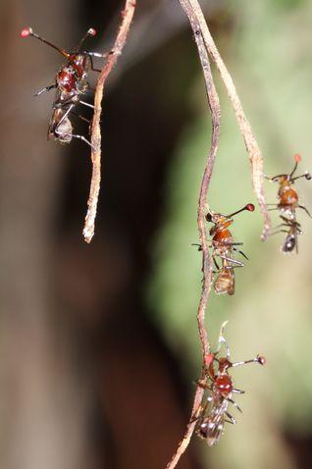


Sex-chromosome Drive
Standard (XST) male
Sex-ratio (X^{SR}) male
~50%
~50%
0-10%
90-100%

Slide 5
Sex-chromosome Drive
Standard (XST) male
Sex-ratio (X^{SR}) male
What is going on genetically in X^{SR} males?
~50%
~50%
0-10%
90-100%

Slide 6
The Data
Males recently from field are screened for drive
(mated, 50+ offspring collected/sexed)

Slide 7
The Data
Males recently from field are screened for drive
(mated, 50+ offspring collected/sexed)
Created three DNAseq pools:
Standard rep 1
Standard rep 2
Female sex-ratio biased (too few for more reps)

Slide 8
The Data
Males recently from field are screened for drive
(mated, 50+ offspring collected/sexed)
Created three DNAseq pools:
Standard rep 1
Standard rep 2
Female sex-ratio biased (too few for more reps)
Illumina 100bp PE, Genomic resequencing
Map to 600MB draft genome, last assembly N50~95kb

Slide 9
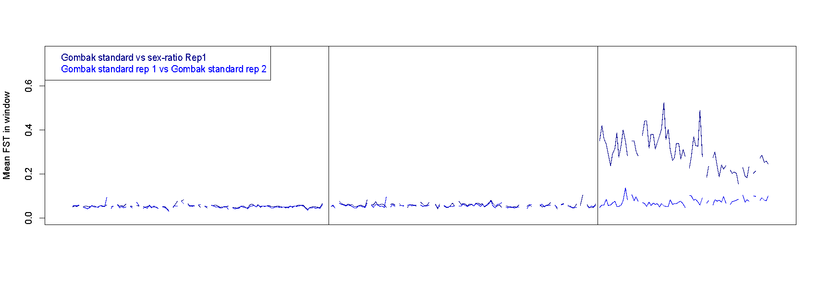
SNPs: Drive X is differentiated
C1
C2
X
ms217A
ms262Z
ms262Y
ms223
CG10082
Bunched
ms167
ms071
CG31064
CG31738
Sequence differentiation due to lack of recombination relative to standard X’s. Difficult to identify a “causal” region.

Slide 10
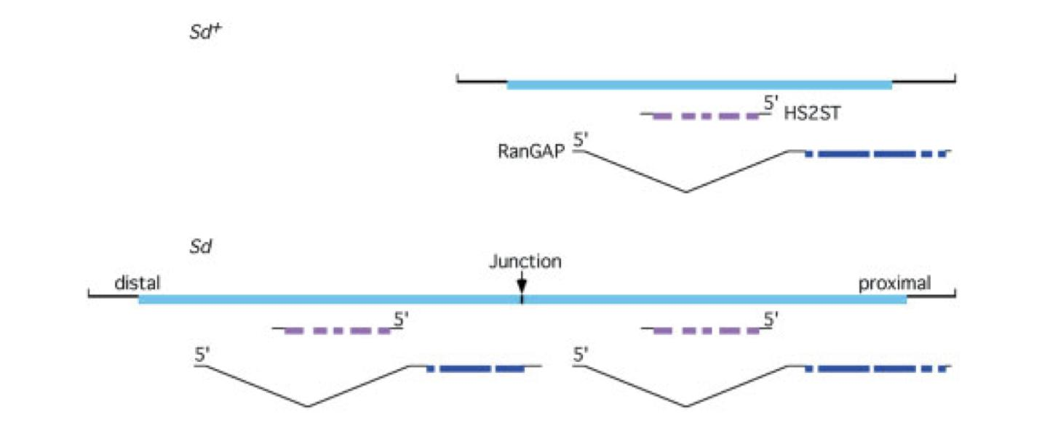
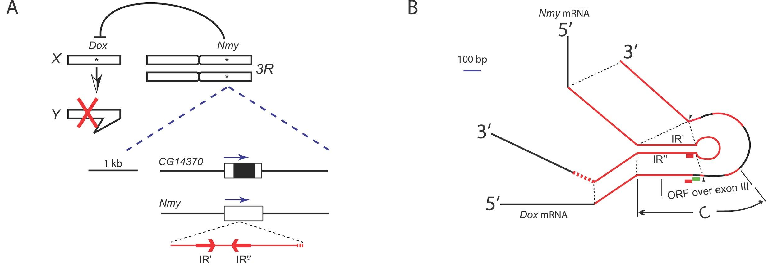
Structural variants & Drive
Molecular mechanism of drive often associated with CNVs, especially duplicates
SD is a partial, tandem duplicate of a RanGAP - functions as some sort of nuclear transporter...
DoX, MDox, and nmy are all derived from a pseudogenized copy of a progenitor gene (CG8664)
Kusano et al 2003, BioEssays
Tao 2007, PLoS Biology

Slide 11
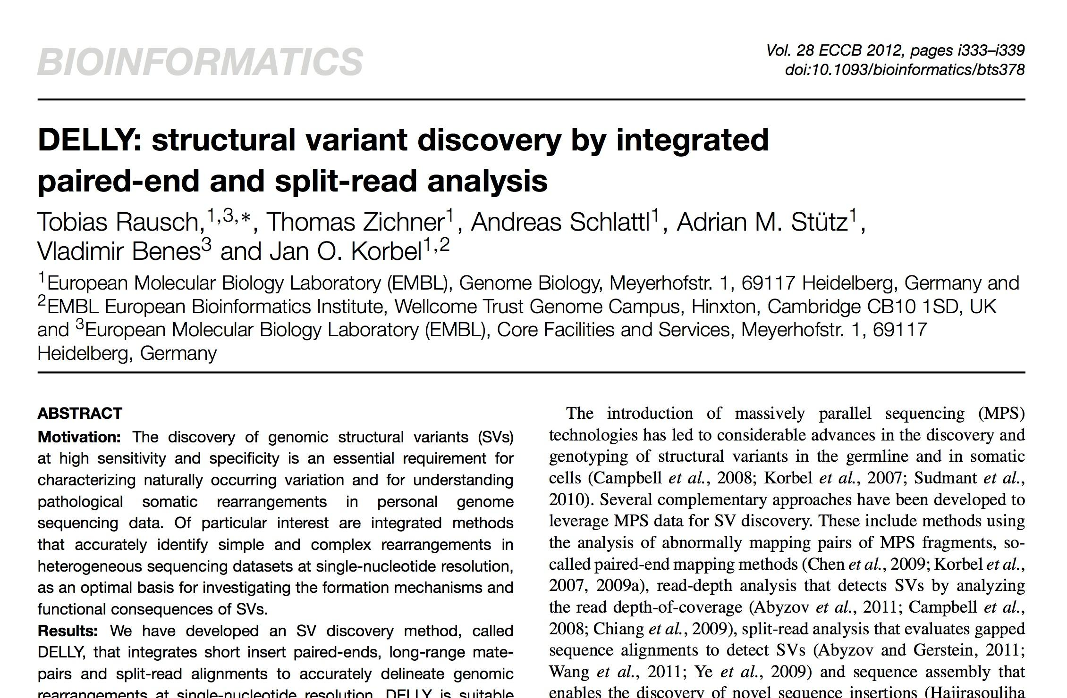
DELLY SV Detection

Slide 12
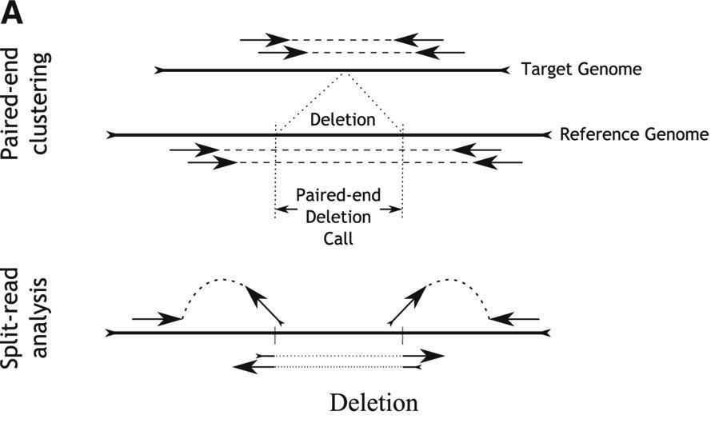
DELLY SV Detection
‘Deletions’ are detected as paired-end outliers at the far end of the insert size distribution but at default library orientation.

Slide 13
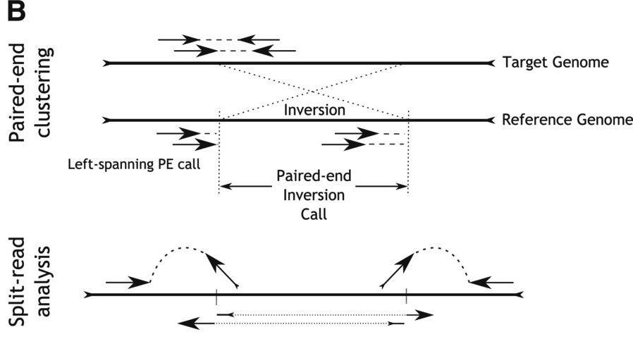
DELLY SV Detection
Inversion
Inversions’ are detected as abnormally oriented paired-ends where an orientation change of one read leads to the default library orientation.

Slide 14
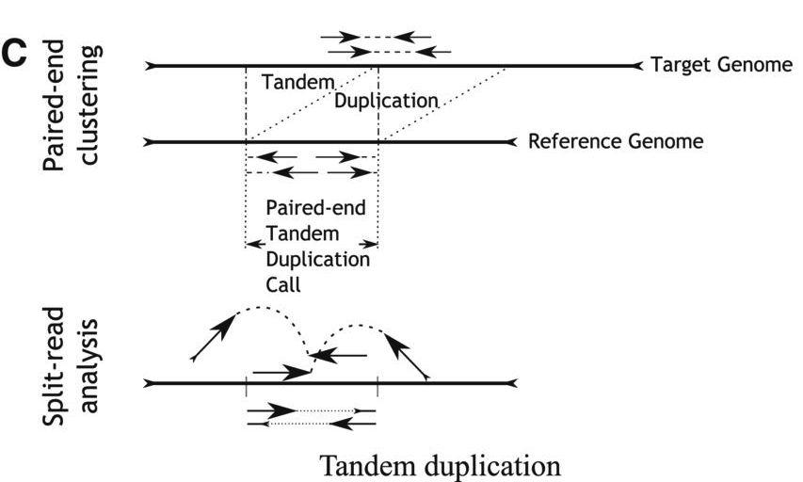
DELLY SV Detection
‘Tandem duplications’ are detected as paired-ends where the first and second read changed their relative order but kept the alignment strand induced by the default library orientation.
Inversion

Slide 15
DELLY SV Detection
Inversion

Slide 16
Running DELLY
link out
Inputs: Genome, sorted/indexed BAM files
Outputs: vcf files showing genotyping data for each variant / sample

Slide 17
Running DELLY
Run DELLY for each type of variant
( Example…)
#PBS -l walltime=36:00:00,vmem=5gb,mem=5gb,nodes=1
#PBS -N 150217_delly
#PBS -M josiereinhardt@gmail.com
#PBS -m e
delly -t DEL -o /N/dc2/scratch/joserein/DELLY/TDG_deletions.vcr -g /N/dc2/scratch/joserein/Genome2015/assembly.CA.coords9.79.15.17.0.05u.fa /N/dc2/scratch/joserein/bwa_split_newgenome/TDGD_full2015_150212_bwasplit2.sort.bam /N/dc2/scratch/joserein/bwa_split_newgenome/TDGND1_full2015contig_150212_bwamem.sort.bam /N/dc2/scratch/joserein/bwa_split_newgenome/TDGND2_full2015contig_150212_bwamem.sort.bam

Slide 18
DELLY output
STDout gives some useful info:
(Translocation mode failed, I will wait until I have linkage groups and try again)

Slide 19
DELLY output
click out for example…
delly output

Slide 20
Running DELLY
Filter output in a way that makes sense for your data
For me… (Pool-seq ST vs SR comparison)
SV’s should be fixed (for first pass)
SV’s should be high quality for the variant allele
example...

Slide 21
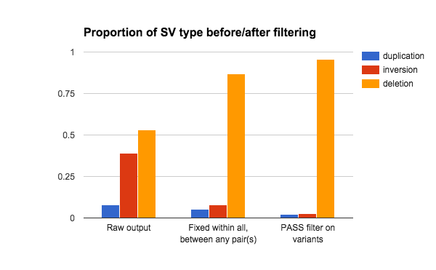
Results - SV’s found
TOTALS | 98791 | 886 | 482

Slide 22
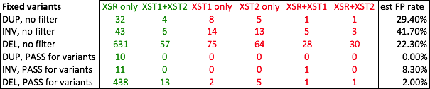
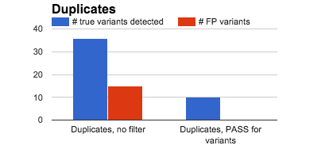
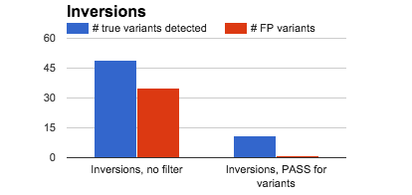
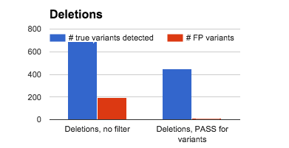
Results - TP/FP estimation

Slide 23
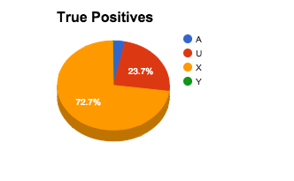
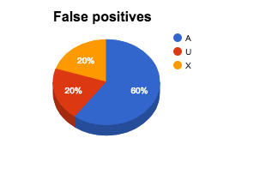
Results - X linkage
Only the X chromosome (not autosomes) are differentiating in sex ratio males…
SVs should only be on the X

Slide 24
Conclusions
DELLY is an easy-to-use all- most-purpose SV detector (no insertions) for HTS data
Generates a lot of junk, so need to design experiment carefully and filter thoughtfully...
Also check out softsearch and PRISM

