Slide 1
Phylotranscriptomics using Orthograph
Josie Reinhardt
BYOB Oct 7, 2014

Slide 2


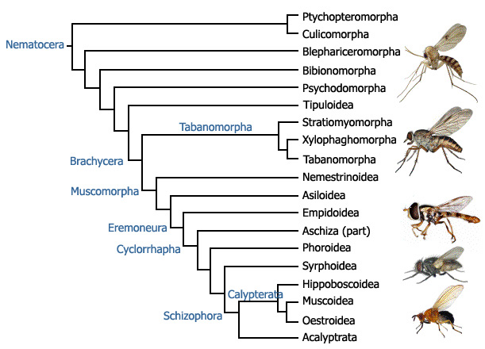
Or... I try to learn how to phylogenetics

Slide 3
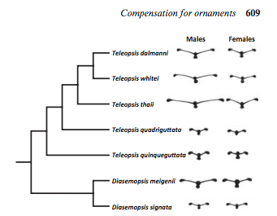
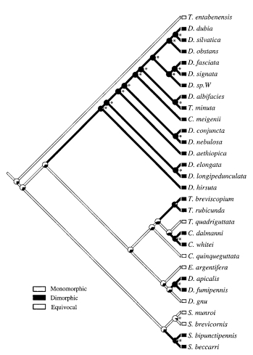
Background
I have…
11 species of Stalk eyed fly testes transcriptomes
I want…
To solidify the phylogenetic relationships between the species, get good branch lengths, etc…
…in order to do molecular evolution (PAML, etc), contrast monomorphy and dimorphy, etc
New spp:
T. pallifacies
S. europaea
T. thaii
Husak et al 2011, Baker and Wilkinson 2001

Slide 4
FLYTREE – the Dipteran ToL
Goal: Solve the Diptera phylogeny
APPROACH 1: mtDNA + 14 nuclear genes + 371 morphological characters for 42 sp; 5 nuclear genes for ~200 species
Weigmann et al 2011

Slide 5

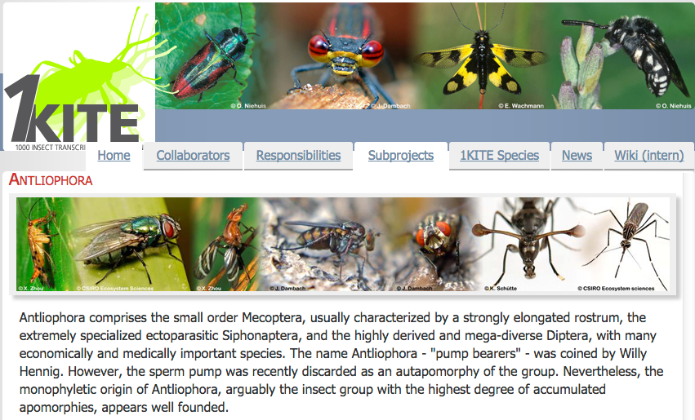

FLYTREE – the Dipteran ToL
APPROACH 2: Transcriptomes from as many insects as possible (eventually 1000, with 200+ dipterans)
Keith Bayless (Schizophora)
Brian Weigmann

Slide 6
Transcriptome -> Tree
Assemble transcriptome
Q.C. transcriptome
Define orthology set
Find orthologs
Align ortholog groups
Pull sequences you care about
Reformat and concatenate as needed
Phylogenetics
Tree?
Trinity, Abyss, etc
Coverage? Misassembly?
OrthoDB
(or your own methods)
Orthograph
Scripts,
Pipelines…
Max. Likelihood, max. parsimony, Bayesian, Neighbor Joining

Slide 7
Transcriptome -> Tree
Assemble transcriptome
Q.C. transcriptome
Define orthology set
Find orthologs
Align ortholog groups
Pull sequences you care about
Reformat and concatenate as needed
Phylogenetics
Tree!
OrthoDB
(or your own methods)
Orthograph
Scripts,
pipelines
Max. Likelihood, max. parsimony, Bayesian, Neighbor Joining

Slide 8
Define orthology set
Orthograph requires you build a database of orthologous groups which will be the “reference” for all other species.
Go to OrthoDB

Slide 9
Orthograph
https://github.com/mptrsen/Orthograph
“Orthology prediction using a graph-based, reciprocal approach with profile hidden Markov models”
Malte Peterson wrote it specifically for the 1kite project, not yet published

Slide 10
Orthograph
Inputs
Orthology set in COG format
Protein Fasta for each species in COG file
Optional: DNA Fasta
Transcriptome(s)
Pipeline
Everything is managed through .conf files
Ortholog-manager – create the ortholog database
Ortholog-analyzer – find new orthologs in a transcriptome
Ortholog-reporter – report results

Slide 11
Ortholog-manager
Conf file for creating database
orthograph-manager --create
orthograph-manager --load-ogs-peptide (run for each fasta in the set)
orthograph-manager COGfile.txt (interactive process…)

Slide 12
Ortholog-analyzer/reporter
.conf file for EACH TRANSCRIPTOME. change
input-file
species-name
output-directory
Run each conf file (can do jobs in parallel)
Result:
Output dir for each transcriptome, contains /aa/ subdir which has the orthologs you need

Slide 13
My completely uninformed phylogenetics pipeline
Merge the genes with the COG group name from across the species sub dirs into a single file (I wrote a script: orthograph_downstream_taxanameonly.pl but later found orthograph includes one: https://github.com/mptrsen/Orthograph/blob/master/summarize_orthograph_results.pl)
2) do an alignment of each COG group constructed (MUSCLE, via
3) Use TRIMAI to trim the alignments and output into PHYLIP
4) Concatenate alignments catfasta2phyml.pl
5) Build trees with RAXML

Slide 14
I made a treeee (9 loci… um)
Diasemopsis
Teleopsis/
Cyrtodiopsis
(All bootstraps were 100%)
Eurydiopsis
Sphyracephala
(Drosophila)

Slide 15
I learn how to phylogenetics?
still
But I made a tree!

Slide 16
In future…?
Add the rest of my species
See if transcriptome filtering by coverage matters
Try different Ortholog sets
Try more than one phylogenetic approach
Any ideas for me?

