Slide 1
Comparative Genomics for Human Disease Using Conserved Protein Domains
B.Y.O.B. Presentation 09-23-14
Thomas A. Peterson
Ph.D. Candidate in Dr. Maricel Kann’s lab at UMBC

Slide 2


The ISCB Student Council (SC) is a section of ISCB dedicated to facilitating opportunities of development for students and young researchers in CompBio and Bioinformatics.
Regional Student Groups (RSGs) bring together local students to network and host events

Slide 3
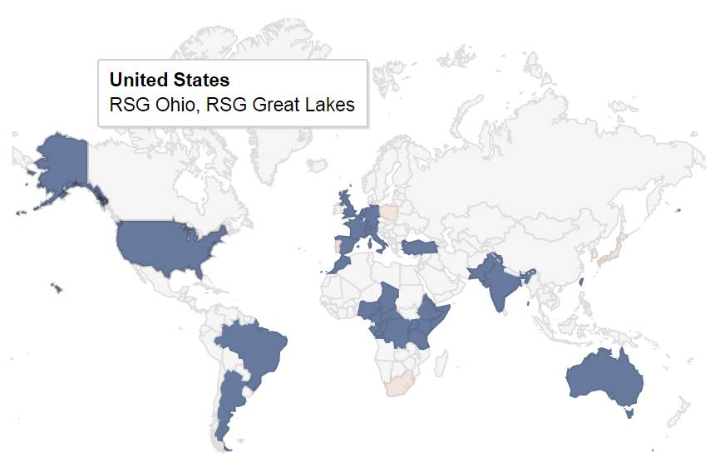
Over 20 RSGs exist around the world

Slide 4
Proposed Activities
Bi-monthly meetings (attendance is not mandatory)
Student-led tutorials / workshops
Experience teaching and organizing events
Student symposia
Experience presenting to peers and exposure to local research
Collaborative projects / hackathons

Slide 5
Proposed Activities
Bi-monthly meetings (attendance is not mandatory)
Student-led tutorials / workshops
Experience teaching and organizing events
Student symposia
Experience presenting to peers and exposure to local research
Collaborative projects / hackathons
$$$ - Money is given by the SC to hold events.
Being a member of a RSG can increase your chance to be awarded travel grants from the SC for ISMB meetings

Slide 6
Please email me to join:
tpeters1@umbc.edu
Or join the google group:
https://groups.google.com/forum/#!forum/rsg-dc-region

Slide 7
Comparative Genomics for Human Disease Using Conserved Protein Domains
B.Y.O.B. Presentation 09-23-14
Thomas A. Peterson
Ph.D. Candidate in Dr. Maricel Kann’s lab at UMBC

Slide 8
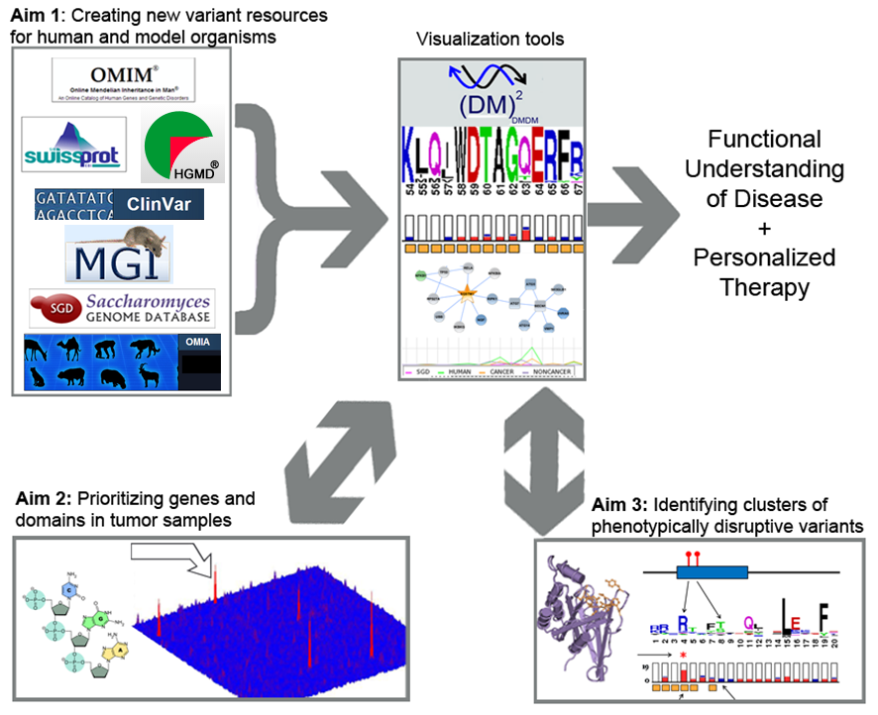

Slide 9


Slide 10
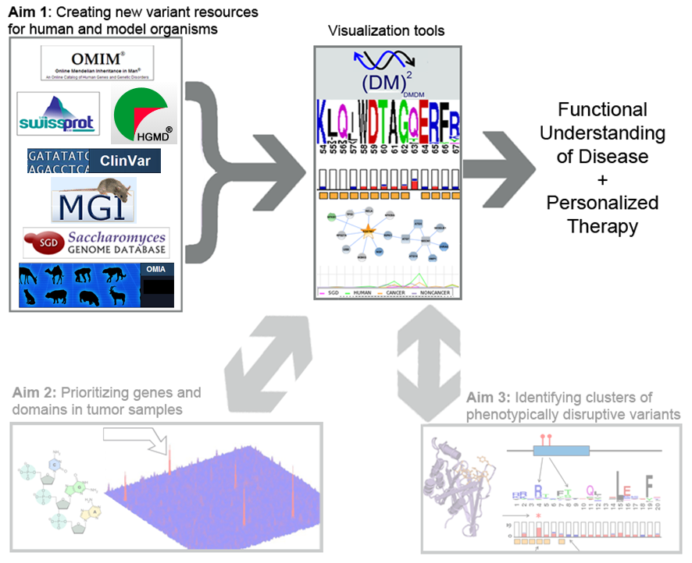

Slide 11
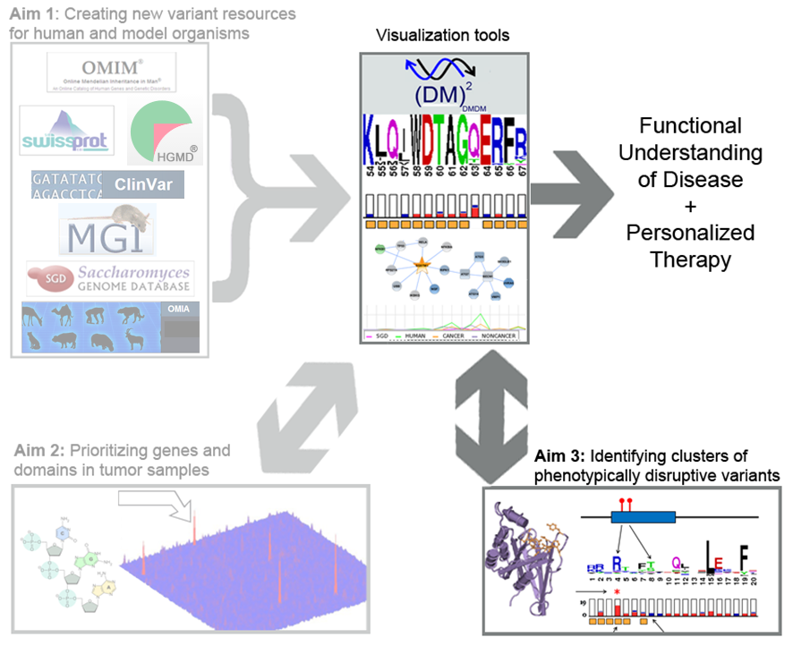

Slide 12
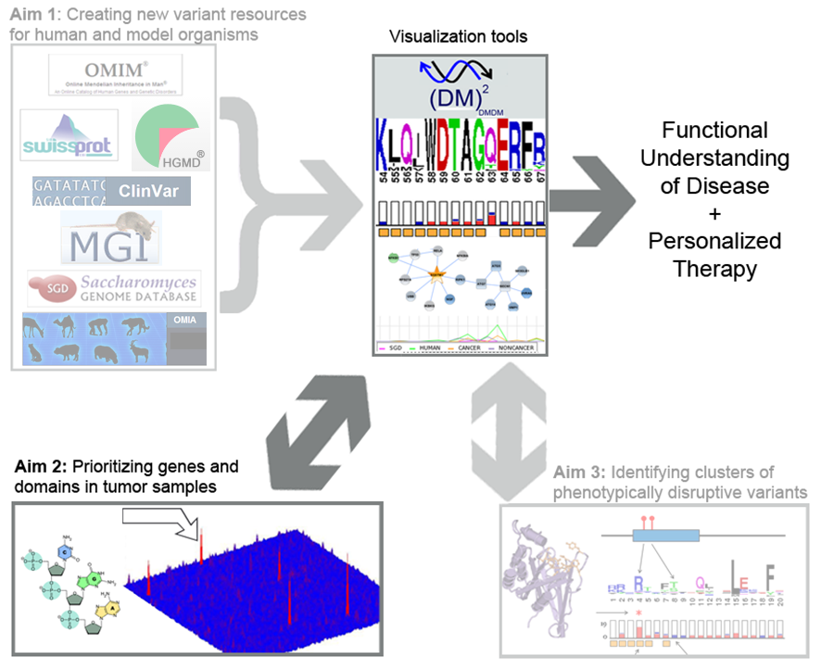

Slide 13
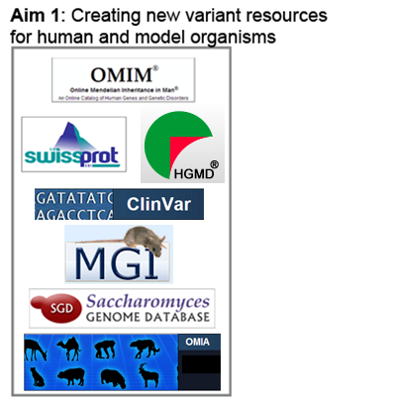

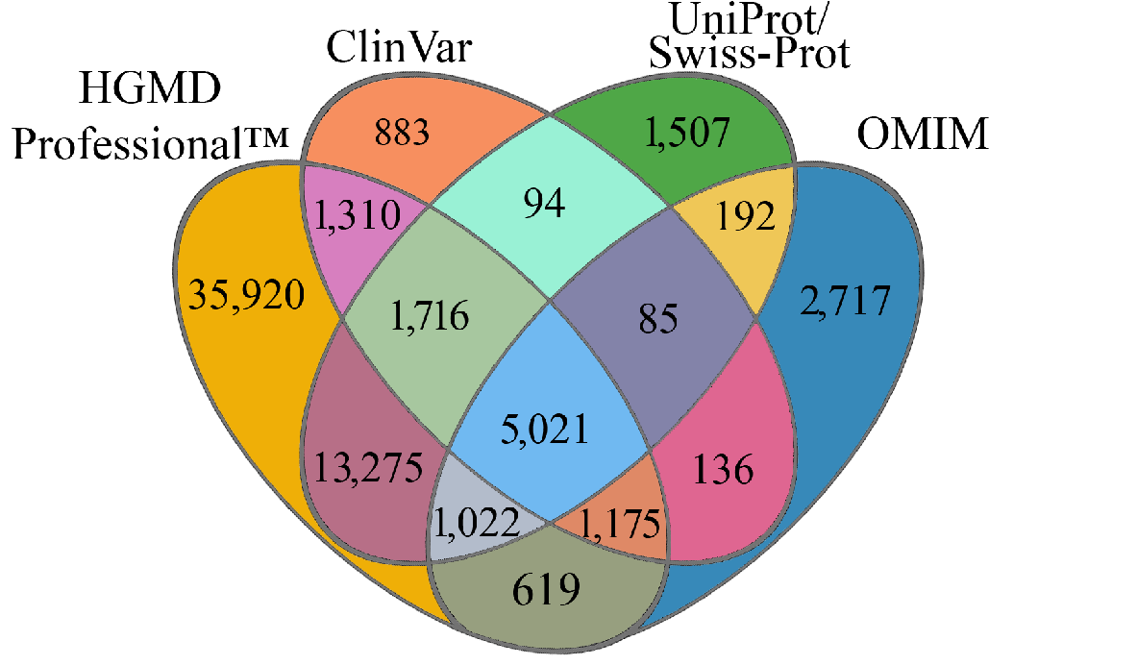
Background: Variant Databases
Type | May 2013 | 2014
Exonic Missense Disease Variants | 27,559 | 65,672
Peterson, T.A., E. doughty, and M.G. Kann, Towards Precision Medicine: Advances in Computational Approaches for the Analysis of Human Variants. Journal of Molecular Biology, 2013.

Slide 14
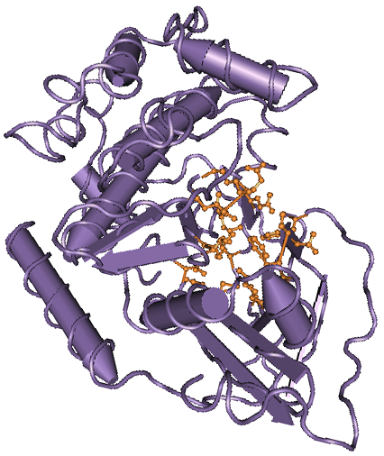
Background: Protein Domains
Evolutionarily conserved
Structural / functional units of proteins
Often mediate interactions between proteins
Protein domain HMM models (CDD, Pfam, Smart, etc.) are manually curated to match the experimentally determined structure and functional feature sites of the protein domain.
Structure of PKc (cd00180), the catalytic domain of protein kinases

Slide 15
Gene-centric Analysis
Disease Variant
Protein 1
Protein 2
Protein 3
Notes:
disease mutations are red lollipops

Slide 16
Shared Protein Domains
Disease Variant
Shared Domain
Protein 1
Protein 2
Protein 3
Notes:
disease mutations are red lollipops

Slide 17
Aggregation of Variants to Shared Protein Domains
Disease Variant
Shared Domain
Protein 1
Protein 2
Protein 3
Domain Aggregation
1
2
3
Variant Count
Notes:
disease mutations are red lollipops

Slide 18
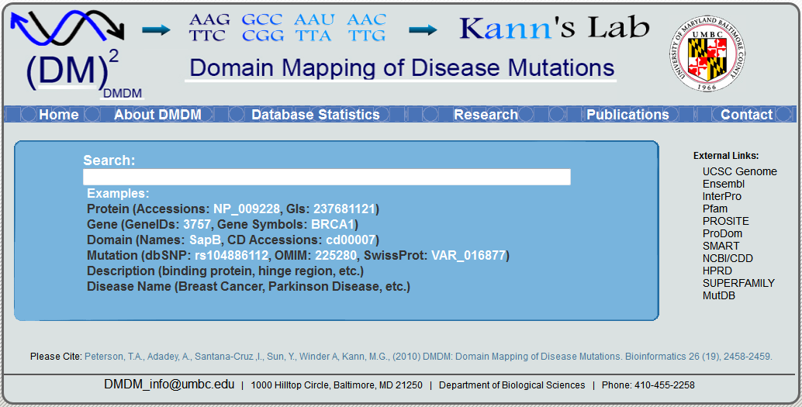
http://bioinf.umbc.edu/DMDM
Peterson, T.A. et al., DMDM: domain mapping of disease mutations. Bioinformatics, 2010. 26(19): p. 2458-9.

Slide 19
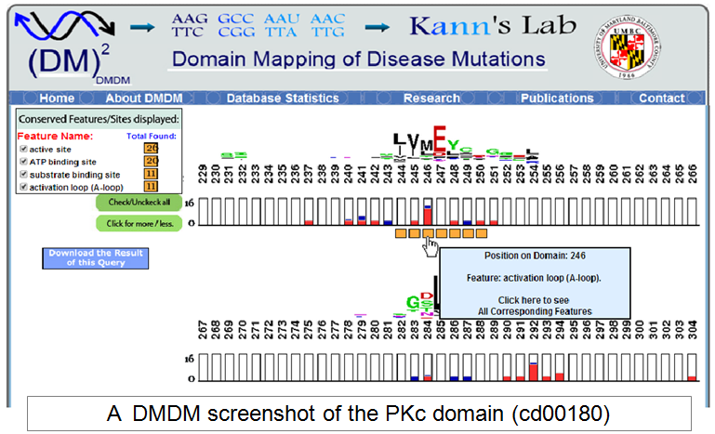
Peterson, T.A. et al., DMDM: domain mapping of disease mutations. Bioinformatics, 2010. 26(19): p. 2458-9.

Slide 20
DS-Score
DS-Score (domain significance score) is a statistical measure designed to identify significantly mutated domain positions, or “protein domain disease hotspots”
Derived from the probability for a domain position to contain its number of disease variants given the domain length and total number of mutations mapping to the domain
Peterson, T.A., N.L. Nehrt, D. Park, and M.G. Kann, Incorporating molecular and functional context into the analysis and prioritization of human variants associated with cancer. J Am Med Inform Assoc, 2012. 19(2): p. 275-83.

Slide 21
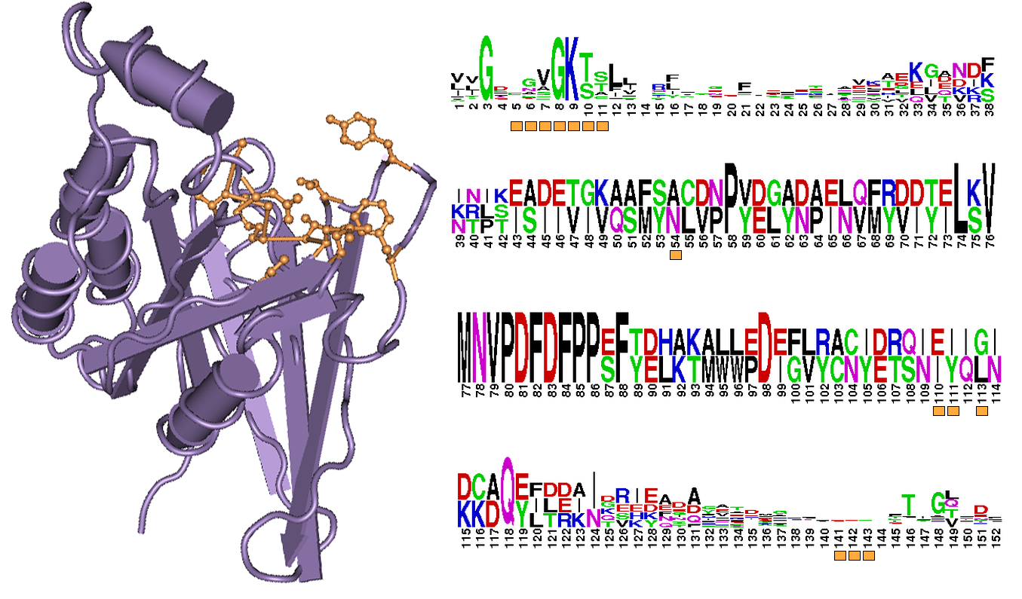
Feature-based DS-Score
Ras-like protein domain (cd00882)
Highlighted (orange): GTP/Mg++ binding site

Slide 22
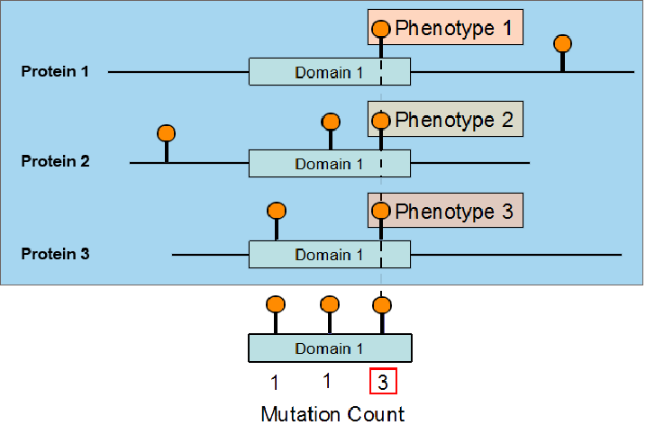
Learning about important protein positions via protein domain information

Slide 23

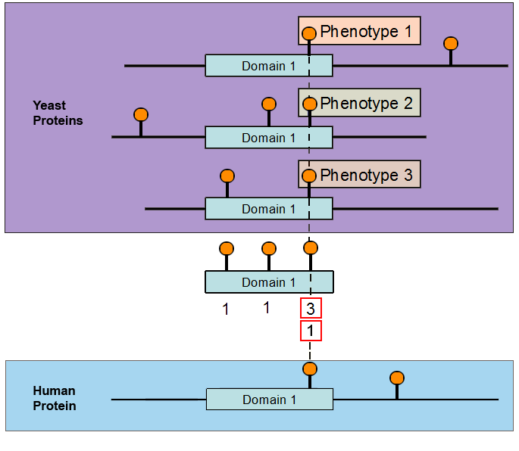
Using Variants from Model Organisms
Database | Phenotypically Altering Variants
 | 1,490
SGD has a database of phenotypically “altering mutations”
Why use protein domains and not orthologous genes?

Slide 24
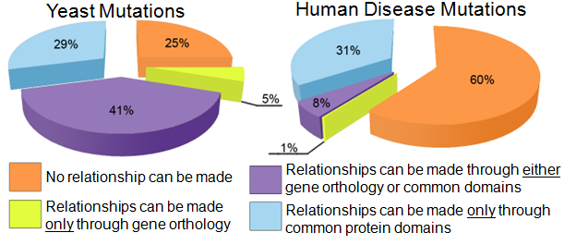
Why use protein domains and not orthologous genes?
Peterson, T.A., D. Park, and M.G. Kann, A protein domain-centric approach for the comparative analysis of human and yeast phenotypically relevant mutations. BMC Genomics, 2013. 14(Suppl 3): p. S5.

Slide 25
Why use protein domains and not orthologous genes?
Peterson, T.A., D. Park, and M.G. Kann, A protein domain-centric approach for the comparative analysis of human and yeast phenotypically relevant mutations. BMC Genomics, 2013. 14(Suppl 3): p. S5.

Slide 26

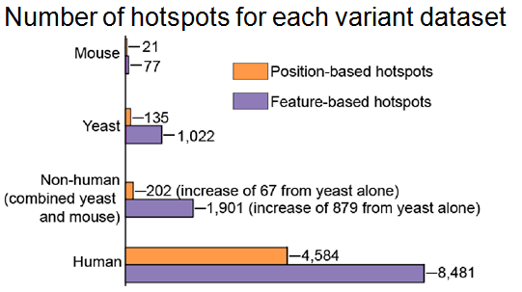
Non-human Variant Databases
Database | Phenotypically Altering Variants
 | 1,490
 | 731

Slide 27


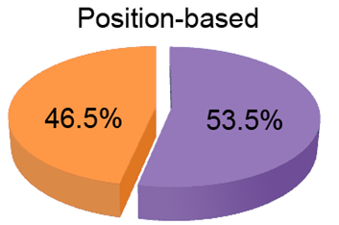
Human and Yeast Hotspot Comparison
We found three common position-based hotspots

Slide 28
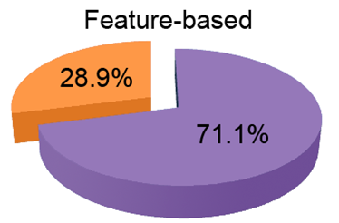
Human and Yeast Hotspot Comparison
We found three common position-based hotspots
103 common feature-based hotspots

Slide 29



Acknowledgements
Committee members
Maricel Kann
Ivan Erill
DoHwan Park
Charles Bieberich
John Spouge
Current and Previous Lab Members
Nathan Nehrt
Guisong Wang
Emily Doughty
Amy Voltz
Rajashree Mishra
Mitsu Shah
Asa Adadey
Andrew Winder
Funding

