Slide 1
Calculating Allele-Specific Expression (ASE) using RNA-Seq data
Kevin Nyberg
Machado Lab
BYOB, 10-22-15

Slide 2

RNA-Seq analyses in highly inbred model organisms is straight-forward
D. pseudoobscura
RAW READS
TopHat2
MAPPED READS
Htseq-count
READ COUNTS PER LOCUS
Richards et al. 2005

Slide 3
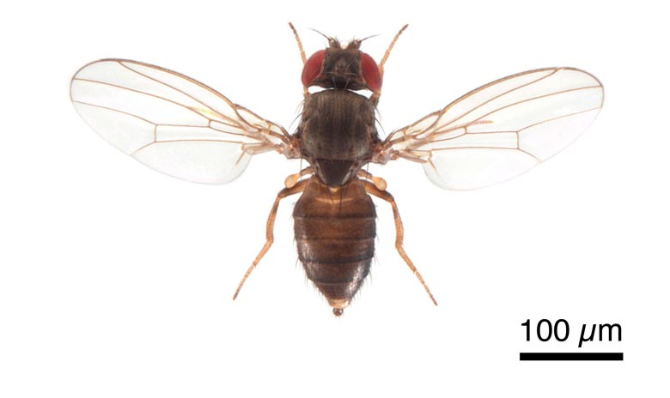
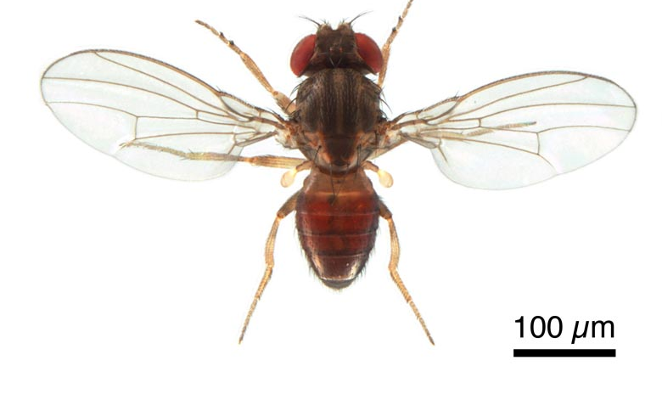
Hybrid analyses require measurement of allele-specific expression (ASE)
X
D. pseudoobscura Female
D. persimilis Male
F₁ Hybrids
Fertile Females
Sterile Males
FlyBase

Slide 4
Calculating ASE can be useful for understanding:
Allelic imbalance in wild (i.e. non-inbred) individuals
Cis/trans regulatory evolution in F₁ hybrids
Genetic imprinting
Nonsense-mediated decay induced by variants that produce premature STOP codons.

Slide 5
Major challenges in calculating ASE:
Mapping bias – expression of single allele may be artificially reduced because of inability to map to reference genome
Sequencing errors – low quality bases at variant site typically filtered out
Mate pair overlap – count overlaps at variant site only once
Duplicate reads from PCR – filter out duplicate reads
Multi-mapping reads – allow only unique mappers to reference

Slide 6
Three methodological approaches to calculating ASE:
Alignment to reference genome with post-hoc filtering (ie.g. samtools mpileup and GATK ASEReadCounter)
Higher genome-wide mapping bias to reference;
Discards higher # of AE sites
Alignment to personalized genomes
Computationally intensive;
Higher mapping bias at monoallelic sites
Variant-aware alignment (e.g. GSNAP)
Higher mapping bias at monoallelic sites

Slide 7
Genome Analysis Toolkit (GATK) approach for calculating ASE
Well-documented, Java (1.7)-based software package for identifying and filtering high-quality variants.
https://www.broadinstitute.org/gatk/
https://www.broadinstitute.org/gatk/guide/bp_step.php?p=1
Input: 1) Reference genome
2a) Genome resequencing data (to ID variants)
2b) Known set of variants (optional)
3) RNA-Seq dataset
Output: Single text file with read counts at bi-allelic sites (SNPs and INDELs)

Slide 8
REFERENCE
RESEQUENCE DNA-SEQ
X
D. pseudoobscura Female
D. persimilis Male
FlyBase
F₁ Hybrid Male
RNA-SEQ

Slide 9
Generate alignment file of genome resequence data to reference genome:
##index genome fasta
bwa index dpse-all-chromosome-r3.2.fa
##align with bwa mem
bwa mem dpse-all-chromosome-r3.2.fa Dpers_PE_R1.fastq Dpers_PE_R2.fastq > Dpersi_PE.sam
##sam to bam conversion
samtools view -bS Dpers_PE.sam > Dpers_PE.bam
##sort bam
samtools sort Dpers_PE.bam Dpers_PE.sorted
Post-alignment filtering and QC
Mark read duplicates
Realign INDELs
Recalibrate base quality scores

Slide 10
Identifying variants using HaplotypeCaller (SNPs and INDELs):
java –jar GenomeAnalysisTK.jar
-T HaplotypeCaller #Tool
-R ../dpse-all-chromosome-r3.2.fa #Reference genome
-I Dpers_PE.sorted.bam #DNA-Seq:Reference alignment
-L lincRNA_loci.list #list of coordinates to ID variants
-o output_MV225_Mather40_variants.vcf
-nct 12 #number of processors
Filter variants using HaplotypeCaller (SNPs and INDELs):
Variant recalibrator (within GATK) if existing variant set is available
Hard filtering if variant set is not available

Slide 11
Calculating allele-specific fragment counts at variants:
java –jar GenomeAnalysisTK.jar
-T ASEReadCounter #tool
-R ../dpse-all-chromosome-r3.2.fa #reference genome
-o ASE_practice_out.csv
-I accepted_hits_RG_reordered.bam #RNA-Seq alignment to reference
-sites output_MV225_Mather40_variants_lincRNAonly.vcf
#variant set
-drf DuplicateRead #allow duplicate reads
-U ALLOW_N_CIGAR_READS #allow INDELs with Ns in alignment
With fragment counts at each variant, you can proceed to statistical analyses of ASE (e.g. MAMBA - http://www.well.ox.ac.uk/~rivas/mamba/)

