Slide 1
PROVEAN: A Tool for Predicting Functional Impacts of Nonsynonymous Mutations
Software from J. Craig Venter Institute
Presented by Will Gammerdinger

Slide 2
Why should I use PROVEAN?
Can provide fast insight into missense mutations
Web and command-line interface
Easy to use
Command-line installation is pretty straightforward
Marginally more accurate than similar programs like SIFT and PolyPhen2

Slide 3
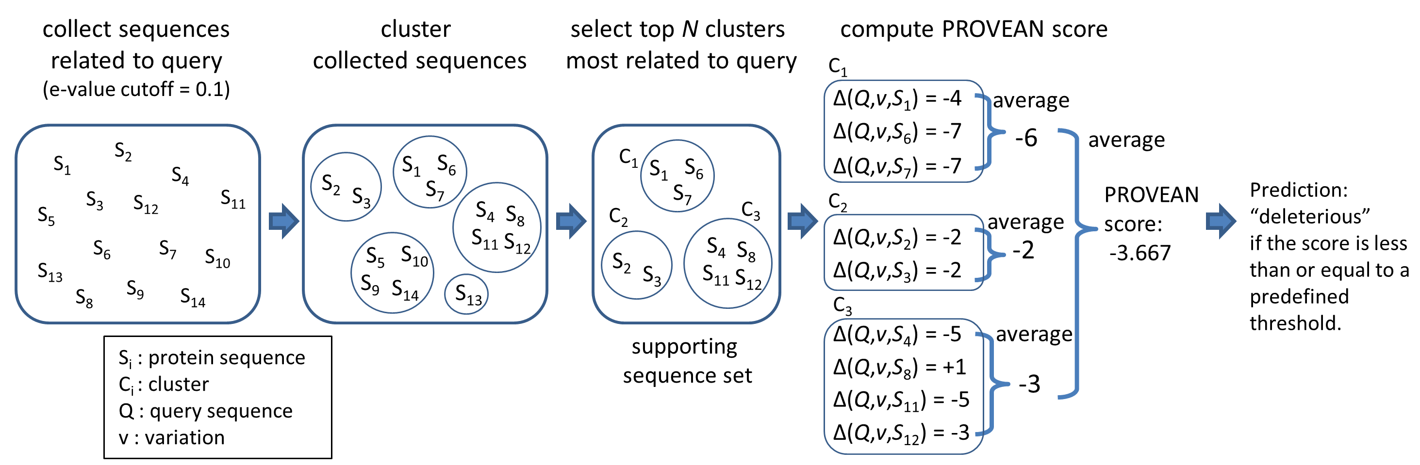
What does PROVEAN do?

Slide 4

Calculating Delta Scores
Q’ is the variant sequence
Q is the query sequence
S is the compared sequence
A(P₁,P₂) is the semi-global alignment score of two proteins using a substitution matrix (BLOSUM62)
Frequency of amino acids
Chemical properties of the amino acid

Slide 5
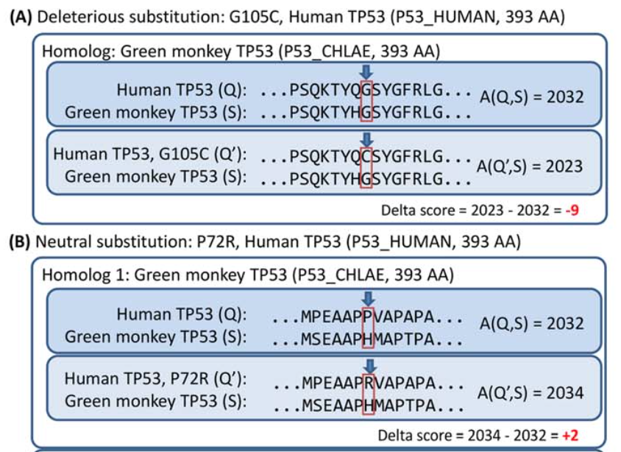
Delta Score Example

Slide 6
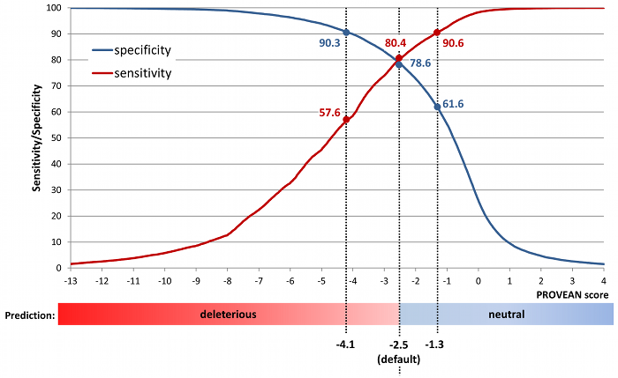
PROVEAN Scores

Slide 7
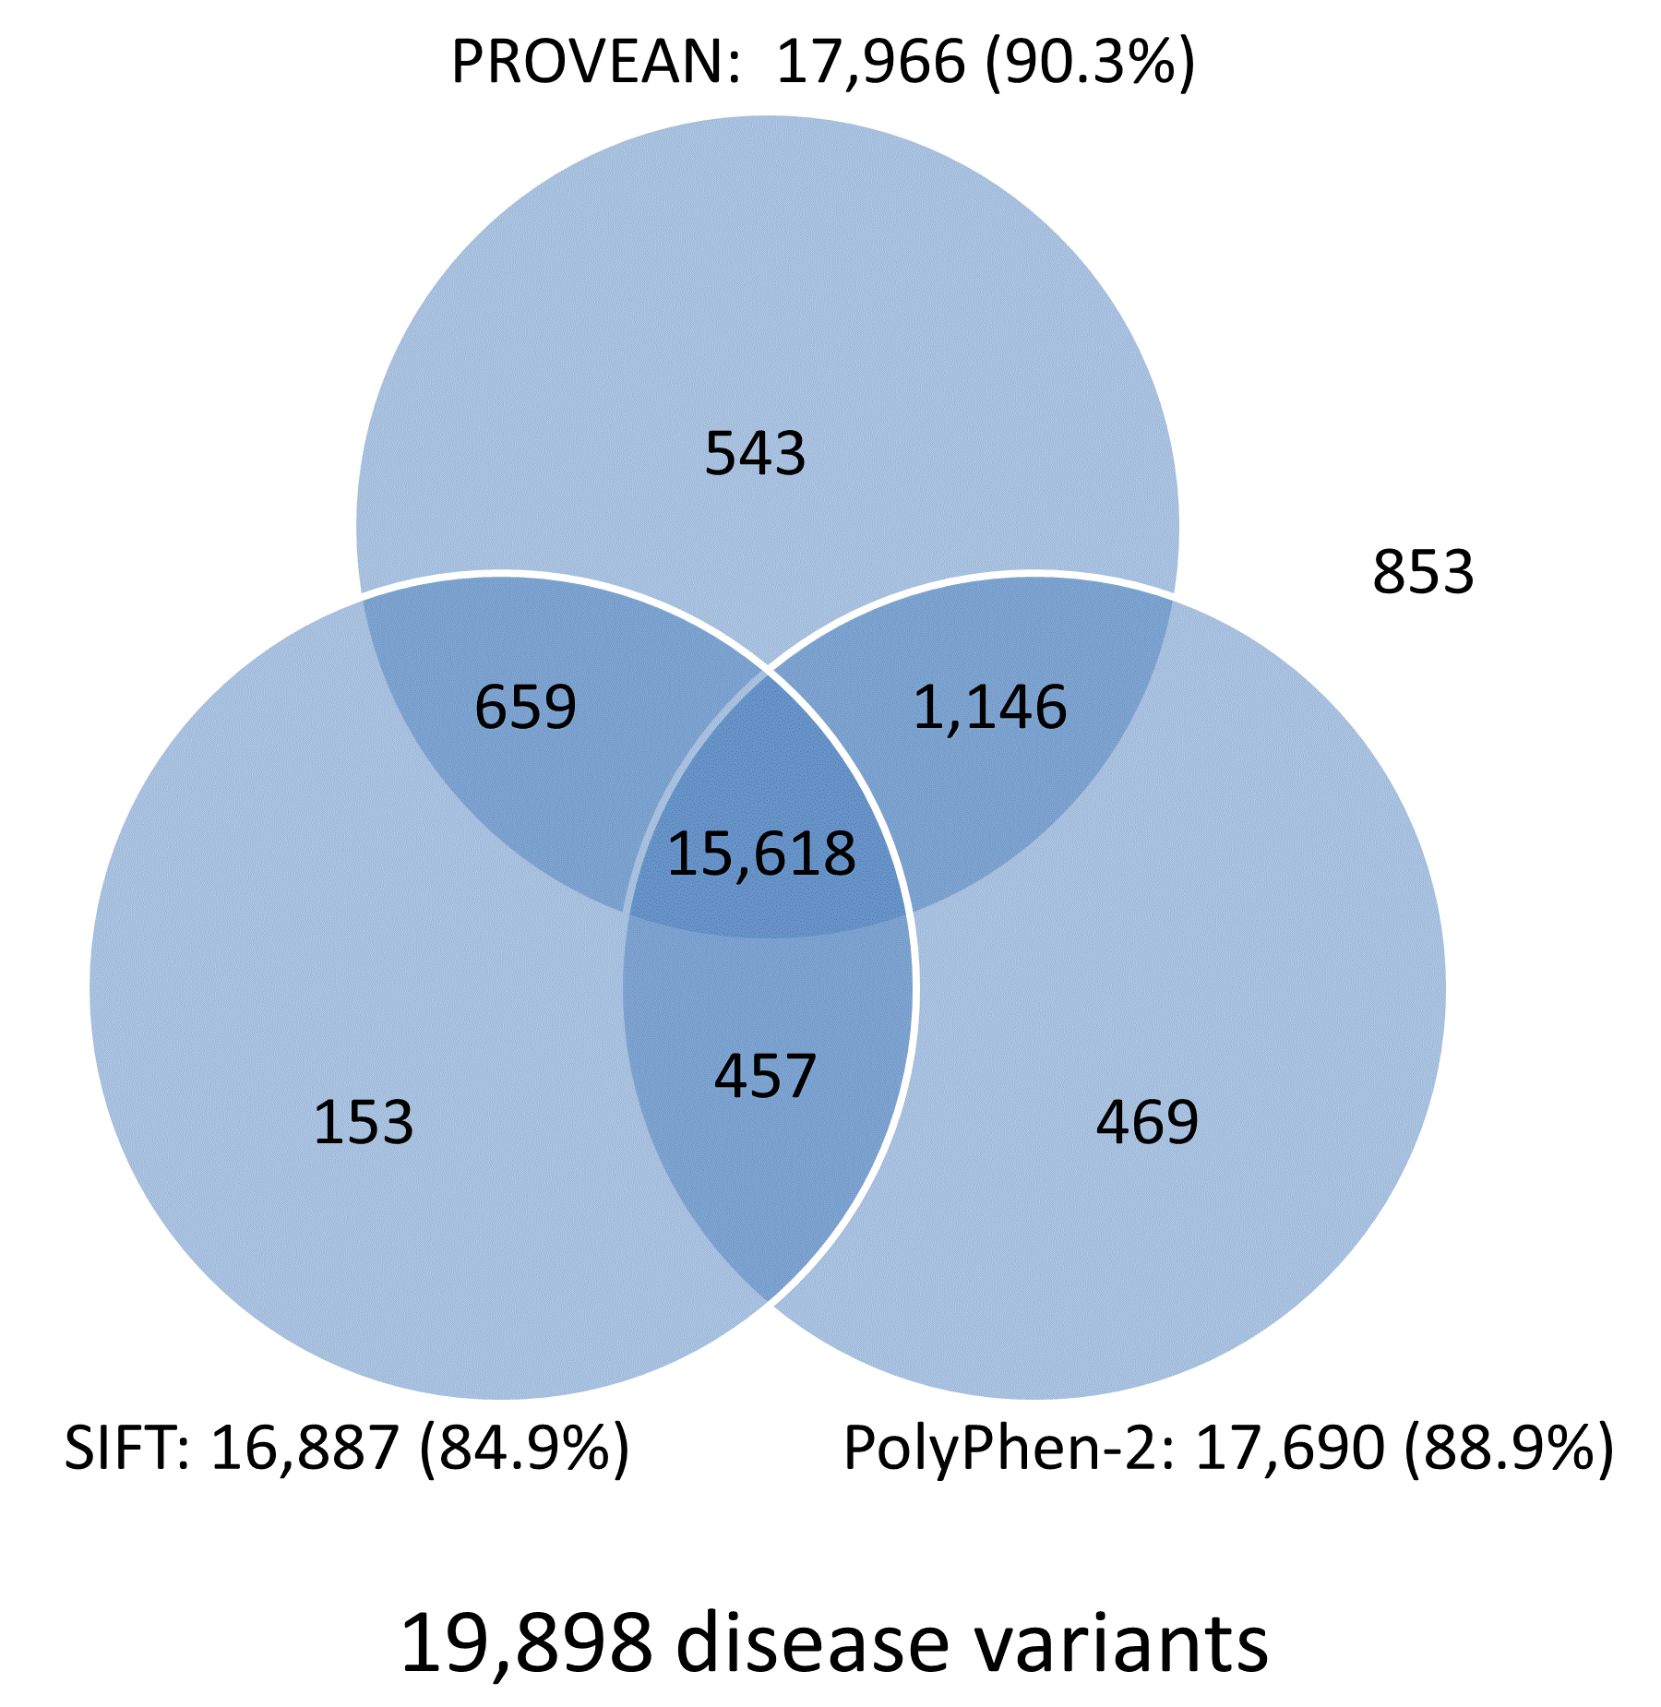
Comparison to other programs

Slide 8
What do you need to run PROVEAN?
NCBI BLAST
CD-HIT
Don’t use v.4.6 or v4.6.1
NCBI non-redundant protein database

Slide 9
Installation of command-line PROVEAN
Unpack it
Edit the configuration file to have the path to:
Non-redundant protein database
You need to make the look like
/path/to/nr/directory/nr
That final /nr should be as if it were a file in your nr database
FAQ #2 : http://provean.jcvi.org/faq.php
PSI BLAST
BLASTDCMD
CD-HIT
make
make install

Slide 10
Running PROVEAN
To run PROVEAN you need two things:
FASTA file of the protein
Variant file with all of the variants in a column
ex: L47W
You can save your supporting sets
This is the time consuming part of any run
Re-use them in future runs to shorten computational time
Website has all of the supporting sets for human genes from Ensemble 66 ready to download

Slide 11
Demo time!!!
Examples:
provean.sh -q P04637.fasta -v P04637.var --save_supporting_set P04637.sss
provean.sh -q P04637.fasta -v P04637.var --supporting_set P04637.sss

