Slide 1
Bring Your Own Bioinformatics
Spring 2015
Tuesdays, 4pm, Bio-Psych 1208

Slide 2
Typical meeting schedule:
4-4:15pm – Social time
4:15-5pm – Short informal talk and discussion
5-5:30pm – More social time or occasional ISCB RSG meeting
Beer money collection? Snacks?

Slide 3
BYOB website: https://groups.google.com/forum/#!forum/umd-byob
Schedule:
http://umd-byob.github.io/
Presentations:
https://github.com/umd-byob/presentations

Slide 4
BYOB Presentations
Short and informal
Tutorials, problem-solving, tools and technologies
List of former topics can be found: http://umd-byob.github.io/#spring-2014

Slide 5
Choosing an expression threshold for your RNA-Seq data
Kevin Nyberg
Machado Lab
BYOB, February 10, 2015

Slide 6
RNA-Seq data is digital in nature. Why choose an expression threshold at all?
Separate expression signal from statistical noise.
What contributes to statistical noise?
Leaky transcription (not replicable)
Read mismapping
Human error (e.g. sample collection, contamination)
Inefficient removal of genomic DNA

Slide 7
Suggestions for expression thresholds:
Mortazavi et al. 2008 – RPKM/FPKM of 1 is equivalent to 1 expressed transcript per cell in mammalian cell culture
Limma manual – 2 case studies
i) Keep all loci with total counts > 50
ii) Keep all loci with cpm > 1 in at least 3 samples
Why? Because.

Slide 8
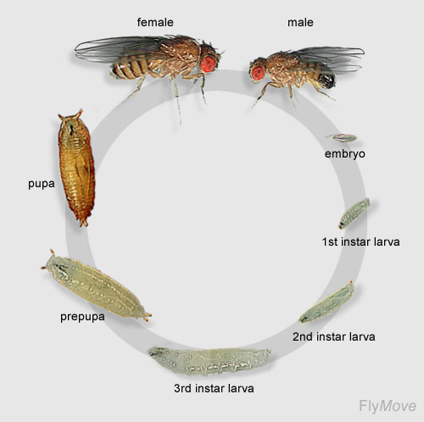
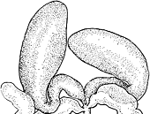
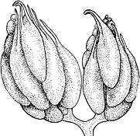
Three RNA-Seq replicates were sequenced for 12 samples at varying depths (4 whole body developmental stages in both sexes, dissected gonads and carcasses)
testes
ovaries
Patterson 1943

Slide 9
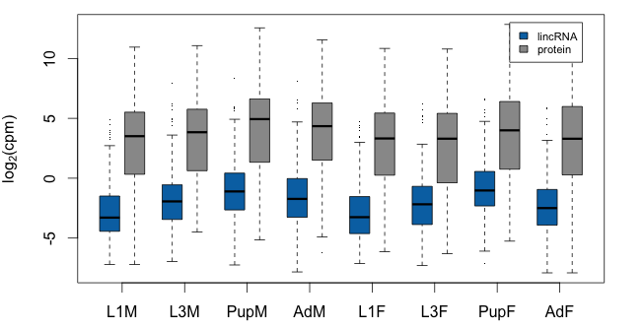
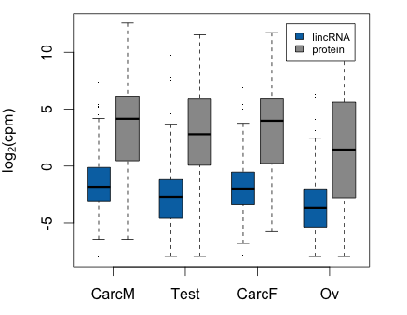
D. pseudoobscura lincRNAs are expressed at lower levels than mRNAs in all samples
cpm = fragment counts per million fragments mapped
threshold cpm = 1
threshold cpm = 1
Mann-Whitney, p < 2.2e-16
for all

Slide 10
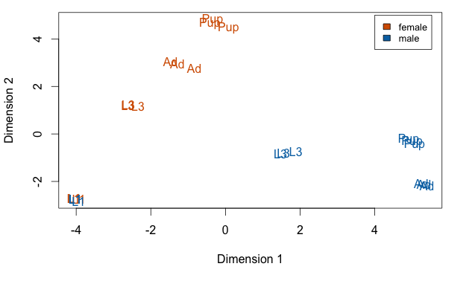
Can we choose a lower expression threshold while still being able to distinguish signal from noise?
cpm ≥ 1

Slide 11
Batched by expression threshold to determine whether signal still distinguishable from noise

Slide 12
Expression threshold of 0.3 cpm seems to be enough to separate signal from noise in this dataset.
Minimum counts per locus:
Largest replicate
83,160,873 mapped fragments => 24.9 counts/locus
Smallest replicate
13,091,880 mapped fragments => 3.93 counts/locus

Slide 13
If RNA-Seq data sampling is a Poisson process…
Signal/Noise ratio = √(mapped fragments)
For minimum S/R = 2, need 4 mapped fragments per locus.
Thanks Karen Carleton

Slide 14
In R:
log2cpm = function(x) {
t(log2(t(x + 0.5)/(colSums(x) + 1) * 1e+06))
}
min_replicates = min(table(condition))
cpms = 2^log2cpm(exprs(raw_counts))
low_count_genes = raw_counts[rowSums(cpms > 1) < min_replicates,]
raw_counts = raw_counts[!row.names(raw_counts) %in% row.names(low_count_genes),]

Slide 15
