Slide 1
Procedures
Preprocessing
Feature extraction
Feature selection
Classification

Slide 2
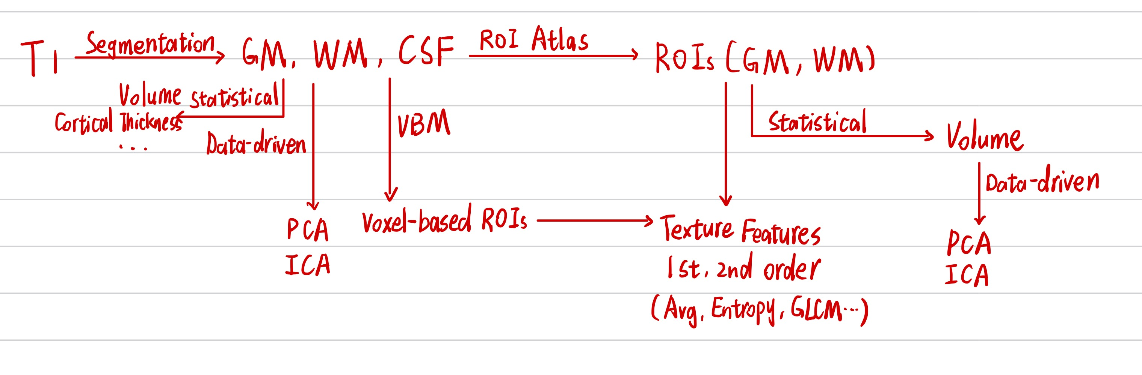
Preprocessing & Feature Extraction

Slide 3
Feature Extraction
Statistical features (using FSL, SPM…)
Volume, cortical thickness
Histogram
Texture features (using PyRadiomics)
First-order: average, central moments, entropy
Second-order: GLCM, GLSZM, run length matrix
Data-driven features
Input: raw voxels or features above
PCA, ICA based methods
Output: features with reduced dimensionality

Slide 4
Feature Selection
Data-driven methods
mRMR(最大相关和最小冗余), NCA, ReliefF
Statistical methods
T-test, Chi2
Regression/Classification models
LASSO

Slide 5
Survey
Structure (T1) Specific Feature Extraction
N=6
General Feature Extraction
N=4

Slide 6
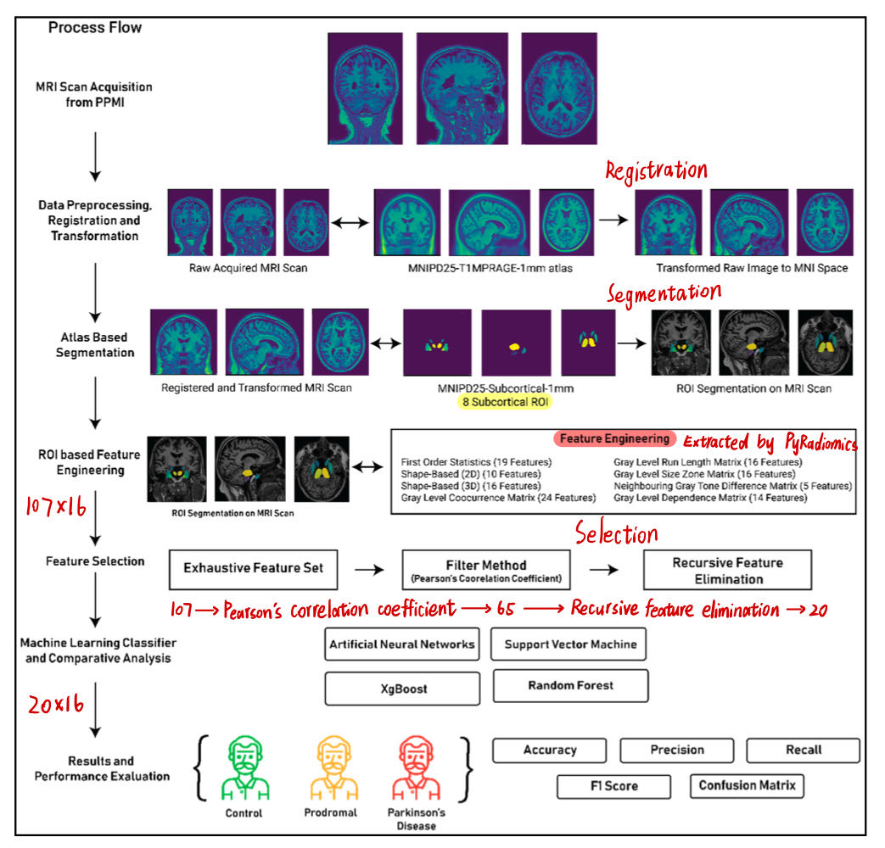
3D Textural, Morphological and Statistical Analysis of Voxel of Interests in 3T MRI Scans for the Detection of Parkinson’s Disease Using Artificial Neural Networks
Recursive feature elimination is a greedy optimization algorithm which aims to find the best performing feature subset. It repeatedly creates baseline models and keeps aside the best or the worst performing feature at each iteration until all the features are exhausted. It then ranks the features based on the order of their elimination.
ROIs: caudate nucleus, putamen, globus pallidus internus and externus (GPi & GPe), thalamus, STN, substantia nigra (SN), and red nucleus (RN)

Slide 7
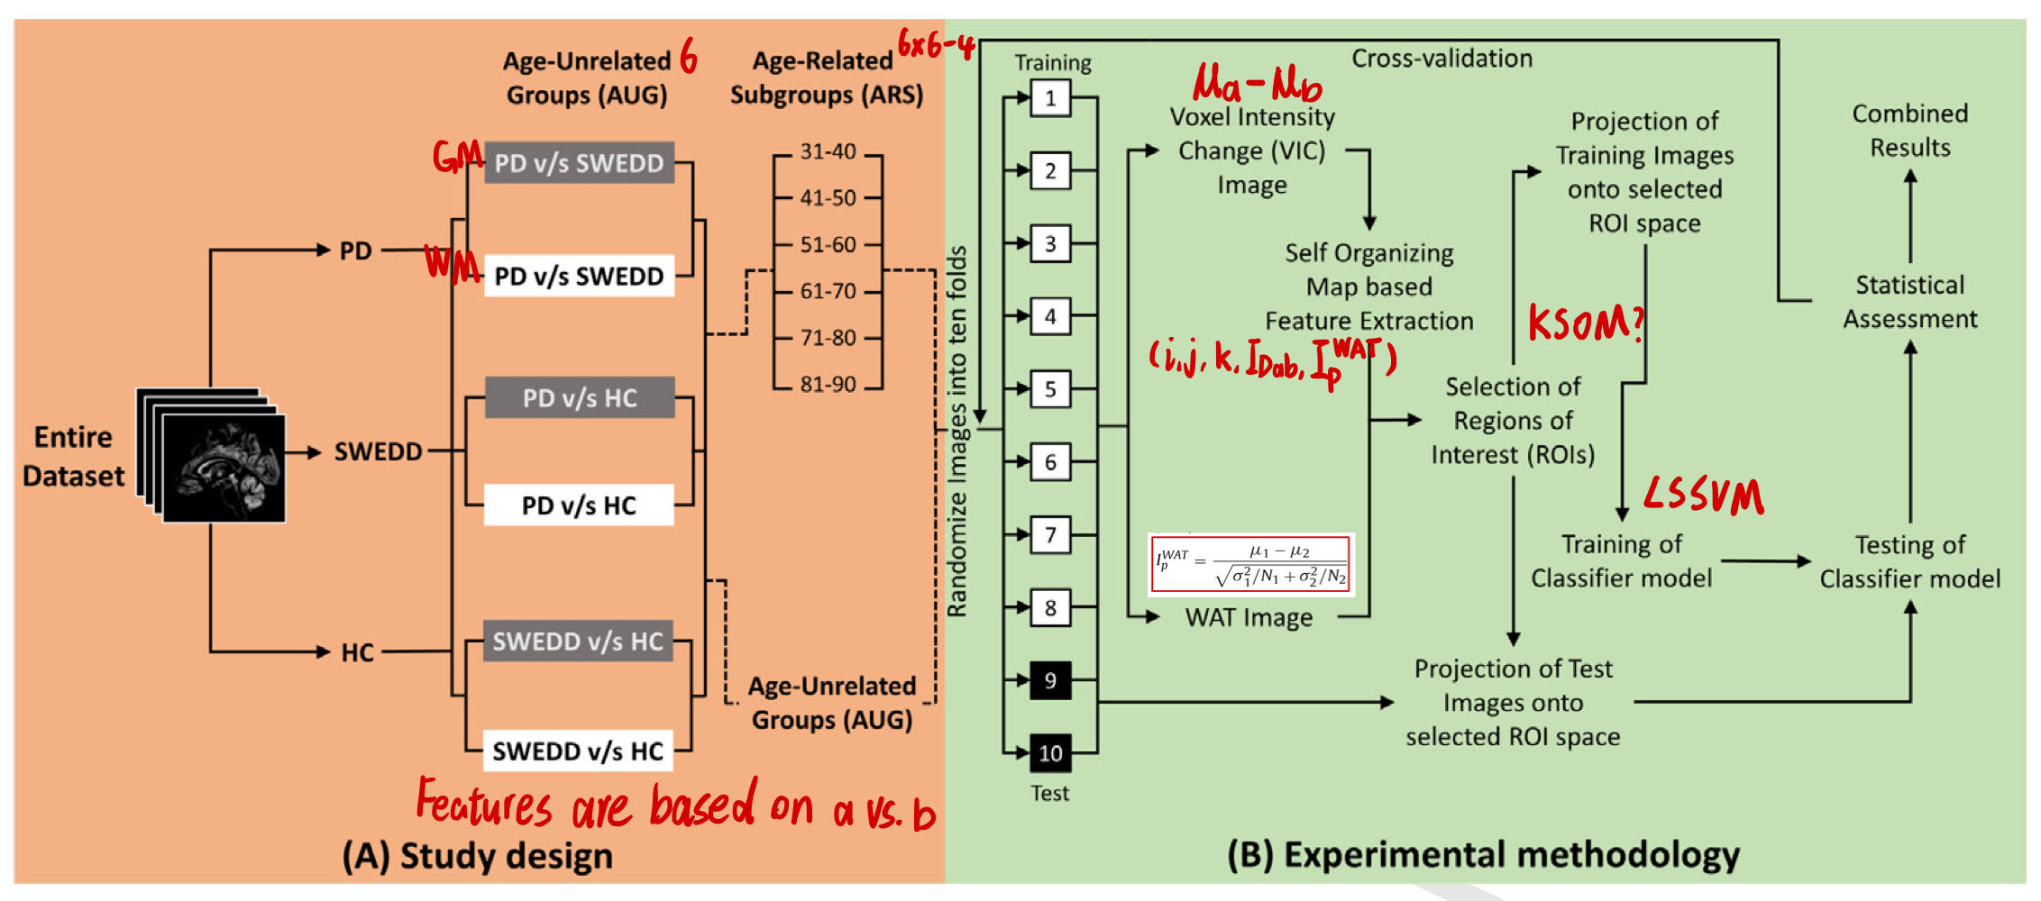
Unsupervised learning based feature extraction for differential diagnosis of neurodegenerative diseases: A case study on early-stage diagnosis of Parkinson disease

Slide 8
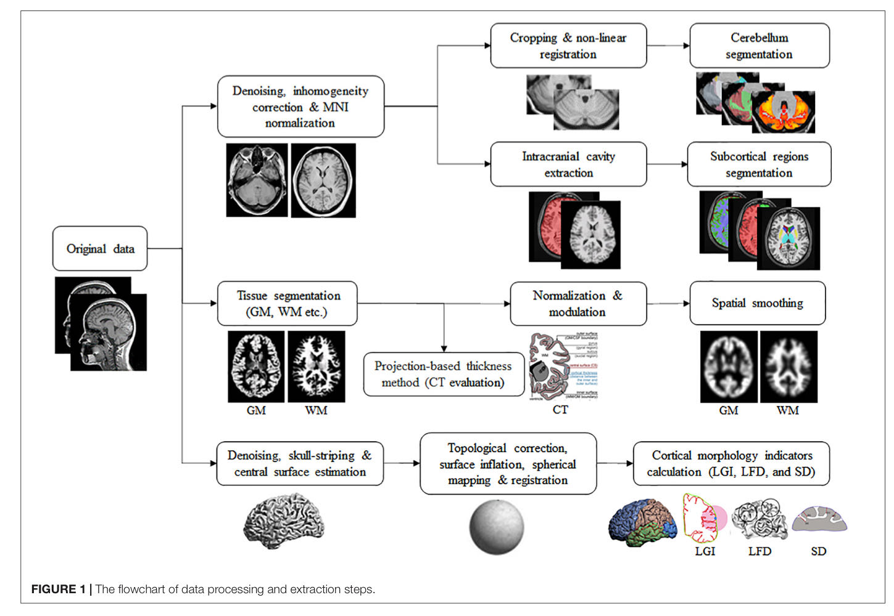
Machine Learning Models for Diagnosis of Parkinson’s Disease Using Multiple Structural Magnetic Resonance Imaging Features
the absolute and relative value of the whole volume, GMV and CT of the cerebellum (including the bilateral Lobule I-II, III, IV, V, VI, Crus I, Crus II, VIIB, VIIIA, VIIIB, IX, and X), and the subcortical volume (including the bilateral caudate nucleus, putamen, thalamus, globus pallidus, hippocampus, amygdala, nucleus accumbens, and the lateral ventricles) . AI (evaluate the asymmetry degree of the aforementioned structures in the left and right hemispheres). LGI can quantitatively assess the degree of gyrification at the vertex level, which represents the ratio of the area of the cortex located within folded regions to the total surface area. LFD can provide a quantitative description of structural complexity in the cerebral cortex, which could be a combination of sulcal depth, the frequency of cortical folding, and the convolution of gyral shape. SD refers to the linear distance from the inner surface of the brain (pia mater) to the outer surface based on the Euclidean distance.

Slide 9
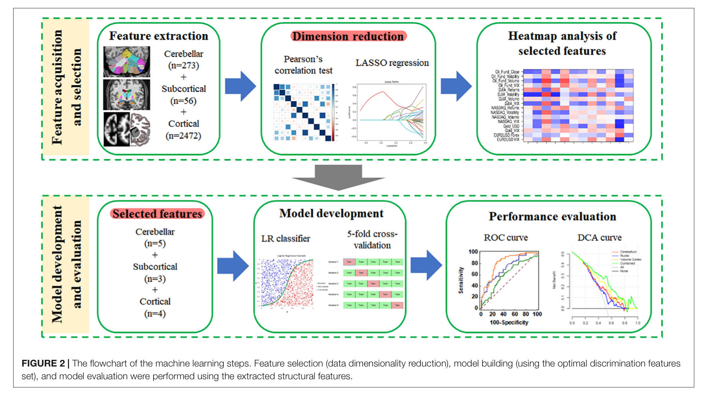
Machine Learning Models for Diagnosis of Parkinson’s Disease Using Multiple Structural Magnetic Resonance Imaging Features

Slide 10
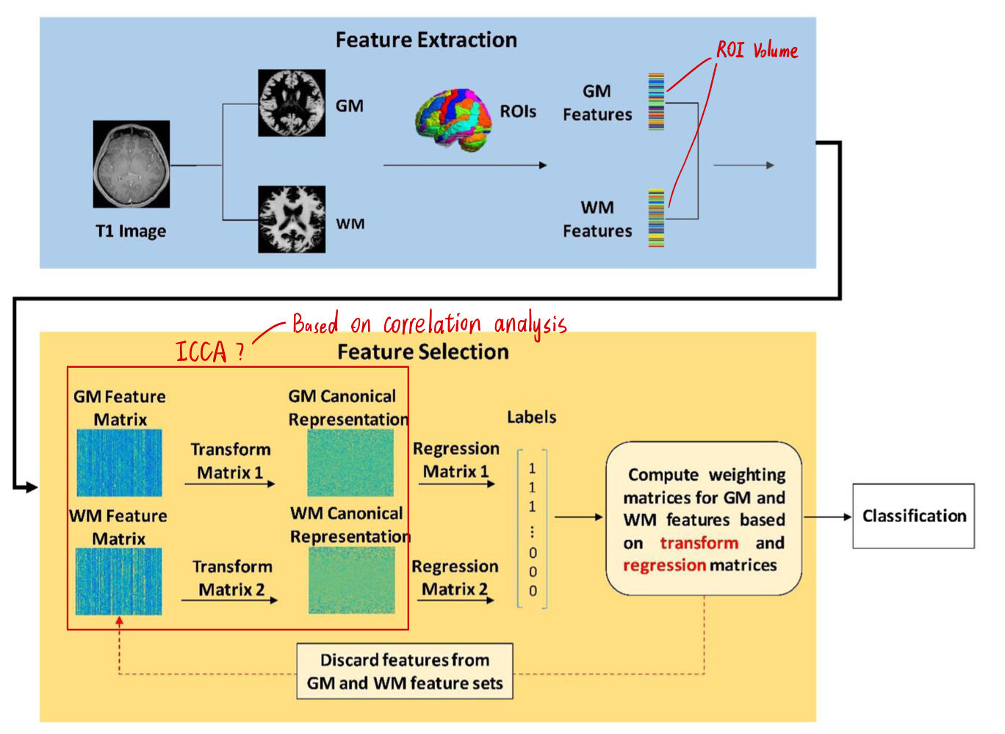
Exploring diagnosis and imaging biomarkers of Parkinson’s disease via iterative canonical correlation analysis based feature selection

Slide 11
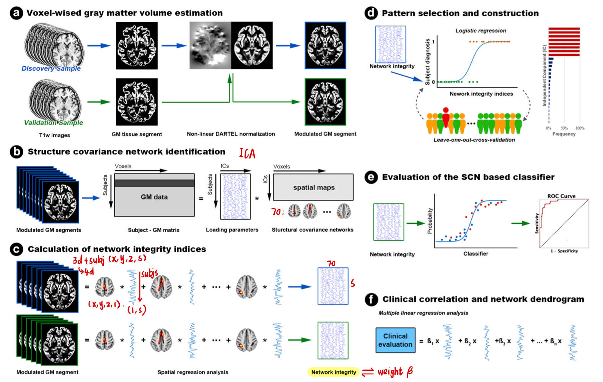
Extraction of large-scale structural covariance networks from grey matter volume for Parkinson’s disease classification

Slide 12
Classification of PPMI MRI scans with voxel-based morphometry and machine learning to assist in the diagnosis of Parkinson’s disease
1. 2020, Computer Methods and Programs in Biomedicine, 7.0
2. PD诊断
3. Male/Female分别预测
4. 方法描述比较详细
5. T1 (PPMI)
6. VBM -- ROI -- Features
1. First-order: average, central moments, entropy
2. Second-order: GLCM based
7. PCA + Wrappers Feature Subset Selection
1. Wrappers Feature Subset Selection: 根据相关性添加新特征，同时去除insignificant特征 (How to evaluate significance using complex models)
1. Logistic, RF, NB, Bayes Network, KNN, MLP, SVM
8. 10-fold cv
1. Logistic, RF, NB, Bayes Network, KNN, MLP, SVM
9. Regions with the most selected features
1. 部分ROI特征没有用到
2. 不同ROI对PD检测的贡献不同

Slide 13
Survey
Strucutre (T1) Specific Feature Extraction
N=6
General Feature Extraction
N=4

Slide 14
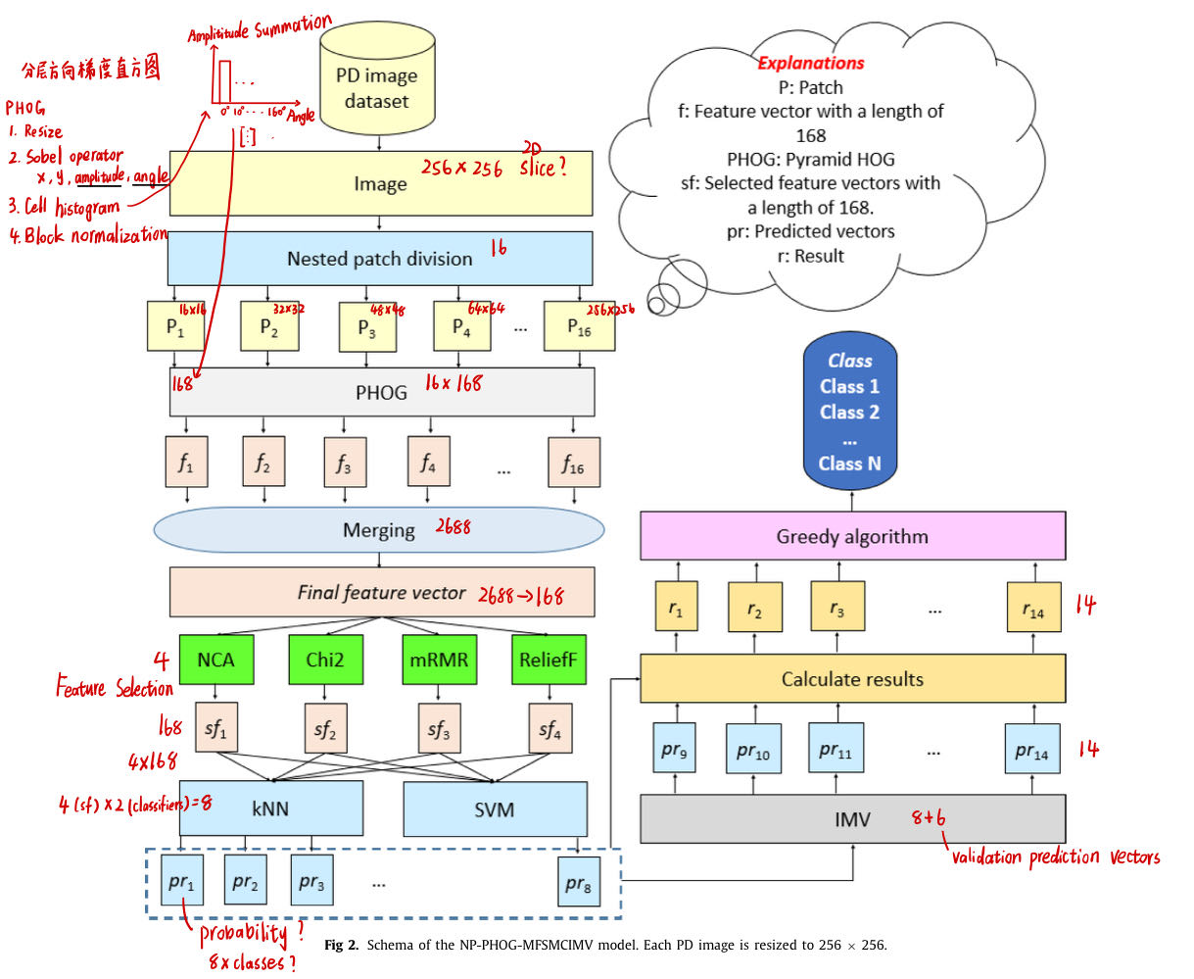
Novel nested patch-based feature extraction model for automated Parkinson’s Disease symptom classification using MRI images
2D slice?
Center?

Slide 15
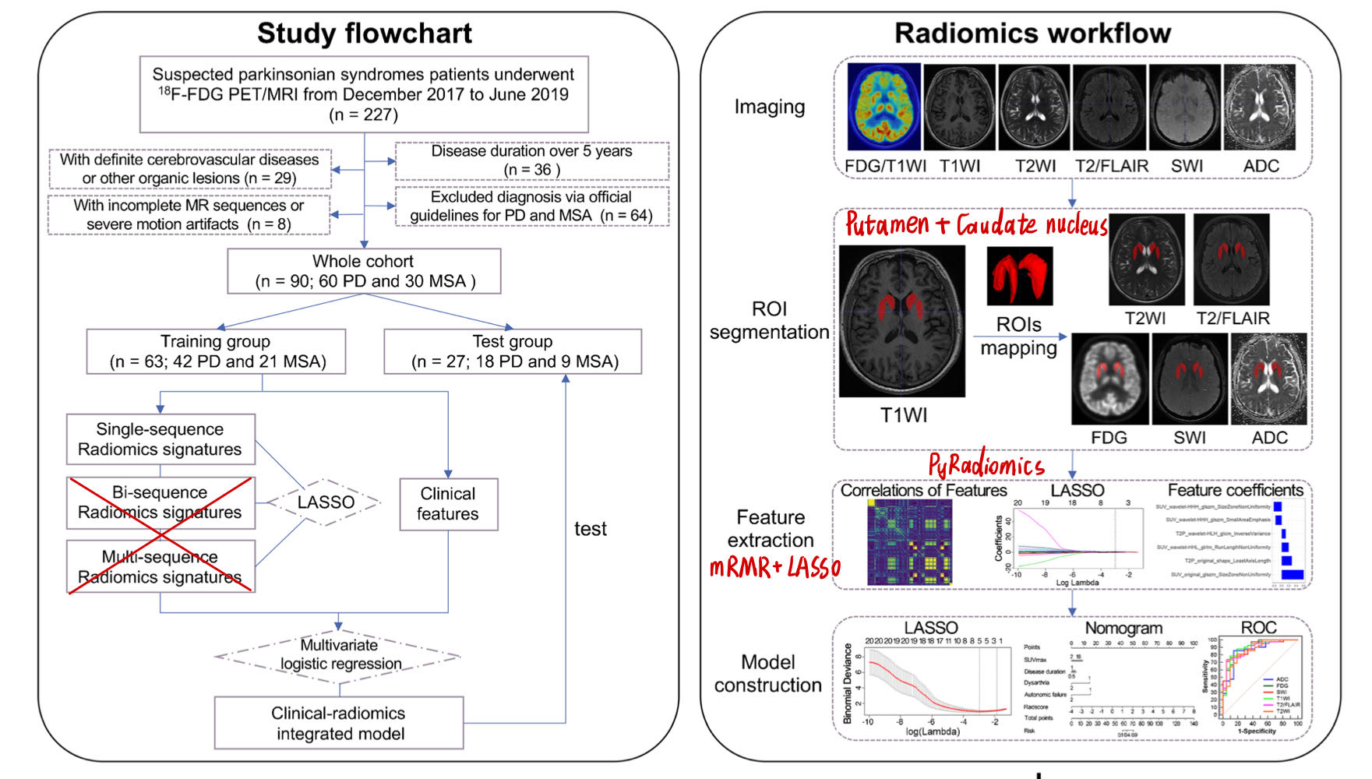
Multivariate radiomics models based on 18F-FDG hybrid PET/MRI for distinguishing between Parkinson’s disease and multiple system atrophy

Slide 16
Substantia Nigra Radiomics Feature Extraction of Parkinson’s Disease Based on Magnitude Images of Susceptibility-Weighted Imaging
1. 2021, Frontiers in Neuroscience
2. PD诊断
3. SWI (In SWI, the magnitude image can be acquired directly and has been an easy applicable diagnostic tool for nigral degeneration in PD)
4. 2D slices of the SN ROI
1. Histogram features (n=42)
2. Form factor features (n=15)
3. GLCM features (n=154)
4. Run length matrix features (n=180)
5. Gray level size zone matrix (GLSZM) features (n=11)
5. 特征筛选: mRMR + LASSO -- 16 features
6. LASSO logistic, RF, svmLinear, svmRadial, KNN
1. 100-fold leave group-out cross-validation (LGOCV)

Slide 17
Feature selection and machine learning methods for optimal identification and prediction of subtypes in Parkinson’s disease
1. 2021, Computer Methods and Programs in Biomedicine, 7.0
2. PD分型 clustering
3. SPECT
4. HMLS (hybrid machine learning system): predictor algorithms linked with faeture selector algorithms (FSAs)
1. Most machine learning algorithms cannot accurately work with a high dimensional dataset
5. 2 stages:
1. Clustering (subtype identification): After dimensionality reduction (PCA), cluster the data via the K-Means algorithm
2. Classification (subtype prediction): FSAs to rank features, and each sequential combination selected by FSAs is assessed using multiple classifiers
6. Feature extraction algorithm (FEA): PCA
7. Clustering algorithm: KMA
8. Feature selection algorithms (FSAs): ILFS, ReliefA, LLBCFS, UMCFS, UDFSA, CSFA, FSASL, UFSOL, LASSO
9. Classification algorithms:

