Slide 1
Survey: Procedures
Preprocessing
Feature Extraction
Feature Selection
Classification

Slide 2
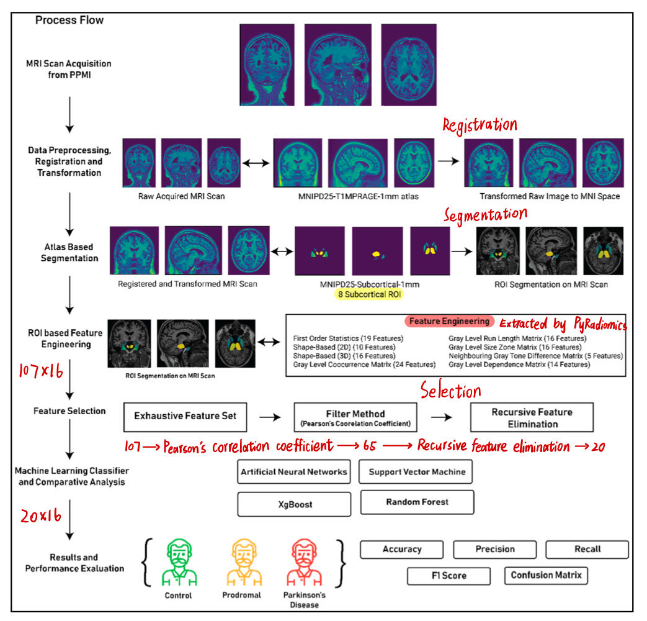
3D Textural, Morphological and Statistical Analysis of Voxel of Interests in 3T MRI Scans for the Detection of Parkinson’s Disease Using Artificial Neural Networks
Recursive feature elimination is a greedy optimization algorithm which aims to find the best performing feature subset. It repeatedly creates baseline models and keeps aside the best or the worst performing feature at each iteration until all the features are exhausted. It then ranks the features based on the order of their elimination.
ROIs: caudate nucleus, putamen, globus pallidus internus and externus (GPi & GPe), thalamus, STN, substantia nigra (SN), and red nucleus (RN)

Slide 3
Survey: Feature Extraction
Statistical features (whole brain/ROIs)
Volume, cortical thickness
Cortical information
Texture features (using PyRadiomics)
First-order: average, central moments, entropy
Second-order: GLCM, GLSZM, run length matrix
Raw voxels
Anatomical ROI-based
Statistical voxel-based

Slide 4
Survey: Feature Extraction
Segmentation
ROI Atlas
T1
GM, WM
Anatomical ROIs
Raw Voxels
VBM
Texture feature extraction
Voxel-based ROIs
Texture Features
1st-order, 2nd-order
(avg, entropy, glcm …)
Statistical Information
Based on Voxels
volume, cortical thickness,
asymmetry degree …

Slide 5
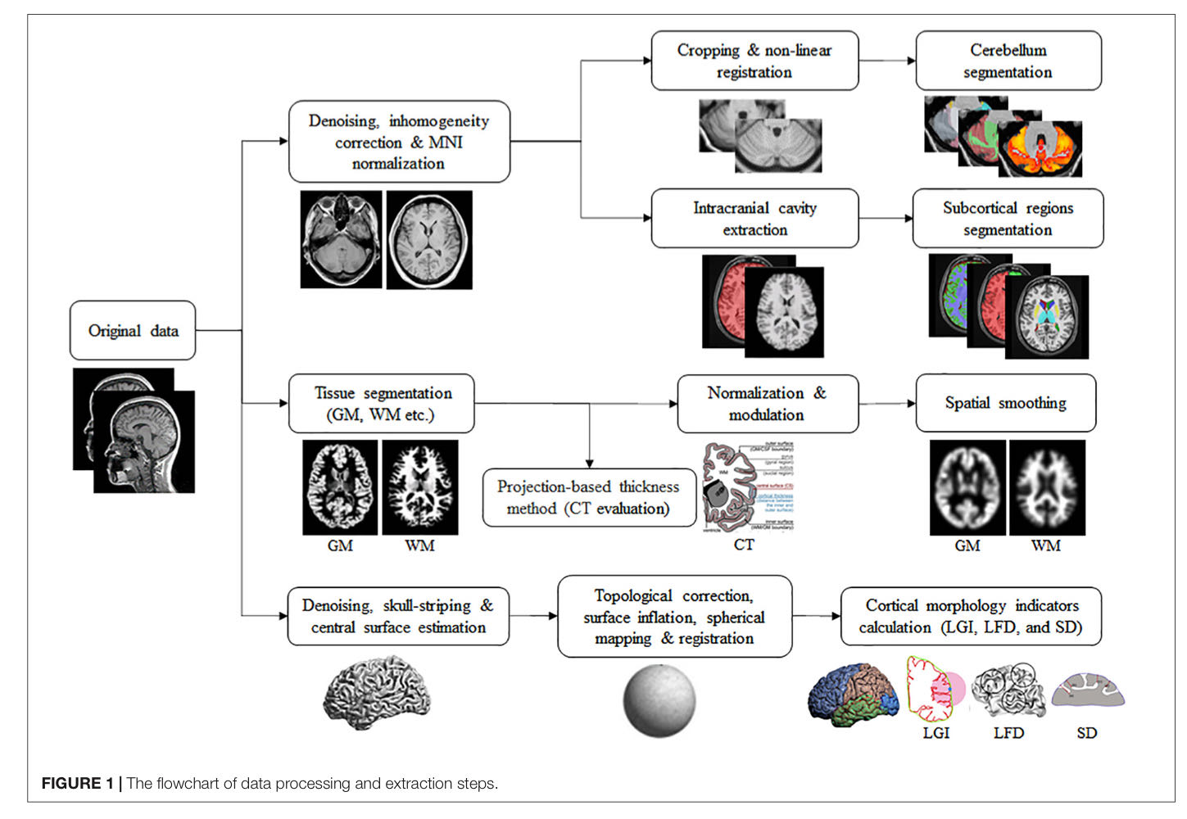
Survey: Feature Extraction (statistical features)
Volume: GM, WM, subcortical
CT (cortical thickness)
AI (asymmetry degree)
LGI: the degree of gyrification at the vertex level
LFD: structural complexity in the cerebral cortex
SD: the linear distance from the inner surface of the brain to the outer surface

Slide 6
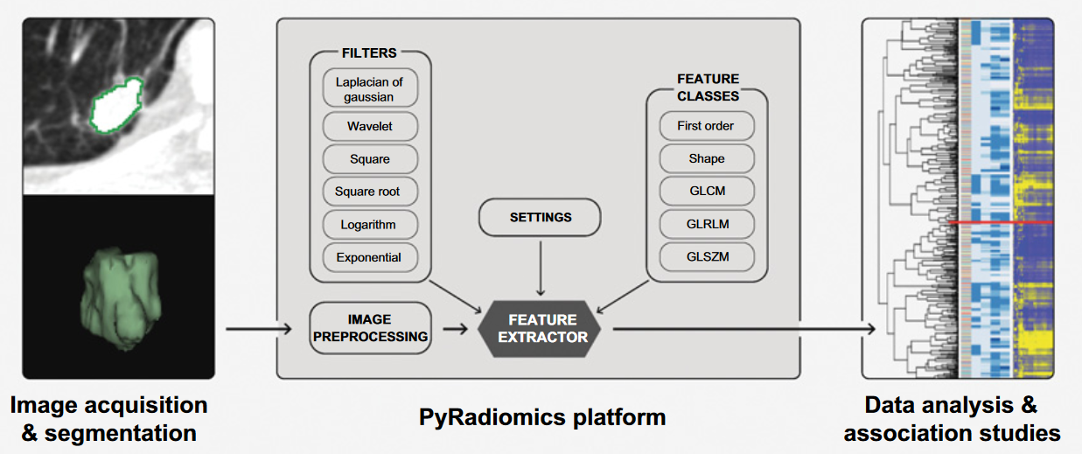
Survey: Feature Extraction (texture features)

Slide 7
Survey: Feature Extraction (texture features)
Texture features extracted by PyRadiomics
First-order: Statistical
avg, variance, kurtosis, skewness, energy …
Shape:
Not used due to registration (all ROIs have the same shape)
GLCM: Gray Level Co-occurrence Matrix
The distribution of co-occurring pixel values at a given offset
GLRLM: Gray Level Run Length Matrix
A line of pixels in a certain direction with the same intensity value
GLSZM: Gray Level Size Zone Matrix
The number of connected voxels that share the same gray level intensity
GLDM: Gray Level Dependence Matrix
The number of connected voxels within distance that are dependent on the center voxel

Slide 8
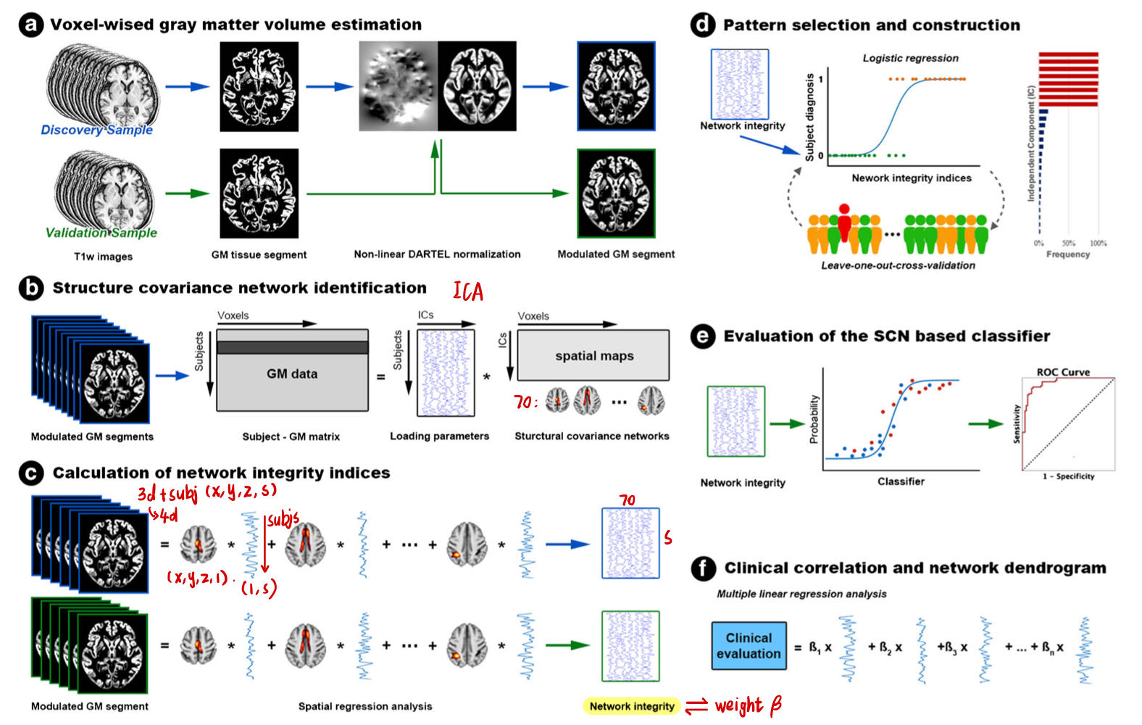
Survey: Feature Extraction (raw voxels)
PCA
ICA

Slide 9
Survey: Feature Selection
Data-driven methods
mRMR(最大相关和最小冗余), PCA, ICA
Statistical methods
T-test, Chi2, Pearson’s Correlation Coefficient
Regression/Classification models
LASSO

Slide 10
Survey: Feature Selection (N=11)
LASSO: 6
mRMR: 3
PCA:3
Pearson’s Correlation Coefficient: 2
NCA, Chi2, ReliefF, ReliefA, t-test, ILFS, LLBCFS, UMCFS, MDFSA, CSFA, FSASL, UFSOL …

Slide 11
Survey: ROIs

Slide 12
Pipeline: Radiomic Features + mRMR
Demo
age, sex
Results:
(1+50)*2
Demo
Clinic
SVM
Clinic
u3, ledd, duration
XgBoost
PPMI
Demo
Clinic
Img
x50
SVM
1 Baseline
50 w/ Img
XgBoost
1 Baseline
50 w/ Img
Img
radiomics
Correlation
Analysis
Img
[0]
Img
[0, 1]
Img
[…]
Img
[0 … 49]
mRMR

Slide 13
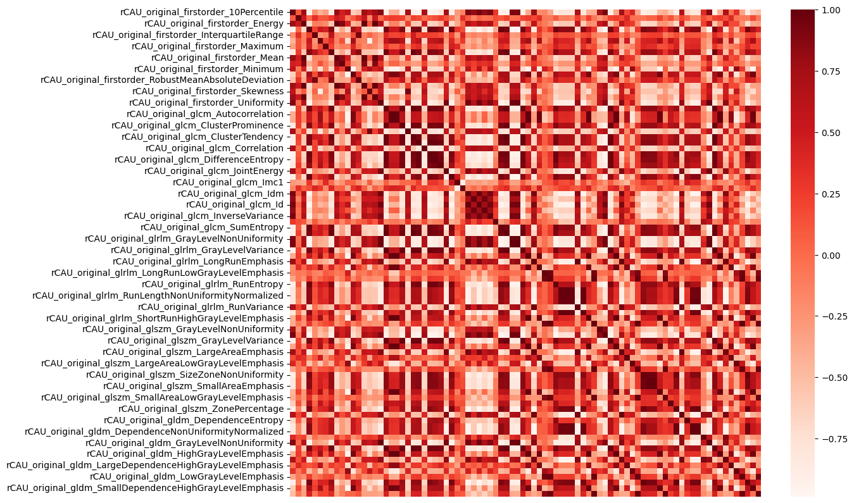
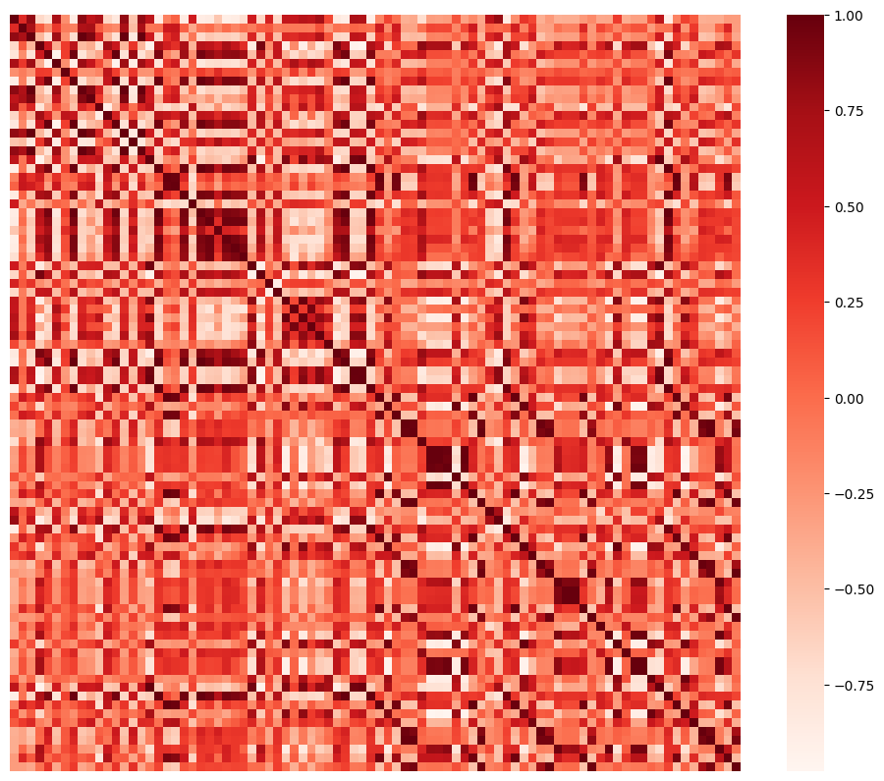
Radiomic Features: Pearson’s Correlation Analysis
rCAU
lCAU

Slide 14
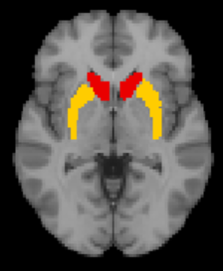
Radiomic Features: mRMR
T1
PyRadiomics
mRMR
Feature Collection
Radiomics: 86
Firstorder
GLCM
GLRLM
GLSZM
GLDM
Rank: 50
Feature 1
Feature 2
…
Feature 50
Feature 1
Feature 1+2
…
Feature 1+2+…+50
ROIs: 6
lCAU rCAU
lPUT rPUT
lSN rSN

Slide 15
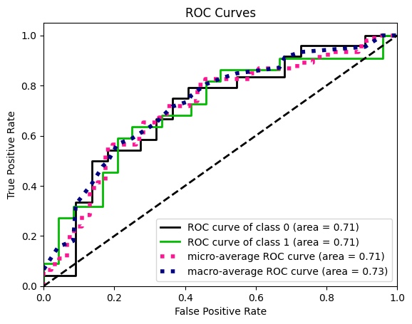
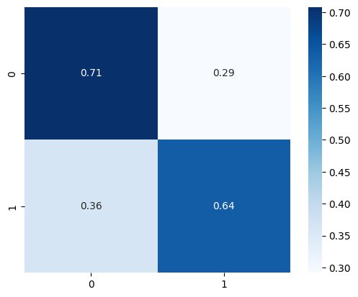
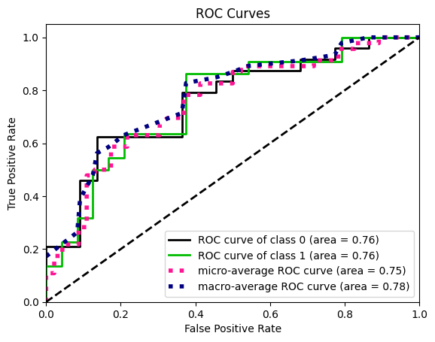
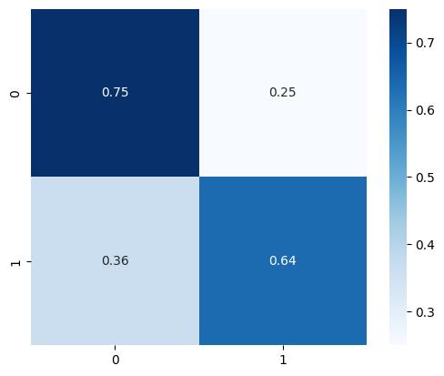
Results: SVM w/ mRMR (N=3)
Demo+Clinic:
AUC train: 0.76
AUC test: 0.71
Demo+Clinic+Img:
AUC train: 0.79
AUC test: 0.76

Slide 16
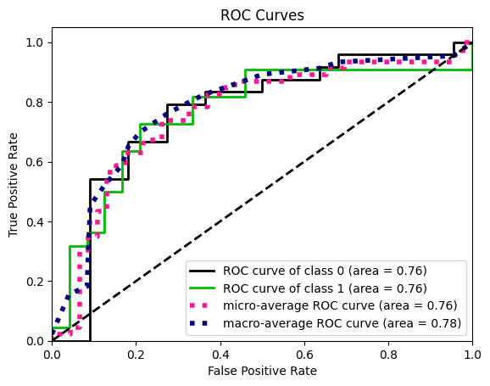
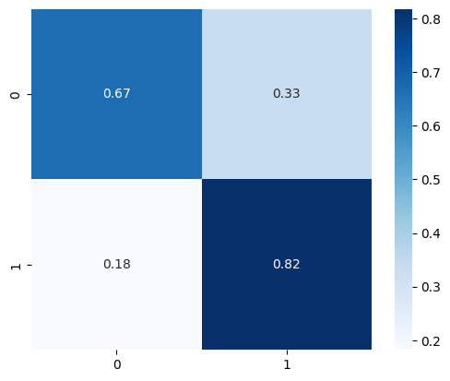
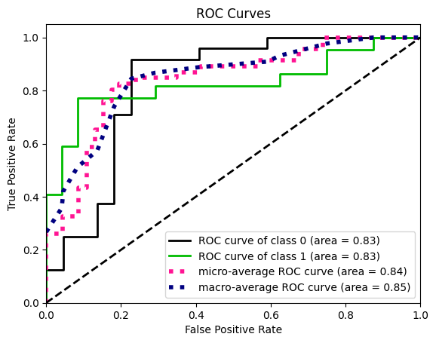
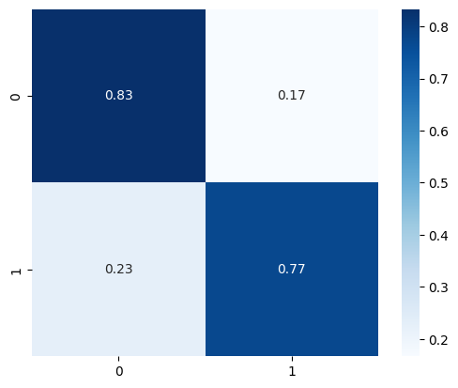
Results: XGBoost w/ mRMR (N=2)
Demo+Clinic:
AUC train: 0.98
AUC test: 0.76
Demo+Clinic+Img:
AUC train: 0.99
AUC test: 0.83

Slide 17
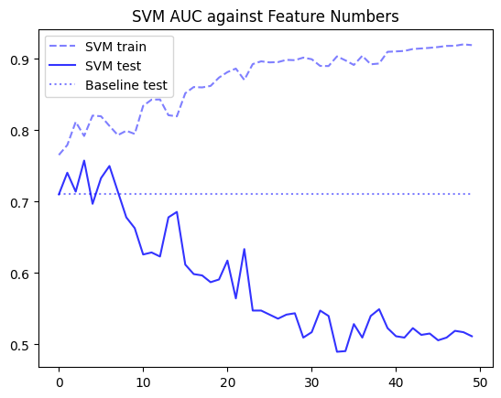
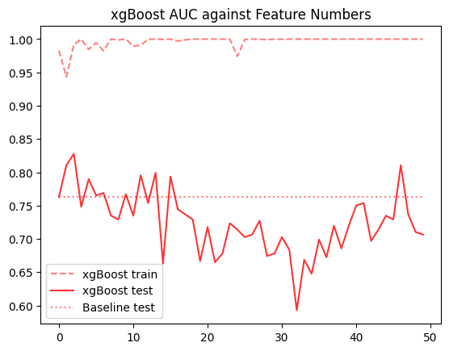
Results: SVM/XGBoost AUC against Feature Numbers

Slide 18
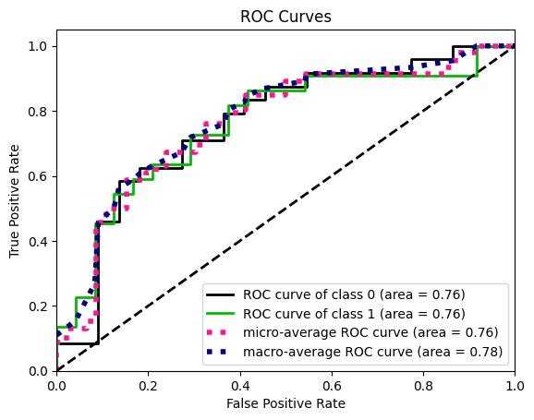
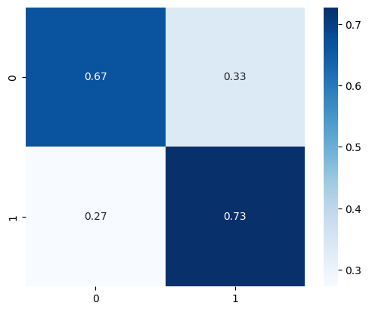
Results: SVM w/ mRMR + LASSO
Demo+Clinic:
AUC train: 0.76
AUC test: 0.71
Demo+Clinic+Img:
AUC train: 0.78
AUC test: 0.76

Slide 19
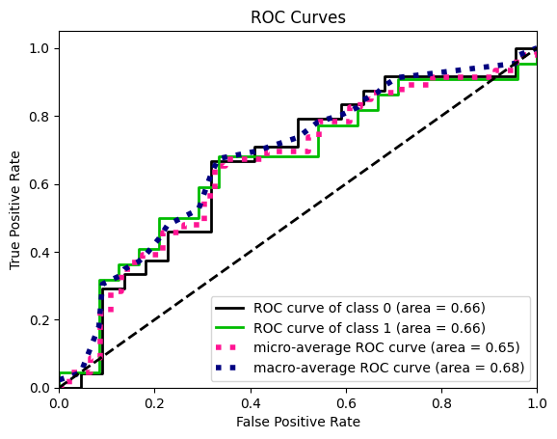
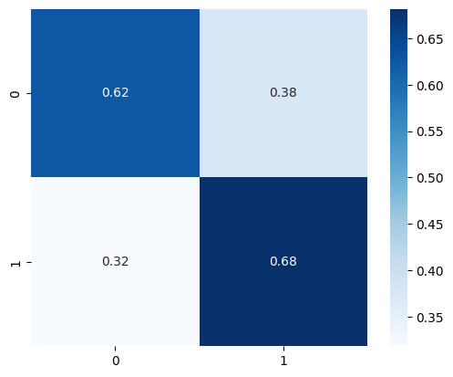
Results: XGBoost w/ mRMR + LASSO
Demo+Clinic:
AUC train: 0.98
AUC test: 0.76
Demo+Clinic+Img:
AUC train: 0.999
AUC test: 0.66

