Slide 1

Examining Trail Rating Influencers
An examination of the impact of factors on overall hike rating and difficulty rating of trails on the hikingproject.com
COMP 4447 Final Project - Ahmed Al Ayoubi, Chris Kirchberg, Harlan Kefalas

Slide 2
Motivation
Hike books lack a direct connection to devices. Great to read a description, but no waypoints, etc.
Which trail website offers the best ratings?
Initial idea: Alltrails.com blocked API requests in December 2020.
Switched to hikingproject.com – a crowd-sourced & curated site

Slide 3
Research Question
”At Hiking Project, our job and our goal are the same — to curate guidebook-quality information that inspires hikers like you to plan an adventure with confidence using the most accurate data available.”
But, can we trust the difficulty rating and/or the rating on hikingproject.com ?
What factors contribute to it?

Slide 4
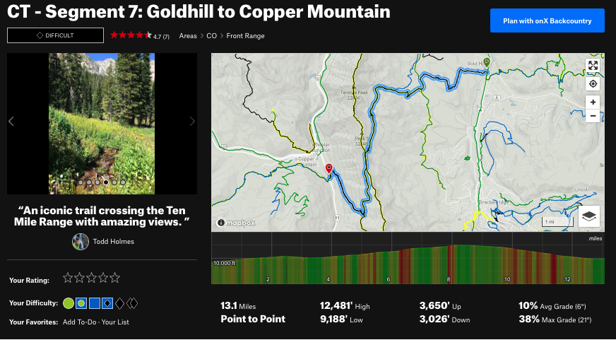
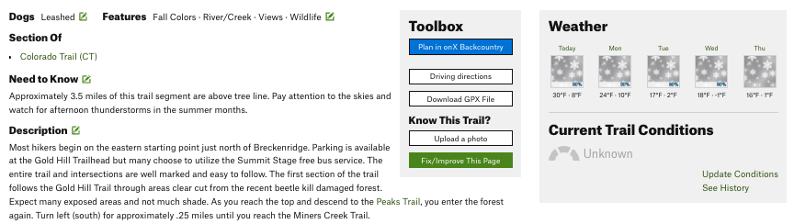
Dataset
From each trail page:
Trail name
Difficulty
Rating
Number of Ratings
Area
Trail Length
Trail Type
High Elevation
Low Elevation
Elevation up
Elevation Down
Average Grade
Max Grade
Dogs
Features

Slide 5

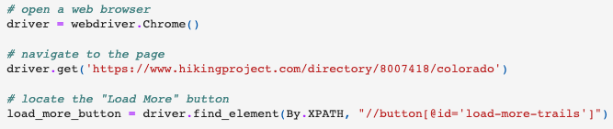
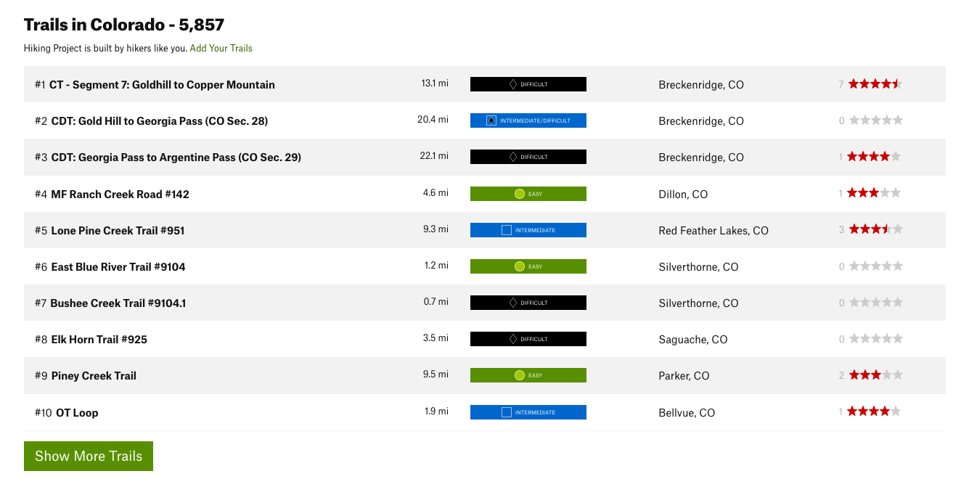
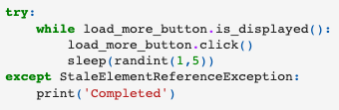
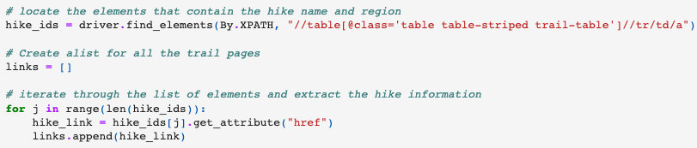
Data Scraping

Slide 6
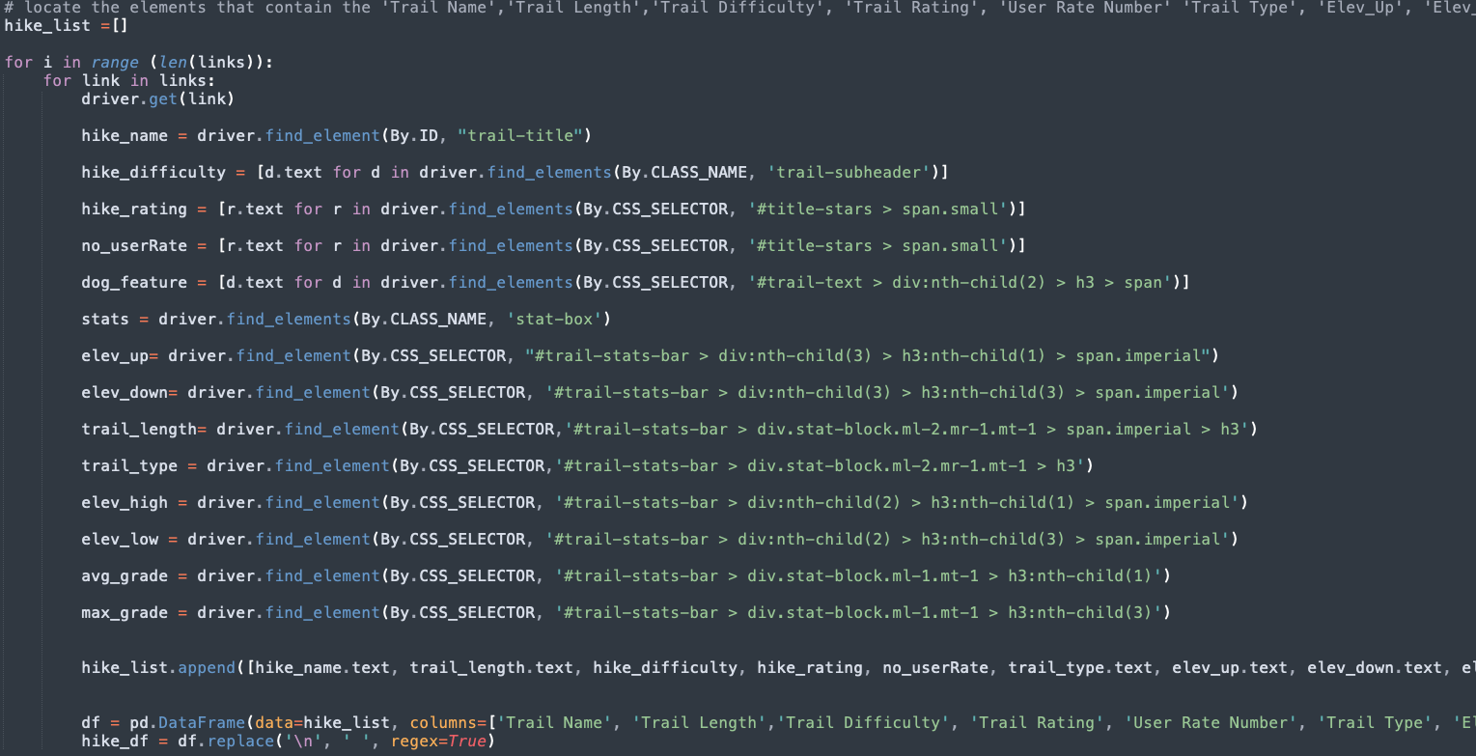



Slide 7
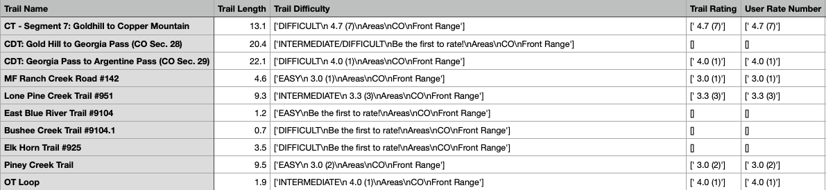
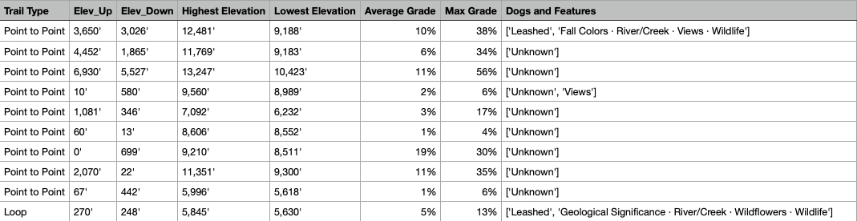
Row Data
Sample of 4,903 scraped hiking trails in Colorado.

Slide 8

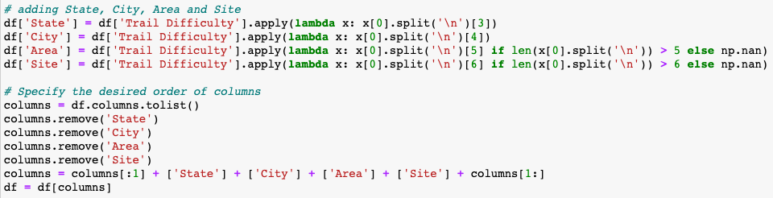

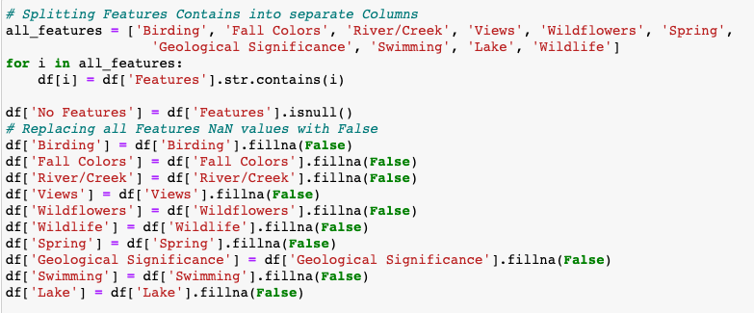
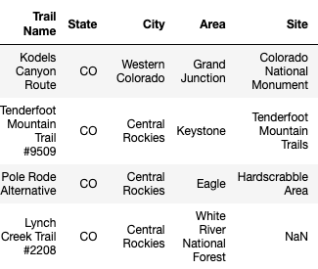

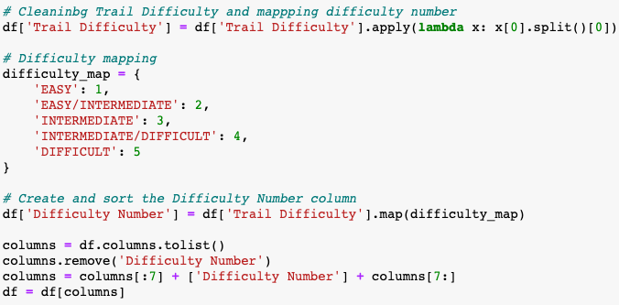
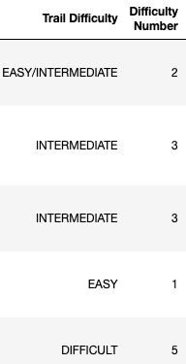
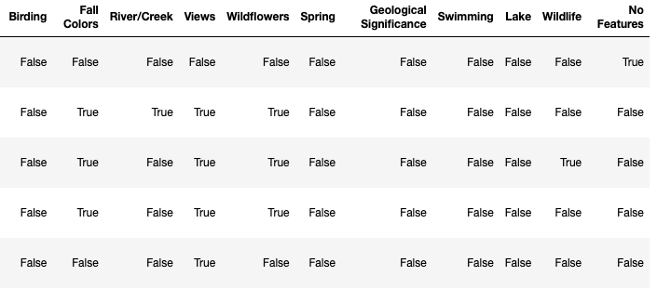
Data Cleaning
Three examples

Slide 9
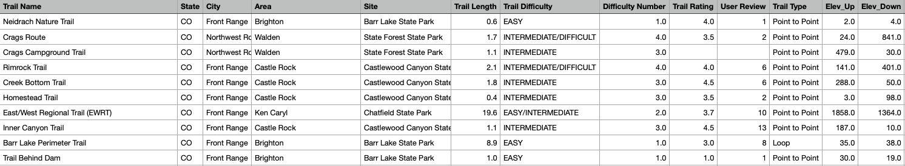
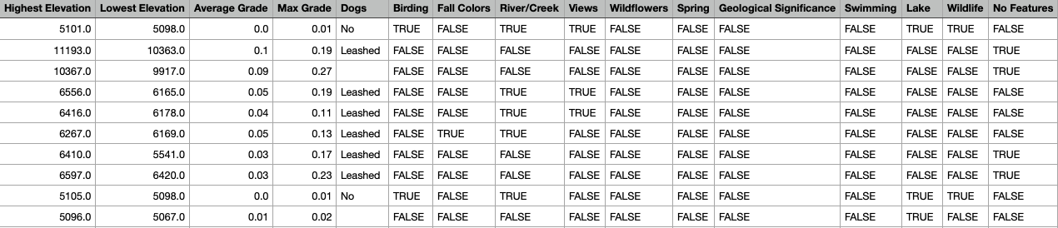
Data Cleaning – Final Table

Slide 10
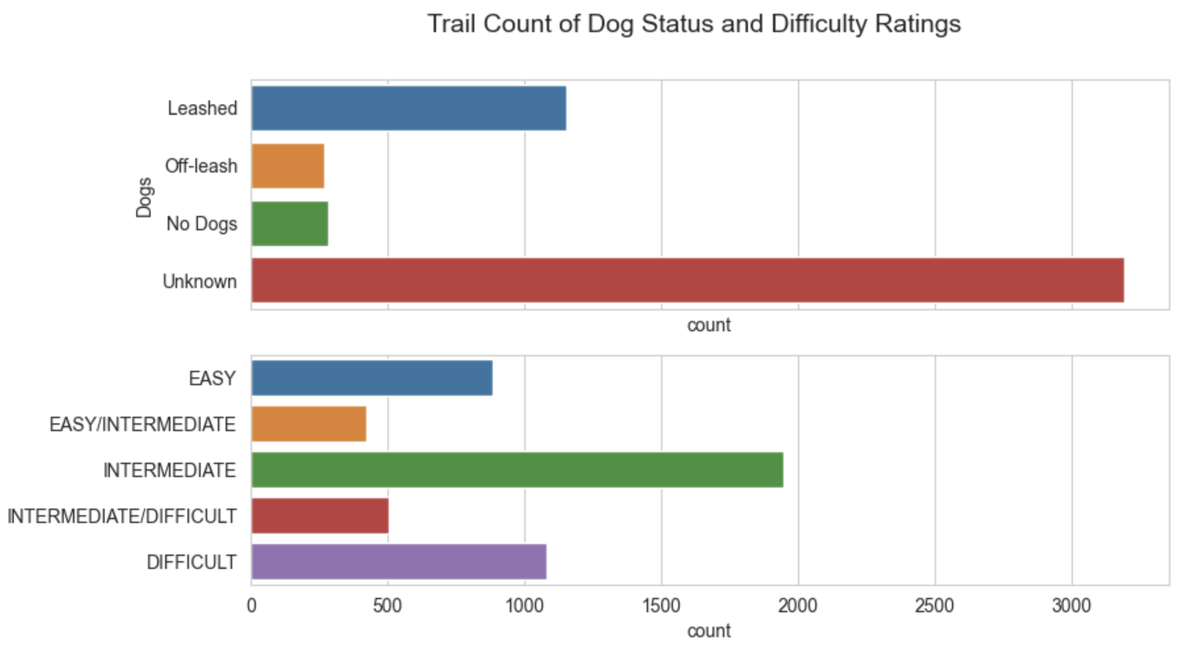
Visualizations

Slide 11
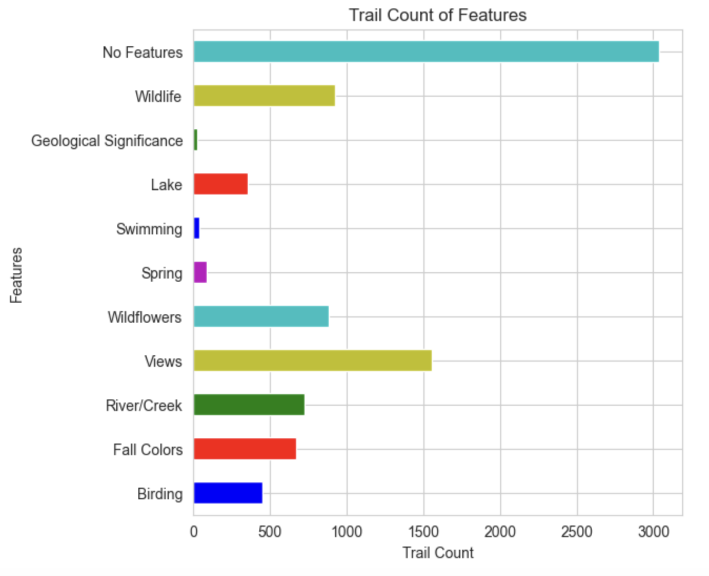
Visualizations

Slide 12
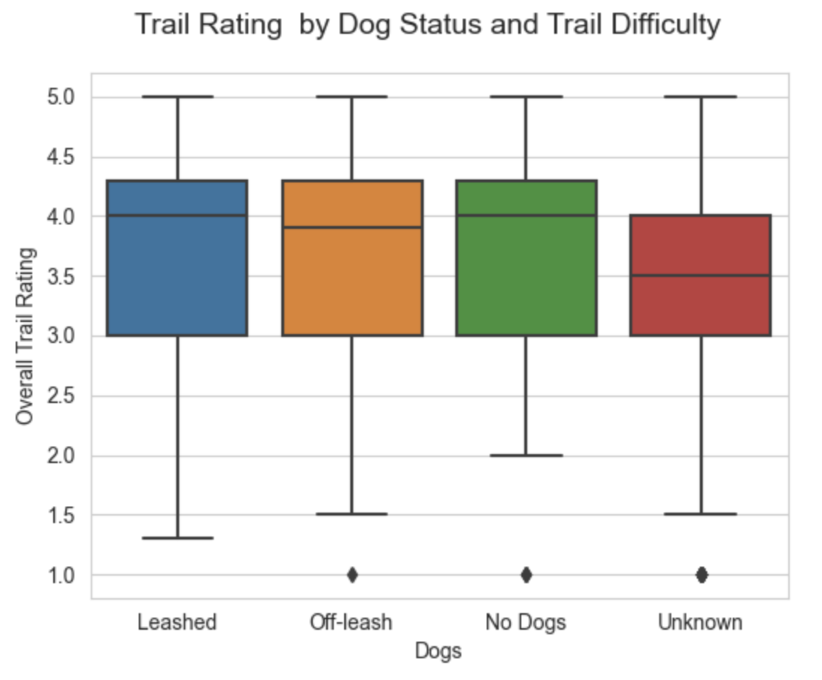
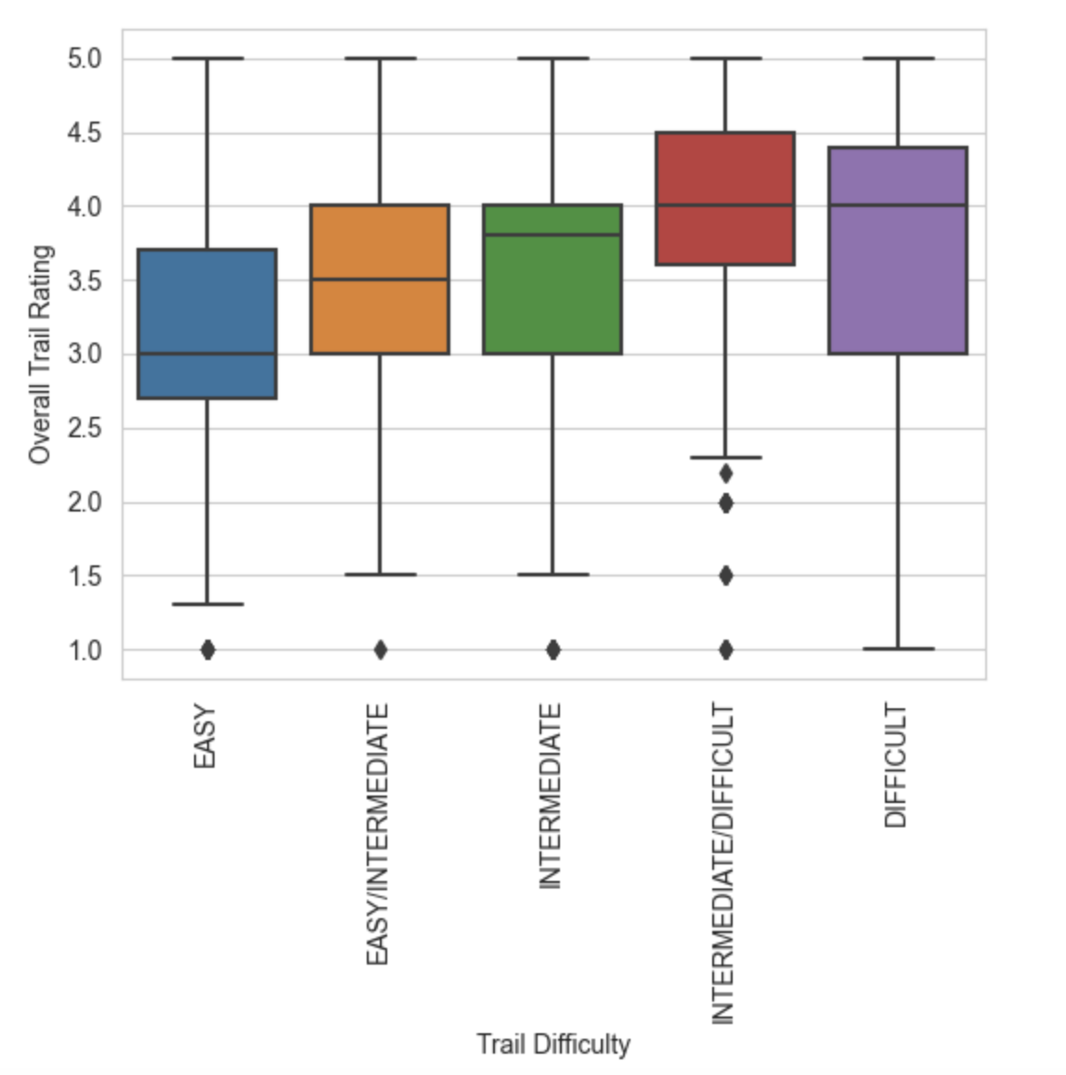
Visualizations

Slide 13
Logistic Regression Conclusions
Statistically significant (p < .05) factors for lm model with all factors:
Positive: Intermediate/Difficulty, Max Grade, Number of Reviews, River (TRUE), Views (TRUE), Lake (TRUE), Geologic Significance (TRUE)
Negative: Easy Difficulty, Average Grade, All Dog Factors
Best subset with all factors: (9 of 28)
Positive: Trail Type (LOOP), Number of Reviews, River (TRUE), Intermediate/Difficulty, Max Grade, Views (TRUE)
Negative: Easy Difficulty, Average Grade, Dog (Unknown)
Best subset without features: (5 of 14)
Positive: Elevation Up, Trail Type (LOOP), Intermediate/Difficulty, Max Grade,
Negative: Easy Difficulty

Slide 14
Conclusions
Answer to our question – can we trust the ratings?
Trails with views and rivers are rated higher. Harder difficulty trails are rated higher than easy trails.
Not enough ratings for the central tendency theorem to occur.
Further research possibilities
Implications for resource managers –
Implications for hikingproject.com
Wider data sampling: more states, pull more data on each trail
Loop trails rate higher, as do those with views, water.
Use processes to add features based on geographical proximity to trails

