Slide 1

Examining Trail Rating Influencers
An examination of the impact of factors on overall hike rating and difficulty rating of trails on the hikingproject.com
COMP 4447 Final Project - Ahmed Al Ayoubi, Chris Kirchberg, Harlan Kefalas

Slide 2
Motivation
Hike books lack a direct connection to devices. Great to read a description, but no waypoints, etc.
Which trail website offers the best ratings?
Initial idea: Alltrails.com blocked API requests in December 2020.
Switched to hikingproject.com – a crowd-sourced & curated site

Slide 3
Research Question
”At Hiking Project, our job and our goal are the same — to curate guidebook-quality information that inspires hikers like you to plan an adventure with confidence using the most accurate data available.”
But, can we trust the difficulty rating and/or the rating on hikingproject.com ?
What factors contribute to it?

Slide 4
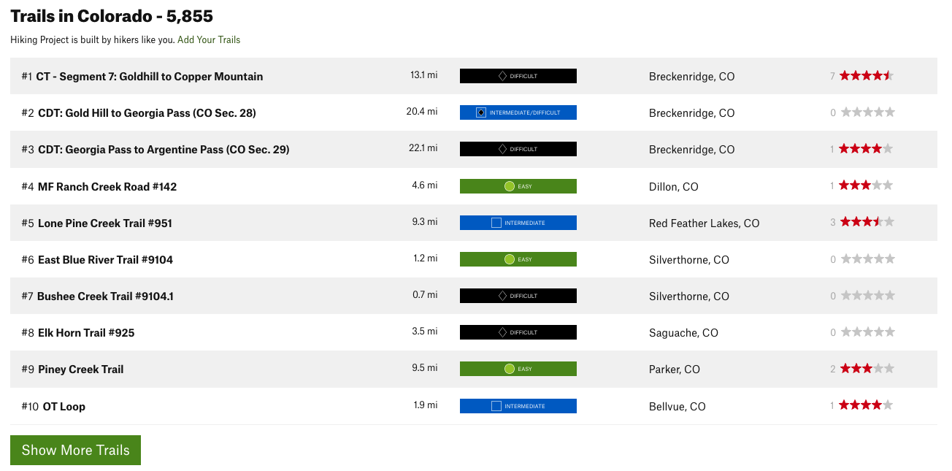
Dataset
try:
while load_more_button.is_displayed():
load_more_button.click()
sleep(randint(1,5))
except StaleElementReferenceException:
print('Completed')

Slide 5
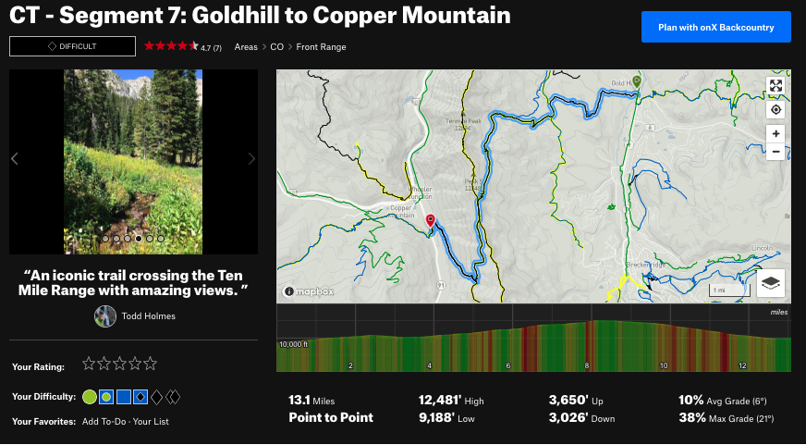
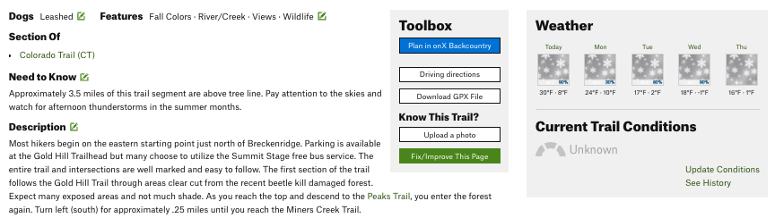
Dataset
From each trail page:
Trail name
Difficulty
Rating
Number of Ratings
Area
Trail Length
Trail Type
High Elevation
Low Elevation
Elevation up
Elevation Down
Average Grade
Max Grade
Dogs
Features

Slide 6
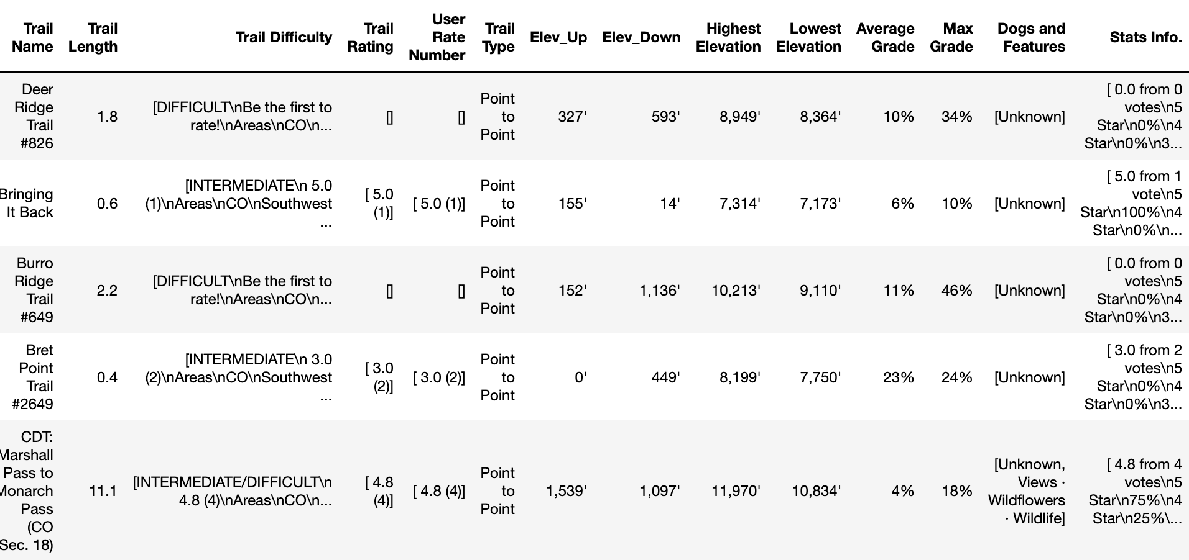
Data Cleaning - Before

Slide 7
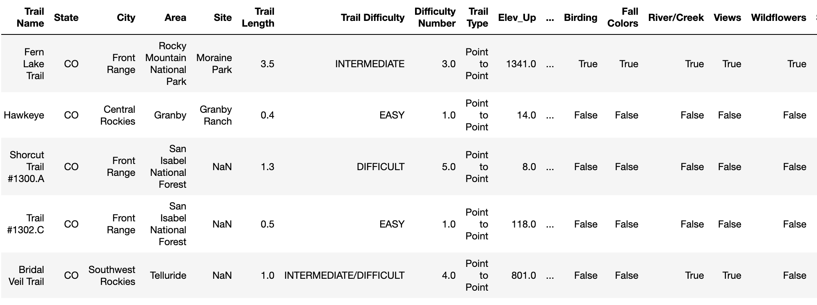
Data Cleaning - After

Slide 8
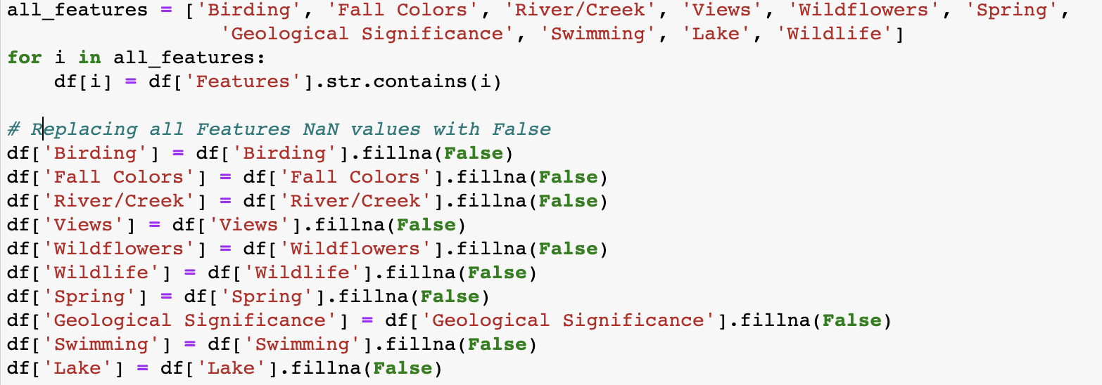
Data Cleaning - Issues
Extracting Dogs and Boolean Columns for Features:

Slide 9
Summary Statistics
Basic statistics breakdown
 | Trail Length | Difficult Number | Elev_Up | Elev_Down | Highest Elevation | Lowest Elevation | Average Grade | Max Grade | Overall Trail Rating | Total User Reviews
count | 4903.00000 | 4844.000000 | 4903.000000 | 4903.000000 | 4903.000000 | 4903.000000 | 4903.000000 | 4903.000000 | 3307.000000 | 3307.000000
mean | 3.50516 | 3.098679 | 758.076280 | 502.997553 | 9087.827860 | 8232.811544 | 0.072011 | 0.219759 | 3.614696 | 3.680677
std | 4.69358 | 1.343443 | 1016.041697 | 884.560557 | 2152.188263 | 1754.707216 | 0.048774 | 0.153531 | 0.863918 | 6.024722
min | 0.00000 | 1.000000 | 0.000000 | 0.000000 | 3886.000000 | 3752.000000 | 0.000000 | 0.000000 | 1.000000 | 1.000000
25% | 1.00000 | 2.000000 | 85.000000 | 22.000000 | 7436.000000 | 6923.000000 | 0.040000 | 0.120000 | 3.000000 | 1.000000
50% | 2.10000 | 3.000000 | 329.000000 | 150.000000 | 9166.000000 | 8332.000000 | 0.060000 | 0.190000 | 3.800000 | 2.000000
75% | 4.30000 | 4.000000 | 1062.000000 | 532.000000 | 10694.000000 | 9413.000000 | 0.090000 | 0.280000 | 4.100000 | 4.000000
max | 124.50000 | 5.000000 | 12176.000000 | 14031.000000 | 14416.000000 | 14131.000000 | 0.620000 | 1.560000 | 5.000000 | 107.000000

Slide 10
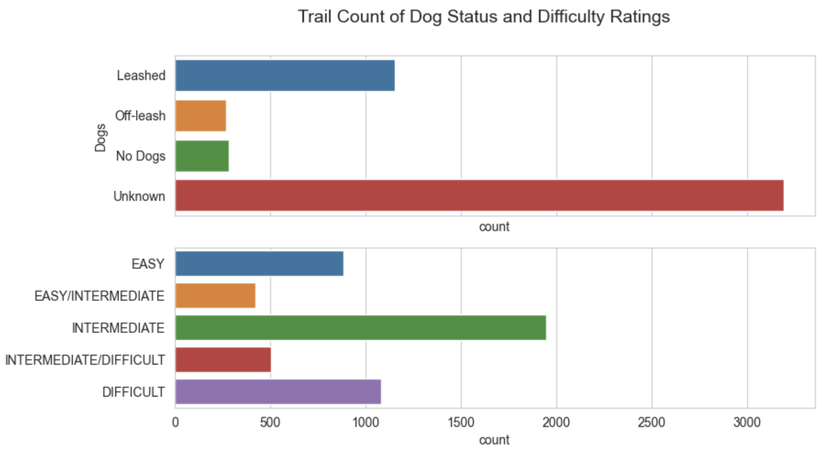
Visualizations

Slide 11
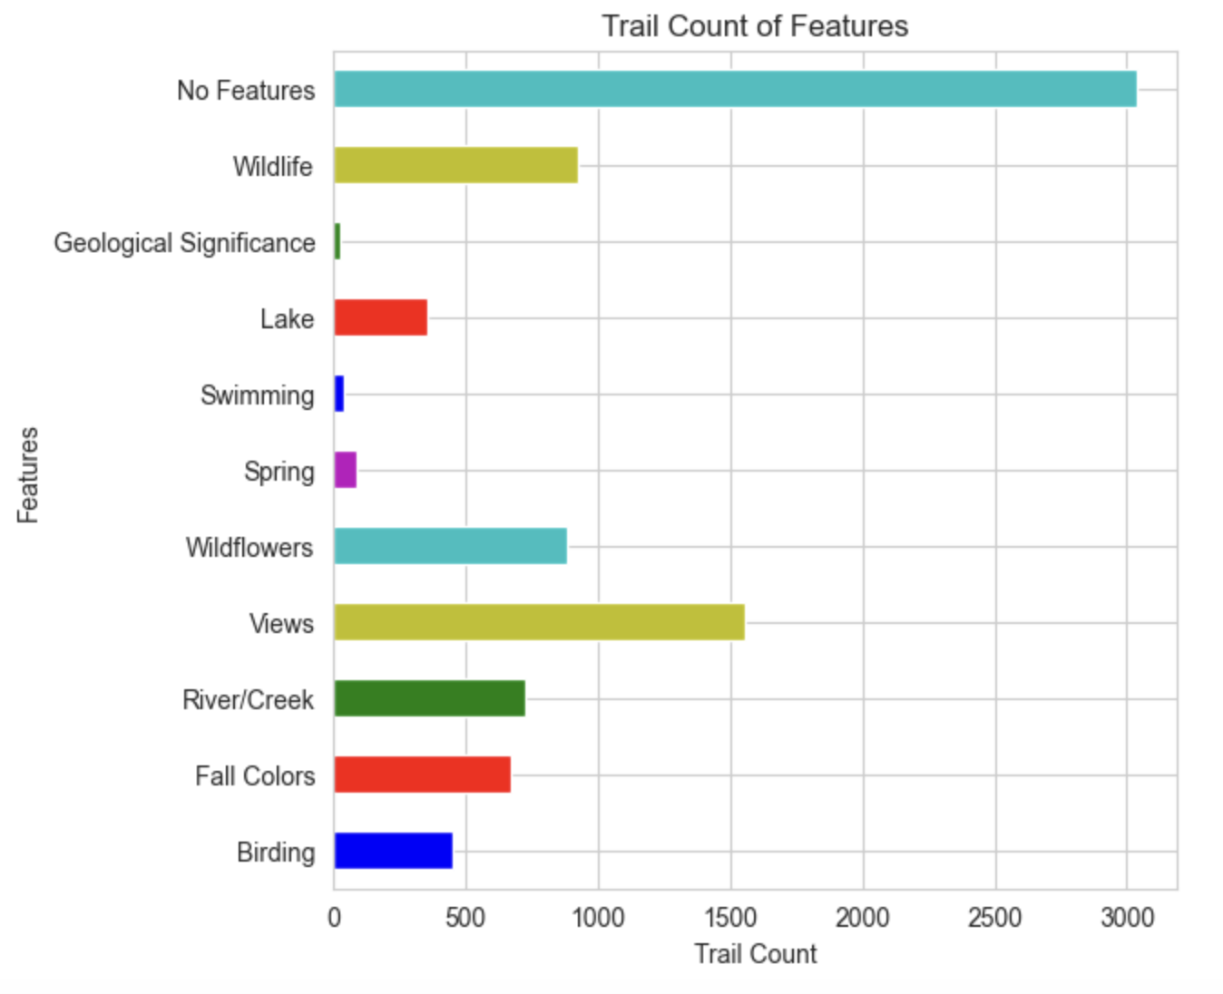
Visualizations

Slide 12
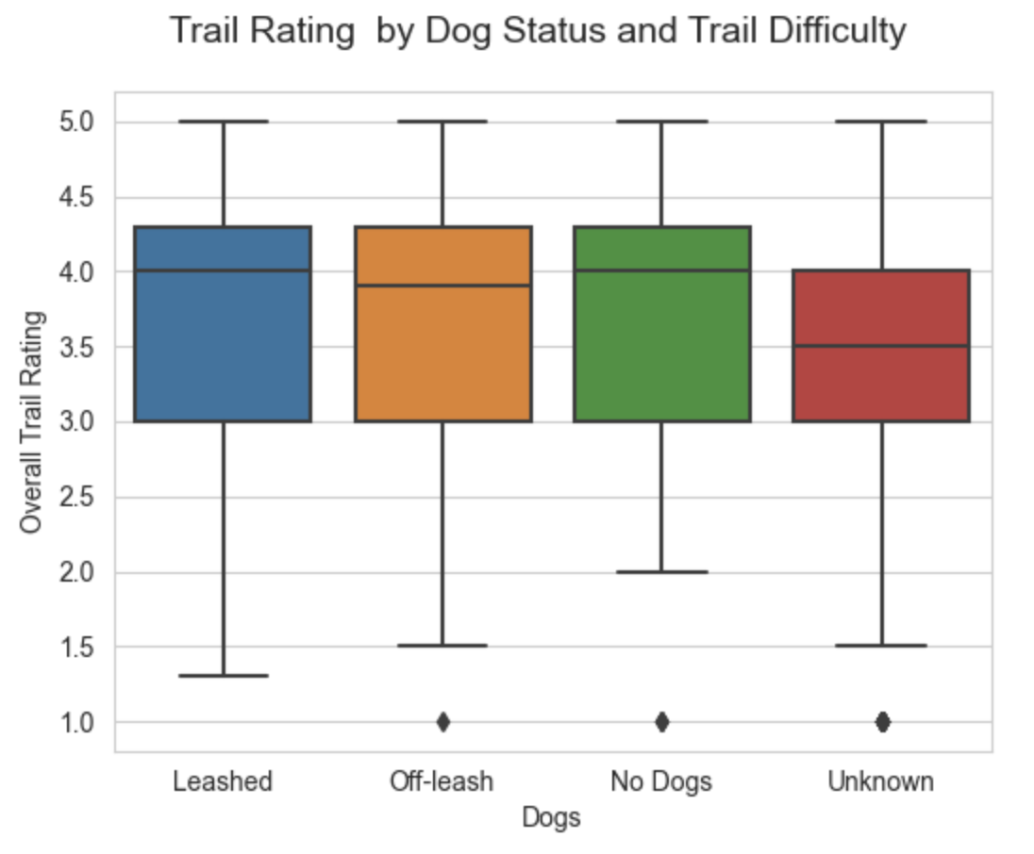
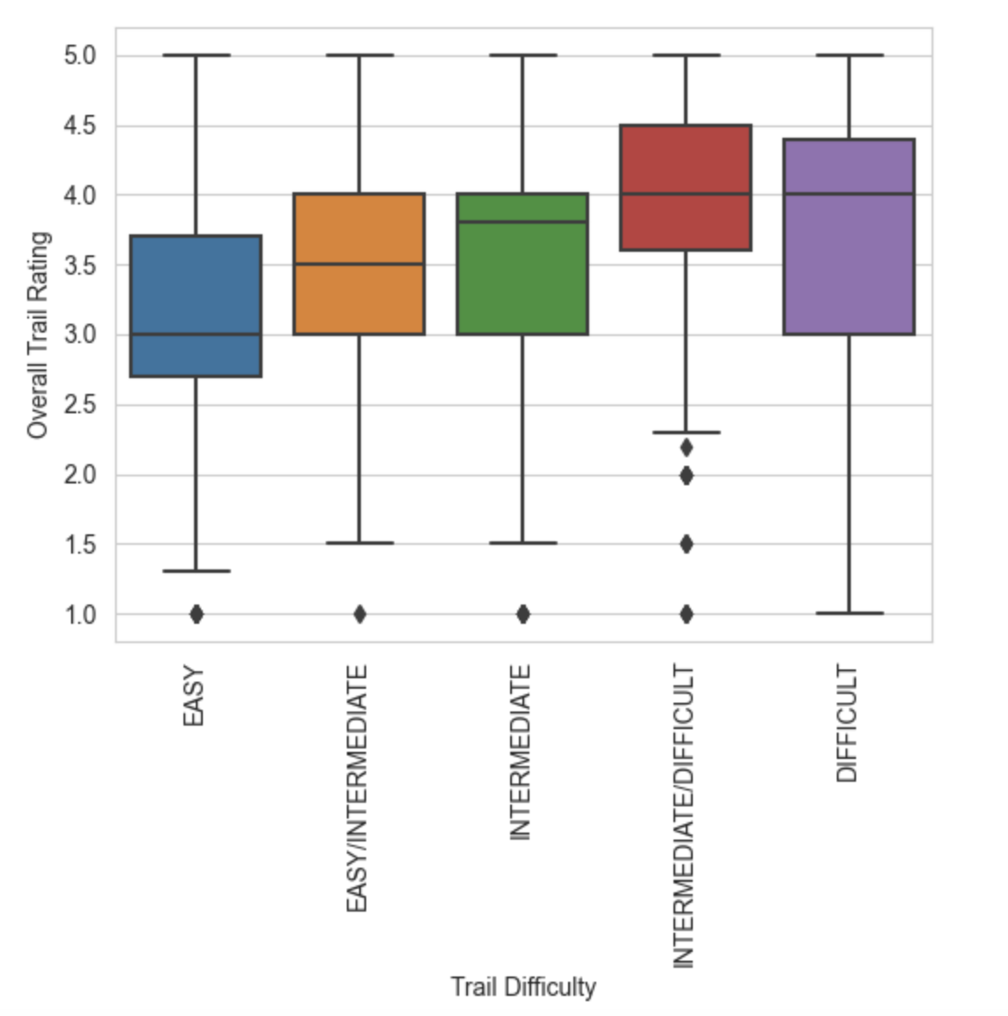
Visualizations

Slide 13
Logistic Regression Conclusions
Statistically significant (p < .05) factors for lm model with all factors:
Positive: Intermediate/Difficulty, Max Grade, Number of Reviews, River (TRUE), Views (TRUE), Lake (TRUE), Geologic Significance (TRUE)
Negative: Easy Difficulty, Average Grade, All Dog Factors
Best subset with all factors: (9 of 28)
Positive: Trail Type (LOOP), Number of Reviews, River (TRUE), Intermediate/Difficulty, Max Grade, Views (TRUE)
Negative: Easy Difficulty, Average Grade, Dog (Unknown)
Best subset without features: (5 of 14)
Positive: Elevation Up, Trail Type (LOOP), Intermediate/Difficulty, Max Grade,
Negative: Easy Difficulty

Slide 14
Conclusions
Answer to our question – can we trust the ratings?
Trails with views and rivers are rated higher. Harder difficulty trails are rated higher than easy trails.
Not enough ratings for the central tendency theorem to occur.
Further research possibilities
Implications for resource managers –
Implications for hikingproject.com
Wider data sampling: more states, pull more data on each trail
Loop trails rate higher, as do those with views, water.
Use processes to add features based on geographical proximity to trails

