Slide 1
Annotating and prioritizing SNVs
Introduction

Slide 2
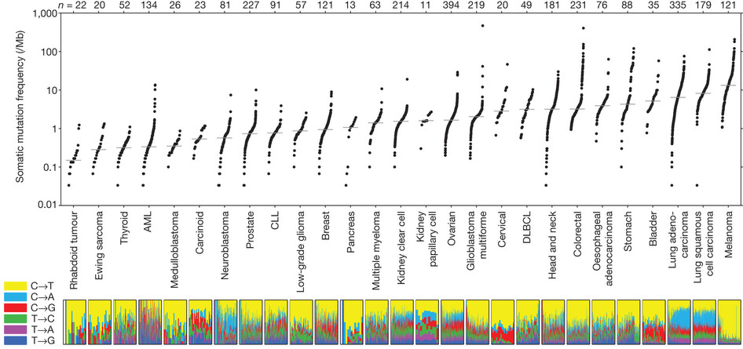
What to do with all the SNVs?
So far: making sure the SNVs are biologically relevant difference and not technical artefacts
Lawrence et al. Nature 2013
Notes:
That’s in exomes

Slide 3
Prioritizing
Does the SNV affect a gene, a transcription factor or miRNA binding site?
How likely is the SNV to affect protein function?
Does the SNV fall within a region that is highly duplicated in the genome?
Does the gene affect a known regulatory element, e.g. enhance or promoter?
How does the SNV affect a gene/transcript?
Is the region containing the SNV evolutionary conserved?
Is the SNV known in other cancers?
Is the SNV known to be prevalent in a healthy population?

Slide 4
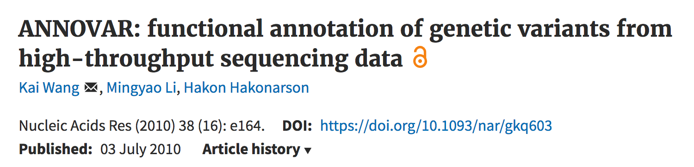
Tools for annotating SNVs/SNPs
There are many…
…we will use ANNOVAR:

Slide 5
Region-based annotation
Annotations of variants based on overlap with specific genomic elements, e.g.:
Gene regions
conserved genomic regions,
(predicted) transcription factor binding sites,
(predicted) microRNA target sites
Especially important for whole-genome sequencing data

Slide 6
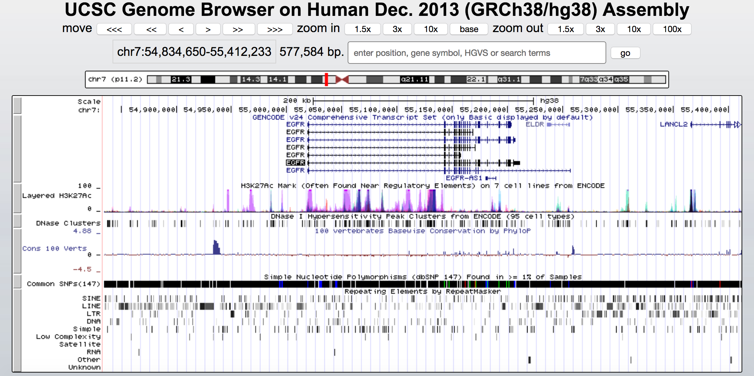
Does the SNV affect a gene, a known enhancer, etc.?

Slide 7
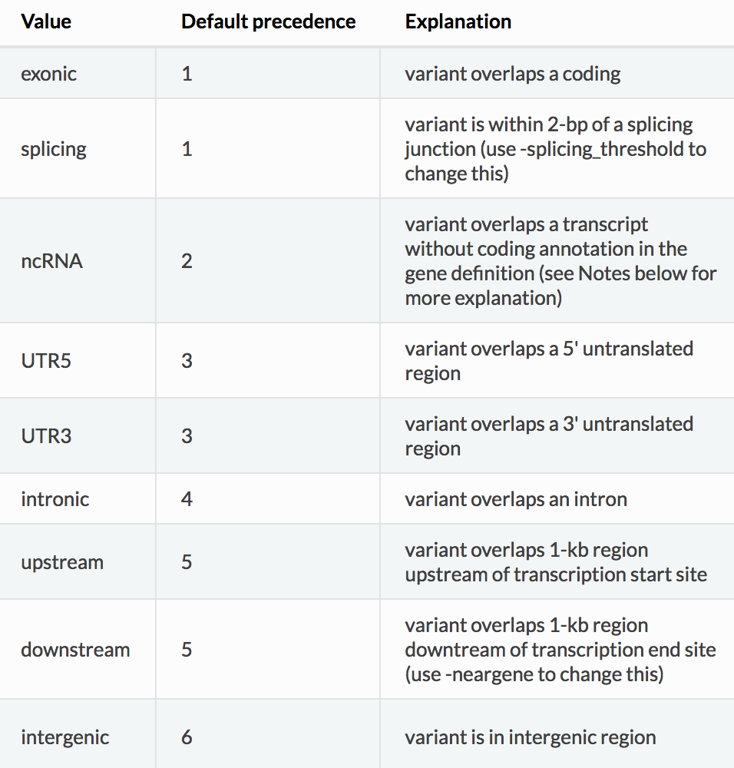
Gene-based annotation – distance to gene
Annotate variants to distinguish between intergenic, exonic, intronic, etc variants
Notes:
http://annovar.openbioinformatics.org/en/latest/user-guide/gene/

Slide 8
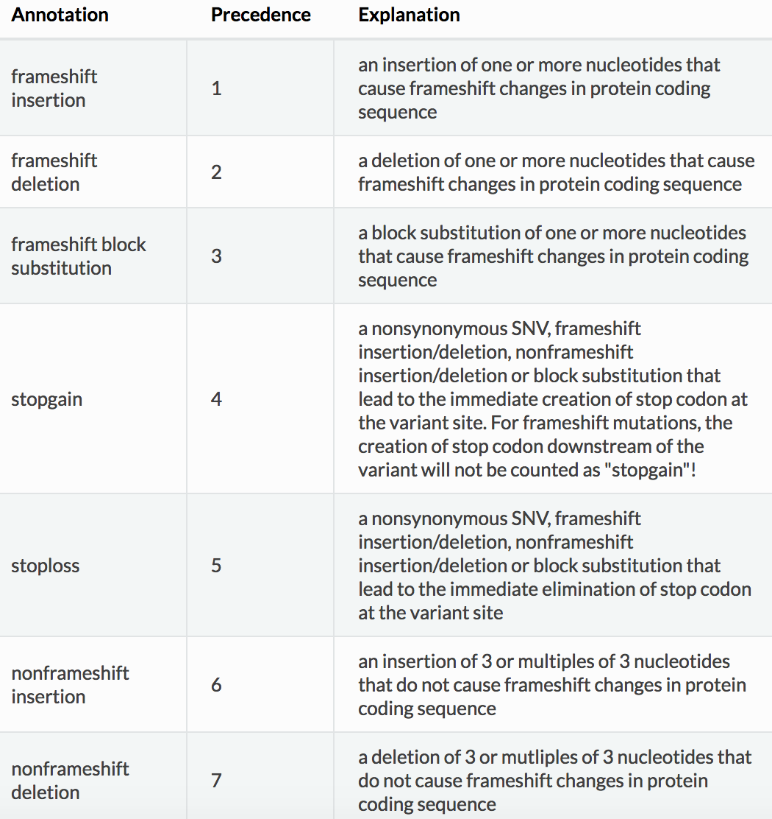
Gene-based annotation – effect on coding region

Slide 9

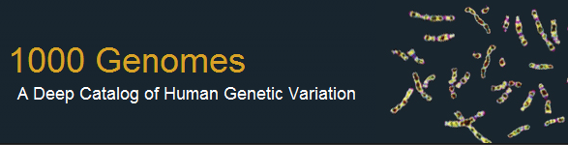
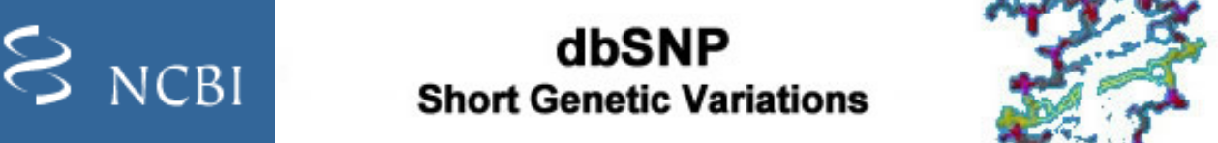

Filter-based annotation
Identify exact variant (with same start position, end position and alleles) in databases of …
Known (disease-related or common) variants
Predicted functional effect

Slide 10
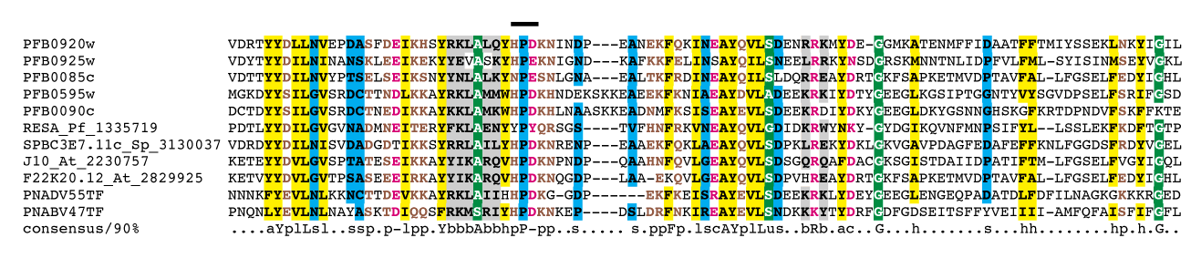
Predicted functional effect – SIFT score
Rational:
Residues that are conserved completely in the protein family are expected to be important for function
Give a protein sequence SIFT
…searches for closely related protein sequences
…performs multiple alignment
…calculates normalized probabilities for all possible substitution at each position (SIFT score)

Slide 11
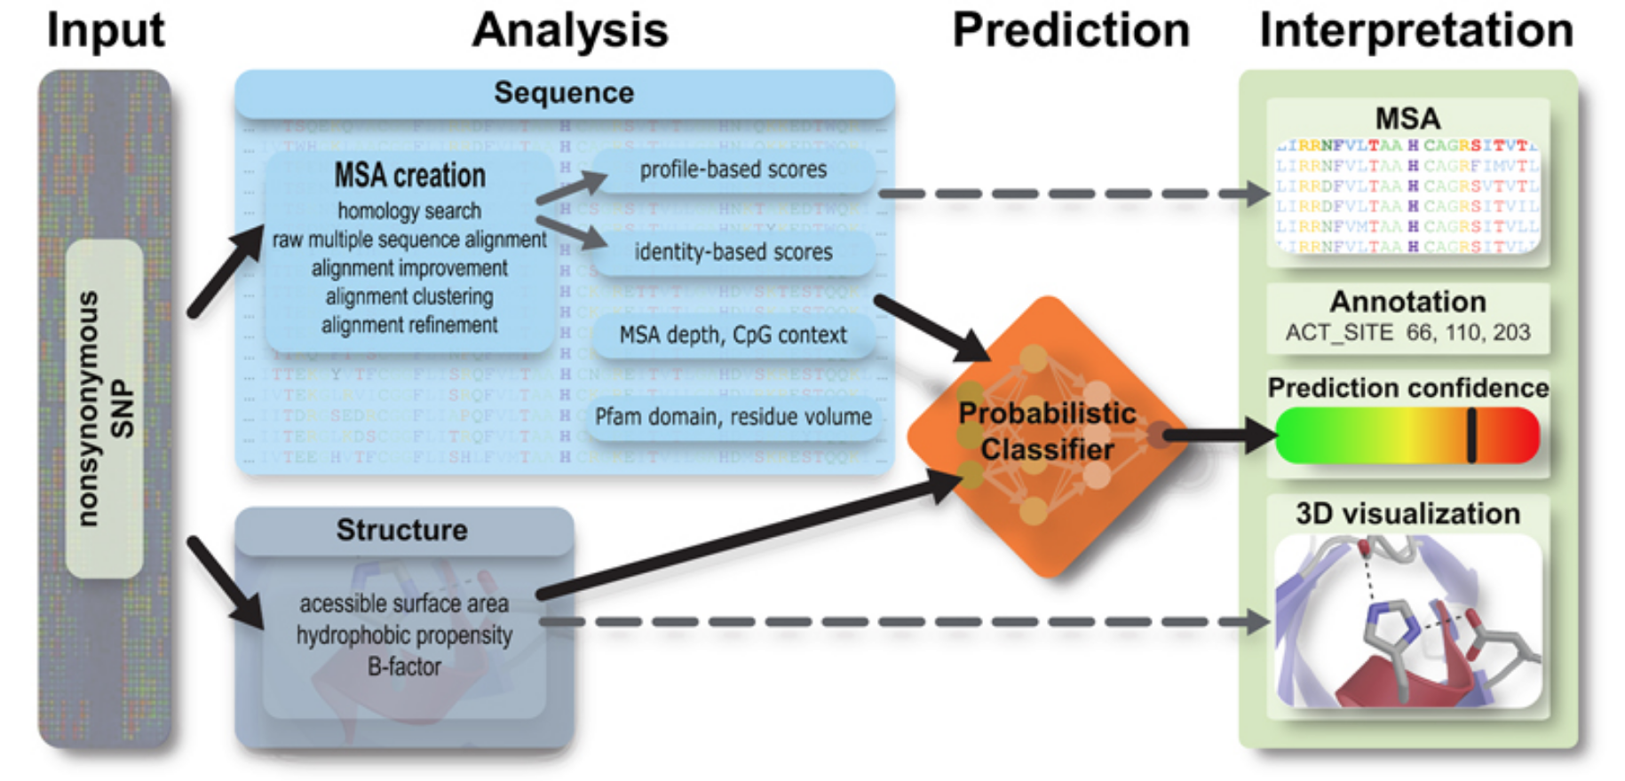
Predicted functional effect – PolyPhen
Prediction using sequence- and structure-based features
Returns probability of a mutation to be deleterious
Uses training set to learn important characteristics of a mutation, e.g.:
13,032 human disease-causing mutations from UniProt
8,946 human nsSNPs without annotated involvement in disease

Slide 12
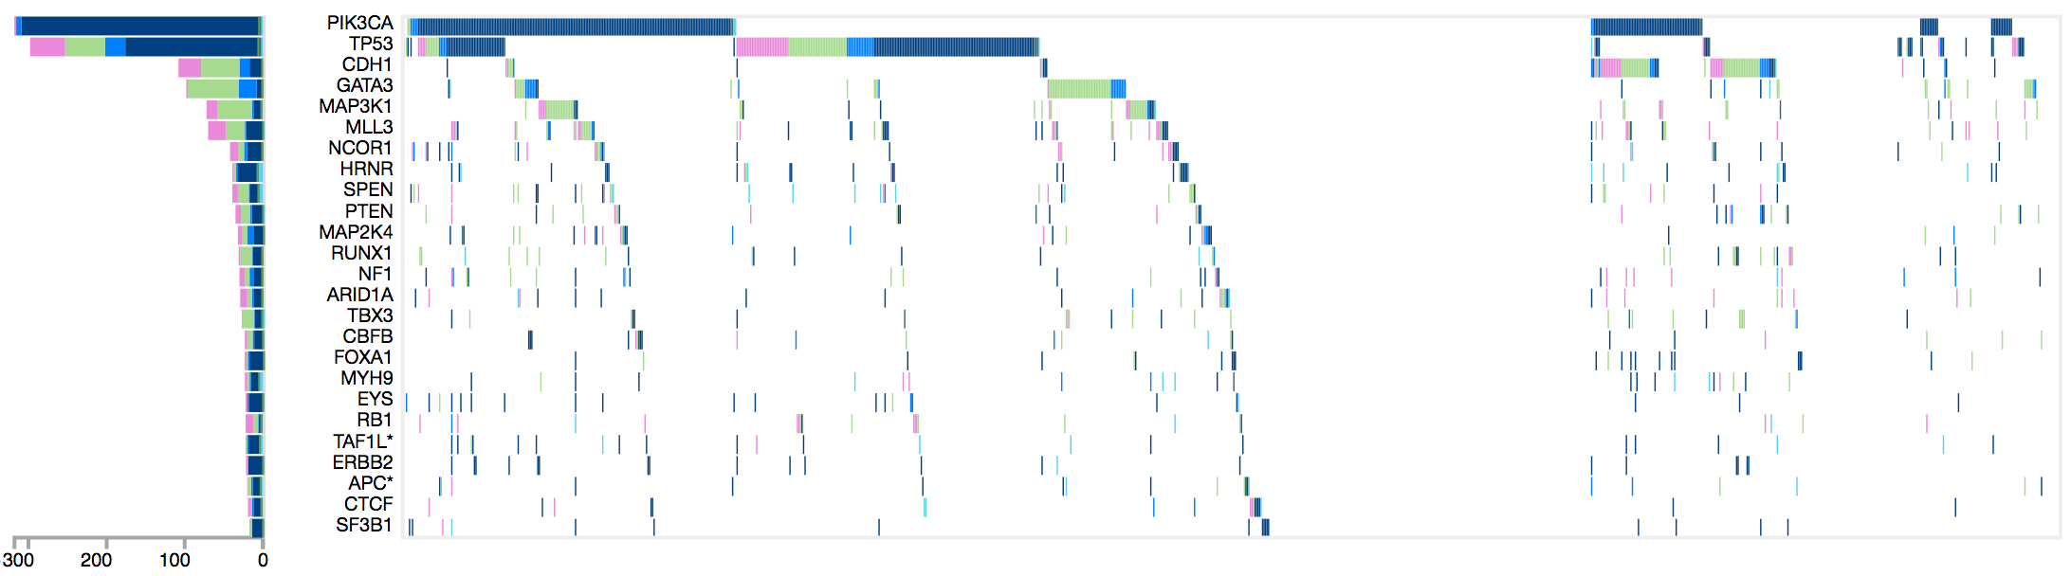
Cohort-Based Prioritization
Patients

