Slide 1



SBOL Visual: Diagrams for Synthetic Biology
Thomas Gorochowski
Biocompute Lab, University of Bristol, UK (@chofski)
James Scott-Brown
University of Oxford, UK (@jamesscottbrown)
Slides and code: https://bit.ly/33v9Q5i
12th International Workshop of Bio-Design Automation (IWBDA)
5th August 2020
This document does not contain technology or technical data controlled under either U.S. International Traffic in Arms Regulation or U.S. Export Administration Regulations.
Thanks to Jake Beal for providing an initial set of these slides

Slide 2
Schedule
Introduction to SBOL Visual (SBOLv) (45 min, Tom)
Rationale and guiding principles
Examples of key features
Getting involved and future directions
Parametric SVG for SBOLv (30 min, James)
What is SVG, parametric SVG and why use in SBOLv?
Examples of parametric SVG in action
Future integration and next steps
ParaSBOLv Python library (30 min, Tom)
Lightweight Python library introduction
Basic examples of programmable diagram creation

Slide 3
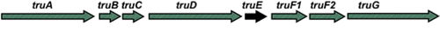
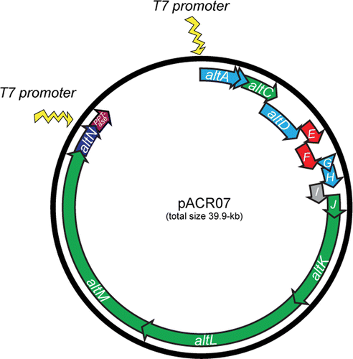
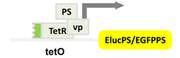
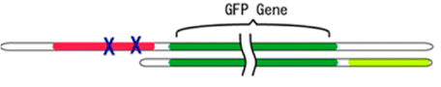
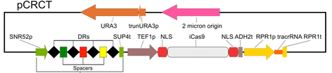
Problem: Communicating Gene Constructs
Construct diagrams from some recent ACS Syn.Bio. papers:
Well, they're sort of similar…
Notes:
I'm not picking on anybody - I just took the most recent 5 "just publishable" papers with constructs

Slide 4
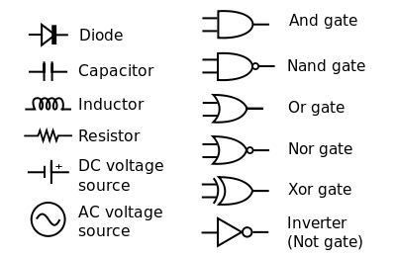
Standards simplify communication
Inspiration: Standard Electronic Symbols:
What is the equivalent for synthetic biology?
… and many others in IEEE Std. 91/91a; IEEE Std. 315
Notes:
Image courtesy of Wikipedia

Slide 5
Diagram Elements
Sequence Feature Glyphs
Molecular Species Glyph
Module
Nucleic Acid
Backbone
GFP
pTet
gfp
tetR
Interactions
Labels
Reverse Complement
Sequence Feature Glyphs
Interaction Node
aTc

Slide 6
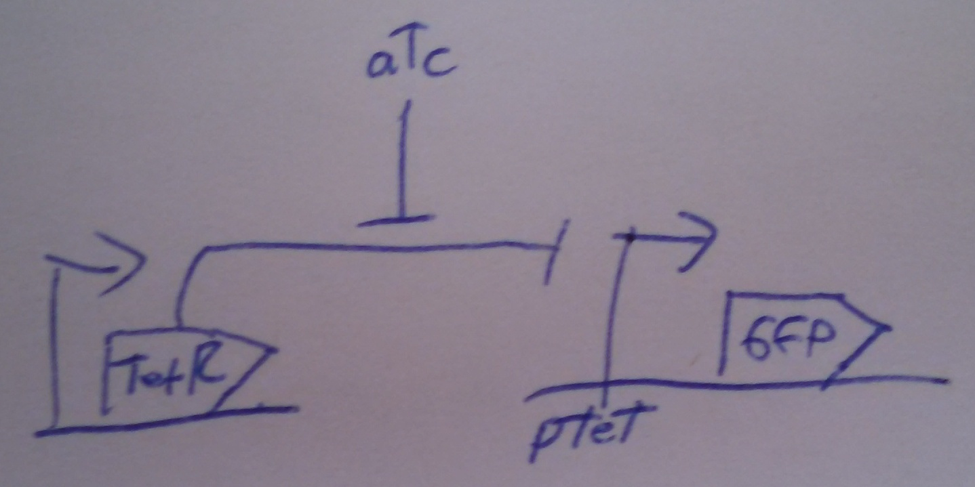
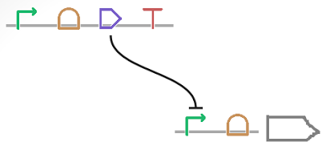
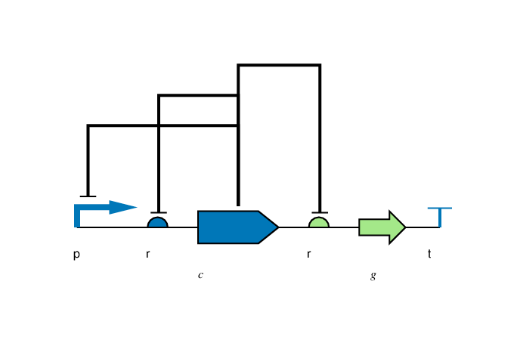
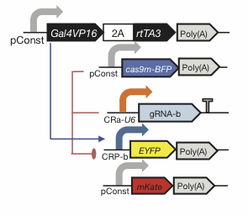
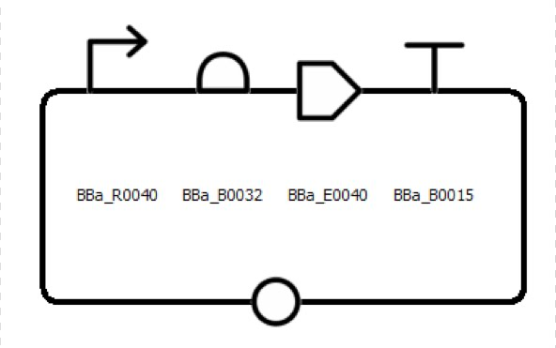
Flexibility of Style
Color, Text, Scaling, Strands, Styling: all your choice

Slide 7
Nucleic Acid Glyphs

Slide 8
Molecular Species & Interaction Glyphs
Molecular Species
superpose glyphs
alternate
recommended alternate
Complex
Macromolecule
Protein
No Glyph
Nucleic Acid (Generic)
alternates
recommended alternate
Nucleic Acid (1-Strand)
Nucleic Acid (2-Strand)
Simple Chemical
Unspecified
Interaction
Control
Degradation
Inhibition
Process
Stimulation
Association
Dissociation
Process

Slide 9
Making SBOL Visual Diagrams
Using your favorite graphics editor:
Many glyphs can be drawn directly
Glyph set available: http://sbolstandard.org/visual/
Specialized visualization tools:
VisBOL: http://visbol.org
SBOLCanvas: https://sbolcanvas.org
dnaplotlib: https://github.com/VoigtLab/dnaplotlib
DEMO!
DEMO!

Slide 10
Example: CRISPR Device

Slide 11
Example: CRISPR Circuit

Slide 12
Example: Rule 30 Circuit

Slide 13
Example: Pathway Engineering

Slide 14
Example: Genome Engineering

Slide 15
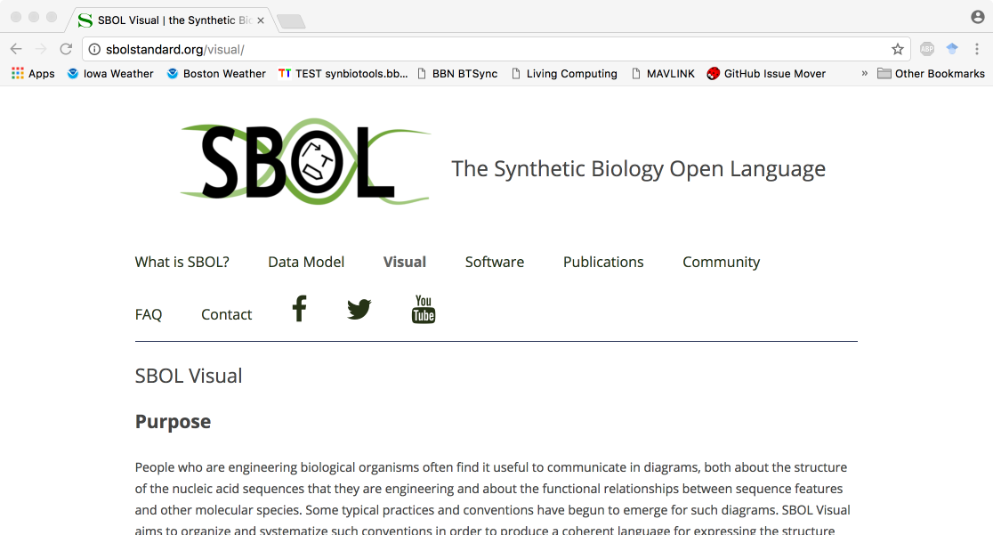
http://sbolstandard.org
Use the symbols in your papers & talks
Contribute opinions, use cases, new symbols
Community is open for anyone to join

Slide 16
Future developments
Alignment with SBOL3 data model
Expand to other synthetic biology domains
RNA parts and devices
Protein design language
Machine readable geometry & customizations
Formalize allowable changes in the shape of symbols
Integration of parametric SVG

Slide 17
PART II
Parametric SVG for SBOLv
James Scott-Brown
University of Oxford, UK (@jamesscottbrown)

Slide 18
PART III
ParaSBOLv Python library
Programmable creation and customization of SBOLv

