Slide 1
BioPlex protein-protein interaction networks
Ludwig Geistlinger
Robert Gentleman
Center for Computational Biomedicine
Harvard Medical School

Slide 2
Goal
to find groups of interested participants to work on a coordinated analysis of this data in one area
Vince, Laurant, Robert happy to help organize and explain the data and how to access it
Several vignettes produced by Ludwig Geistlinger and Roger Vargas that can be jumping off points
Spend 4+ hours investigating the data and making some progress – ideally contributing to the vignettes so others can build off of them
What you get:
chance to work across modalities
learn to work in a group
learn some interesting tools

Slide 3
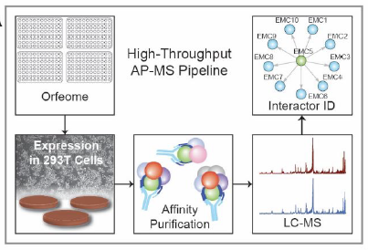
Experimental procedures
uses affinity purification–mass spectrometry methodology
protein interaction networks of more than 70% of protein-coding genes from the human genome

Slide 4
Relevant literature
Huttlin et al, Cell, 2015: Bioplex 1.0 (293T cells)
Huttlin et al, Nature, 2017: Bioplex 2.0 (293T cells)
Huttlin et al, Cell, 2021: Bioplex 3.0 (293T cells & HCT116 cells)

Slide 5
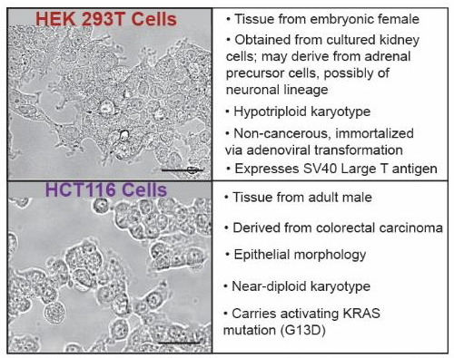
Cell lines
293T: highly transfectable derivative of Human Embryonic Kidney 293 (HEK293) cell line
HCT116: Human Colon Tumor-derived cell line initiated from an adult male

Slide 6
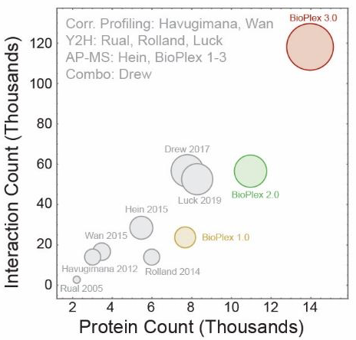
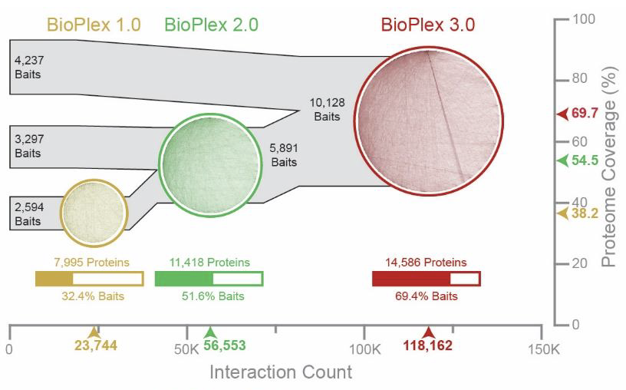
Bioplex PPIs (293T cells)
Version | Year | #Proteins | #Interactions
1.0 | 2015 | 8k | 24k
2.0 | 2017 | 11k | 57k
3.0 | 2021 | 15k | 120k

Slide 7
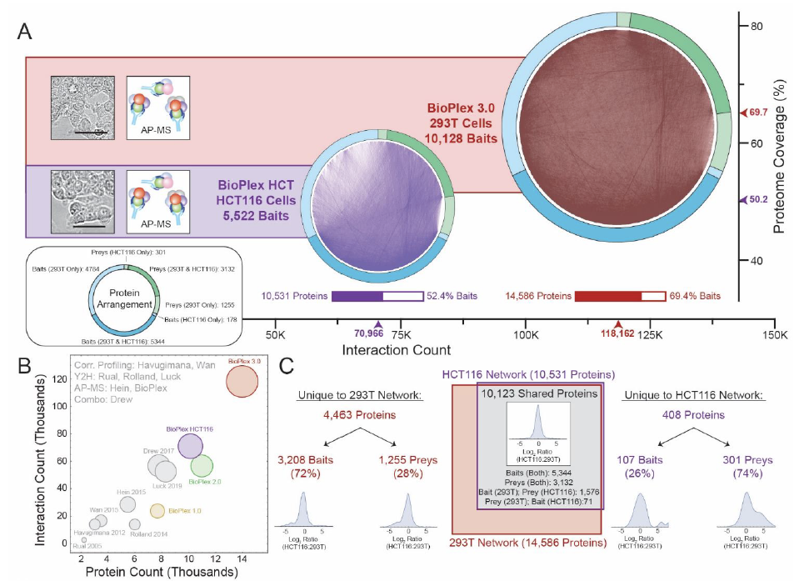
Bioplex 3.0 (293T cells vs HCT116 cells)

Slide 8
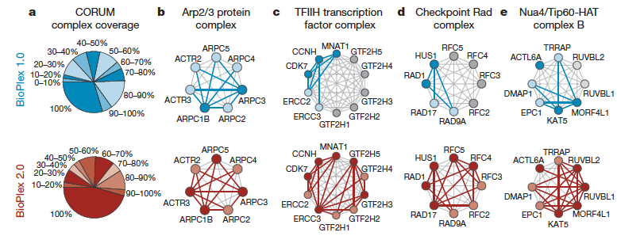
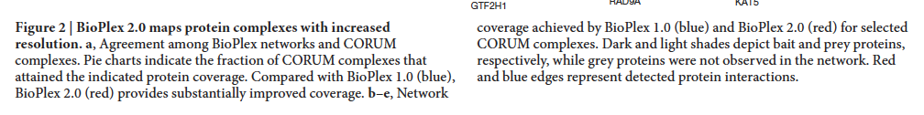
Agreement with CORUM protein complexes

Slide 9
Data resources
BioPlex PPI networks (293T & HCT116)
CORUM protein complexes
PFAM protein domains
Transcriptome data (293T & HCT116)
Proteome data (293T & HCT11
BioPlex – Bioconductor Package (https://bioconductor.org/packages/release/bioc/html/BioPlex.html )
https://ccb-hms.github.io/BioPlexAnalysis/articles/BioNet.html
https://github.com/ccb-hms/BioPlex
https://ccb-hms.github.io/BioPlex/articles/BioPlex.html

Slide 10
BioPlex PPI networks (Huttlin et al., Cell, 2021)
293T cells:
Versions: 1.0, 2.0, 3.0
120k interactions, 15k proteins
HCT116 cells:
Versions: 1.0
70k interactions, 10k proteins
data.frame, graphNEL
Challenge: GraphFrames backend

Slide 11
Transcriptome data
293T cells:
GSE122425 (Sun et al., Epigenomics, 2019)
3 WT samples & 3 NSUN2-KO samples
Raw RNA-seq read counts and RPKMs
HCT116 cells:
Genentech (Klijn et al., Nat Biotechnol, 2015)
675 cancer cell lines (incl. HCT116); raw read counts
Cancer Cell Line Encyclopedia (CCLE, Ghandi et al. Nature, 2019)
934 cancer cell lines (incl. HCT116); raw read counts
Alignment / splicing → challenge / project

Slide 12
Proteome data
HCT116 cells:
Cancer Cell Line Encyclopedia (CCLE, Nusinov et al., Cell, 2020)
375 cancer cell lines (incl HCT116)
Normalized log2 expression levels of 12,755 proteins (MS)
293T cells & HCT116 cells:
Part of BioPlex 3.0 (Huttlin et al., Cell, 2021)
5 samples each for both cell lines
Relative abundance of 9,604 proteins (sums to 1 across samples)
Challenge: transcriptome/proteome data integration

Slide 13
Data checks
Extract BioPlex PPIs for a CORUM complex
Identify interacting PFAM domains
Expressed genes showing up as prey
Relationship: prey frequency vs. prey expression
…
https://ccb-hms.github.io/BioPlex/articles/BasicChecks.html

Slide 14
Applications
Maximum scoring subnetwork analysis
PFAM domain-domain association analysis
Transcriptome / proteome data integration (Challenge)
https://github.com/ccb-hms/BioPlexAnalysis

Slide 15
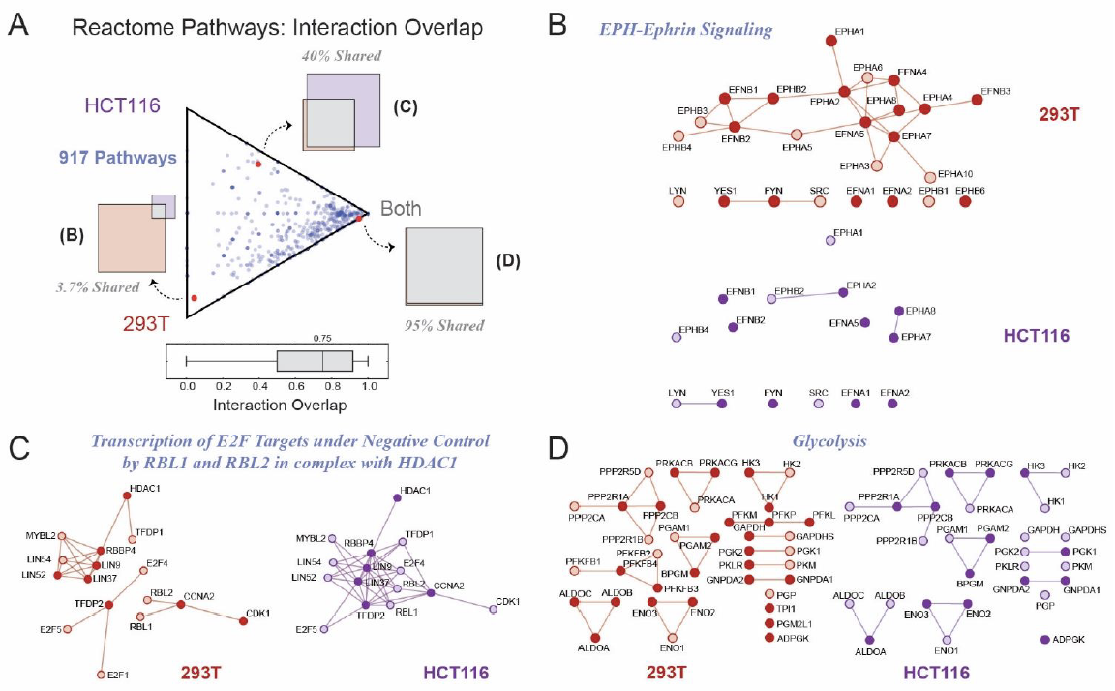
Overlap with gene set DBs (GO, Reactome, DisGeNET, …)

Slide 16
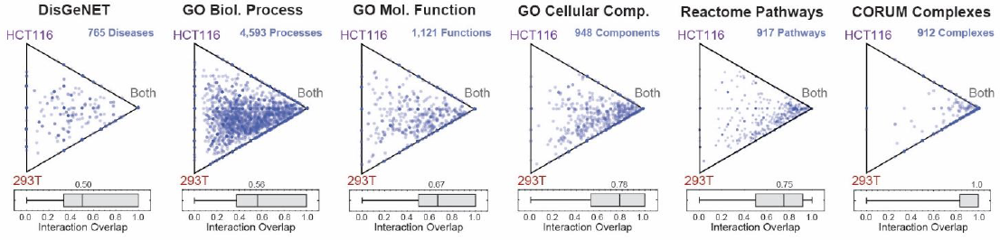
Overlap with gene set DBs (GO, Reactome, DisGeNET, …)
Less
preserved
More
preserved

