Slide 1

High-throughout sequencing and using short-read aligners
Simon Anders

Slide 2
High-throughput sequencing (HTS)
Sequencing millions of short DNA fragments in parallel.
a.k.a.: next-generation sequencing (NGS)
massively-parallel sequencing (MPS)
Market leader: Illumina (“HiSeq” instruments)

Slide 3
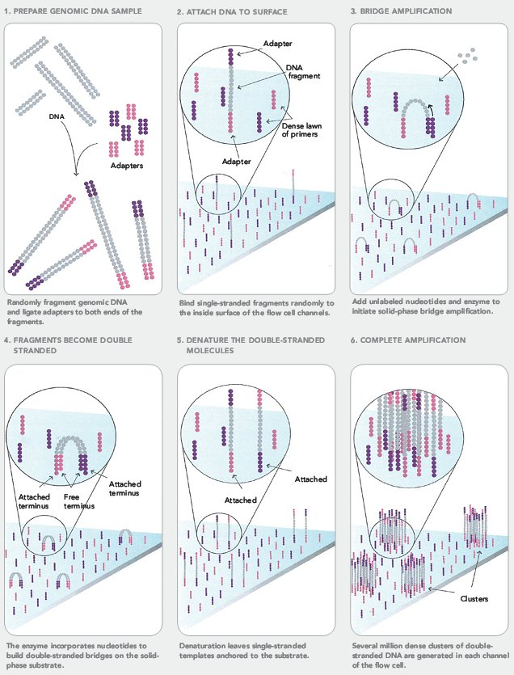
Illumina’s sequencing technology
Bridge PCR
Sequencing-by- synthesis

Slide 4
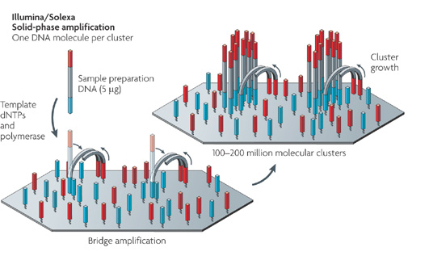
Bridge PCR
ML Metzker, Nat Rev Genetics (2010)

Slide 5
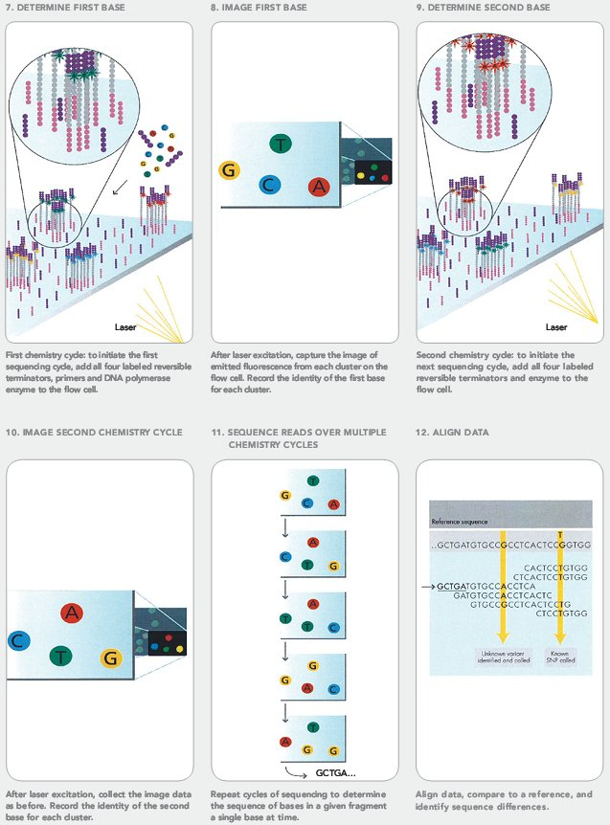
Illumina’s sequencing technology
Bridge PCR
Sequencing-by- synthesis

Slide 6
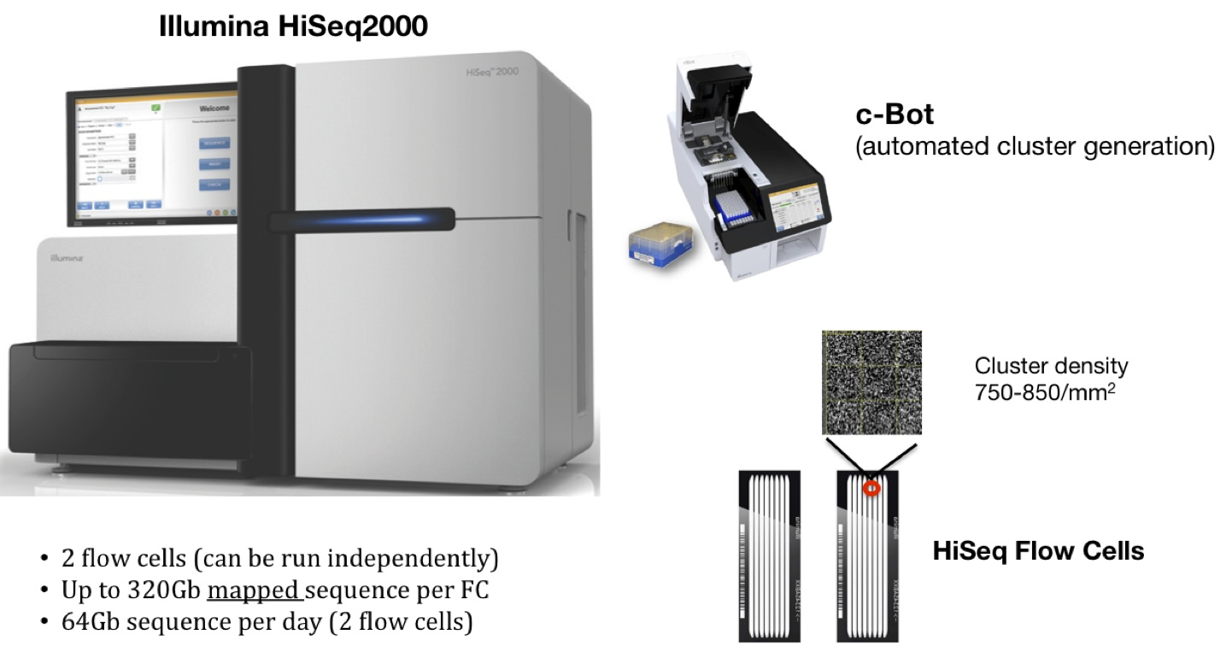
Illunia HiSeq instrument

Slide 7
Illumina HiSeq -- typical numbers
1 or 2 flow cells, each with 8 lanes
up to ~ 200 M clusters per lane
max 2x 150 bp read length
350 GB per flow cell and run
3 d per run (23 h in “rapid mode”)
price per instrument: ~ €500k
reagent costs per run: ~ €10k

Slide 8
HTS: Application
de-novo sequencing
resequencing, variant calling (whole genome or targeted)
RNA-Seq
ChIP-Seq and other enrichment assays
barcodes (tagged mutation collections)
and many more …

Slide 9
Short reads and longer reads
Illumina:
maximum fragment length: 1 .. 2 kb
maximum read length: 150 .. 200 bp (x2)
Not really enough for
calling structural variants
assembling genomes
phasing SNPs

Slide 10
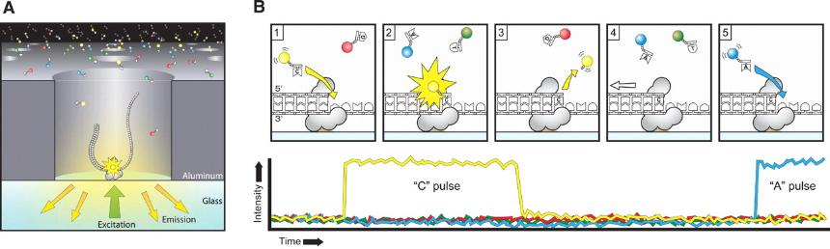
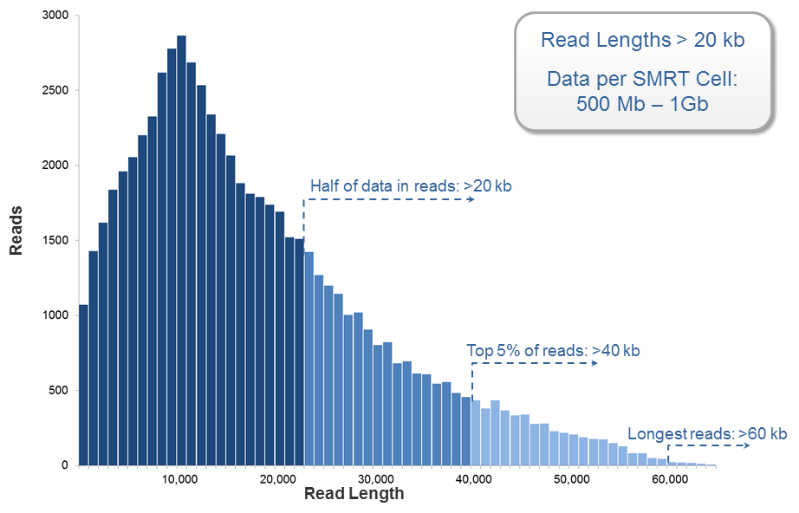
Short reads and longer reads
Pacific Biosystems: SMRT sequencing

Slide 11
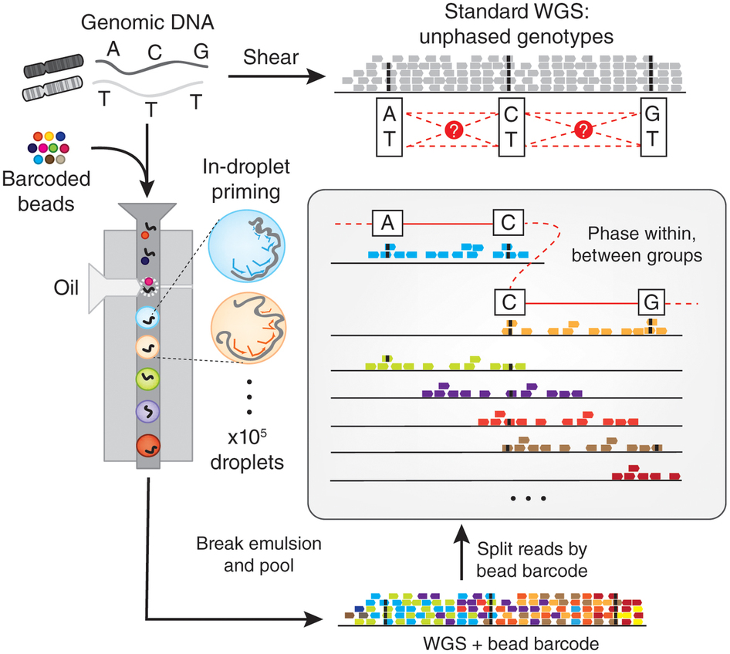
Droplet-based sequencing
10X Genomics

Slide 12
Next hot topic: Single-cell sequencing
Each read gets barcoded to indicate which cell it came from,
by clever use of microfluidics.

Slide 13
Practical part: Getting started with raw sequencing data

Slide 14
Raw sequencing data: FASTQ files
@HWI-ST1177:156:C38WNACXX:6:1101:8512:2169 1:N:0:GAGTGG
CTCCTTTGTGTGCTTGGAATGTGAAGAATTTAGNAGACAATCCTAGACTGTTGCAGTGTTGGGGGATCCTTGTTTGAATTGGGGACACAATGCAGCCGGCT
+
CCCFFFFFHHHHHIJJJHIGIHIJJJJJJJJIJ#1?FHIJIJJJJJJJJJIJJJJJIIIGGIIJIHFFFFDEEEEEDDDEDDBDDDDDDDDDCDDCDBDD>
@HWI-ST1177:156:C38WNACXX:6:1101:8567:2179 1:N:0:GAGTGG
TGGGTAAGAAAAGTCAAAACACTAATGAGTTGTCCATGAAGCCAACTGCTAAGAACGCGCTCAACTATACGCGACATGAAGACACTATGCACGAAGCCTTA
+
BCCFDEFFHHHHHHIIJJJJJJJJJJJJJHIJJJJJJJJJJJJIJJJJIJJIJJJJJIJJJJHHHHFFFFFDDDDBBDDDDDDDDDDDDDEDBDBDDDDD>
@HWI-ST1177:156:C38WNACXX:6:1101:8677:2194 1:N:0:GAGTGG
TGTGGTTGTTCCTGGGGCCTCCAGCTAGCACAGCTGGCTCAGCCTGGGCAGTTCTCAGCAGGAGCGTGAGCTGCAGAGTTGCGCAGGTGAAGAGCGAGGAG
+
CCBFFFFFHHHHHJJJJIJJJJJJJJJJJJJJJJJJJJIJJJJJJIJJJJJHJJJJGIJJJHHHHFDDDDDDDDDACD@DDDDDDDD?CDDDDDDDDDDDD
@HWI-ST1177:156:C38WNACXX:6:1101:8552:2194 1:N:0:GAGTGG
CGCTCTGCTGGACCTGCTGGGCCATCATCCTGCTGATCCCCATGAGGCTCTCAGTGATGGTACTGGATGTCTGGGCCAGGCTCTCTTTGGTGGTTTTCCTT
+
CCCFFFFFHHHHHJJJJJJJJIJIJJJJJJJJJJJJIJJJJIJJJJJJJJJJJJIIJJJJIIJJJJGIJJHGEFHFFFFDDECDDDDDCCBDD88ABDDDD
@HWI-ST1177:156:C38WNACXX:6:1101:8746:2209 1:N:0:GAGTGG
CTTTGGTCAGTGAACAGACACGGGTGAATGCTGCTAAAAACAAGACTGGGGCTGCTCCCATCATTGATGTGGTGCGATCGGGCTACTATAAAGTTCTGGGA
+
CCCFFFFFHHHHHJJJJJJJJHJIFHGJJJJJIJJJJJJIIJIJJJJJIIJJIJJJJJHGHHF@BDDFFDEECBE>@DDDDDDDDDDCECDEDACDDCDDD
@HWI-ST1177:156:C38WNACXX:6:1101:8685:2212 1:N:0:GAGTGG
CAGCAGCTTCCTCTTCCTCTGTCTCTTTTCCAGGTCGATATCCCCAGCCCCTGAAGTGGGCCCTCTGGTCCGGGTGGGAGGGATGTGGGTCTGACTCAGCT
+
CCCFFFFFHHHHHJJJJIJIJHHIJJJJJIJJIJGGHIJJJIJJIJJIIJJJJHJIHGHHIEHGHHHHCEFFDD39?B@BDD@DDCDDD<CDDDDDDDDCD
@HWI-ST1177:156:C38WNACXX:6:1101:8630:2227 1:N:0:GAGTGG
GCTTTATCTTGCTAAAGACAATTTTTCAAGCAATCCTTTAGTTTTAGTTTTCTGGAATAGCTAGTATTGGGTTTTCTAGTTTTTTCACCTTTTAGTTTTTA
+
CCCFFFFFHHHHHJJJJJJJJJIJJJJJJJJIJJJJJJJIJIJJJIJHIJJJIJJGIJJJJJJJCGHHIIJ@FHIEHIJ?HHHHFEAEAEEDDDD@ADDD?
@HWI-ST1177:156:C38WNACXX:6:1101:8792:2186 1:N:0:GAGTGG
GTCTGGCATTCCATGTTTCTGCTCCTGTGGCCTCCACGGTGCAACAAGCTAGCGGTTTACTTGGACCTCTGCCTCATCTTTCTTCTTTTGCGCTTCAGCCT
+
CCCFFFFFHHHHHJJJIJGIIIJJJJJHJIIJJJJJJJJHGJJJJJJJGGIJJJJ@GHGIJJHECHHGFDFFFEEEEEEDDDD35;CD@::/'80&(+>3A
@HWI-ST1177:156:C38WNACXX:6:1101:8932:2202 1:N:0:GAGTGG
CCCGCATGTTCTCCTCACACAGTGCGCCCTCCTTGGTGGCCCACTGGAAGCCGGCCACCACACTGTCCTTGATCTCGTTGAGGTACTGCACACCCTTGGTG
+
CCCFFFFFHHHHHJJJJJJJIJIJJJJJJJJJJJJJDHIIJJJJGIJIJJGIJHHFFAEADDDDDDDDDDDDCDECDDDDDDCCDDDDDDDDDBDDCDCCB
@HWI-ST1177:156:C38WNACXX:6:1101:8805:2221 1:N:0:GAGTGG
GCCTCAAGCAGCGTGGTTCCACTGGCATTGCCATCCTTACGGGTGACTTTCCATCCCTTGAACCAAGGCATGTTAGCACTTGGCTCCAGCATGTTGTCACC
+
CCCFFFFFHHHHHJJJIJJJIJJJJIJJIIIJJIJJIEHIIIIGHEHGIJGIIIJDIAAGECEEF=DEFBEEEEEEDDDDDDDDCDDDDDDCDACCDCDD:
@HWI-ST1177:156:C38WNACXX:6:1101:9005:2191 1:N:0:GAGTGG
ATCAATATTTACTCTTGGCTCAAGGTCAATTTCATGATCTTAAGCAACTTTTCATGTCTGCAAATAATAATTTCACTCCCTCCAACAATTCCTCTTCAGAA
+
BCCFFFFFHHHHHJJ?GHIJJJJJJFHGIIJJIJIJGHJJJJJJJJJJJJJJIJJJIJJJJIEIJJIIJJJJJJJJIJJJIJIHHHGFFFFFFFEEEDECC
@HWI-ST1177:156:C38WNACXX:6:1101:9241:2240 1:N:0:GAGTGG
GAATTACCTCCCCAGCCAGGAGGATATGCCTCATAACCAGTTCATCAAGATGATGATCATCTTTTCCATCGCCTTCATCACTGTCCTTATCTTCAAGGTCT
+
CCCFFFFFHHHHHIJJJIJJGIJIIJJJJJJJJJJJJJJJJHIJJJIIIJIJJJJJJIJJIJJJJHHEHIIIGHFFFFFFEDEEEECDDDDDFEDCDDCDC
@HWI-ST1177:156:C38WNACXX:6:1101:9337:2170 1:N:0:GAGTGG
CAGGTGTTTGAGTGCGCCGTCCGAACTGCCGTCNACCAGGCCAGGAGACGAAACAGAAGGAGGCTCTTCTCCATCAATGAGTGCAAGATCTTCTAAACCCC
+
@@@DADEFHHHHFIJIIJGIJJIGHIIIJIGHG#-<CDGDIGIGGFHHHFFDDDCCDC?BDBDDDDDDDDDDDDDDCDDDD>@CCDCDDDDDDDDED?<?9
@HWI-ST1177:156:C38WNACXX:6:1101:9381:2185 1:N:0:GAGTGG
CTGGGTGGGGCCCGTGACGAGCTCGGGGGCCGCAGTGGCCCGGAGGCCGAGGGCCTGGGCTCAGAGACTAGCCCCACAGTGGATGACGAGGAGGAGATGCT
+
CCCFFDDFHHHHHJJJIJJJJJJIJJJJFDDDDDDBDDDDDDDBDDDDDDDDDDDDDDDDDDDDDDDDDDDDDDDDBBBCDCCDDDDDDDDBDD@DACCCC
@HWI-ST1177:156:C38WNACXX:6:1101:9285:2186 1:N:0:GAGTGG
CTGAAAGCAGGGTCGATGATTAAAAGCTGATGTTCCTAACTAGTCTTTTATGGACTGCCAGCCATGGTATGCTCTCAAATTCTTCTGATGTGATTAAAATC
+
CCCFFFFFHHHHFHIIJJJJJJJJJJJJJJJJJJJJJJJJJJJIJJJJJJJJIIIJJJJJIHJJIJJDEGHHHHHGFFFFFFEEEEEEEDEDEEEECDDEC

Slide 15
@HWI-ST1177:156:C38WNACXX:6:1101:8512:2169 1:N:0:GAGTGG
CTCCTTTGTGTGCTTGGAATGTGAAGAATTTAGNAGACAATCCTAGACTGTTGCAGTGTTGGGGGATCCTTGTTTGAATTGGGGACACAATGCAGCCGGCT
+
CCCFFFFFHHHHHIJJJHIGIHIJJJJJJJJIJ#1?FHIJIJJJJJJJJJIJJJJJIIIGGIIJIHFFFFDEEEEEDDDEDDBDDDDDDDDDCDDCDBDD>
@HWI-ST1177:156:C38WNACXX:6:1101:8567:2179 1:N:0:GAGTGG
TGGGTAAGAAAAGTCAAAACACTAATGAGTTGTCCATGAAGCCAACTGCTAAGAACGCGCTCAACTATACGCGACATGAAGACACTATGCACGAAGCCTTA
+
BCCFDEFFHHHHHHIIJJJJJJJJJJJJJHIJJJJJJJJJJJJIJJJJIJJIJJJJJIJJJJHHHHFFFFFDDDDBBDDDDDDDDDDDDDEDBDBDDDDD>
@HWI-ST1177:156:C38WNACXX:6:1101:8677:2194 1:N:0:GAGTGG
TGTGGTTGTTCCTGGGGCCTCCAGCTAGCACAGCTGGCTCAGCCTGGGCAGTTCTCAGCAGGAGCGTGAGCTGCAGAGTTGCGCAGGTGAAGAGCGAGGAG
+
CCBFFFFFHHHHHJJJJIJJJJJJJJJJJJJJJJJJJJIJJJJJJIJJJJJHJJJJGIJJJHHHHFDDDDDDDDDACD@DDDDDDDD?CDDDDDDDDDDDD
@HWI-ST1177:156:C38WNACXX:6:1101:8552:2194 1:N:0:GAGTGG
CGCTCTGCTGGACCTGCTGGGCCATCATCCTGCTGATCCCCATGAGGCTCTCAGTGATGGTACTGGATGTCTGGGCCAGGCTCTCTTTGGTGGTTTTCCTT
+
CCCFFFFFHHHHHJJJJJJJJIJIJJJJJJJJJJJJIJJJJIJJJJJJJJJJJJIIJJJJIIJJJJGIJJHGEFHFFFFDDECDDDDDCCBDD88ABDDDD
@HWI-ST1177:156:C38WNACXX:6:1101:8746:2209 1:N:0:GAGTGG
CTTTGGTCAGTGAACAGACACGGGTGAATGCTGCTAAAAACAAGACTGGGGCTGCTCCCATCATTGATGTGGTGCGATCGGGCTACTATAAAGTTCTGGGA
+
CCCFFFFFHHHHHJJJJJJJJHJIFHGJJJJJIJJJJJJIIJIJJJJJIIJJIJJJJJHGHHF@BDDFFDEECBE>@DDDDDDDDDDCECDEDACDDCDDD
@HWI-ST1177:156:C38WNACXX:6:1101:8685:2212 1:N:0:GAGTGG
CAGCAGCTTCCTCTTCCTCTGTCTCTTTTCCAGGTCGATATCCCCAGCCCCTGAAGTGGGCCCTCTGGTCCGGGTGGGAGGGATGTGGGTCTGACTCAGCT
+
CCCFFFFFHHHHHJJJJIJIJHHIJJJJJIJJIJGGHIJJJIJJIJJIIJJJJHJIHGHHIEHGHHHHCEFFDD39?B@BDD@DDCDDD<CDDDDDDDDCD
@HWI-ST1177:156:C38WNACXX:6:1101:8630:2227 1:N:0:GAGTGG
GCTTTATCTTGCTAAAGACAATTTTTCAAGCAATCCTTTAGTTTTAGTTTTCTGGAATAGCTAGTATTGGGTTTTCTAGTTTTTTCACCTTTTAGTTTTTA
+
CCCFFFFFHHHHHJJJJJJJJJIJJJJJJJJIJJJJJJJIJIJJJIJHIJJJIJJGIJJJJJJJCGHHIIJ@FHIEHIJ?HHHHFEAEAEEDDDD@ADDD?
@HWI-ST1177:156:C38WNACXX:6:1101:8792:2186 1:N:0:GAGTGG
GTCTGGCATTCCATGTTTCTGCTCCTGTGGCCTCCACGGTGCAACAAGCTAGCGGTTTACTTGGACCTCTGCCTCATCTTTCTTCTTTTGCGCTTCAGCCT
+
CCCFFFFFHHHHHJJJIJGIIIJJJJJHJIIJJJJJJJJHGJJJJJJJGGIJJJJ@GHGIJJHECHHGFDFFFEEEEEEDDDD35;CD@::/'80&(+>3A
@HWI-ST1177:156:C38WNACXX:6:1101:8932:2202 1:N:0:GAGTGG
CCCGCATGTTCTCCTCACACAGTGCGCCCTCCTTGGTGGCCCACTGGAAGCCGGCCACCACACTGTCCTTGATCTCGTTGAGGTACTGCACACCCTTGGTG
+
CCCFFFFFHHHHHJJJJJJJIJIJJJJJJJJJJJJJDHIIJJJJGIJIJJGIJHHFFAEADDDDDDDDDDDDCDECDDDDDDCCDDDDDDDDDBDDCDCCB
@HWI-ST1177:156:C38WNACXX:6:1101:8805:2221 1:N:0:GAGTGG
GCCTCAAGCAGCGTGGTTCCACTGGCATTGCCATCCTTACGGGTGACTTTCCATCCCTTGAACCAAGGCATGTTAGCACTTGGCTCCAGCATGTTGTCACC
+
CCCFFFFFHHHHHJJJIJJJIJJJJIJJIIIJJIJJIEHIIIIGHEHGIJGIIIJDIAAGECEEF=DEFBEEEEEEDDDDDDDDCDDDDDDCDACCDCDD:
@HWI-ST1177:156:C38WNACXX:6:1101:9005:2191 1:N:0:GAGTGG
ATCAATATTTACTCTTGGCTCAAGGTCAATTTCATGATCTTAAGCAACTTTTCATGTCTGCAAATAATAATTTCACTCCCTCCAACAATTCCTCTTCAGAA
+
BCCFFFFFHHHHHJJ?GHIJJJJJJFHGIIJJIJIJGHJJJJJJJJJJJJJJIJJJIJJJJIEIJJIIJJJJJJJJIJJJIJIHHHGFFFFFFFEEEDECC
@HWI-ST1177:156:C38WNACXX:6:1101:9241:2240 1:N:0:GAGTGG
GAATTACCTCCCCAGCCAGGAGGATATGCCTCATAACCAGTTCATCAAGATGATGATCATCTTTTCCATCGCCTTCATCACTGTCCTTATCTTCAAGGTCT
+
CCCFFFFFHHHHHIJJJIJJGIJIIJJJJJJJJJJJJJJJJHIJJJIIIJIJJJJJJIJJIJJJJHHEHIIIGHFFFFFFEDEEEECDDDDDFEDCDDCDC
@HWI-ST1177:156:C38WNACXX:6:1101:9337:2170 1:N:0:GAGTGG
CAGGTGTTTGAGTGCGCCGTCCGAACTGCCGTCNACCAGGCCAGGAGACGAAACAGAAGGAGGCTCTTCTCCATCAATGAGTGCAAGATCTTCTAAACCCC
+
@@@DADEFHHHHFIJIIJGIJJIGHIIIJIGHG#-<CDGDIGIGGFHHHFFDDDCCDC?BDBDDDDDDDDDDDDDDCDDDD>@CCDCDDDDDDDDED?<?9
@HWI-ST1177:156:C38WNACXX:6:1101:9381:2185 1:N:0:GAGTGG
CTGGGTGGGGCCCGTGACGAGCTCGGGGGCCGCAGTGGCCCGGAGGCCGAGGGCCTGGGCTCAGAGACTAGCCCCACAGTGGATGACGAGGAGGAGATGCT
+
CCCFFDDFHHHHHJJJIJJJJJJIJJJJFDDDDDDBDDDDDDDBDDDDDDDDDDDDDDDDDDDDDDDDDDDDDDDDBBBCDCCDDDDDDDDBDD@DACCCC
@HWI-ST1177:156:C38WNACXX:6:1101:9285:2186 1:N:0:GAGTGG
CTGAAAGCAGGGTCGATGATTAAAAGCTGATGTTCCTAACTAGTCTTTTATGGACTGCCAGCCATGGTATGCTCTCAAATTCTTCTGATGTGATTAAAATC
+
CCCFFFFFHHHHFHIIJJJJJJJJJJJJJJJJJJJJJJJJJJJIJJJJJJJJIIIJJJJJIHJJIJJDEGHHHHHGFFFFFFEEEEEEEDEDEEEECDDEC

Slide 16
FASTQ format
Each read is represented by four lines:
'@', followed by read ID
sequence
'+', optionally followed by repeated read ID
quality string:
same length as sequence
each character encodes the base-call quality of one base

Slide 17
FASTQ quality scores
quality score Q | error prob. p | characters
0 .. 9 | 1 .. 0.13 | !”#$%&'()*
10 .. 19 | 0.1 .. 0.013 | +,-./01234
20 .. 29 | 0.01 .. 0.0013 | 56789:;<=>
30 .. 39 | 0.001 .. 0.00013 | ?@ABCDEFGH
40 .. 40 | 0.0001 .. 0.000013 | I
Q = –10 log₁₀ p

Slide 18
FASTQ files for paired end
Simple: two FASTQ files,
one with all first reads, one with all second reads
Read names and ordering must match.

Slide 19
Alignment
Given a reference genome, where did each read come from?
A short-read aligner finds for each read all possible matches in the reference genome.
Reference (FASTA)
Index
Aligner
Reads (FASTQ)
Alignments (SAM)

Slide 20
Popular aligners
For genomic DNA
Bowtie2
BWA
…
For RNA
Tophat2
GSNAP
STAR
…

Slide 21
Spliced alignment
exon
intron
exon
read
For RNA-Seq data, we need a splice-aware aligner.

Slide 22
Criteria to choose an aligner
Reputation
Publication year
Still developed and maintained?
Speed and memory requirements
Sensitivity
Special functions
(e.g., bisulfite mapping, fusion gene detection, multiple references, etc.)

Slide 23
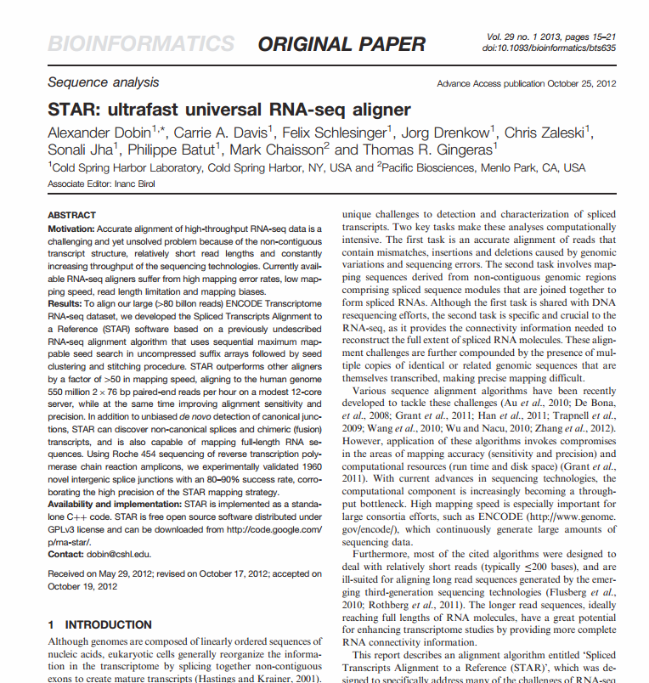
Example: Aligning RNA-Seq data with STAR

Slide 24
Using STAR: Creating the index
We need
a FASTA file with the human reference genome sequence
e.g., from Ensembl
a GTF file with gene models
e.g., from Ensembl
the STAR software:
from github.com/alexdobin/STAR

Slide 25
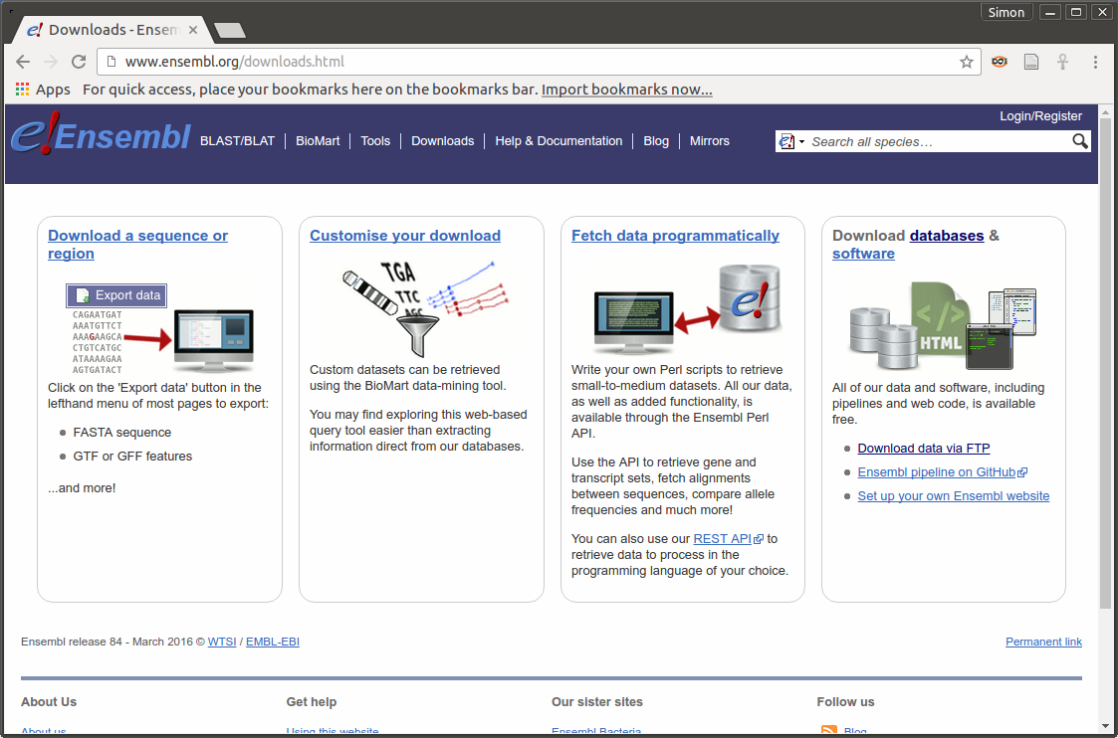

Slide 26
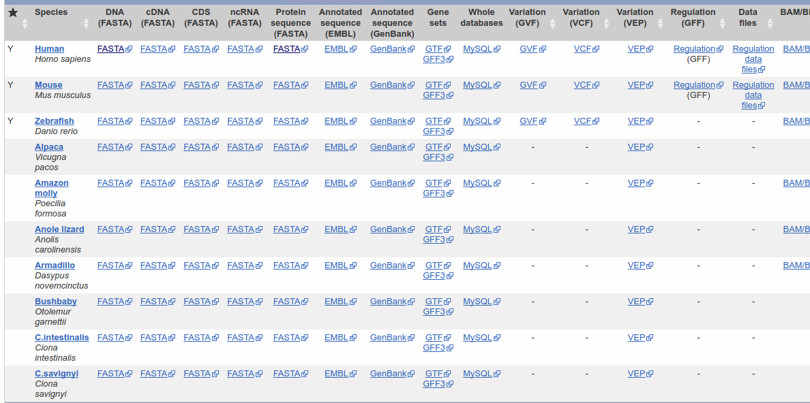
Ensembl FTP download server

Slide 27
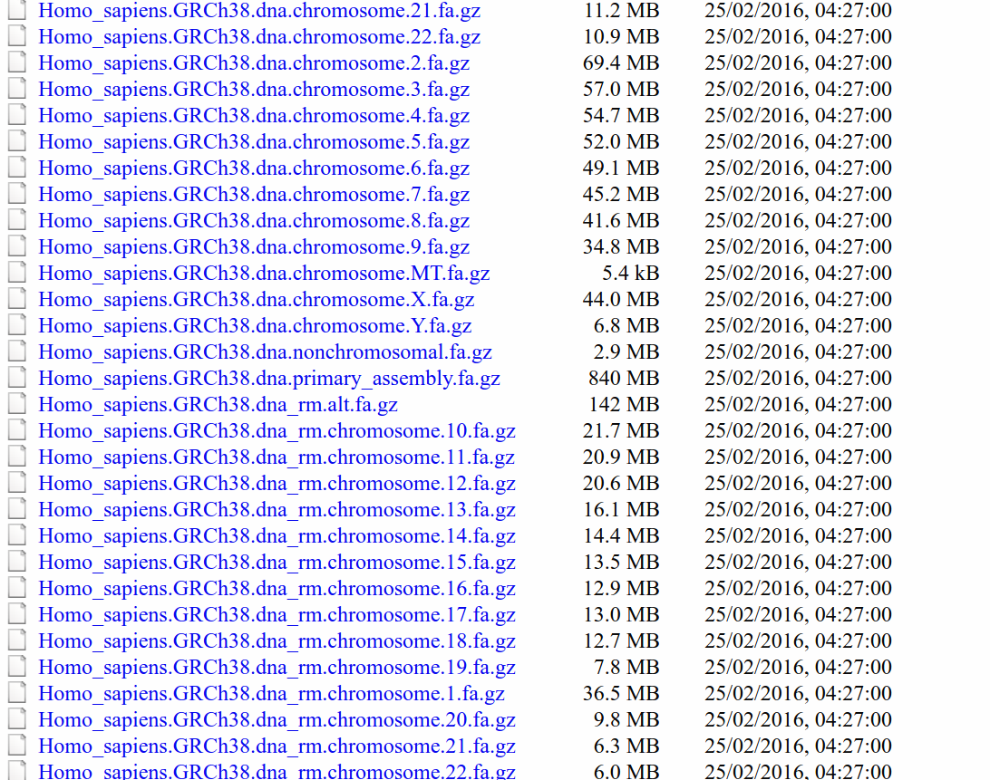
Ensembl genome reference sequence

Slide 28
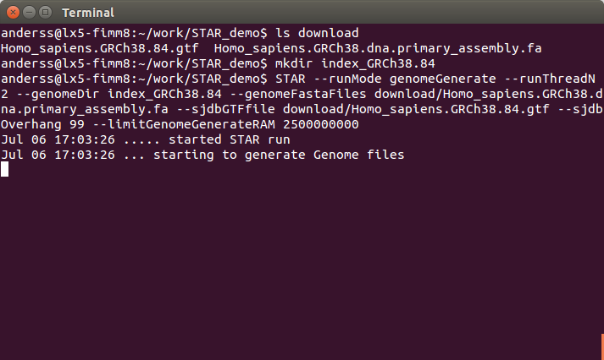
STAR: Generate genome index

Slide 29
STAR: Generate genome index
STAR \ --runMode genomeGenerate \ --runThreadN 2 \ --genomeDir index_GRCh38.84 \ --genomeFastaFiles download/Homo_sapiens.GRCh38.\ dna.primary_assembly.fa \ --sjdbGTFfile download/Homo_sapiens.GRCh38.84.gtf

Slide 30
STAR: Align the reads
STAR \
--runThreadN 2 \
--genomeDir index_GRCh38.84 \
--readFilesIn sample1_1.fastq \ sample1_2.fastq \
--outFileNamePrefix sample1_ \
--outSAMtype BAM SortedByCoordinate
and maybe:
--quantMode GeneCounts

Slide 31
STAR: output
Created files:
size file name
34M sample1_Aligned.sortedByCoord.out.bam
4.0K sample1_Log.final.out
16K sample1_Log.out
4.0K sample1_Log.progress.out
20K sample1_ReadsPerGene.out.tab
72K sample1_SJ.out.tab

Slide 32
Alignment output: SAM files
Part of a SAM file:
Header
(lines start with @)
command line
chromosome names
etc
Alignments
tab-separated table, at least 11 columns
one line per alignment

Slide 33
SAM alignment section
[...]
HWI-EAS225_309MTAAXX:5:1:689:1485 0 XIII 863564 25 36M * 0 0 GAAATATATACGTTTTTATCTATGTTACGTTATATA CCCCCCCCCCCCCCCCCCCCCCC4CCCB4CA?AAA< NM:i:0 X0:i:1 MD:Z:36
HWI-EAS225_309MTAAXX:5:1:689:1485 16 XIII 863766 25 36M * 0 0 CTACAATTTTGCACATCAAAAAAGACCTCCAACTAC =8A=AA784A9AA5AAAAAAAAAAA=AAAAAAAAAA NM:i:0 X0:i:1 MD:Z:36
HWI-EAS225_309MTAAXX:5:1:394:1171 0 XII 525532 25 36M * 0 0 GTTTACGGCGTTGCAAGAGGCCTACACGGGCTCATT CCCCCCCCCCCCCCCCCCCCC?CCACCACA7?<??? NM:i:0 X0:i:1 MD:Z:36
HWI-EAS225_309MTAAXX:5:1:394:1171 16 XII 525689 25 36M * 0 0 GCTGTTATTTCTCCACAGTCTGGCAAAAAAAAGAAA 7AAAAAA?AA<AA?AAAAA5AAA<AAAAAAAAAAAA NM:i:0 X0:i:1 MD:Z:36
HWI-EAS225_309MTAAXX:5:1:393:671 0 XV 440012 25 36M * 0 0 TTTGGTGATTTTCCCGTCTTTATAATCTCGGATAAA AAAAAAAAAAAAAAA<AAAAAAAA<AAAA5<AAAA3 NM:i:0 X0:i:1 MD:Z:36
HWI-EAS225_309MTAAXX:5:1:393:671 16 XV 440188 25 36M * 0 0 TCATAGATTCCATATGAGTATAGTTACCCCATAGCC ?9A?A?CC?<ACCCCCCCCCCCCCCCCCACCCCCCC NM:i:0 X0:i:1 MD:Z:36
[...]

Slide 34
Columns in a SAM file
QNAME ID of the read (“query”)
FLAG alignment flags
RNAME ID of the reference (typically: chromosome name)
POS Position in reference (1-based, left side)
MAPQ Mapping quality (as Phred score)
CIGAR Alignment description (gaps etc.) in CIGAR format
RNEXT Mate reference sequence name
PNEXT Mate position
ISIZE inferred insert size
SEQ sequence of the read
QUAL quality string of the read
extra fields
for paired- end data

Slide 35
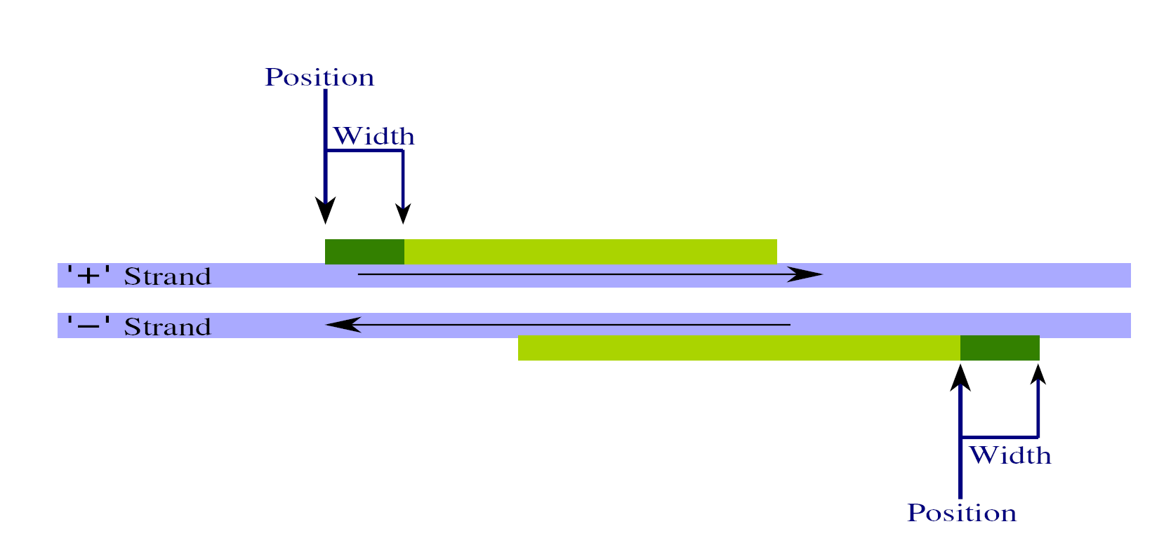
Reads and fragments

Slide 36
SAM format: FLAG field
bit | hex | decimal
0 | 00 01 | 1 | read is a paired-end read
1 | 00 02 | 2 | read pair is properly matched
2 | 00 04 | 4 | read has not been mapped
3 | 00 08 | 8 | mate has not been mapped
4 | 00 10 | 16 | read has been mapped to “-” strand
5 | 00 20 | 32 | mate has been mapped to “-” strand
6 | 00 40 | 64 | read is the first read in a pair
7 | 00 80 | 128 | read is the second read in a pair
8 | 01 00 | 256 | alignment is secondary
9 | 02 00 | 512 | read did had not passed quality check
10 | 04 00 | 1024 | read is a PCR or optical duplicate

Slide 37
SAM format: Optional fields
last column
triples of the format TAG : VTYPE : VALUE
some important tag types:
NH: number of reported aligments
NM: number of mismatches
MD: positions of mismatches

Slide 38
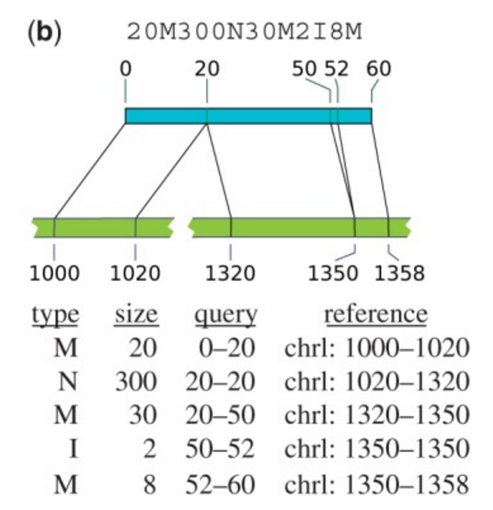
SAM format: CIGAR string

Slide 39
SAM format: Paired-end and multiple alignments
Each line is one alignment for one read.
Multiple alignments for a read take several lines
The Read ID groups them.
Paired-end alignments take two lines.
All these lines are not necessarily in adjacent lines!

Slide 40
SAM and BAM
Text SAM files (“.sam”): human readable
Binary SAM files (“.bam”): smaller, quicker to read
Use samtools for conversion.

Slide 41
SAMtools
A small program to
convert between .bam and .sam
sort and merge SAM files
index SAM and FASTA files for fast access
calculate tallies (“flagstat”)
…
The SAMtools C API is a library for tool development.

Slide 42
Visually inspecting SAM files
Look at all your big files!
Learn to use text views and graphical tools.
For SAM, use e.g. the Integrated Genome Viewer (IGV).

Slide 43
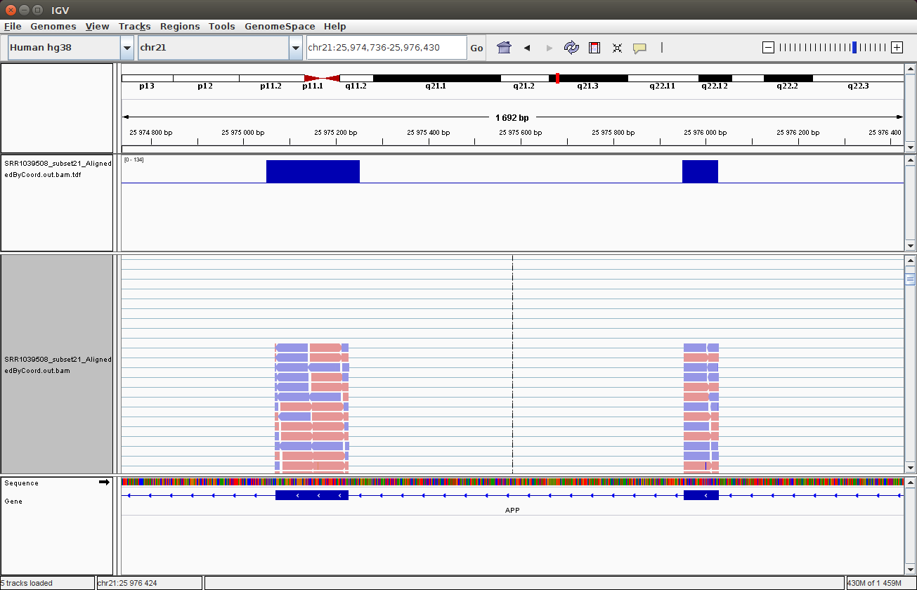
IGV

Slide 44
Aligning multiple files
Sample table:
Library_ID Cell_line Treatment
1 SRR1039508 N61311 none
2 SRR1039509 N61311 dexa
3 SRR1039512 N052611 none
4 SRR1039513 N052611 dexa
5 SRR1039516 N080611 none
6 SRR1039517 N080611 dexa
7 SRR1039520 N061011 none
8 SRR1039521 N061011 dexa

Slide 45
Generating multiple alignment commands with R
sample_table <- read.csv( "reads/sample_table.csv" )
command <- paste0(
"STAR --runThreadN 2 --genomeDir GRCh38.84 \\\n",
" --readFilesIn reads/###_1.fastq \\\n”,
" reads/###_2.fastq \\\n",
" --outSAMtype BAM SortedByCoordinate \\\n",
" --outFileNamePrefix star_out/###_ \\\n",
" --quantMode GeneCounts\n”,
"\n" )
f <- file( "aligner_commands.sh", open="w" )
for( sampleID in sample_table$Library_ID ) {
cat( gsub( "###", sampleID, command, fixed=TRUE ),
file=f )
}
close( f )

Slide 46
Next step: Using the alignments
RNA-Seq:
What transcripts are there?
Which genes change expression due to treatment?
Mike’s talk and this afternoon’s lab
ChIP-Seq:
Peak finding and comparing
Thursday lab
In general:
The real work starts only now. So far, this was just preparation.

Slide 47
*

