Slide 1


R/Bioconductor for computational biology in drug discovery: lessons learned with
Jitao David Zhang
Roche Pharma Research and Early Development, Pharmaceutical Sciences
Roche Innovation Center Basel. For EuroBioc2016, Basel, Dec 6th, 2016

Slide 2


Computational Biology in Drug Discovery
Areas in which computational biology is needed in modern drug discovery:
Characterising molecular landmarks of diseases
Benchmarking and prioritising disease models
Target assessment
Biomarker identification
Chemo- and toxico-genomics
…
Efficacy
Safety

Slide 3
Our mission in SLICE …and why we benefit from and contribute to Bioconductor
Support drug-discovery projects in a collaborative and dynamic environment
Leverage tools to systematically analyze paramount volume of omics data
Integrate and interpret both external and internal data
Create new ways of improving both safety and efficacy of drugs
Educate and empower scientists to harness the power of bioinformatics
Educate
Support
Create
Leverage
Integrate
Bioconductor provides almost everything that we need, but …
Notes:
How parallel: on average 48 projects per year, or 5 days per project

Slide 4
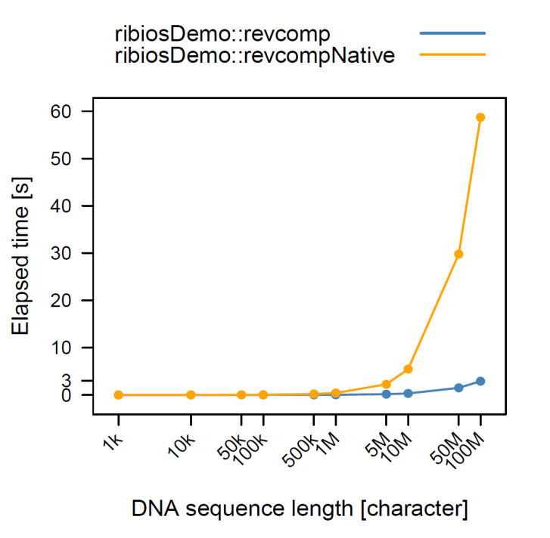
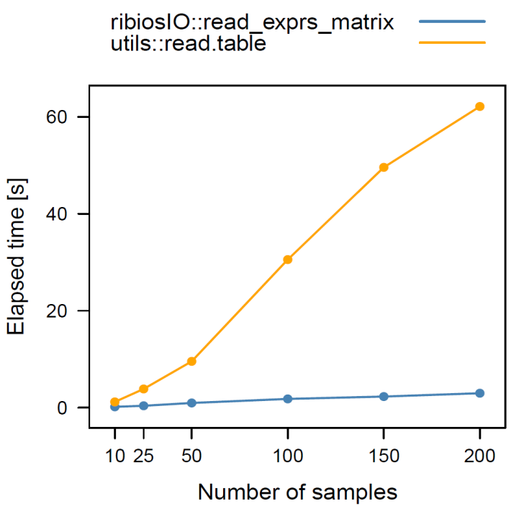

Gaps that we have identified and tried to fill
Customization to local IT infrastructure
Efficient functions/modules for routine tasks
Pipelinability: the feasibility of using R/BioC packages/scripts as modules of software pipelines designed for a specific task (e.g. differential gene expression analysis)
Cluster Nodes
Cluster Head
Pipelines can be like BioC workflows and must have following features:
Applied to data from heterogeneous sources with different qualities
Allowing communication with modules written in other languages
As little human intervention as necessary
Client
Task: reverse complementation of a DNA sequence (e.g. ATGCAA → TTCGAT). X-axis: sequence length. Y-axis: time needed in seconds.
Task: read in gene expression signal matrix (22000 genes X N samples, X-axis) in the gct format into a matrix. Y-axis: time needed in seconds.
ribiosBatchJobs sends batch jobs to a remote cluster head and collects results. Its extends the functionalities in the BatchJobs package.

Slide 5

RiBIOS
BIOS: A C library for bioinformatics created by Clemens Broger and the Roche Bioinformatics Group. Publicly available as BioinfoLib at SourceForge (LGPL).
: A collection of R packages that use BioinfoLib (as well as Rcpp) with customised, efficient, and pipelining functionalities required for computational biology in drug discovery. It contains currently 27 packages and is publicly available at GitHub (GPL).
Three brief examples illustrated today:
ribiosArg: command-line pipelining
ribiosCGI: web-based pipelining
BioQC: An former RiBIOS package (ribiosBioQC) which is now part of Bioconductor. BioQC detects tissue heterogeneity in gene expression data.

Slide 6
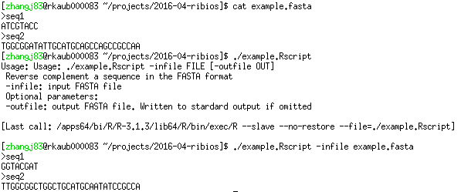
Pipelining on the command-line with ribiosArg
Our goal: A command-line program that reads in sequences in the FASTA format, performs reverse complement translation, and writes the sequences in the FASTA format.

Slide 7
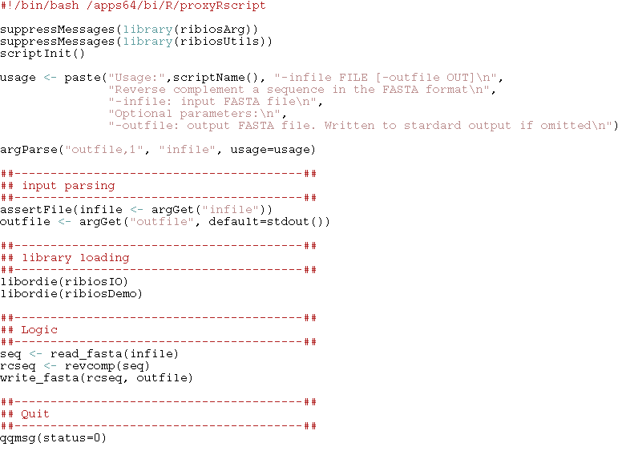
Pipelining on the command-line with ribiosArg: the program in 14 lines
shebang
Preparation
Usage
Parsing
Library loading
Logic
Exit

Slide 8
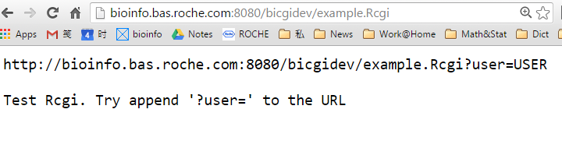
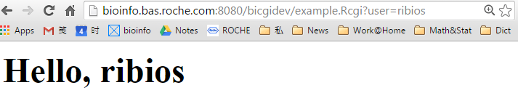
Pipelining over the network with ribiosCGI

Slide 9
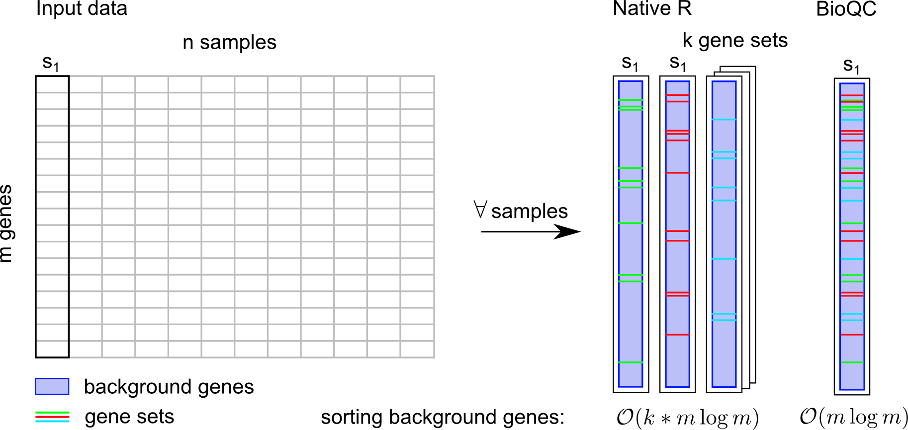
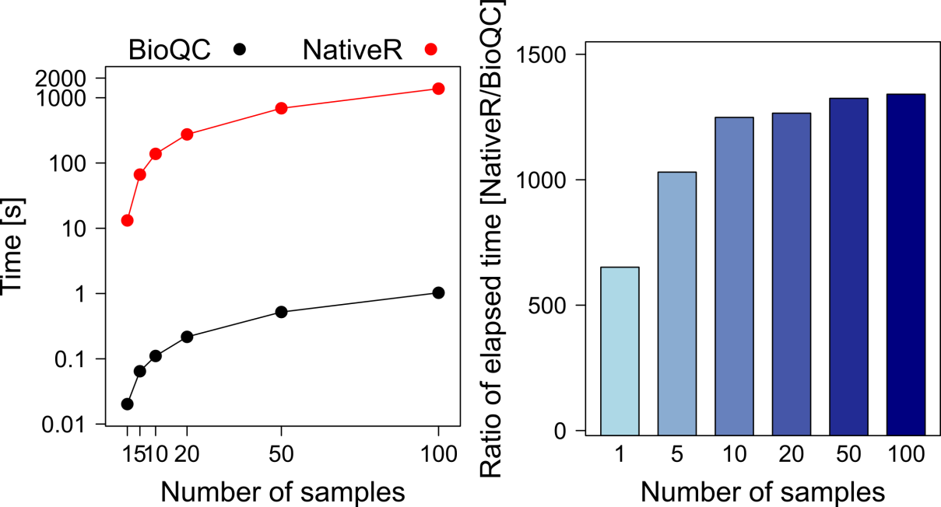
Tissue heterogeneity and BioQC
The concept of tissue heterogeneity stems from our observations that gene expression data is often compromised by cells originating from other tissues than the target tissue of profiling.
Zhang et al, BMC Genomics, in revision
BioQC implements a computationally efficient variant of the Wilcoxon-Mann-Whitney test (Mann & Whitney, 1947) to test enrichment of gene sets against background genes sample-by-sample. It also provides a comprehensive list of tissue-enriched genes.

Slide 10
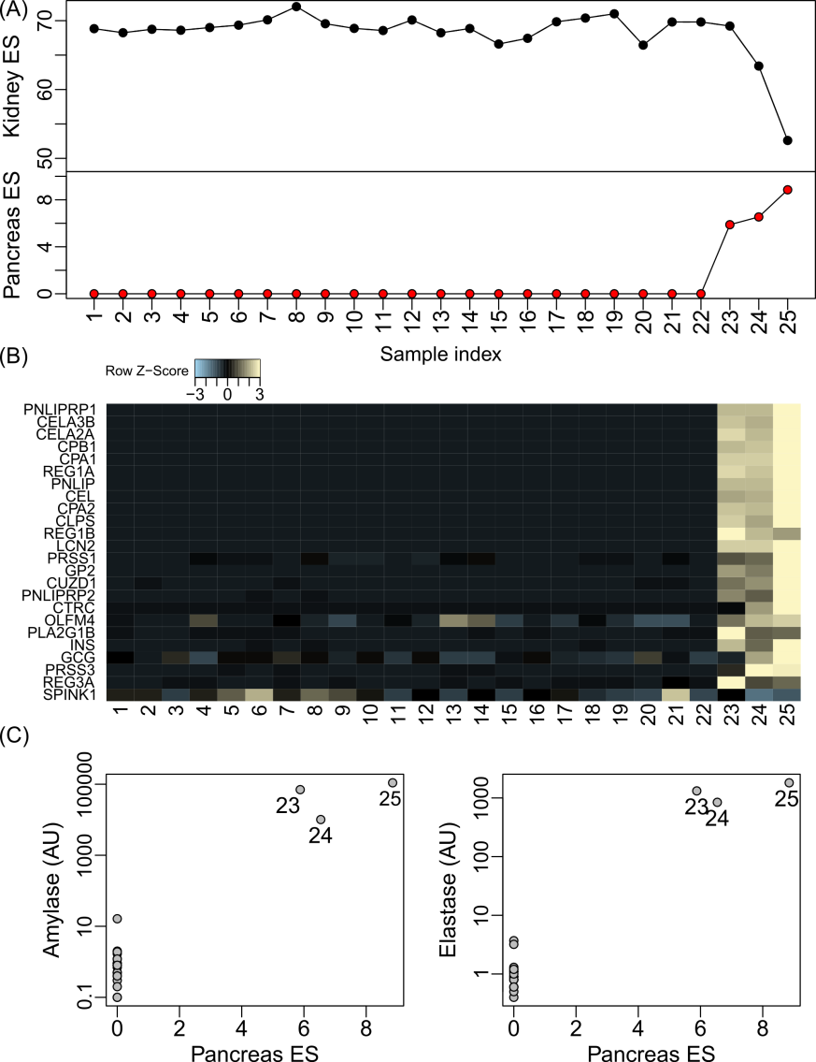
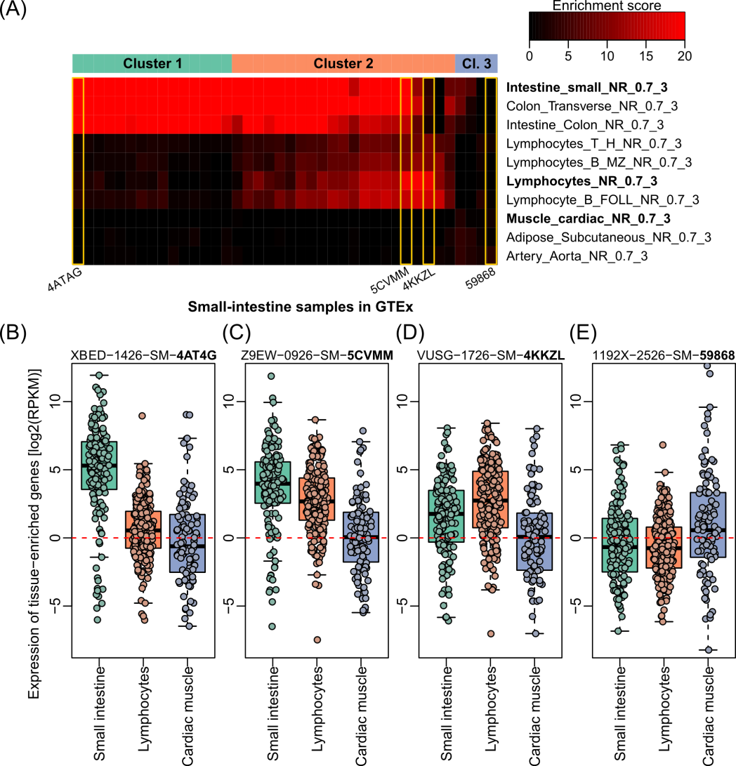
BioQC detects tissue heterogeneity in real-world data
Zhang et al, BMC Genomics, in revision
BioQC detects tissue contamination in data generated in Roche research program
BioQC detects tissue heterogeneity in GTEx gene expression data.

Slide 11

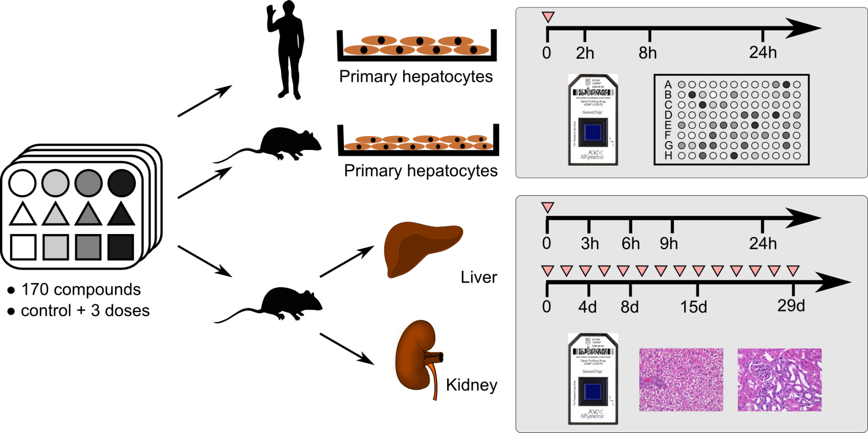
What’s possible with ribios? An example with TG-GATEs: Toxicogenomics Project-Genomics Assisted Toxicity Evaluation system
170
Compounds
>2000
Cellular assays
>12000
Pathology records
>24000
Expression profiles
http://toxico.nibio.go.jp
Notes:
To improve the current SVM systems, we searched for external datasets and were alerted about the TG-GATEs database. Our initial aim was to find in vivo gene expression profiles that are labelled with pathological outcomes. To our surprise, TG-GATEs provided much more. 170 compounds, each in three doses (low, middle, and high), with corresponding vehicle controls, are delivered into three systems: in vitro human primary hepatocytes, in vitro rat primary hepatocytes, and in rat in vivo. In in vitro experiments, samples are profiled at 2h, 8h and 24h after compound administration for gene expression profiles using microarray, and the cytotoxicity using PicoGreen DNA quantification assay. For in vivo experiments, rat liver and kidney are profiled 3h, 6h, 9h, and 24h after single-dose treatment of the compound, and they are profiled after 4d, 8d, 15d, and 29d after repeated treatment of the compound. Together with gene expression profiles, liver and kidney pathology was assessed by pathologists as well.

Slide 12
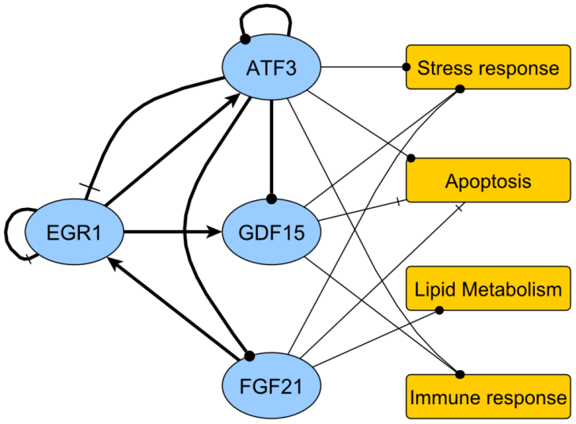
TG-GATEs: Toxicogenomics Project-Genomics Assisted Toxicity Evaluation system
Total raw data size >2 TB
Data pre-processing: 8h
QC (technical QC and BioQC): 4h
Differential gene expression analysis (vsn+limma): 4h
Pathway analysis (limma): 4h
Signature identification & biological interpretation: ~4 weeks
Conclusion: pipelining with ribios and available R/BioC packages allows us investing time where it is mostly needed!
Zhang, Berntenis, Roth & Ebeling, J Pharmacogenomics 2014
Notes:
As we can easily imagine, the effort to build the dataset is huge. Actually it took the Japanese consortium almost ten years to prepare these data. They released all data to the public. The total data amount superseded two tetrabytes. After initial analysis, we decided the dataset is of very high quality and the study design is ideal to answer several very interesting questions. The first one is, whether we can use TG-GATEs to improve our current SVM prediction tool?

Slide 13
Lessons learned
Balance ‘not reinvent the wheel’ and ‘as little dependency as necessary’;
For reproducibility and long-term efficiency: wrap and test external code thoroughly; wrap test internal code ruthlessly;
It is feasible to accelerate the ‘prototyping – developing - prototyping’ cycle for efficient large-scale data mining and analysis by (a) combining R and C/C++ and (b) leveraging existing tools, and thereby optimising those that are critical and filling the gaps.
Computational biology in drug discovery can benefit more from the BioC community.

Slide 14
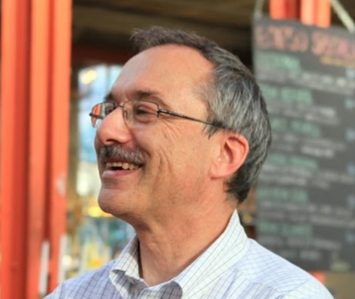






Acknowledgment
Clemens Broger
Detlef Wolf
Laura Badi
Martin Ebeling
Roland Schmucki
Gregor Sturm
… and many users of

Slide 15
Doing now what patients need next

Slide 16
Backup slides

Slide 17
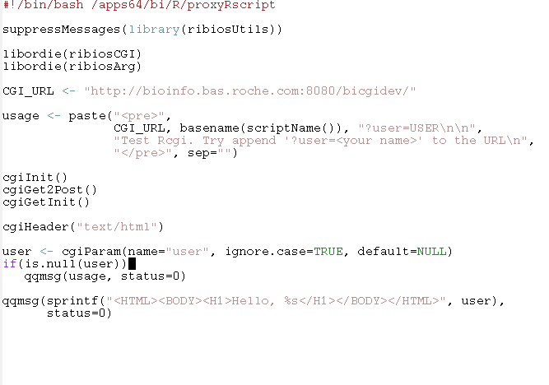
Pipelining over the network with ribiosCGI: the program in 13 lines
shebang
Preparation
Library loading
Usage
CGI-specific
Parsing
Logic & Exit

Slide 18

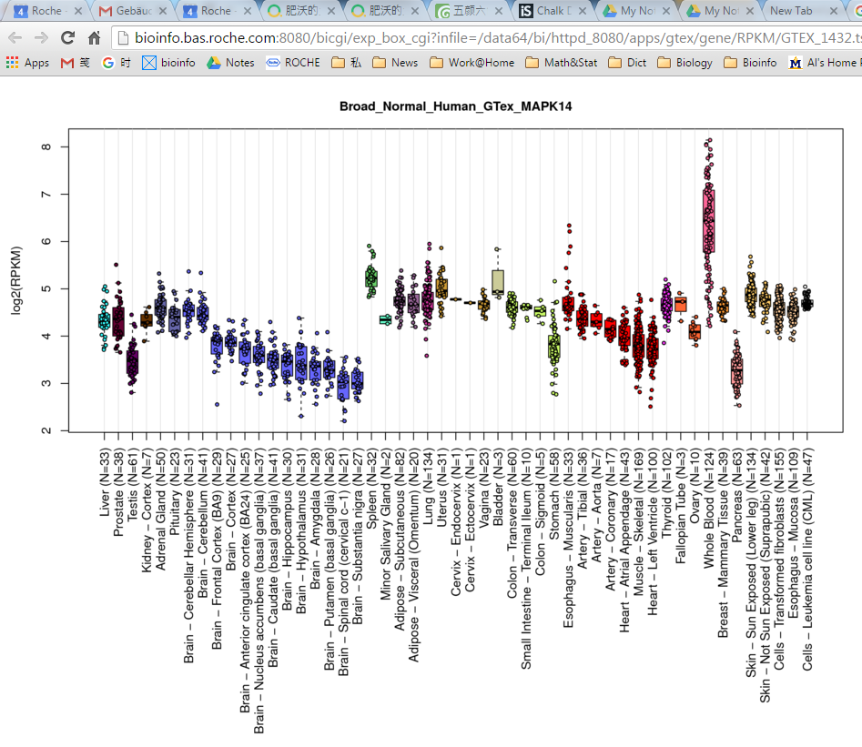
Pipeline example: A generic web boxplot tool
Three layers:
Model: calling a third-party API to provide gene expression data
View: A Rcgi program visualizing any files with specified format
Controller: controlling which gene to show in which samples
MAPK14 gene expression in the GTEx dataset (re-analysed from Lonsdale et al., Nature 2013)

Slide 19
What components does RiBIOS have?
Key packages include
ribiosUtils: various utilities and customized functions
ribiosArg: handle command-line options in a BIOS-compatible way
ribiosPlot: data structures and functions for visualization
ribiosIO: Low-level high-performance input/output library
ribiosAnnotation: interface to Roche internal databases and the bioinformatics data infrastructure
Other packages include
ribiosAuth: user authentication in the bioinformatics application environment
ribiosCGI: enabling Rscript work as a CGI program
ribiosExpression: data structures and functions useful for gene expression analysis
ribiosNGS: data structures and functions useful for NGS data analysis
ribiosMath: collection of mathematical and statistical functions
ribiosBioQC: BioQC algorithm
ribiosGSEA: algorithms and utilities for gene set enrichment analysis
…

Slide 20
Further pipelines
Microarray data quality control and differential gene expression analysis
NGS differential gene expression analysis
ChIP-seq data analysis
Machine learning algorithms for dimension reduction (PCA, MDS, COA, etc.)
Network expansion by gene-gene interaction
Gene Set Enrichment Analysis
…

Slide 21
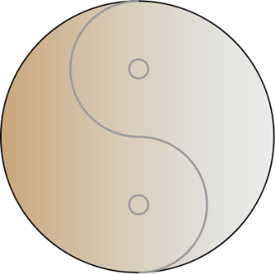
RiBIOS
BIOS: A C library for bioinformatics application development
Bioinfo-C: A public version of BIOS, available at SourceForge [LGPL].
RiBIOS: A collection of R packages using BIOS/Bioinfo-C.
● High-level operations
● Rich public resources
● For prototyping & scripting
● Bioinformatics functions
● Time and memory efficient
● For tuning & upscaling
R/Bioconductor
C/BIOS
RiBIOS

Slide 22
Doing now what patients need next

